Slide 1
Number
Representation

Slide 2
OBJECTIVES
After reading this chapter, the reader should
be able to :
Convert a number from decimal to binary notation and vice versa.
Understand the different representations of an integer inside a computer: unsigned, sign-and-magnitude, one’s complement, and two’s complement.
Understand the Excess system that is used to store the exponential part of a floating-point number.
Understand how floating numbers are stored inside a computer using the exponent and the mantissa.

Slide 3
3.1
DECIMAL
AND
BINARY

Slide 4
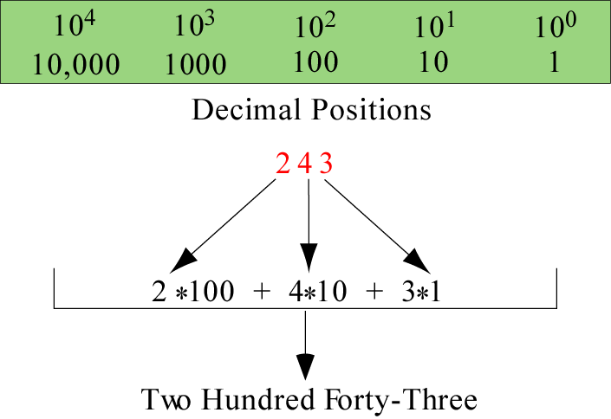
Decimal system
The decimal system has 10 digits and is based on powers of 10
(0~9)

Slide 5
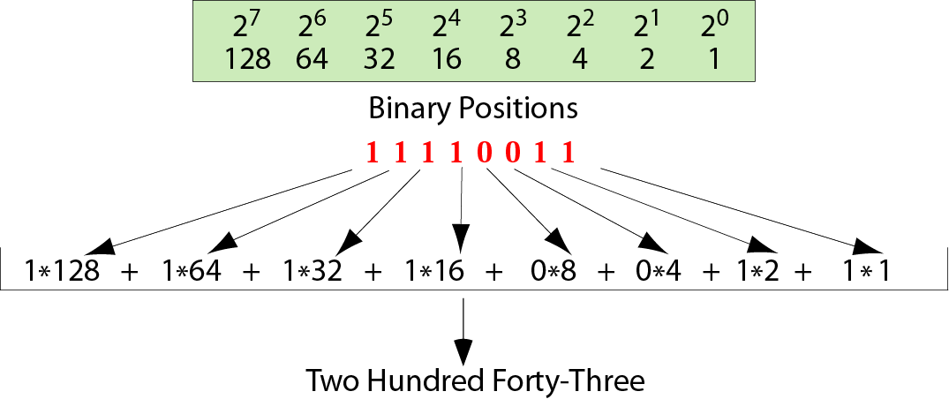
Binary system
The binary system, used by computers to store numbers, has 2 digits, 0 and 1, and is based on powers of 2.

Slide 6
3.2
CONVERSION

Slide 7
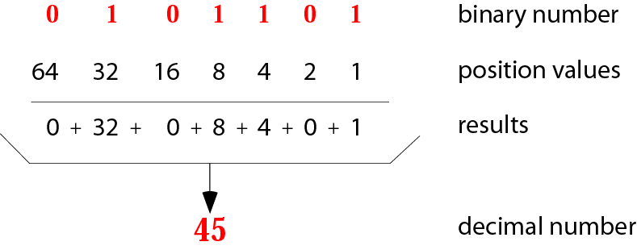
Binary to decimal conversion

Slide 8
Example 1
Convert the binary number 10011 to decimal.
Solution
Write out the bits and their weights. Multiply the bit by its corresponding weight and record the result. At the end, add the results to get the decimal number.
Binary 1 0 0 1 1
Weights 16 8 4 2 1
-------------------------------------
16 + 0 + 0 + 2 + 1
Decimal 19

Slide 9
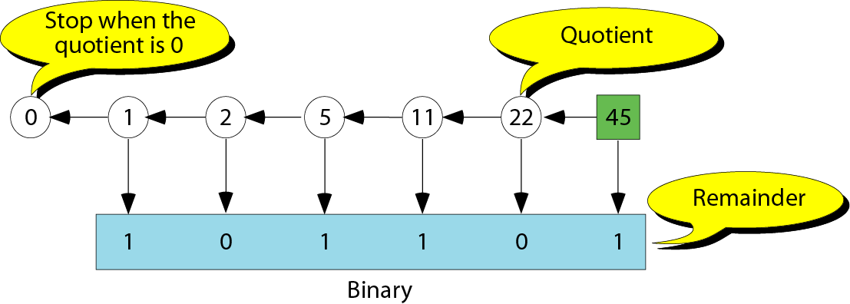
Decimal to binary conversion

Slide 10
Example 2
Convert the decimal number 35 to binary.
Solution
Write out the number at the right corner. Divide the number continuously by 2 and write the quotient and the remainder. The quotients move to the left, and the remainder is recorded under each quotient. Stop when the quotient is zero.
0 ⬅ 1 ⬅ 2 ⬅ 4 ⬅ 8 ⬅ 17 ⬅ 35 Dec.
Binary 1 0 0 0 1 1

Slide 11
3.4
INTEGER
REPRESENTATION

Slide 12
Range of integers
An integer can be positive or negative
To use computer memory more efficiently, Integers can be represented as unsigned or signed numbers
There are three major methods of signed number representation:
  Sign-and-magnitude
  One’s complement
  Two’s complement

Slide 13
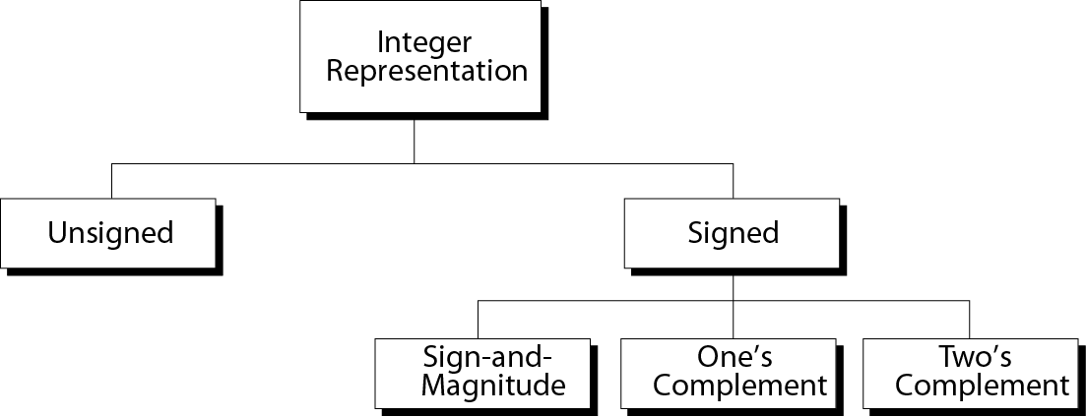
Taxonomy of integers
（分類）
8 = 00001000
-8 11110111 11111000

Slide 14
Unsigned integer
Unsigned integer range: 0 … (2^{N}-1)
# of Bits
---------
8
16
Range
-------------------------------------
0 ~ 255
0 ~ 65,535
Storing unsigned integers process:
The number is changed to binary
If the number of bits is less than N, 0s are add to the left of the binary number so that there is a total of N bits

Slide 15
Example 3
Store 7 in an 8-bit memory location.
Solution
First change the number to binary 111. Add five 0s to make a total of N (8) bits, 00000111. The number is stored in the memory location.

Slide 16
Example 4
Store 258 in a 16-bit memory location.
Solution
First change the number to binary 100000010. Add seven 0s to make a total of N (16) bits, 0000000100000010. The number is stored in the memory location.

Slide 17
Example of storing unsigned integers in
two different computers
Decimal
------------
7
234
258
24,760
1,245,678
8-bit allocation
------------
00000111
11101010
overflow
overflow
overflow
16-bit allocation
------------------------------
0000000000000111
0000000011101010
0000000100000010
0110000010111000
overflow
Unsigned numbers are commonly used for counting and addressing
counting: start counting from 1 (sometimes from 0)
address in the memory. Address are postive number starting from 0

Slide 18
Example 5
Interpret 00101011 in decimal if the number was stored as an unsigned integer.
Solution
Using the procedure shown in Figure 3.3 , the number in decimal is 43.

Slide 19

Note:
In sign-and-magnitude representation,
the leftmost bit defines the sign of the number. If it is 0, the number is positive.If it is 1, the number is negative.
0: (+)
1: (-)

Slide 20
Sign-and-magnitude integers
Range: -(2^{N-1}-1) … +(2^{N-1}-1)
# of Bits
----------
8
16
32
Range
-------------------------------------------------------
−127 −0
−32767 −0
−2,147,483,647 −0
+0 +127
+0 +32767
+0 +2,147,483,647
Storing sign-and-magnitude integers process:
The number is changed to binary; the sign is ignored
If the number of bits is less than N-1, 0s are add to the left of the binary number so that there is a total of N-1 bits
If the number is positive, 0 is added to the left (to make it N bits). If the number is negative, 1 is added to the left

Slide 21
Note:
There are two 0s in sign-and-magnitude
representation: positive and negative.
In an 8-bit allocation:
+0 ➔ 00000000
-0 ➔ 10000000

Slide 22
Example 6
Store +7 in an 8-bit memory location using sign-and-magnitude representation.
Solution
First change the number to binary 111. Add four 0s to make a total of N-1 (7) bits, 0000111. Add an extra zero because the number is positive. The result is:
00000111
(+)

Slide 23
Example 7
Store –258 in a 16-bit memory location using sign-and-magnitude representation.
Solution
First change the number to binary 100000010. Add six 0s to make a total of N-1 (15) bits, 000000100000010. Add an extra 1 because the number is negative. The result is:
1000000100000010

Slide 24
Example of storing sign-and-magnitude
integers in two computers
Decimal
------------
+7
-124
+258
-24,760
8-bit allocation
------------
00000111
11111100
overflow
overflow
16-bit allocation
------------------------------
0000000000000111
1000000001111100
0000000100000010
1110000010111000

Slide 25
Example 8
Interpret 10111011 in decimal if the number was stored as a sign-and-magnitude integer.
Solution
Ignoring the leftmost bit, the remaining bits are 0111011. This number in decimal is 59. The leftmost bit is 1, so the number is –59.

Slide 26
Note:
There are two 0s in one’s complement
representation: positive and negative.
In an 8-bit allocation:
+0 ➔ 00000000
-0 ➔ 11111111

Slide 27
One’s complement integers
Range: -(2^{N-1}-1) … +(2^{N-1}-1)
# of Bits
---------
8
16
32
Range
-------------------------------------------------------
−127 −0
−32767 −0
−2,147,483,647 −0
+0 +127
+0 +32767
+0 +2,147,483,647
Storing one’s complement integers process:
The number is changed to binary; the sign is ignored
0s are added to the left of the number to make a total of N bits
If the sign is positive, no more action is needed. If the sign is negative, every bit is complemented (0. 1; 1 0)

Slide 28
Note:
In one’s complement representation,
the leftmost bit defines the sign of the number. If it is 0, the number is positive.If it is 1, the number is negative.

Slide 29
Example 9
Store +7 in an 8-bit memory location using one’s complement representation.
Solution
First change the number to binary 111. Add five 0s to make a total of N (8) bits, 00000111. The sign is positive, so no more action is needed. The result is:
00000111

Slide 30
Example 10
Store –258 in a 16-bit memory location using one’s complement representation.
Solution
First change the number to binary 100000010. Add seven 0s to make a total of N (16) bits, 0000000100000010. The sign is negative, so each bit is complemented. The result is:
1111111011111101

Slide 31
Example of storing one’s complement integers in
two different computers
Decimal
------------
+7
−7
+124
−124
+24,760
−24,760
8-bit allocation
------------
00000111
11111000
01111100
10000011
overflow
overflow
16-bit allocation
------------------------------
0000000000000111
1111111111111000
0000000001111100
1111111110000011
0110000010111000
1001111101000111

Slide 32
Example 11
Interpret 11110110 in decimal if the number was stored as a one’s complement integer.
Solution
The leftmost bit is 1, so the number is negative. First complement it . The result is 00001001. The complement in decimal is 9. So the original number was –9. Note that complement of a complement is the original number.

Slide 33
Note:
One’s complement means reversing all bits. If you one’s complement a positive number, you get the corresponding negative number. If you one’s complement a negative number, you get the corresponding positive number. If you one’s complement a number twice, you get the original number.

Slide 34
Note:
Two’s complement is the most common, the most important, and the most widely used representation of integers today.

Slide 35
Two’s complement integers
Range: -(2^{N-1}) … +(2^{N-1}-1)
# of Bits
---------
8
16
32
Range
-------------------------------------------------------
−128
−32,768
−2,147,483,648
0 +127
0 +32,767
0 +2,147,483,647
Storing two’s complement integers process:
The number is changed to binary; the sign is ignored
If the number of bits is less than N, 0s are added to the left of the number so that there is a total of N bits.
If the sign is positive, no further action is needed. If the sign is negative, leave all the rightmost 0s and the first 1 unchanged. Complement the rest of the bits.

Slide 36
Note:
In two’s complement representation,
the leftmost bit defines the sign of the number. If it is 0, the number is positive.
If it is 1, the number is negative.

Slide 37
Example 12
Store +7 in an 8-bit memory location using two’s complement representation.
Solution
First change the number to binary 111. Add five 0s to make a total of N (8) bits, 00000111.The sign is positive, so no more action is needed. The result is:
00000111

Slide 38
Example 13
Store –40 in a 16-bit memory location using two’s complement representation.
Solution
First change the number to binary 101000. Add ten 0s to make a total of N (16) bits, 0000000000101000. The sign is negative, so leave the rightmost 0s up to the first 1 (including the 1) unchanged and complement the rest. The result is:
1111111111011000

Slide 39
Example of storing two’s complement integers in
two different computers
Decimal
------------
+7
−7
+124
−124
+24,760
−24,760
8-bit allocation
------------
00000111
11111001
01111100
10000100
overflow
overflow
16-bit allocation
------------------------------
0000000000000111
1111111111111001
0000000001111100
1111111110000100
0110000010111000
1001111101001000
Practice -7, -124

Slide 40
Note:
There is only one 0 in two’s complement:
In an 8-bit allocation:
0 ➔ 00000000

Slide 41
Example 14
Interpret 11110110 in decimal if the number was stored as a two’s complement integer.
Solution
The leftmost bit is 1. The number is negative. Leave 10 at the right alone and complement the rest. The result is 00001010. The two’s complement number is 10. So the original number was –10.

Slide 42
Note:
Two’s complement can be achieved by reversing all bits except the rightmost bits up to the first 1 (inclusive). If you two’s complement a positive number, you get the corresponding negative number. If you two’s complement a negative number, you get the corresponding positive number. If you two’s complement a number twice, you get the original number.

Slide 43
Summary of integer representation
Contents of Memory
------------
0000
0001
0010
0011
0100
0101
0110
0111
1000
1001
1010
1011
1100
1101
1110
1111
Unsigned
------------
0
1
2
3
4
5
6
7
8
9
10
11
12
13
14
15
Sign-and-Magnitude
−−−−−−−−−
+0
+1
+2
+3
+4
+5
+6
+7
−0
−1
−2
−3
−4
−5
−6
−7
One’s
Complement
−−−−−−−−−
+0
+1
+2
+3
+4
+5
+6
+7
−7
−6
−5
−4
−3
−2
−1
−0
Two’s
Complement
−−−−−−−−
+0
+1
+2
+3
+4
+5
+6
+7
−8
−7
−6
−5
−4
−3
−2
−1
Practice 1111

Slide 44
3.5
FLOATING-POINT
REPRESENTATION

Slide 45
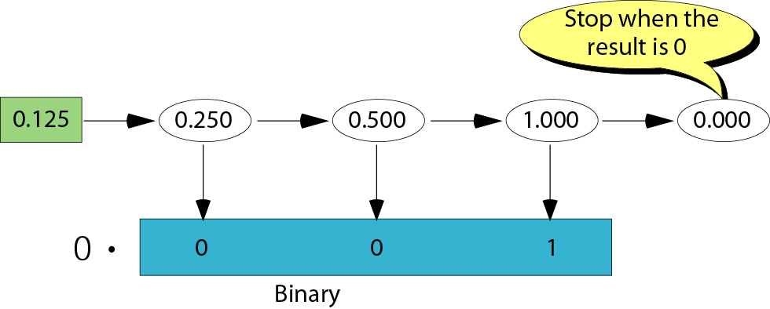
Changing fractions to binary
A floating-point number is an integer and a fraction.
Conversion floating-point number to binary
  Convert the integer part to binary
  Convert the fraction to binary
  Put a decimal point between the two parts
Converting the fraction part
x2
x2
x2

Slide 46
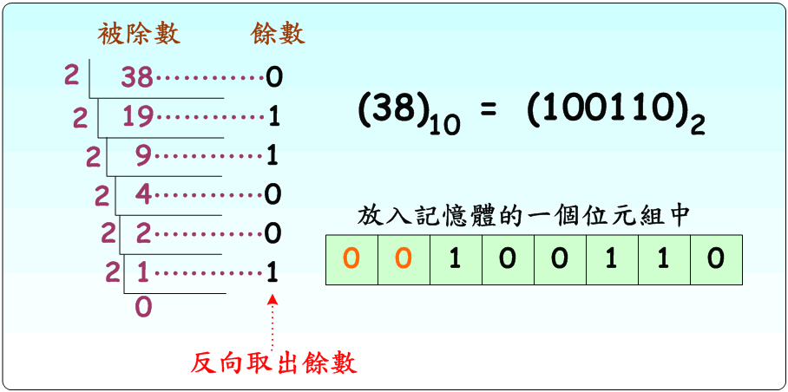
十進制轉二進制
【範例】：將38.375₁₀轉換為2進制。
  Step1：整數與小數部分需要分開處理。
  Step2：求出整數部分的轉換，38₁₀=(100110)₂=(00100110) ₂ 【若需補足為1個位元組】。

Slide 47
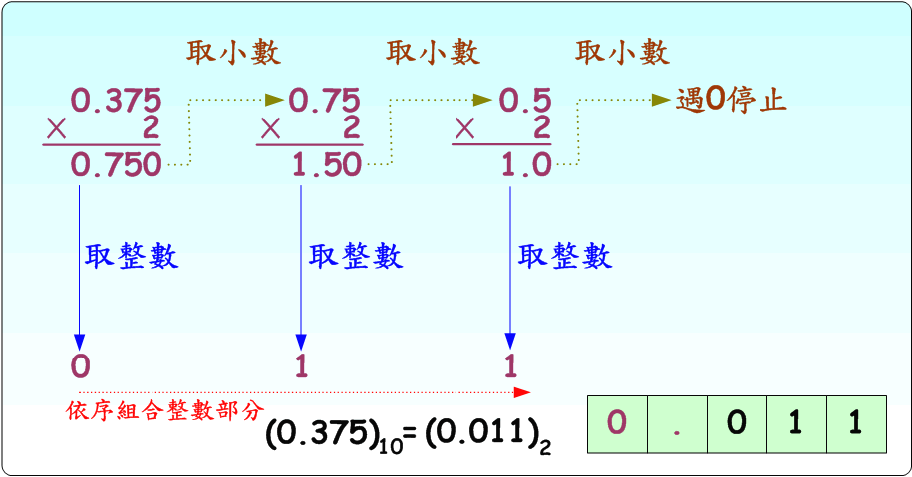
十進制轉二進制
  Step3：求出小數部分的轉換，0.375₁₀=(0.011) ₂。
  Step4：合併整數與小數，38.375₁₀=(100110.011) ₂。

Slide 48
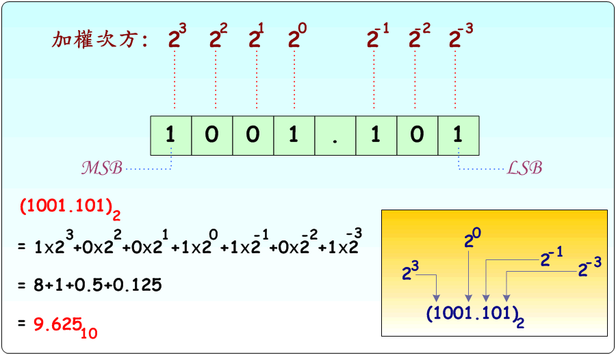
2.2.1 二進制數字系統
      【範例】：1001.101₂之位數及加權計算如下：

Slide 49
Example 17
Transform the fraction 0.875 to binary
Solution
Write the fraction at the left corner. Multiply the number continuously by 2 and extract the integer part as the binary digit. Stop when the number is 0.0.
0.75x2
0.5x2
0.875 ➔ 1.750 ➔ 1.5 ➔ 1.0 ➔ 0.0
0 . 1 1 1

Slide 50
Example 18
Transform the fraction 0.4 to a binary of 6 bits.
Solution
Write the fraction at the left cornet. Multiply the number continuously by 2 and extract the integer part as the binary digit. You can never get the exact binary representation. Stop when you have 6 bits.
0.4 ➔ 0.8 ➔ 1.6 ➔ 1.2 ➔ 0.4 ➔ 0.8 ➔ 1.6
0 . 0 1 1 0 0 1
Repeated!

Slide 51
3.5
EXCESS
SYSTEM

Slide 52
Representation
To represent a number in Excess, use the following procedure:
  Add the magic number to the integer
  Change the result to binary and 0s so that there is a total of N bits
  Usually in storing the exponential value of a fraction
  Advantage: easy to transform from decimal to binary, and vice versa
  Disadvantage: Operation on the numbers are very complicated

Slide 53
Excess sysem
Another representation that allows you to store both positive and negative numbers in a computer is call the Excess system
A positive number, called the magic number, is used in the conversion process
The magic number is normally (2^{N-1}) or (2^{N-1}-1), where N is the bit allocation
if N=8, magic number is 128 or 127, Excess_128 or Excess_127
The bit allocation is the number of bits used to represent an integer

Slide 54
Example 15
Represent –25 in Excess_127 using an 8-bit allocation.
Solution
First add 127 to get 102. This number in binary is 1100110. Add one bit to make it 8 bits in length. The representation is 01100110.

Slide 55
Example 16
Interpret 11111110 if the representation is Excess_127. (binary is unsigned integer)
Solution
First change the number to decimal. It is 254. Then subtract 127 from the number. The result is decimal 127.

Slide 56
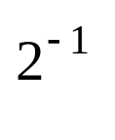

Normalization
e.g. +1010001.1101 makes operation on numbers difficult.
A fraction is normalized so that operations are simpler
Normalization: the moving of the decimal point so that there is only one 1 to the left of the decimal point. (e.g. 1.XXXXXXXXX)
Original Number
------------
+1010001.1101
-111.000011
+0.00000111001
-001110011
Move
------------
⬅ 6
⬅ 2
6 ➔
3 ➔
Original Number
------------
+1010001.1101
−111.000011
+0.00000111001
−0.001110011
Normalized
------------
+2⁶ x 1.01000111001
−2² x 1.11000011
+2⁻⁶ x 1.11001
−2⁻³ x 1.110011

Slide 57
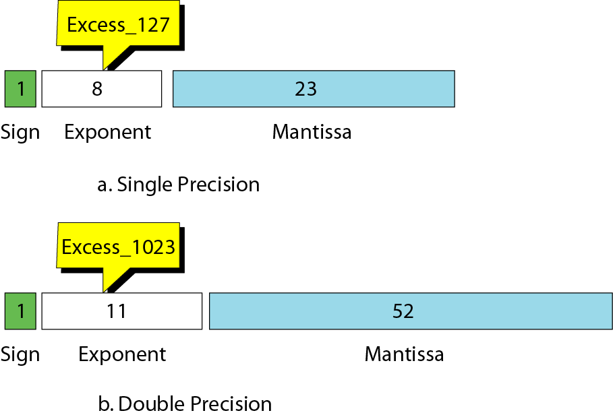
IEEE standards
Sign: stored using 1 bit (0 or 1)
Exponent: (stored in Excess representation)
Mantissa: (stored as unsigned integer)
bits
32bits
指數
(對數的)尾數
64bits

Slide 58
Example 19
Show the representation of the normalized number + 2⁶ x 1.01000111001
Solution
The sign is positive. The Excess_127 representation of the exponent is 133. You add extra 0s on the right to make it 23 bits. The number in memory is stored as:
sign exponent (133) Mantissa
0 10000101 01000111001000000000000

Slide 59
Example of floating-point representation
Number
------------
-2² x 1.11000011
+2⁻⁶ x 1.11001
-2⁻³ x 1.110011
Sign
----
1
0
1
Exponent
-----------
10000001
01111001
01111100
Mantissa
-------------------------------
11000011000000000000000
11001000000000000000000
11001100000000000000000
-6+127

Slide 60
Example 20
Interpret the following 32-bit floating-point number
1 01111100 11001100000000000000000
Solution
The sign is negative. The exponent is –3 (124 – 127). The number after normalization is
-2⁻³ x 1.110011

Slide 61
3.6
HEXADECIMAL
NOTATION

Slide 62
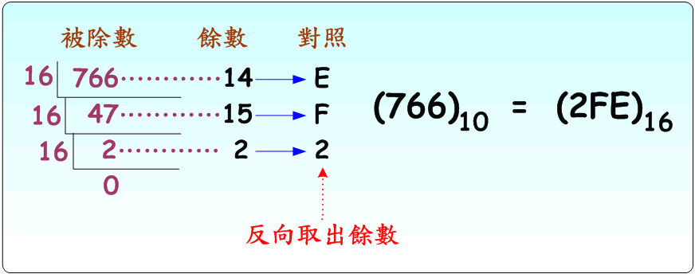
十進制轉十六進制
【範例】：將766.28125₁₀轉換為16進制。
  Step1：整數與小數部分需要分開處理。
  Step2：求出整數部分的轉換，766₁₀=(2FE) ₁₆=(02FE) ₁₆ 【若需補足為2個位元組】。

Slide 63
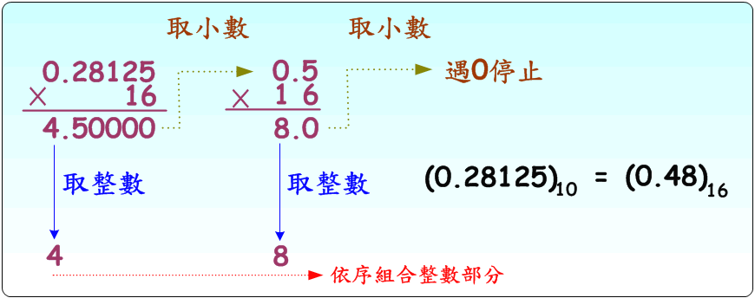
十進制轉十六進制
  Step3：求出小數部分的轉換，0.28125₁₀=(0.48) ₁₆。
  Step4：合併整數與小數，766.28125₁₀=(2FE.48) ₁₆。

Slide 64
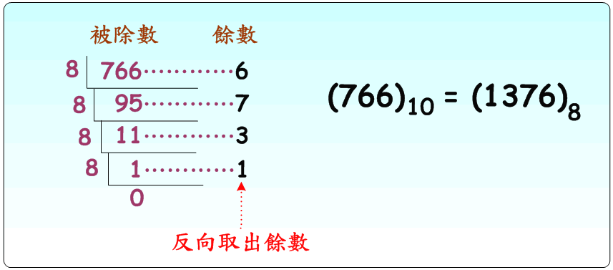
十進制轉八進制
【範例】：將766.28125₁₀轉換為8進制。
  Step1：整數與小數部分需要分開處理。
  Step2：求出整數部分的轉換，766₁₀=(1376)₈。

Slide 65
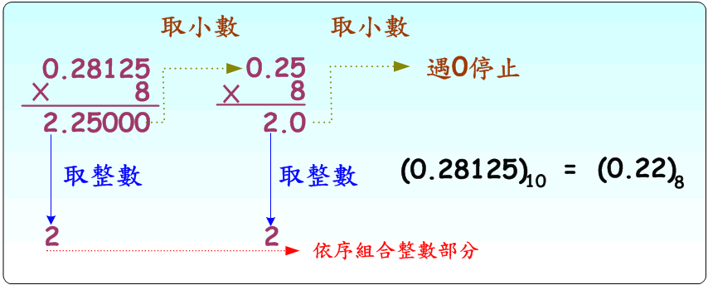
十進制轉八進制
  Step3：求出小數部分的轉換，0.28125₁₀=(0.22)₈。
  Step4：合併整數與小數，766.28125₁₀=(1376.22)₈。

