Slide 1
Chapter 4:
Selection
C++ PROGRAMMING:
PRINCIPLES AND PRACTICES FOR SCIENTISTS AND ENGINEERS

Slide 2
Objectives
In this chapter, you will learn about:
  Selection criteria
  The if-else statement
  Nested if statements
  The switch statement
  Program testing
  Common programming errors

Slide 3
Selection Criteria
if-else statement: Implements a decision structure for two alternatives
Syntax:
if (condition)
statement executed if condition is true;
else
statement executed if condition is false;

Slide 4
Selection Criteria (continued)
The condition is evaluated to its numerical value:
  A non-zero value is considered to be true
  A zero value is considered to be false
The else portion is optional
  Executed only if the condition is false
The condition may be any valid C++ expression

Slide 5
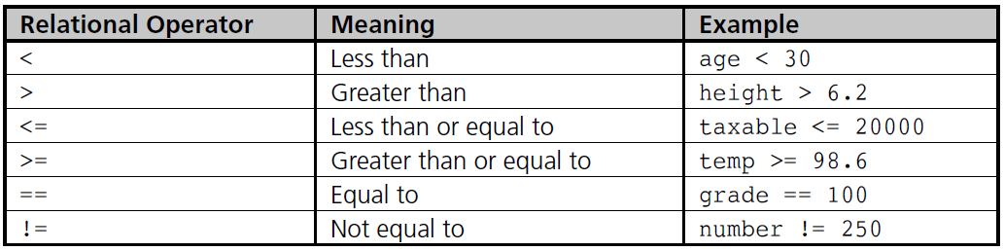
Relational Operators
Relational expression: Compares two operands or expressions using relational operators
Table 4.1 C++’s Relational Operators

Slide 6
Relational Operators (continued)
Relational expressions are evaluated to a numerical value of 1 or 0 only:
  If the value is 1, the expression is true
  If the value is 0, the expression is false
char values are automatically coerced to int values for comparison purposes
Strings are compared on a character by character basis
  The string with the first lower character is considered smaller

Slide 7
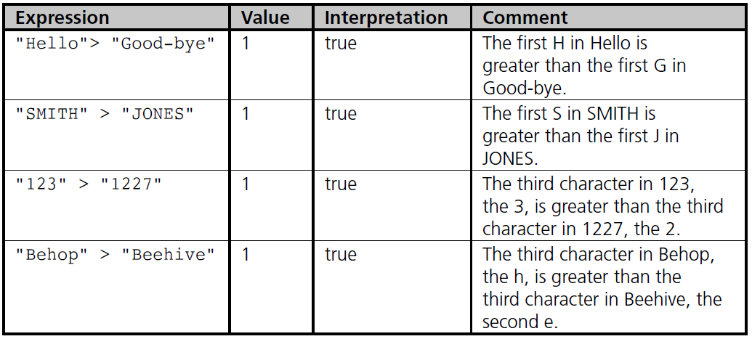
Relational Operators (continued)
Examples of string comparisons

Slide 8
Logical Operators
AND (&&): Condition is true only if both expressions are true
OR (||): Condition is true if either one or both of the expressions is true
NOT (!): Changes an expression to its opposite state; true becomes false, false becomes true

Slide 9
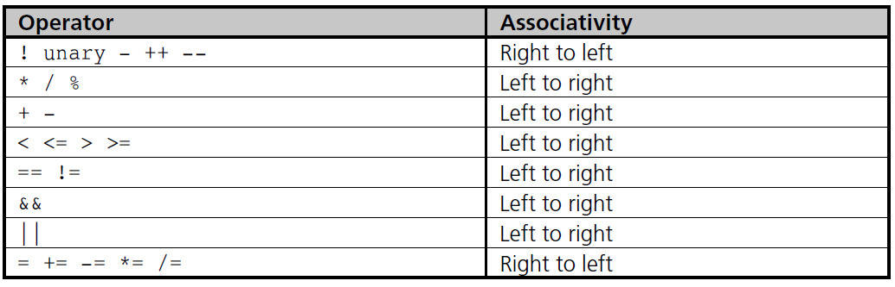
Logical Operators (continued)
Table 4.2 Operator Precedence and Associativity

Slide 10
A Numerical Accuracy Problem
Comparing single and double precision values for equality (==) can lead to errors because values are stored in binary
Instead, test that the absolute value of the difference is within an acceptable range
  Example:
    abs(operandOne – operandTwo) < 0.000001

Slide 11
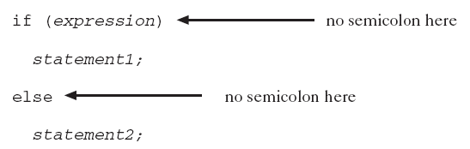
The if-else Statement
if-else performs instructions based on the result of a comparison
Place statements on separate lines for readability
Syntax:

Slide 12
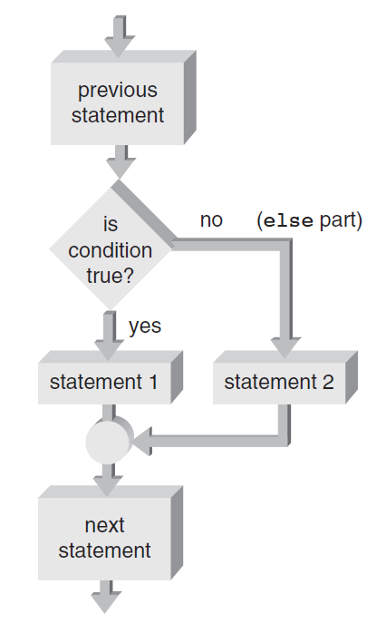
The if-else Statement (cont’d)
Figure 4.2 The if-else flowchart

Slide 13
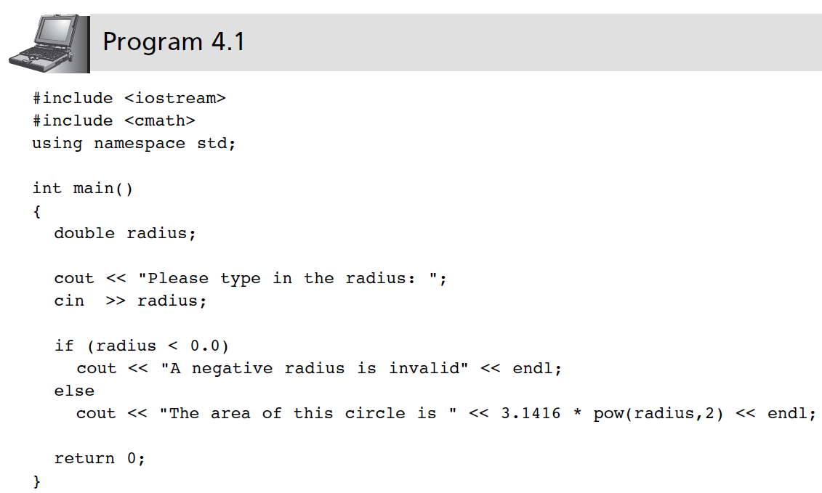
The if-else Statement (continued)

Slide 14
Compound Statements
Compound statement: A sequence of single statements contained between braces
  Creates a block of statements
  A block of statements can be used anywhere that a single statement is legal
  Any variable declared within a block is usable only within that block
Scope: The area within a program where a variable can be used
  A variable’s scope is based on where the variable is declared

Slide 15
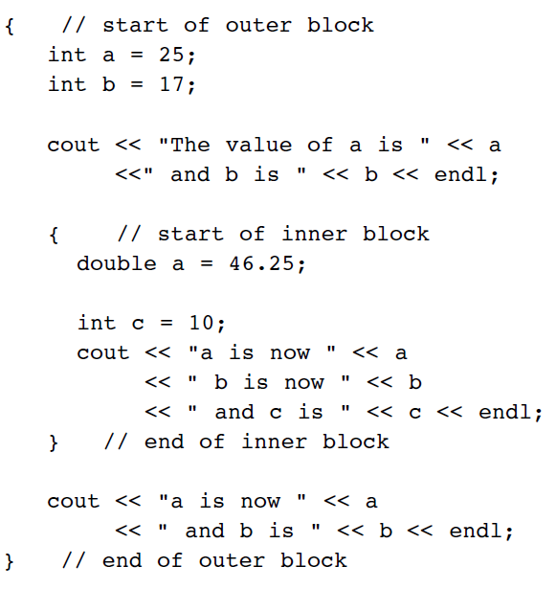
Block Scope (continued)

Slide 16
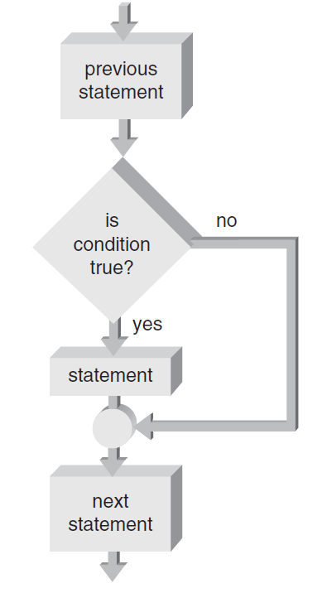
One-Way Selection
One-way selection: An if statement without the optional else portion
Figure 4.3 A one-way selection if statement

Slide 17
Problems Associated with the if-else Statement
Common problems with if-else statements:
  Misunderstanding what an expression is
  Using the assignment operator (=) instead of the relational operator (==)

Slide 18
Nested if Statements
if-else statement can contain any valid C++ statement, including another if-else
Nested if statement: an if-else statement completely contained within another if-else
Use braces to block code, especially when inner if statement does not have its own else

Slide 19
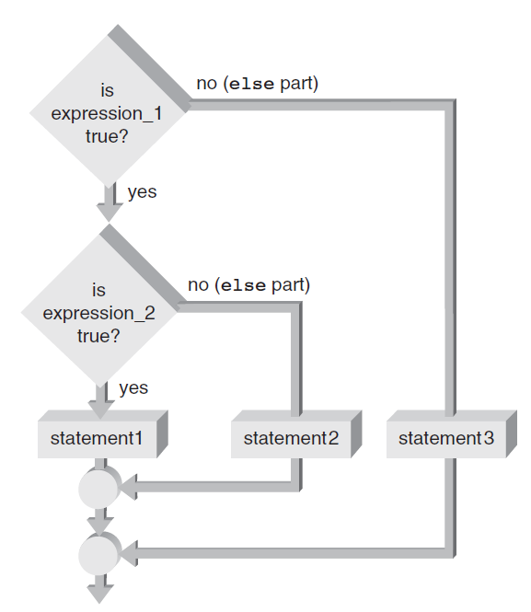
Nested if Statements (continued)
Figure 4.4a Nested within the if part

Slide 20
The if-else Chain
if-else chain: A nested if statement occurring in the else clause of the outer if-else
If any condition is true, the corresponding statement is executed and the chain terminates
Final else is only executed if no conditions were true
  Serves as a catch-all case
if-else chain provides one selection from many possible alternatives

Slide 21
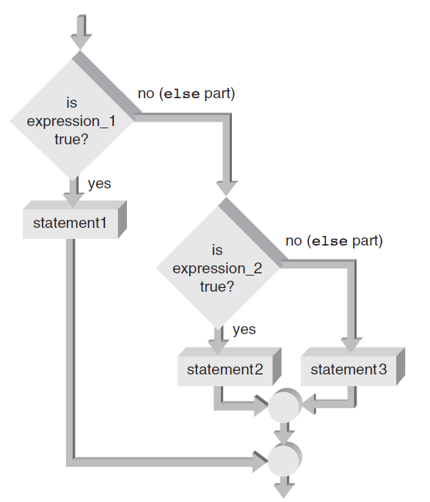
The if-else Chain (continued)
Figure 4.4b Nested within the else part

Slide 22
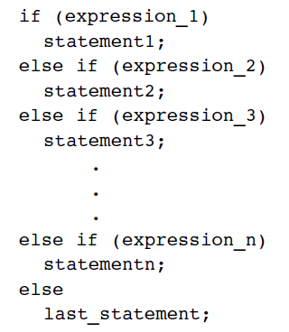
The if-else Chain (continued)
General form of an if-else chain

Slide 23
The switch Statement
switch statement: Provides for one selection from many alternatives
switch keyword starts the statement
  Is followed by the expression to be evaluated
case keyword identifies a value to be compared to the switch expression
  When a match is found, statements in this case block are executed
All further cases after a match is found are executed unless a break statement is found

Slide 24
The switch Statement (continued)
default case is executed if no other case value matches were found
default case is optional

Slide 25
A Case Study: Solving Quadratic Equations
Data validation: Use defensive programming techniques to validate user input
  Includes code to check for improper data before an attempt is made to process it further
Solving quadratic equations: Use the software development procedure to solve for the roots of a quadratic equation

Slide 26
A Closer Look: Program Testing
Theory: A comprehensive set of test runs would test all combinations of input and computations, and would reveal all errors
Reality: There are too many combinations to test for any program except a very simple one
Example:
  One program with 10 modules, each with five if statements, always called in the same order
  There are 2⁵ paths through each module, and more than 2⁵⁰ paths through the program!

Slide 27
A Closer Look: Program Testing (continued)
Conclusion: there is no error-free program, only one in which no errors have recently been encountered

Slide 28
Common Programming Errors
Using the assignment operator (=) instead of the relational operator (==) for an equality test
Placing a semicolon immediately after the condition
Assuming a structural problem with an if-else causes the error instead of focusing on the data value being tested
Using nested if statements without braces to define the structure

Slide 29
Summary
Relational expressions, or conditions, are used to compare operands
If the relation expression is true, its value is 1; if false, its value is 0
Use logical operators && (AND), || (OR), and ! (NOT) to construct complex conditions
if-else allows selection between two alternatives

Slide 30
Summary (continued)
An if expression that evaluates to 0 is false; if non-zero, it is true
if statements can be nested
Chained if statement provides a multiway selection
Compound statement: contains any number of individual statements enclosed in braces

Slide 31
Summary (continued)
switch statement: Provides a multiway selection
switch expression: Evaluated and compared to each case value
  If a match is found, execution begins at that case’s statements and continues unless a break is encountered

