Slide 1
Chapter 5:
Repetition

Slide 2
Objectives
In this chapter, you will learn about:
Basic loop structures
while loops
Interactive while loops
for loops
Loop programming techniques

Slide 3
Objectives (continued)
Nested loops
do while loops
Common programming errors

Slide 4
Basic Loop Structures
Repetition structure has four required elements:
  Repetition statement
  Condition to be evaluated
  Initial value for the condition
  Loop termination
Repetition statements include:
  while
  for
  do while

Slide 5
Basic Loop Structures (continued)
The condition can be tested
  At the beginning: Pretest or entrance-controlled loop
  At the end: Posttest or exit-controlled loop
Something in the loop body must cause the condition to change, to avoid an infinite loop, which never terminates

Slide 6
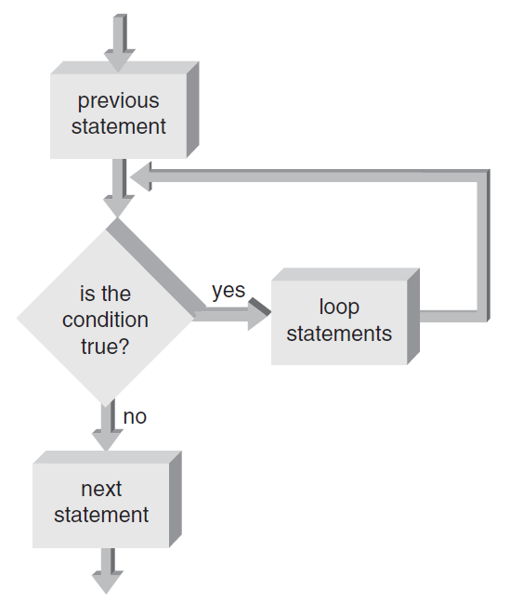
Pretest and Posttest Loops
Pretest loop: Condition is tested first; if false, statements in the loop body are never executed
while and for loops are pretest loops
Figure 5.1 A pretest loop

Slide 7
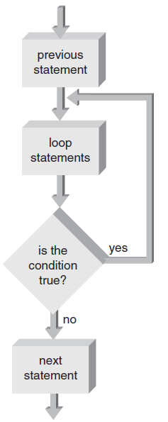
Pretest and Posttest Loops (continued)
Posttest loop: Condition is tested after the loop body statements are executed; loop body always executes at least once
do while is a posttest loop
Figure 5.2 A posttest loop

Slide 8
Fixed-Count Versus Variable-Condition Loops
Fixed-count loop: Loop is processed for a fixed number of repetitions
Variable-condition loop: Number of repetitions depends on the value of a variable

Slide 9
while Loops
while statement is used to create a while loop
  Syntax:
while (expression)
statement;
Statements following the expressions are executed as long as the expression condition remains true (evaluates to a non-zero value)

Slide 10
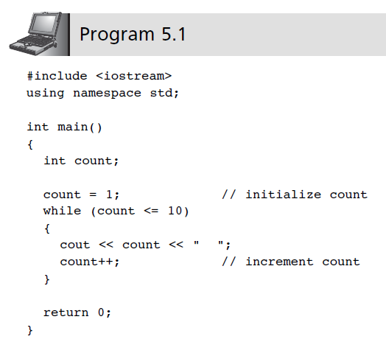
while Loops (continued)

Slide 11
Interactive while Loops
Combining interactive data entry with the while statement provides for repetitive entry and accumulation of totals

Slide 12
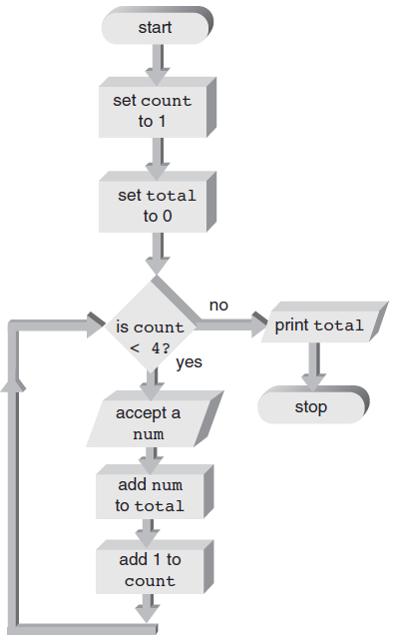
Interactive while Loops (cont’d)
Figure 5.7 Accumulation flow of control

Slide 13
Sentinels
Sentinel: A data value used to signal either the start or end of a data series
  Use a sentinel when you don’t know how many values need to be entered

Slide 14
break and continue Statements
break statement
  Forces an immediate break, or exit, from switch, while, for, and do-while statements
  Violates pure structured programming, but is useful for breaking out of loops when an unusual condition is detected

Slide 15
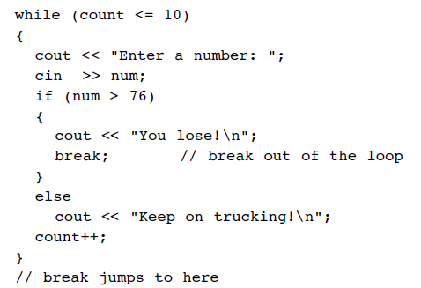
break and continue Statements (cont’d)
Example of a break statement:

Slide 16
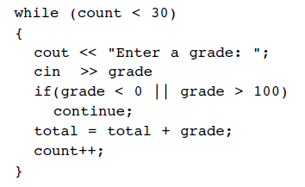
break and continue Statements (cont’d)
A continue statement where invalid grades are ignored, and only valid grades are added to the total:

Slide 17
break and continue Statements (cont’d)
continue statement
  Applies to while, do-while, and for statements; causes the next iteration of the loop to begin immediately
  Useful for skipping over data that should not be processed in this iteration, while staying within the loop

Slide 18
The Null Statement
Null statement
  Semicolon with nothing preceding it
    ;
  Do-nothing statement required for syntax purposes only

Slide 19
for Loops
for statement: A loop with a fixed count condition that handles alteration of the condition
  Syntax:
for (initializing list; expression; altering list)
statement;
Initializing list: Sets the starting value of a counter
Expression: Contains the maximum or minimum value the counter can have; determines when the loop is finished

Slide 20
for Loops (continued)
Altering list: Provides the increment value that is added or subtracted from the counter in each iteration of the loop
If initializing list is missing, the counter initial value must be provided prior to entering the for loop
If altering list is missing, the counter must be altered in the loop body
Omitting the expression will result in an infinite loop

Slide 21
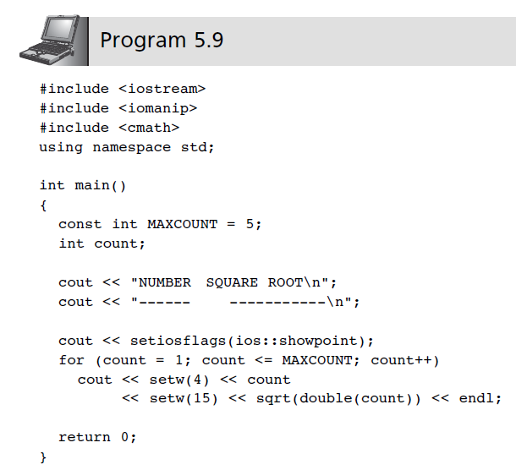
for Loops (continued)

Slide 22
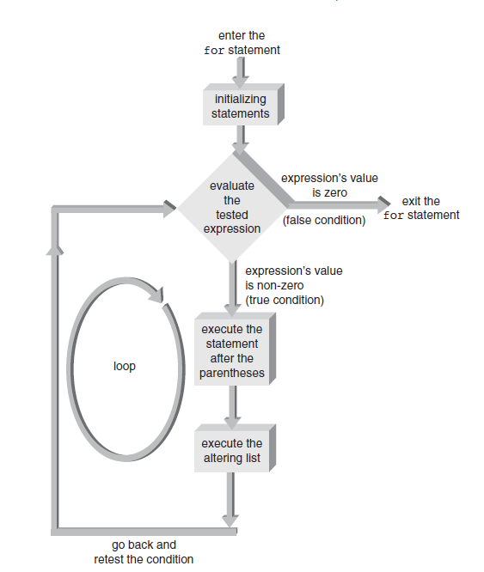
for Loops (cont’d)
Figure 5.10 for loop flowchart.

Slide 23
A Closer Look: Loop Programming Techniques
These techniques are suitable for pretest loops (for and while):
  Interactive input within a loop
    Includes a cin statement within a while or for loop
  Selection within a loop
    Using a for or while loop to cycle through a set of values to select those values that meet some criteria

Slide 24
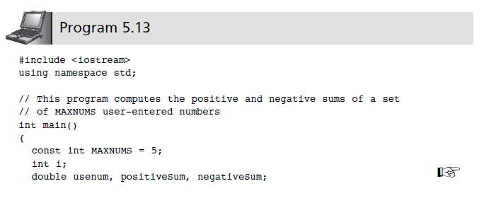
A Closer Look: Loop Programming Techniques (continued)

Slide 25
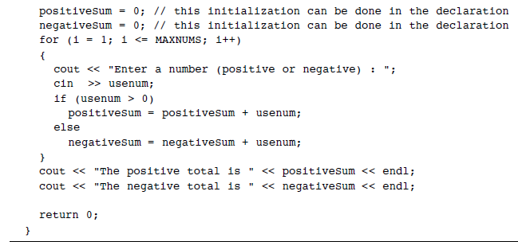
A Closer Look: Loop Programming Techniques (continued)

Slide 26
A Closer Look: Loop Programming Techniques (continued)
Evaluating functions of one variable
  Used for functions that must be evaluated over a range of values
  Noninteger increment values can be used

Slide 27
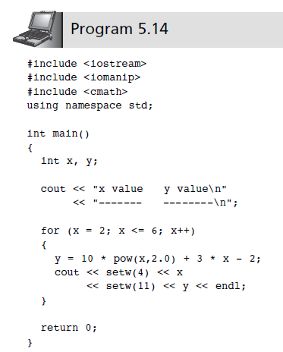
A Closer Look: Loop Programming Techniques (continued)

Slide 28
A Closer Look: Loop Programming Techniques (continued)
Interactive loop control
  Variable is used to control the loop repetitions
  Provides more flexibility at run-time
Random numbers and simulation
  Pseudorandom generator used for simulators
  C++ functions: rand(); srand()

Slide 29
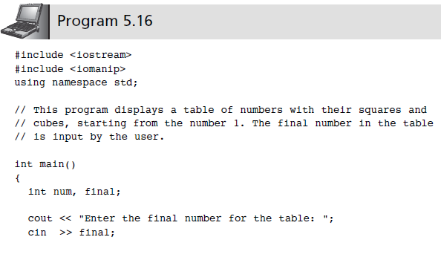
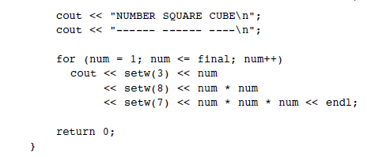
A Closer Look: Loop Programming Techniques (continued)

Slide 30
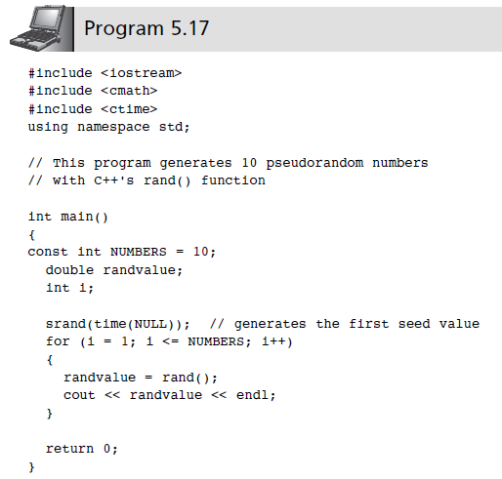
A Closer Look: Loop Programming Techniques (continued)

Slide 31
Nested Loops
Nested loop: A loop contained within another loop
  All statements of the inner loop must be completely contained within the outer loop; no overlap allowed
  Different variables must be used to control each loop
  For each single iteration of the outer loop, the inner loop runs through all of its iterations

Slide 32
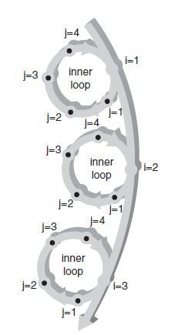
Nested Loops (continued)
Figure 5.12 For each i, j loops.

Slide 33
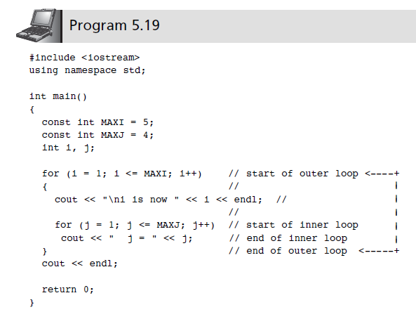
Nested Loops (continued)

Slide 34
do while Loops
do while loop is a posttest loop
  Loop continues while the condition is true
  Condition is tested at the end of the loop
  Syntax:
do
statement;
while (expression);
All statements are executed at least once in a posttest loop

Slide 35
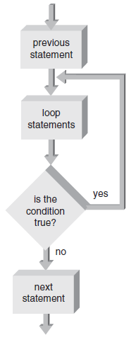
do while Loops
Figure 5.13 The do while loop structure.

Slide 36
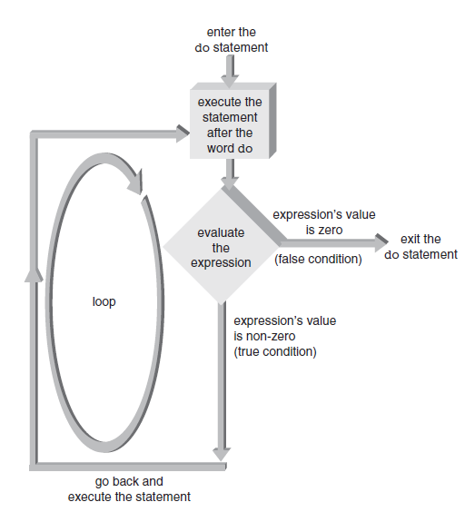
do while Loops
Figure 5.14 The do statement’s flow of control.

Slide 37
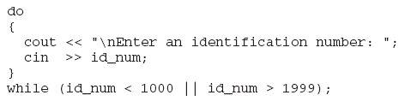
Validity Checks
Useful in filtering user-entered input and providing data validation checks
Can enhance with if-else statement

Slide 38
Common Programming Errors
Making the “off by one” error: loop executes one too many or one too few times
Using the assignment operator (=) instead of the equality comparison operator (==) in the condition expression
Testing for equality with floating-point or double-precision operands; use an epsilon value instead

Slide 39
Common Programming Errors (continued)
Placing a semicolon at the end of the for clause, which produces a null loop body
Using commas instead of semicolons to separate items in the for statement
Changing the value of the control variable
Omitting the final semicolon in a do statement

Slide 40
Summary
Loop: A section of repeating code, whose repetitions are controlled by testing a condition
Three types of loops:
  while
  for
  do while
Pretest loop: Condition is tested at beginning of loop; loop body may not ever execute; ex., while, for loops

Slide 41
Summary (continued)
Posttest loop: Condition is tested at end of loop; loop body executes at least once; ex., do while
Fixed-count loop: Number of repetitions is set in the loop condition
Variable-condition loop: Number of repetitions is controlled by the value of a variable

