Slide 1

Chapter 5:
Structural Modeling

Slide 2
Objectives
Understand the rules and style guidelines指南 for creating CRC cards, class diagrams, and object diagrams.
Understand the processes used to create CRC cards, class diagrams, and object diagrams.
Be able to create CRC cards, class diagrams, and object diagrams.
Understand the relationship among structural models.
Understand the relationship between structural and functional models.

Slide 3
Introduction
Functional models represent system behavior
Structural models represent system objects and their relationships:
  People
  Places
  Things
Create a conceptual model and evolve it into a design model using
  CRC cards
  Class diagrams
  Object diagrams

Slide 4
Structural Models
Drawn using an iterative process
  First drawn in a conceptual, business-centric中心 way
  Then refined in a technology-centric way describing the actual實際 databases and files
  More and more detail is added in each iteration
Create a vocabulary for analysts & users
  Allows effective communication between analysts & users

Slide 5

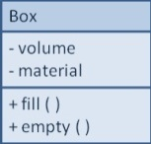
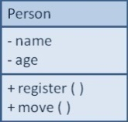
Structural Models
Main goal: to discover the key data contained in the problem domain and to build a structural model of the objects
Structural
Modeling
Solution Domain
Problem Domain

Slide 6
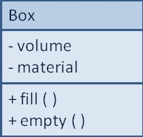
Classes, Attributes, & Operations
Classes
  Templates for instances of people, places, or things
Attributes
  Properties that describe the state of an instance of a class (an object)
Operations
  Actions or functions that a class can perform

Slide 7
Relationships
Describe how classes relate to one another
Three basic types in UML
  Generalization泛化/一般化
    Enables inheritance of attributes and operations
    屬性和操作的繼承
    Represents代表 relationships that are “a-kind-of”
  Aggregation聚合
    Relates parts to wholes
    Represents relationships that are “a-part-of”
  Association關聯
    Miscellaneous relationships between classes
    Usually a weaker form of aggregation通常是較弱的聚集形式

Slide 8
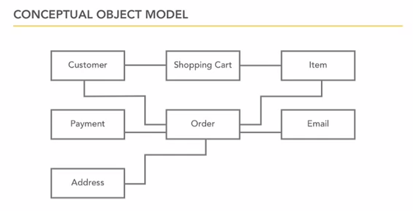

Slide 9
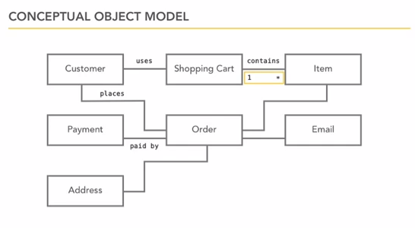

Slide 10
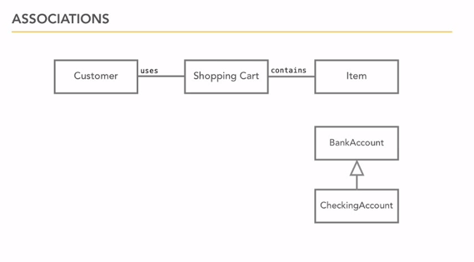

Slide 11
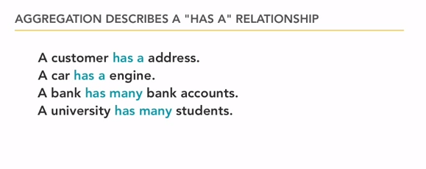

Slide 12
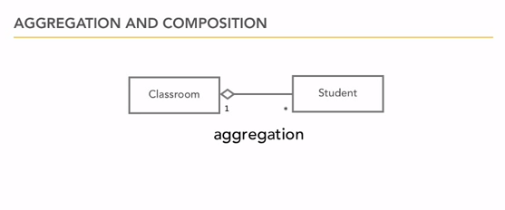

Slide 13
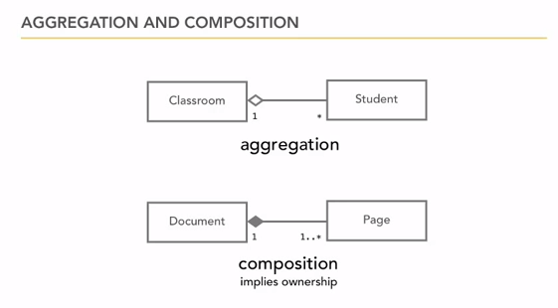

Slide 14
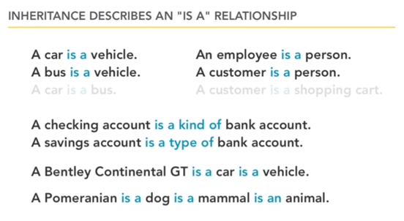

Slide 15
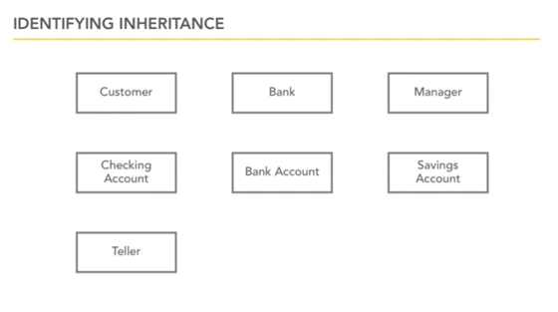

Slide 16
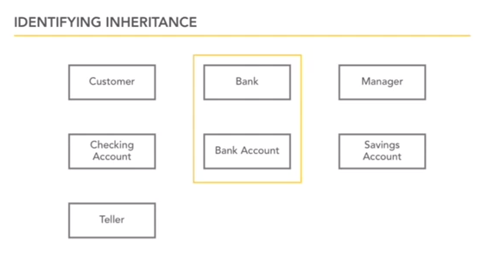

Slide 17
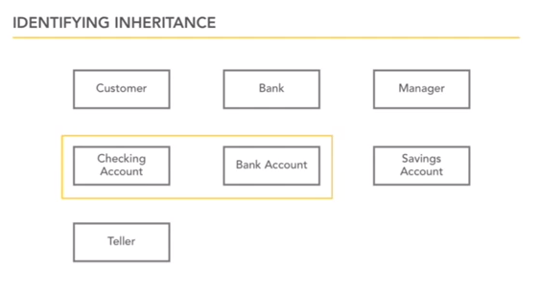

Slide 18
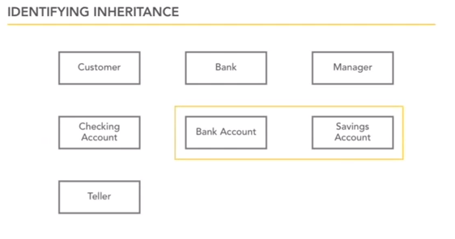

Slide 19
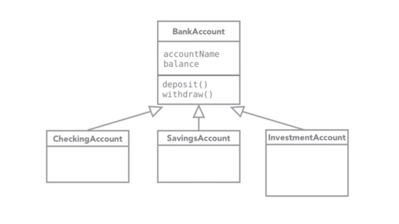

Slide 20
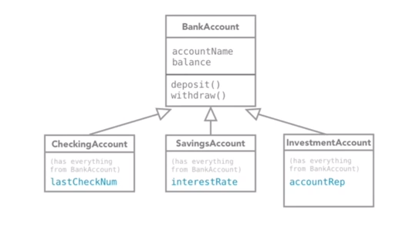

Slide 21
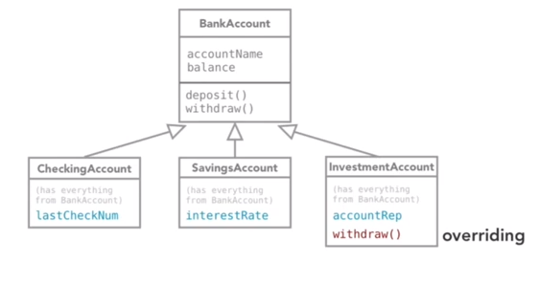

Slide 22
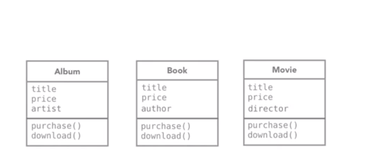

Slide 23
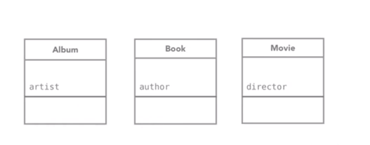

Slide 24
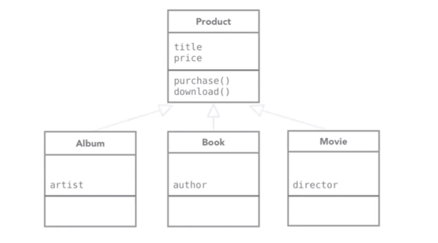

Slide 25
Object Identification
Textual文字 analysis of use-case information
  Nouns名詞 suggest classes
  Verbs動詞 suggest operations
  Creates a rough first cut to provide an object list
Brainstorming—people offering ideas
  Initial list of classes (objects) is developed
  Attributes, operations and relationships to other classes can be assigned in a second round

Slide 26
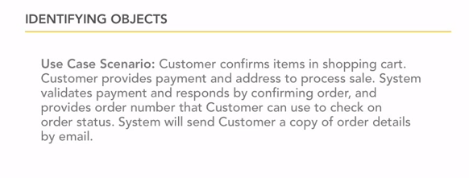

Slide 27
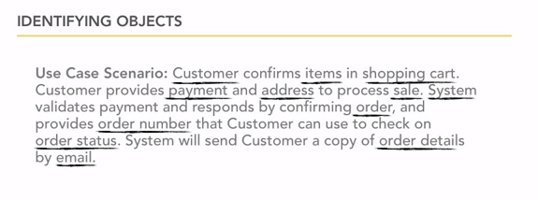

Slide 28
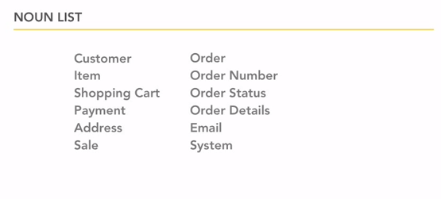

Slide 29
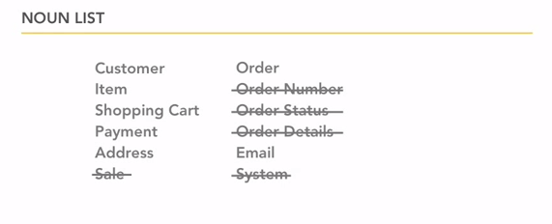

Slide 30
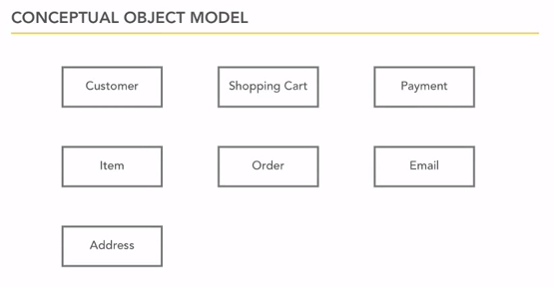

Slide 31
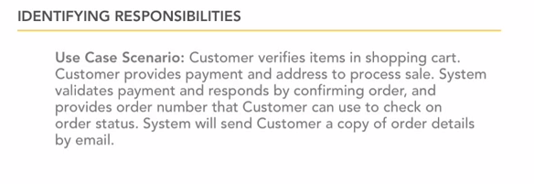

Slide 32
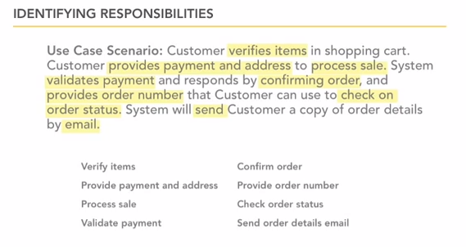

Slide 33
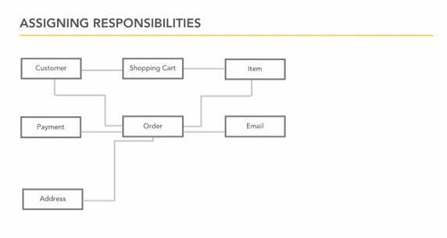

Slide 34
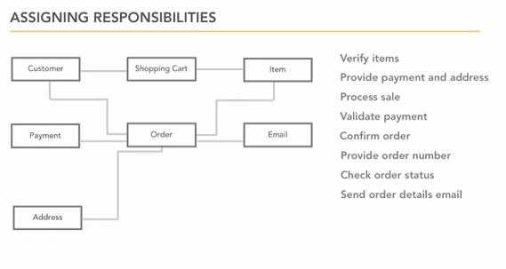

Slide 35
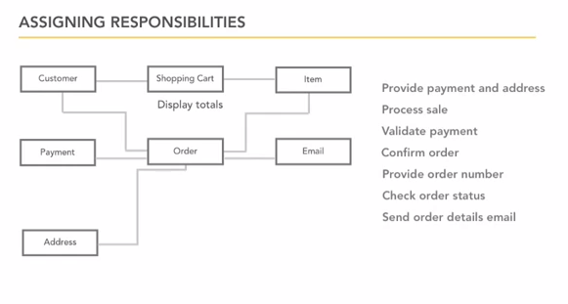

Slide 36
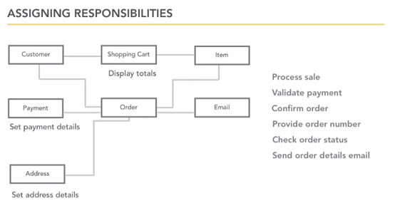

Slide 37
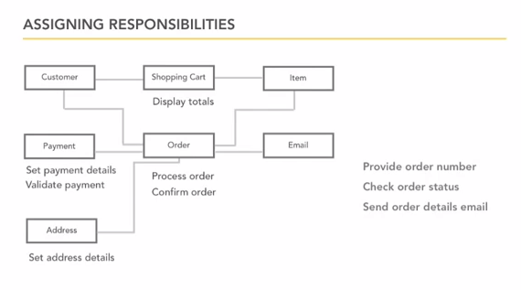

Slide 38
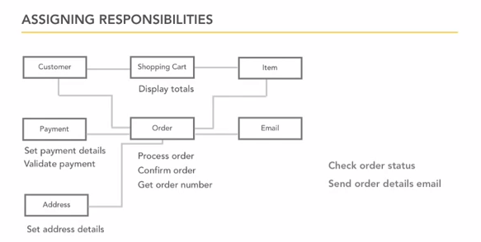

Slide 39
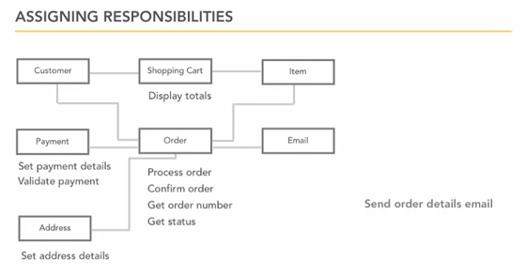

Slide 40
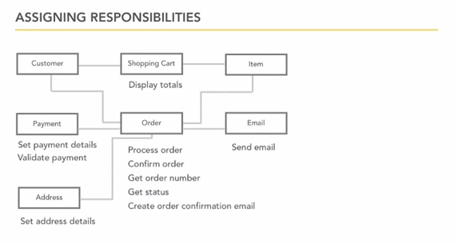

Slide 41
Object Identification (cont.)
Common Object Lists
  Physical things
  Incidents事件
  Roles
  Interactions互動
Patterns
  Useful groupings of collaborating合作 classes that provide solutions to common problems (are reusable可重複使用)
  Developed patterns模式 provide a starting point for work in similar domains

Slide 42
CRC Cards
Index cards used to document the responsibilities and collaborations of a class
Responsibilities責任
  Knowing—what a class must know manifested表現 as attributes
  Doing—what a class must do manifested later as operations
Collaboration合作
  Objects working together to service a request:
    Requestor (client)
    Responder (server)
  Bound by a contract

Slide 43
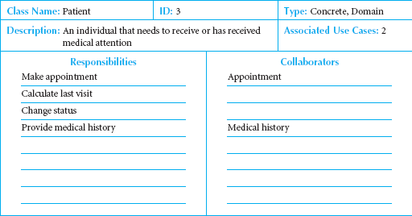
Front-Side of a CRC Card

Slide 44
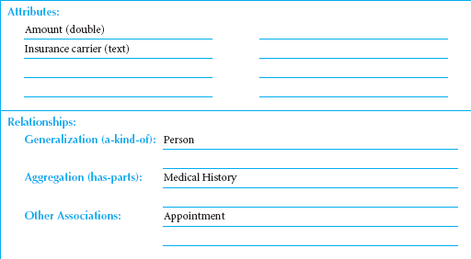
Back-Side of a CRC Card

Slide 45
CRC Cards & Role-Playing
An exercise to help discover additional objects, attributes, relationships & operations
Team members perform roles associated with the actors and objects previously identified
Utilize activity diagrams to run through the steps in a scenario
  Identify an important use-case
  Assign roles based on actors and objects
  Team members perform each step in the scenario
  Discover and fix problems until a successful conclusion is reached
  Repeat for remaining use-cases

Slide 46
Class Diagrams
A static model that shows classes and their relationships to one another
Elements
  Classes
    Objects within the system (a person, place or thing)
    Stores and manages information in the system and contains:
      Attributes—characteristics of the class
      Operations—activities the class can perform
  Relationships—the associations between classes
    Depicted as lines between classes
    Multiplicity indicates how many of one object is/are associated with other objects

Slide 47
Attributes
Properties of a class
  Person: last name, first name, address, etc.
  Attributes can be derived
    Preceded with a slash (/)
    e.g., age is derived from date of birth
Visibility of an attribute:
  Restricts access to attributes to ensure consistency
  Public attributes (+): visible to all classes
  Private attributes (-): visible only to an instance of the class in which they are defined
  Protected attributes (#): visible only to an instance of the class in which they are defined and its descendants

Slide 48
Operations
Common operations are not shown
  Create or delete an instance
  Return or set a value
Types of operations:
  Constructor—creates an object
  Query—makes information about the state of an object available
  Update—changes values of some or all of an object’s attributes
  Destructor—deletes or removes an object

Slide 49
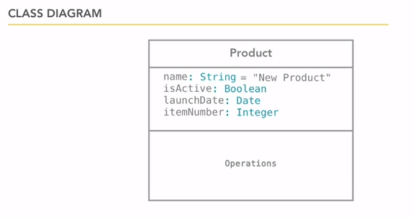

Slide 50
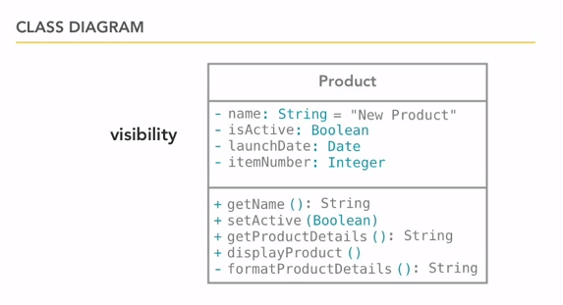

Slide 51
Relationships
Denotes associations between classes
  Depicted with a line labeled with the name of the relationship
  May be directional (depicted with a triangle; e.g., a patient schedules an appointment)
Classes may be related to themselves (e.g., employees and managers who may be members of the same class)
Multiplicity indicates how many of one class are related to another class

Slide 52
Multiplicities
Department
Boss
Exactly one:
A department has one and only one boss
1
1
Employee
Child
Zero or more:
An employee has zero to many children
1
0..*
Boss
Employee
One or more:
A boss is responsible for one or more employees
1
1..*

Slide 53
Association Classes
Common in many-to-many relationships
Used when attributes about the relationship between two classes needs to be recorded
  Students are related to courses; a Grade class provides an attribute to describe this relationship
  Illnesses are related to symptoms; a Treatment class provides an attribute to describe this relationship

Slide 54
Generalization & Aggregation Associations
Generalization denotes inheritance
  Properties and operations of the superclass are valid for the sub-class
  Depicted as a solid line with a hollow arrow pointing at the superclass
Aggregation denotes a logical “a-part-of” relationship
Composition denotes a physical “a-part-of” relationship

Slide 55
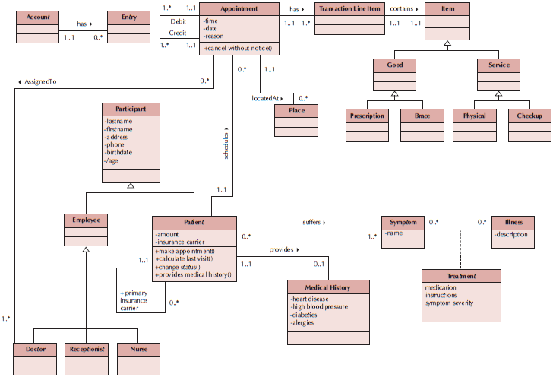
Sample Class Diagram

Slide 56
Simplifying Class Diagrams
Fully populated class diagrams of real-world system can be difficult to understand
Common ways of simplifying class diagrams:
  Show only concrete classes
  The view mechanism shows a subset of classes
  Packages show aggregations of classes (or any elements in UML)

Slide 57
Object Diagrams
Class diagrams with instantiated classes
  Example: instead of a Doctor class, create an actual doctor, say Dr. Smith
  Place values into each attribute
Used to discover additional attributes, relationships and/or operations or those that are misplaced

Slide 58
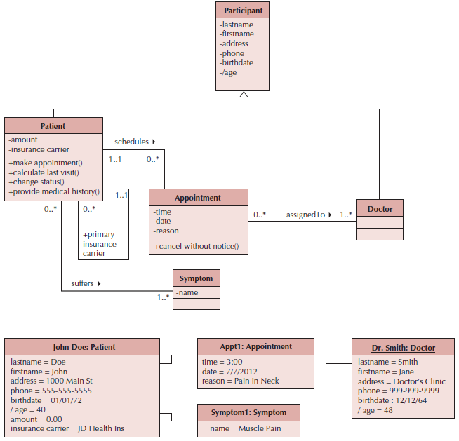
Example Object Diagram

Slide 59
7 Steps to Structural Models
Create CRC Cards
Review CRC Cards & identify missing objects, attributes, operations and/or relationships
Role-play the CRC cards—look for breakdowns & correct; create new cards as necessary
Create the class diagram
Review the class diagram—remove unnecessary classes, attributes, operations and/or relationships
Incorporate patterns
Review and validate the model

Slide 60
Verifying & Validating the Model
Analyst presents to developers & users
  Walks through the model
  Provides explanations & reasoning behind each class
Rules
  Each CRC card is associated with a class
  Responsibilities on the front of the card are included as operations on the class diagram
  Collaborators on the front of the card imply a relationship on the back of the card
  Attributes on the back of the card are listed as attributes on the class diagram

Slide 61
Rules for Validating & Verifying the Model (cont.)
Attributes on the back of the CRC card each have a data type (e.g., salary implies a number format)
Relationships on the back of the card must be properly depicted on the class diagram
  Aggregation/Association
  Multiplicity
Association classes are used only to include attributes that describe a relationship

Slide 62
Summary
Structural Models
CRC Cards
Class Diagrams
Creating CRC Cards and Class Diagrams

