Slide 1
Memento Pattern

Slide 2
Intent
Without violating encapsulation, capture and externalize an object's internal state so that the object can be restored to this state later.
16-<number>

Slide 3
Also Known As
Token
16-<number>

Slide 4
Store and Restore State of an Object
In Java, one can use cloning to store and restore an object.
Sometimes, it is desired that only the object itself is allowed to access the stored state. Objects normally encapsulate some or all of their states, making it inaccessible to other objects and impossible to save externally. Exposing this state would violate encapsulation, which can compromise the application's reliability and extensibility.
The memento pattern solves this problem.
16-<number>

Slide 5
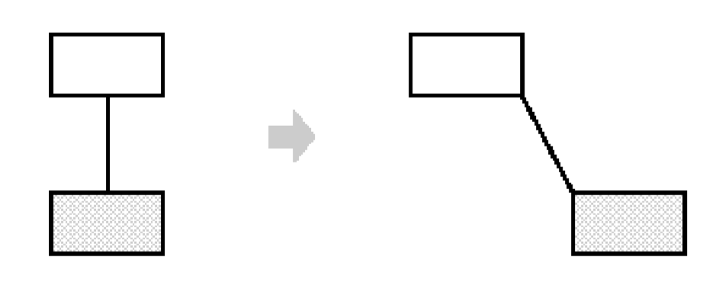
Motivation
A user can connect two rectangles with a line, and the rectangles stay connected when the user moves either of them. The editor ensures that the line stretches to maintain the connection.
16-<number>

Slide 6
Applicability
Use the Memento pattern when
a snapshot of (some portion of) an object's state must be saved so that it can be restored to that state later, and
a direct interface to obtaining the state would expose implementation details and break the object's encapsulation.
16-<number>

Slide 7
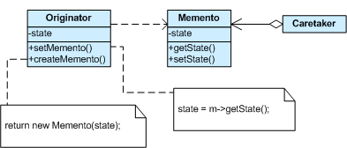
Structure

Slide 8
Participants
Memento:
  the basic object that is stored in different states. It is a lock box that is written and read by the Originator, and shepherded by the Caretaker.
  stores internal state of the Originator object. The memento may store as much or as little of the originator's internal state as necessary at its originator's discretion.
  Only the originator that created a memento will assign or retrieve its state. When mementos get created and passed back to their originator in a predictable sequence, then Memento can save just the incremental change to the originator's internal state.
16-<number>

Slide 9
Participants
Memento:
  protects against access by objects other than the originator. Mementos have effectively two interfaces. Caretaker sees a narrow interface to the Memento—it can only pass the memento to other objects. Originator, in contrast, sees a wide interface, one that lets it access all the data necessary to restore itself to its previous state. Ideally, only the originator that produced the memento would be permitted to access the memento's internal state.
16-<number>

Slide 10
Participants
Originator:
  the object that knows how to save itself. Sets and gets values from the currently targeted Memento. Creates new Mementos and assigns current values (internal state) to them.
  uses the memento to restore its internal state.
Caretaker:
  holds a list that contains all previous versions of the Memento. the object that knows why and when the Originator needs to save and restore itself.
  is responsible for the memento's safekeeping.
  never operates on or examines the contents of a memento.
16-<number>

Slide 11
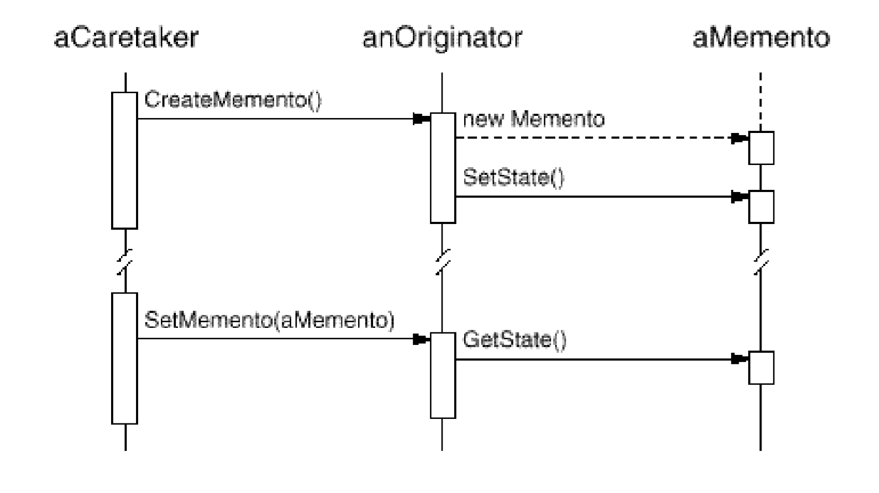
16-<number>

Slide 12
Memento Pattern
Memento m=new Memento();
State s= (DiagramState)state.clone();
m.setState(s, pass);
return m;
int h=pass.hashCode();
if (pass==h)
return state;
else throws IllegalAccessException(...);
DiagramState
state
State Diagram
pass: int
createMemento(): Memento
setMemento(m: Memento)
// other operations
Memento
pass: int
getState(pass: int): State
setState(s: State, pass: int)
originator
memento
try { state=m.getState (pass); }
catch (IllegalAccessException e) {...}
state=s;
pass=pass.hashCode();
Client
memento=originator.createMemento();
...
originator.setMemento(memento);
16-<number>

