Slide 1
Iterator Pattern

Slide 2
Traversing Different Class Structures
A state diagram is a complex directed graph.
The diagraph may be stored using different class structures.
Analyzing a state diagram needs to process each component of the diagram.
Design problem: how to process the components independent of the class structure used to store the state diagram?
16-<number>

Slide 3
Iterator
According to GoF, iterator design pattern intent is: “Provides a way to access the elements of an aggregate object without exposing its underlying representation.”
Iterator pattern is to support multiple traversals of aggregate object.
It is to provide a uniform interface for traversing different aggregate structures.
16-<number>

Slide 4
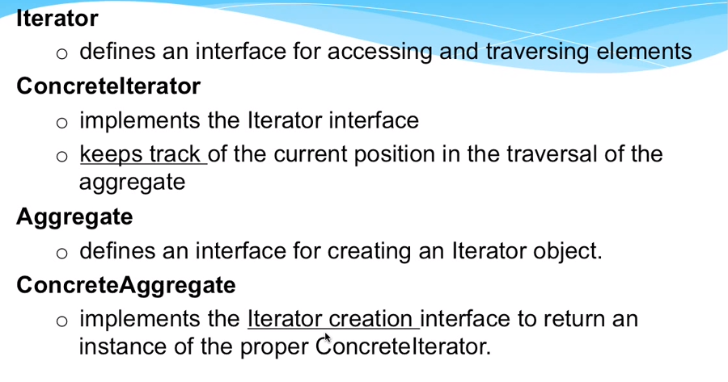
Iterator Pattern: Participants
16-<number>

Slide 5
Iterator
Client uses concrete iterators to access concrete aggregates.
It defines a common
interface for all concrete iterators.
Iterator
hasNext(): boolean
next(): Object
remove()
Aggregate
iterator(): Iterator
// other operations
Client
return new Iterator2(self);
Aggregate 1
iterator(): Iterator
// other operations
Aggregate 2
iterator(): Iterator
// other operations
Iterator 2
hasNext(): boolean
next(): Object
remove()
Iterator 1
hasNext(): boolean
next(): Object
remove()
traverse
traverse
16-<number>

