Slide 1
Strategy Pattern

Slide 2
Strategy (policy)
Client
Strategy
operation()
setContext(c: Context)
Context
getContextData(): Data
strategy
Strategy 1
operation()
Strategy 2
operation ()
Strategy 3
operation ()
16-<number>

Slide 3
Object Interaction in Strategy
client:
c:Context
s:Strategy K
K=1, 2, 3
create()
setContext(c)
process context, may get
data from context
operation()
d:=getContext():Data
16-<number>

Slide 4
Applying Strategy: The Mapping
Pattern:
Client
strategy
Strategy
operation()
setContext(c: Context)
Contex
getContextData(): Data
context
Strategy 1
operation()
Strategy 2
operation ()
Strategy 3
operation ()
Editor design:
Edit Diagram Controller
State Diagram
draw(g: Graphics)
setLayoutAlgo(a: LayoutAlgo)
// other operations
<<Strategy>>
Layout Algorithm
layout()
setDiagram(d: State Diagram)
<<Strategy>>
Force-Based Layout
layout()
<<Strategy>>
Orthogonal Layout
layout()
<<Strategy>>
Hierarchical Layout
layout()
16-<number>

Slide 5
Applying Strategy
Edit Diagram Controller
The client calls setLayoutAlgo(a) to set selected algorithm, then calls draw (g).
State Diagram
draw(g: Graphics)
setLayoutAlgo(a: LayoutAlgo)
// other operations
layoutAlgo.layout();
for each c in components
c.draw(g);
diagram
layoutAlgo=a;
layoutAlgo. setDiagram(self);
layoutAlgo
<<Strategy>>
Layout Algorithm
layout()
setDiagram(d: State Diagram)
<<Strategy>>
Force-Based Layout
layout()
<<Strategy>>
Orthogonal Layout
layout()
<<Strategy>>
Hierarchical Layout
layout()
16-<number>

Slide 6
Object Interaction in Editor Strategy
:Edit Diagram Controller
:State Diagram
a :Layout Algorithm
beautify()
setLayoutAlgo(a)
setDiagram(self)
draw(g)
layout()
for each c in components
c.draw(g);
16-<number>

Slide 7
Benefits and Liabilities of Strategy
Benefits
  Eliminate conditional statements – reducing complexity.
  Let the client select the algorithm – changing the behavior of the subject dynamically.
  Allow different algorithms to apply to the same data structure – hiding the data structure from the subject.
Liabilities
  The client must know the strategies and how to choose them.
  Breaking encapsulation – the strategies may need to know the data structure of the subject.
  A little increase in communication overhead.
16-<number>

Slide 8
Application
Consider how strategy can be applied in the following situations:
  networks routing
  circuit layout
  work scheduling
  work flow management
  discount policy
  printing a document
16-<number>

Slide 9
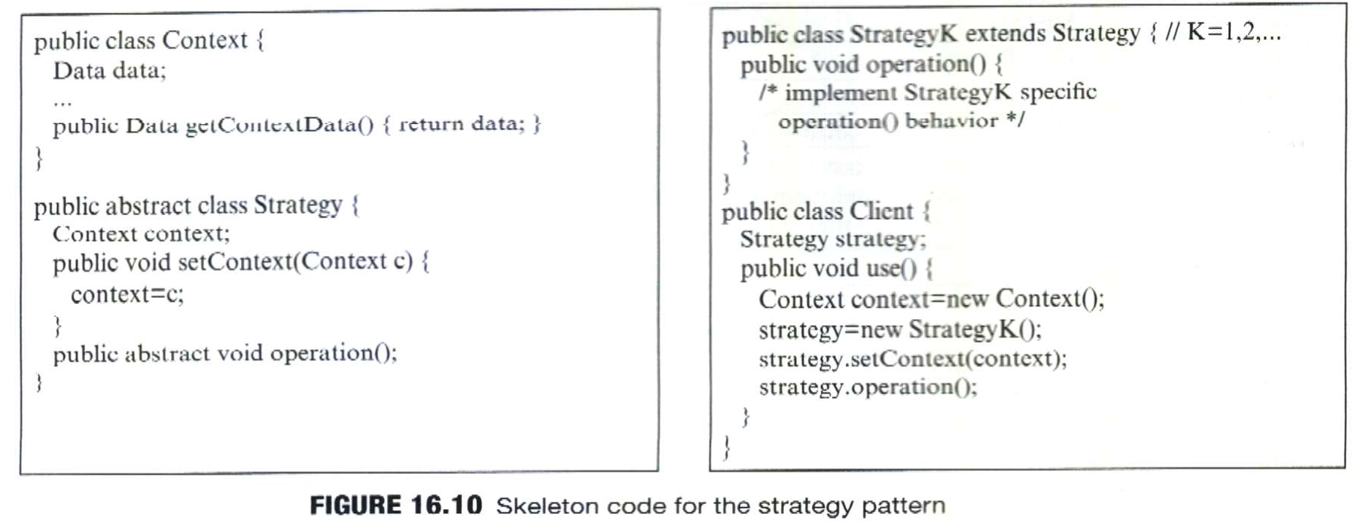
16-<number>

Slide 10
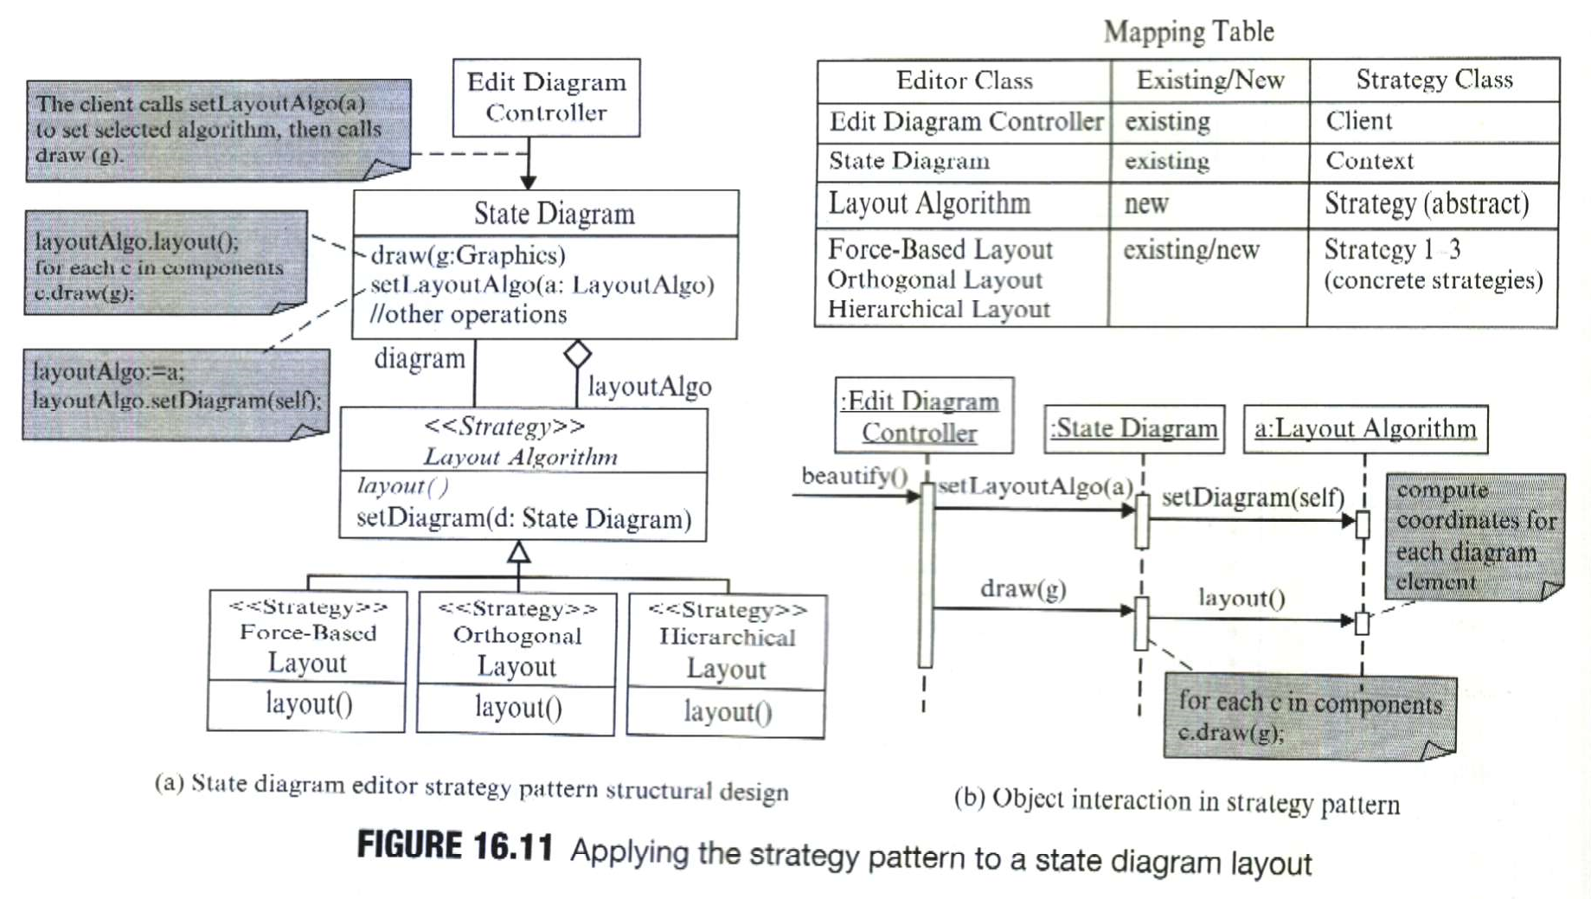
16-<number>

Slide 11
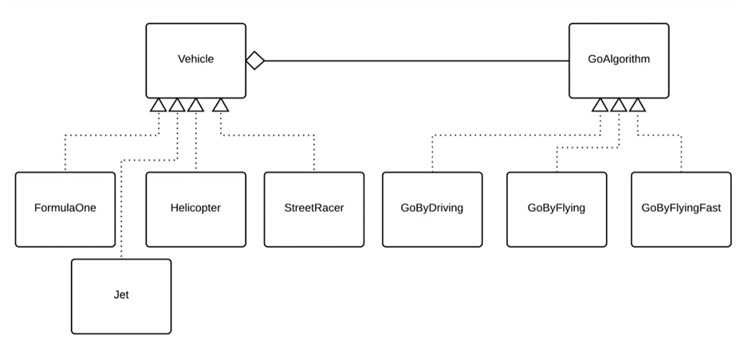
Strategy Pattern - Example
16-<number>

