Slide 1
Prototype Pattern

Slide 2
How to Reduce Number of Classes
Car
Do different cars have
different behavior and
different relationships?
housepower
numOfSeats
milesPerGallon
If not, then only one
class is sufficient.
...
Toyota
Santana
Ford
Camry
Corolla
Edge
Granada
17-<number>

Slide 3
Prototype Pattern
get prototype
<<Singleton>>
ProtoMgr
get(key):Object
add(key, Object)
remove(key)
maintain
Client
operation()
prototype
*
Prototype
clone():Object
*
ProtoMgr pm =
ProtoMgr.getInstance();
Prototype p=pm.get(“Ford Edge”);
if (p==null) {
Car edge=new Car();
edge.setMake(“Ford”);
edge.setModel(“Edge”);
...
pm.add(“Ford Edge”, edge);
p=pm.get(“Ford Edge”);
}
Car c=(Car)p.clone();
c.setX(...); ...
Car
Document
make
model
housepower
numOfSeasts
milesPerGallon
type
callNumber
author
title
clone():Object
...
...
clone():Object
...
17-<number>

Slide 4
Object Interaction in Prototype
client:
:ProtoMgr
:TypeK
c:Car
prototype:
c:=(Car)get(“Ford Edge”)
c:=get(“Ford Edge”)
setX(...)
foo()
17-<number>

Slide 5
Prototype Pattern
Benefits
  Reducing the number of classes
  Easy to add/remove prototypes at run time
  Improving complex object creation efficiency
  Support dynamically loaded classes (DLC)
    DLC cannot be referenced at compile time.
    The class loader creates and registers an instance of the DLC at run time when the DLC is loaded
  As an alternative to abstract factory – avoiding the factory hierarchy parallel to the product hierarchy
17-<number>

Slide 6
The Prototype Pattern
Liabilities
  Each subclass of Prototype must implement the clone operation
    deep copy if copy and original must be independent
    shallow copy is sufficient otherwise
  Implementing clone may be difficult if
    the component objects do not support cloning, or
    there are circular references
17-<number>

Slide 7
Difference between shallow cloning and deep cloning
Shallow cloning copies the top level of a tree, but anything pointed to from that top level (e.g., object properties) remains shared by both copies. Deep cloning copies all levels of the tree, leaving no links between the source and the copy.
17-<number>

Slide 8
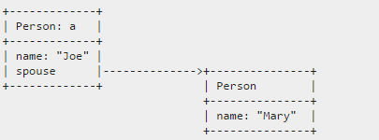
Difference between shallow cloning and deep cloning
For instance, you have a Person object (a) with a spouse property, which is also a Person object:
17-<number>

Slide 9
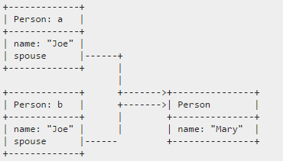
Difference between shallow cloning and deep cloning
If you do a shallow clone of a to b, both a and b point to the same Person from their spouse property:
17-<number>

Slide 10
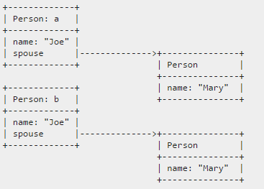
Difference between shallow cloning and deep cloning
If you do a deep clone, you not only clone a to b, but you clone a.spouse to b.spouse so that they each end up having their own copy.
17-<number>

Slide 11
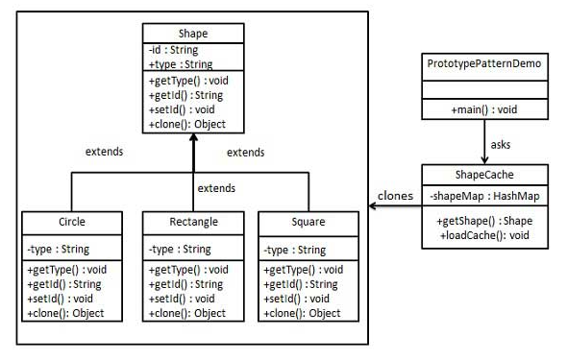
Prototype Pattern Implementation
16-<number>

Slide 12
Steps
Step 1. Create an abstract class implementing Cloneable interface.
Step 2. Create concrete classes extending the above class.
Step 3. Create a class to get concrete classes from database and store them in a Hashtable.
Step 4. PrototypePatternDemo uses ShapeCache class to get clones of shapes stored in a Hashtable.
16-<number>

Slide 13
Remarks
What are the design objectives of singleton, flyweight, and prototype?
What are the similarities and differences between prototype and flyweight?
In the persistence framework, can prototype be applied to reduce the number of command classes?
Can prototype be applied to eliminate an Abstract Factory?
17-<number>

Slide 14
Persistence Framework: Putting It Together
Controller
DBMgr
DB Access Interface
Net Interface
getX(): X
saveX(x:X)
getX(): X
saveX(x:X)
openSocket()
closeSocket()
calls hook1() and hook2()
DBX Cmd
DBX Access
DBY Proxy
Remote DBY
execute(): Object
hook1()
hook2(): Object
getX(): X
saveX(x:X)
getX(): X
saveX(x:X)
openSocket()
closeSocket()
getX(): X
saveX(x:X)
openSocket()
closeSocket()
bridge
Get X
Save X
remote proxy
GetX(...)
hook1()
hook2(): Object
SaveX(...)
hook1()
hook2(): Object
command, template method and factory method
17-<number>

