Slide 1
Chapter 16. Applying Patterns to Design a State Diagram Editor
Adapter

Slide 2
Adapter Pattern

Slide 3
Adapter Pattern
Adapter Pattern: Connects incompatible components.
  It converts the interface of one component into another interface expected by the other (calling) component
  Used to provide a new interface to existing legacy components (Interface engineering, reengineering)
Also known as a wrapper.
Notes:
The adapter pattern lets classes work together that couldn’t otherwise because of incompatible interfaces
Object adapters are much more frequent.
We will only cover object adapters (and call them therefore simply adapters)

Slide 4
Adapter Pattern
Problem
  Want to use an existing class but its interface does not match the one needed
Solution
  Convert original interface into the needed interface through an adapter class
The Adapter pattern has two forms
  class adapter
  object adapter
16-<number>

Slide 5
Adapter Pattern
New System
Old System
(“Legacy System”)
Client
ClientInterface
LegacyClass
Request()
ExistingRequest()
adaptee
Adapter
Request()
Notes:
Delegation is used to bind an Adapter and an Adaptee (Legacy Class)
Interface inheritance is use to specify the interface of the Adapter class.
Adaptee (usually called legacy system) pre-exist the Adapter.
Client Interface may be realized as an interface in Java.

Slide 6
Class Adapter and Object Adapter
Client IF
Adaptee
Client IF
Client
Client
request()
request()
operation()
inheritance
composition
Adapter
Adapter
request()
request()
adaptee
...
adaptee.operation();
...
Adaptee
...
operation();
...
operation ()
Adaptee 1
Adaptee 2
Class Adpater
operation()
operation()
Object Adpater
16-<number>

Slide 7
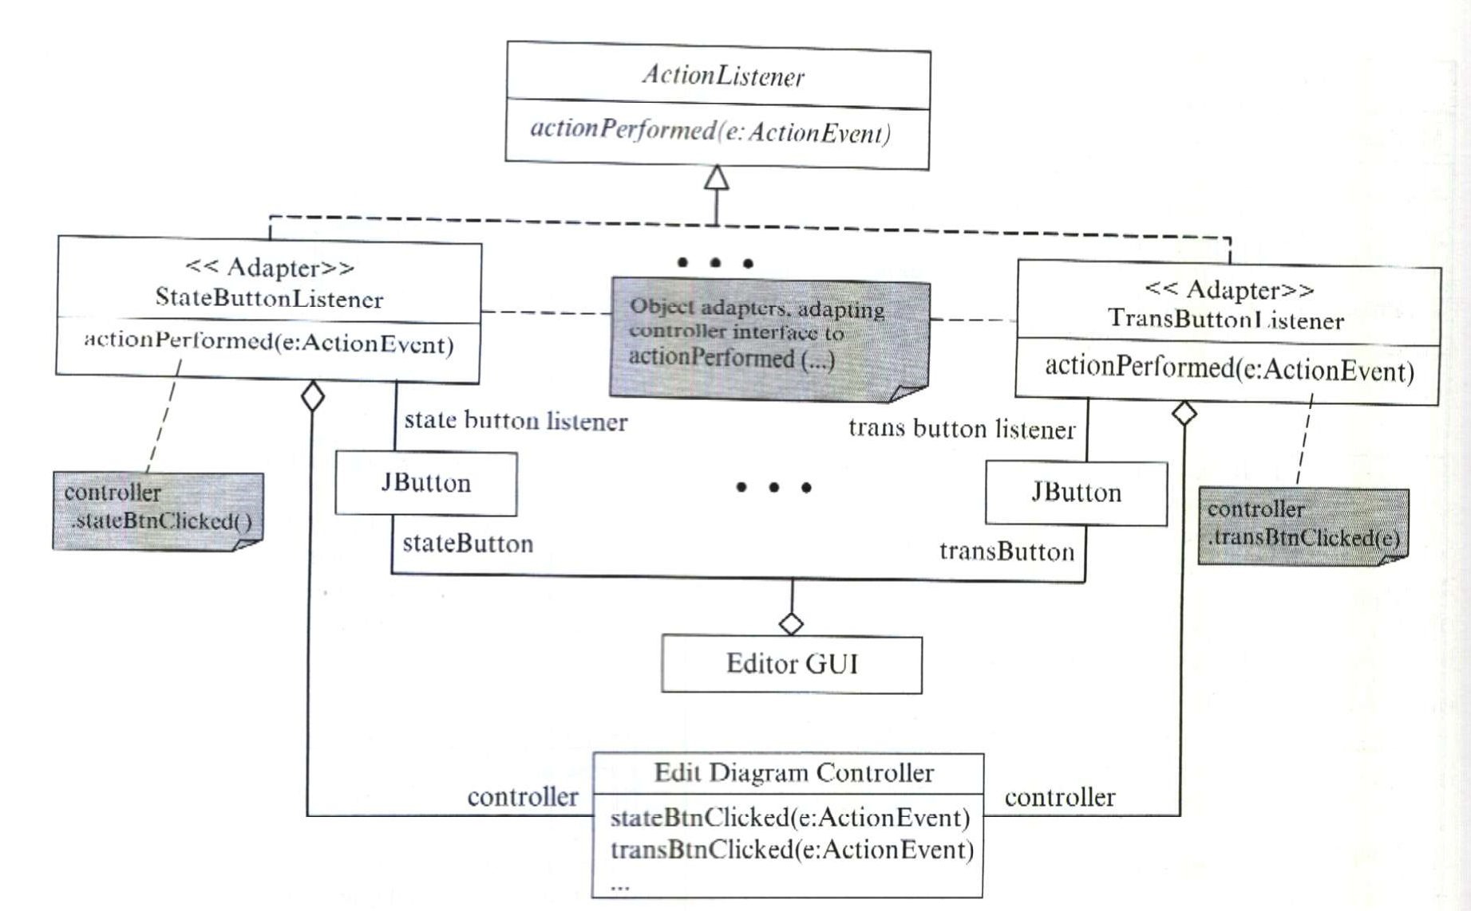
16-<number>

Slide 8
Class Adapter and Object Adapter
Class adapter
  commit to a concrete adaptee class
  can override behavior of the adaptee class
  introduces only one object
  cannot change the adaptee class at run time
  can add functionality to the adaptee class
Object adapter
  do not commit to an adaptee class
  may introduce a subclass of the adaptee class and override its behavior
  introduces more than one object
  can change the adaptee at run time
  can add functionality to the adaptees through subclassing
16-<number>

Slide 9
A Class Adapter Example
Problem
  An application program wants to read from an ascii file using
    readString()
    readChar()
    readInt()
    etc.
  But Java IO does not provide this convenience
  How can we do?
    implement an adapter class to convert the needed interface to an appropriate Java API
16-<number>

Slide 10
A Class Adapter Example
AsciiInputInterface
Client
readString(): String
readChar(): char
readInt(): int
...
StreamTokenizer
sval: String
nextToken(): int
String result=“”;
if (nextToken()==TT_EOF) {
throw new EOFException();
} else if (ttype != TT_WORD) {
throw new IOException
("Not a string!");
} else {
result=sval;
checkEolEof();
return result;
}
AsciiInputInterfaceAdapter
readString(): String
readChar(): char
readInt(): int
checkEolEof()
...
16-<number>

Slide 11
Pluggable Adapters
*
File
Class0
subClasses():String[]
NormalFile
Directory
list():String[]
Class1
Class2
A directory hierarchy
An inheritance hierarchy
How do we design a generic display that can display any hierarchical structures?
The solution is using pluggable adapters.
16-<number>

Slide 12
Pluggable Adapters
HierarchicalDisplay
Client/Target
getChild(n:Node):Node
createGraphNode(n:Node)
display()
buildHierarchy(n:Node)
Directory
ClassHierarchy
Adapters
DirectoryDisplay
InheritanceTreeDisplay
getChild(n:Node):Node
createGraphNode(n:Node)
getChild(n:Node):Node
createGraphNode(n:Node)
16-<number>

