Slide 1
Decorator Pattern

Slide 2
Decorating User Interface
What needs to be done?
  adding a border around the editing area
  adding a vertical and a horizontal scroll bar to allow the user to view different parts of the document
  the system must be able to dynamically add or remove any of these decorations
16-<number>

Slide 3
One Solution Is Using Inheritance
Glyph
Scrolled Area
Bordered Area
...
Bordered Scrolled Area
Inheritance provides only a static solution. The
decoration cannot be changed dynamically.
Unmanageable number of subclasses, due to number
of possible combinations.
The decorations cannot be combined.
16-<number>

Slide 4
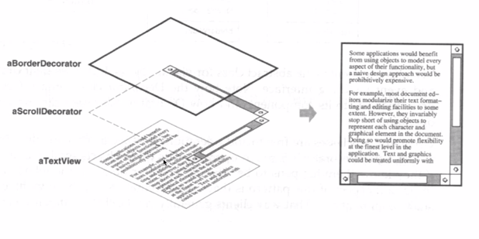
16-<number>

Slide 5
Applying Decorator Pattern – textbook diagram
Diagram Element
name: String
loc: Point
draw(g: Graphics)
intersect(p: Point): boolean
<<Decorator>>
Decorator
draw(g: Graphics)
intersect(p: Point): boolean
component. draw(g);
component
compo-nent
*
super.draw(g);
drawNote (g);
<<Decoroator>>
UML Note
draw(g: Graphics)
drawNote (g:Graphics)
*
State Diagram
draw note
State
Transition
*
16-<number>

Slide 6
Applying Decorator Pattern - Revised
DiagramElement
draw(g: Graphics)
<<Decorator>>
DeDecorator
DiagramElement de
DeDecorator(de: DiagramElement)
DiagramElement. draw(g);
component
*
<<Decorator 1>>
UMLNote
UMLNote(de: DiagramElement)
draw(g: Graphics)
super.draw(g);
*
State Diagram
State
Transition
+"draw note….."
*
16-<number>

Slide 7
Expanding the Composite Representation
Composite
Diagram Element
children
Decorator
component
draw(...)
*
component.
draw(...)
Decorator
State
Transition
State Diagram
draw(...)
draw(...)
draw(...)
draw(...)
Scroller
Border
super.draw(...);
drawBorder(...);
draw(...)
drawScroller(...)
draw(...)
drawBorder(...)
Added functionality
Added functionality
super.draw(...);
drawScroller(...);
16-<number>

Slide 8
Decorator Pattern
Component
operation ()
component
component.
operation()
Comp1
Decorator
operation ()
operation ()
Decorator1
Decorator2
super.operation()
addedFunct2()
operation ()
addedFunct1()
operation ()
addedFunct2()
16-<number>

Slide 9
The Decorator Pattern
Adding functionality to an existing object dynamically.
A flexible alternative to subclassing, especially when subclassing is impractical:
  too many subclasses
  cannot be subclassed, e.g., final class
16-<number>

Slide 10
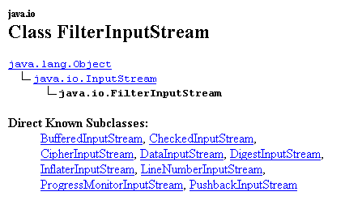
Known Uses
Encrypted, compressed communication streams
Stream I/O:
<-----component to decorate
<-- decorator superclass
16-<number>

Slide 11
Class Discussion
Decorator and Visitor both visit and process the elements of a class hierarchy.
What are the similarities between these two patterns?
What are the differences between these two patterns?
When to apply each of these patterns?
16-<number>

