Slide 1



CHOCOLATE MARKET STRATEGIC ANALYSIS
Reopening Strategy Guided by 2022-2023 Sales
Team 6 Data Analysts: Juda, Juan, Malika
Ironhack - SQL Project
CONFIDENTIAL
Notes:
Speaker 1: Good morning. We are reopening our chocolate business in 2026, so we looked back at 2022-2023 sales data to guide where we should focus next. The goal is not just to describe past sales, but to turn those numbers into practical reopening decisions.

Slide 2


OBJECTIVES
BUSINESS CASE
1. Which market should guide our 2026 reopening?
As Data Analysts, our mission is to use 2022-2023 chocolate sales data to guide our 2026 business reopening. We compare markets, products, channels, seasonality, and sales performance to decide where to focus next.
2. Which products, channels, and seasons should shape launch planning?
3. Which sales patterns should we replicate?
DATA-DRIVEN STRATEGY
Notes:
Speaker 1: Our business case is simple: use historical sales to decide where to relaunch, which products to prioritize, which channels to focus on, and what seasonal timing matters most. We answer three questions around market priority, demand drivers, and sales performance.

Slide 3


ETL PIPELINE & PREPARATION
STAGE
TOOLS
RESULT
Python / CSV
Kaggle chocolate sales dataset
Extract
Python (Pandas)
Cleaning, date typing, and normalization
Transformation
MySQL Workbench
MySQL relational database
Loading
199,563 clean invoice rows loaded with referential integrity
Notes:
Speaker 2: The project follows an ETL pipeline. We extracted the Kaggle chocolate sales CSV, cleaned and normalized it with Python and Pandas, exported three clean tables, and loaded them into MySQL. The final invoice table has 199,563 clean rows linked to products and salespeople.

Slide 4
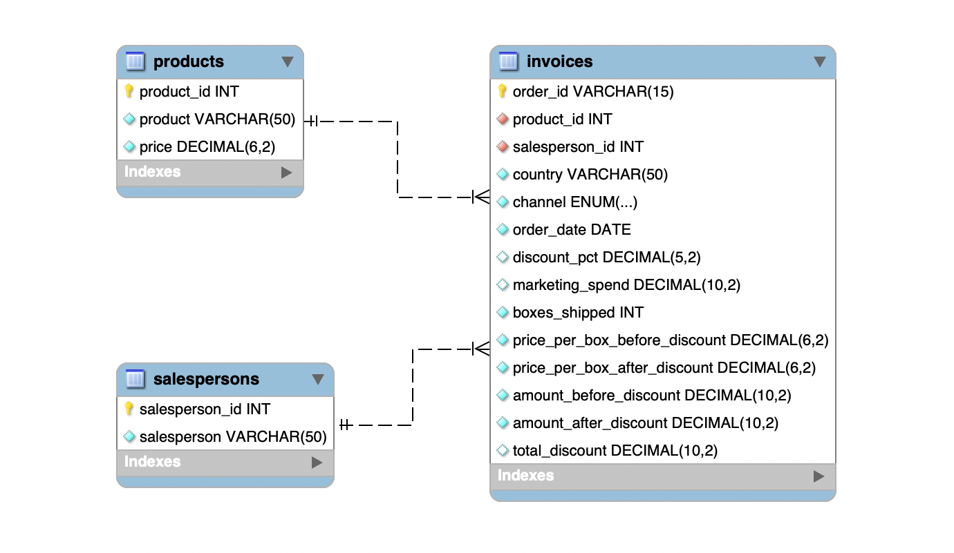
RELATIONAL ARCHITECTURE (ERD)
TABLE: INVOICES
Central fact table containing 199,563 clean invoices with product and salesperson foreign keys.
TABLE: PRODUCTS
Catalog dimension: Product_ID, Product Name, and Unit Price per Box.
TABLE: SALESPERSONS
Team dimension: Unique identifiers for tracking individual sales performance.
"Referential integrity ensures no orphan sales, securing the reliability of our strategic KPIs."
Notes:
Speaker 2: The database has one central invoices table and two dimension tables: products and salespersons. This structure lets us join sales activity back to product names and salesperson names while keeping the model simple and reliable.

Slide 5

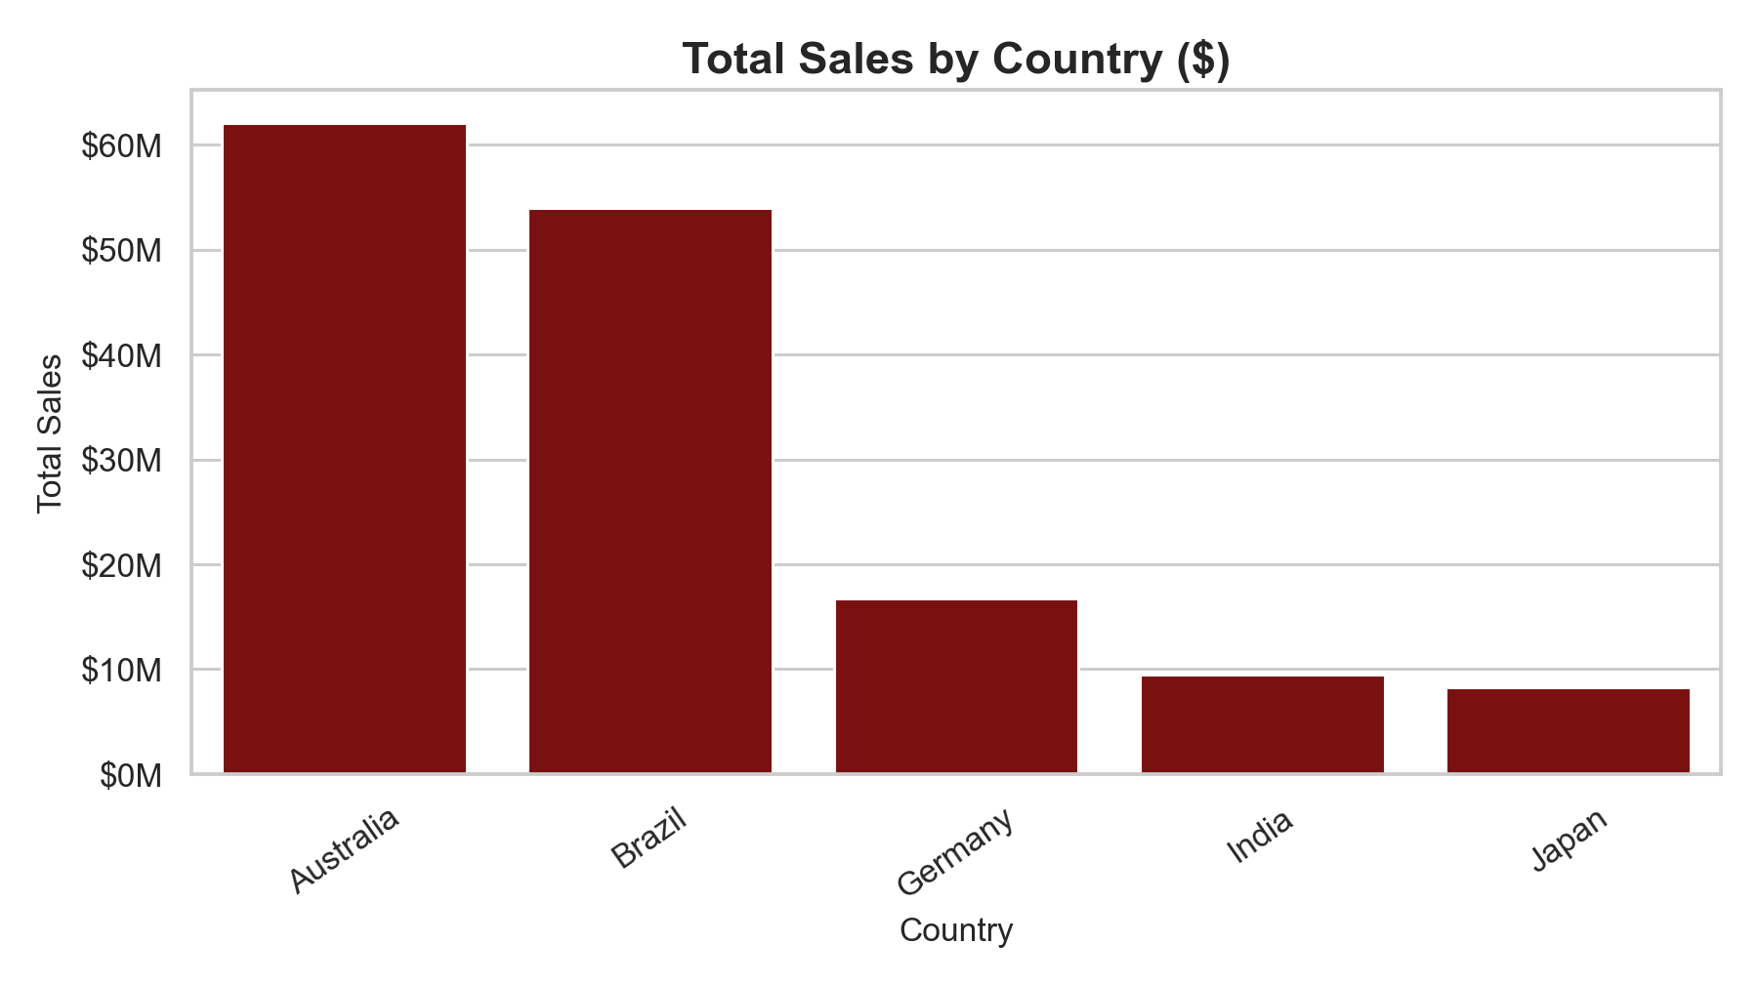
AUSTRALIA: REVENUE LEADER
EFFICIENCY
7.14
REV / MARKETING $
Australia gives us scale; Brazil shows the strongest marketing efficiency.
RECOMMENDATION:
Scale in Australia; apply Brazil's campaign efficiency lessons.
Highest total sales at $62.1M.
Brazil is the efficiency benchmark at 10.80 revenue per marketing dollar.
Notes:
Speaker 3: Australia is the largest revenue market at about $62.1 million, so it is the best market for scale. However, Brazil has the strongest marketing efficiency at 10.80 dollars of revenue per marketing dollar. Our recommendation is to prioritize Australia for scale while learning from Brazil's efficiency.

Slide 6




PRODUCT-CHANNEL MIX & SEASONALITY
LEVER
DOMINANT SEGMENT
KEY OBSERVATION
PRODUCT INSIGHT
Mixed Assortment Box leads revenue; 70% Dark Bar leads unit volume.
Product
Mixed Assortment Box
Top revenue product
Channel
Retail
Highest revenue channel
CHANNEL INSIGHT
Season
Dec
Strong year-end peak
Retail leads revenue; Wholesale remains a volume lever.
RETAIL FOCUS
YEAR-END STOCK
GIFT BOXES
Notes:
Speaker 1: The strongest revenue product is Mixed Assortment Box, which suggests gift and assortment products should be central to the reopening offer. Retail is the leading revenue channel, while Wholesale remains important for volume. Seasonally, the peak is at year-end rather than summer.

Slide 7
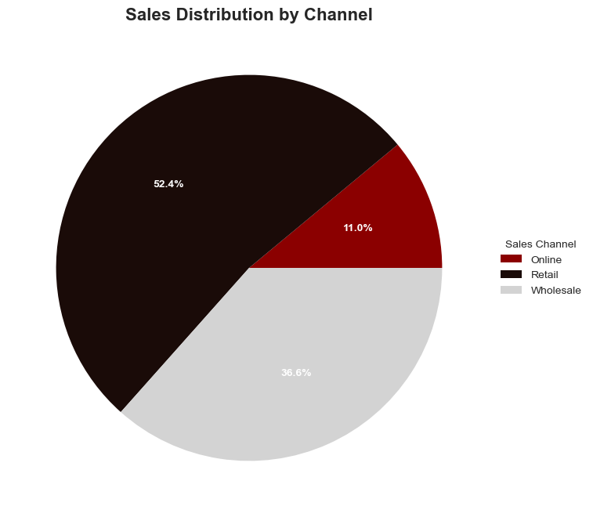
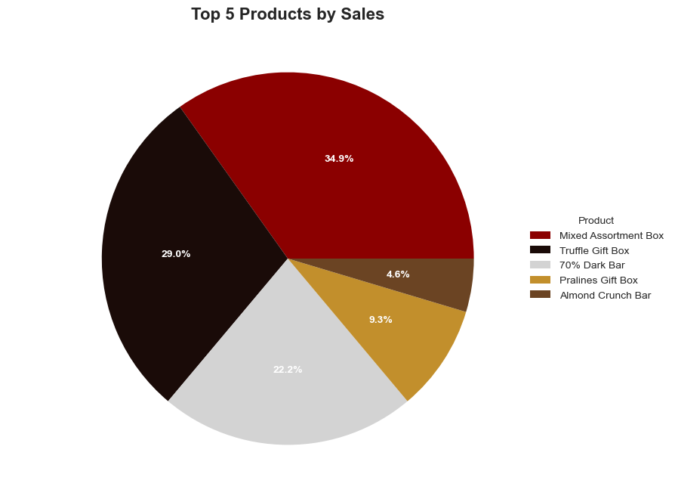
PRODUCT-CHANNEL MIX & SEASONALITY
Notes:
Speaker 1: The strongest revenue product is Mixed Assortment Box, which suggests gift and assortment products should be central to the reopening offer. Retail is the leading revenue channel, while Wholesale remains important for volume. Seasonally, the peak is at year-end rather than summer.

Slide 8
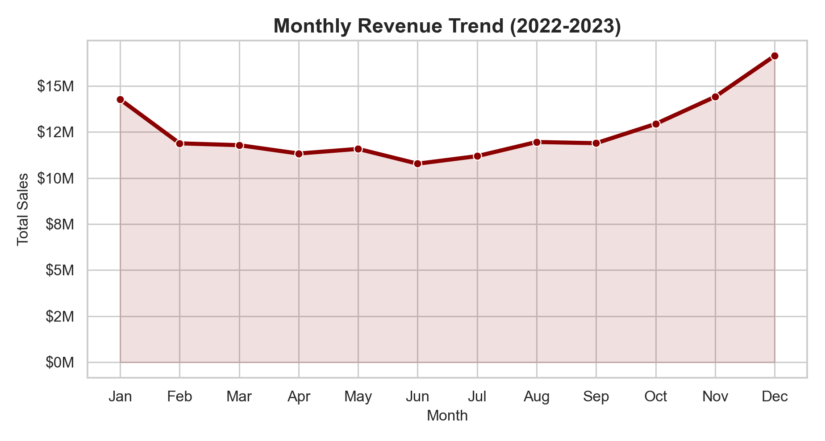
MONTHLY SEASONALITY
YEAR-END PEAK
$16.6M
Dec revenue
Revenue builds toward November and December, making the reopening plan strongest when inventory and campaigns prepare for year-end gift demand.
-- December is the strongest sales month across 2022-2023.
-- Reopening plans should treat Q4 as a stocking and campaign priority.

Slide 9

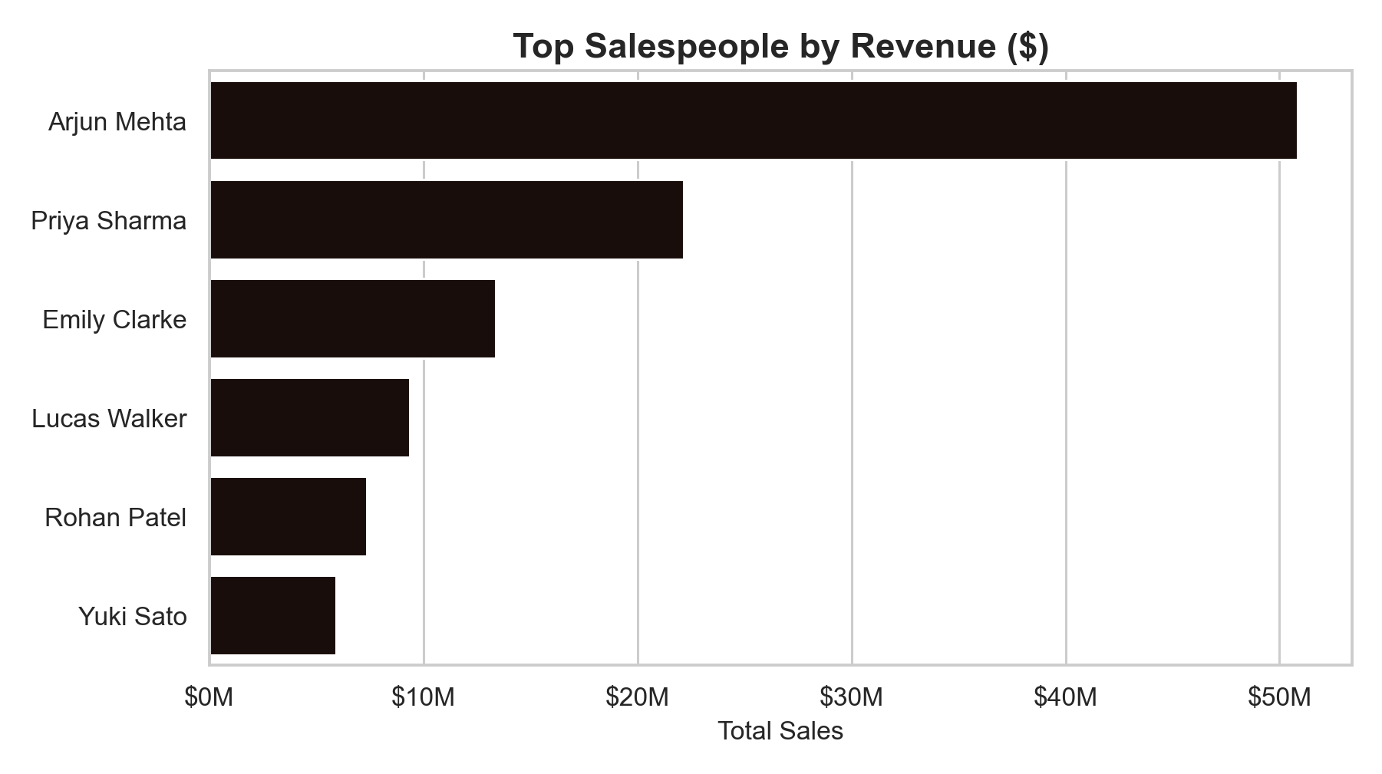
SALESFORCE PERFORMANCE
SALESPERSON
SALES ($M)
AVG DISC.
Arjun Mehta
$50.9M
13.1%
Priya Sharma
$22.2M
13.1%
Emily Clarke
$13.4M
13.1%
DISCOUNT LEVERAGE
Arjun Mehta leads revenue. Discount levels are similar across top performers, so performance appears driven by account coverage and execution.
Notes:
Speaker 2: The salesforce analysis shows Arjun Mehta leading revenue by a large margin. Average discount rates among the top sellers are similar, so the result seems less about extreme discounting and more about account coverage, market mix, and execution.

Slide 10
SQL POWER
PYTHON ANALYSIS
SQL grouped markets, products, channels, and months into reusable decision tables.
ADVANCED VISUALIZATION
SELECT country,
SUM(amount_after_discount) AS revenue,
SUM(marketing_spend) AS marketing,
SUM(amount_after_discount) / SUM(marketing_spend) AS roi
FROM invoices
WHERE boxes_shipped >= 0
GROUP BY country
ORDER BY revenue DESC;
Python charts turn SQL outputs into decision visuals.
DATA INTEGRITY
MYSQL WORKBENCH
Return rows are excluded from sales KPIs; normalized tables keep joins reliable.
PANDAS / SEABORN
Notes:
Speaker 3: SQL was used to aggregate the normalized tables into decision views, and Python turned those SQL outputs into presentation charts. We also made a clear data-quality choice: return rows are excluded from sales KPIs so they do not reduce market demand as negative sales.

Slide 11

CHALLENGES & OBSTACLES
KEY LEARNINGS
ROBUST MODELING
A simple invoices-products-salespersons schema made the SQL analysis easier to explain.
DATA QUALITY
Negative shipped boxes required a business rule: treat returns as zero sales in KPI queries.
ETL AUTOMATION
Reusable cleaning and SQL notebooks allow the team to refresh the analysis as the story changes.
SQL INTEGRITY
Maintaining product and salesperson keys across CSV export and MySQL import was critical.
TECHNICAL EXPERTISE GAINED
Notes:
Speaker 1: The main challenge was deciding how to treat messy business data, especially negative boxes shipped. The main learning is that a simple ERD and reusable notebooks make the analysis easier to refresh when the business story changes.

Slide 12
CONCLUSION & 2026 REOPENING STRATEGY
MARKET
PRODUCT
SALES
Australia For Scale
Gift Box Expansion
Retail-Led Launch
Lead with Australia as the largest market at $62.1M. Use Brazil's 10.80 ROI as the marketing-efficiency benchmark.
Prioritize Mixed Assortment Box for revenue, while keeping 70% Dark Bar available for high unit demand.
Retail leads revenue. Wholesale remains useful for volume, but it should not be the primary launch story.
TEAM 6 = JUDA, JUAN, MALIKA | IRONHACK 2026
Thank you for your attention!
Notes:
Speaker 2: Our 2026 strategy is to lead with Australia for scale, use Brazil as a marketing-efficiency benchmark, prioritize Mixed Assortment Box for revenue, keep 70% Dark Bar for high unit demand, and make Retail the main launch channel while preserving Wholesale as a volume lever.

