Slide 1
Market Sizing – Identifying potential customers in Gwinnet County
Jude omozegie

Slide 2
Identifying local businesses and their locations in Gwinnett County.
Small and medium (SMB) sized companies require information and data to help them reduce their time to market and shorten their learning curve.
They would be very interested in accurate prediction of suitable locations to establish their businesses, to leverage unique opportunities existing in those locations.
They require expertise on how to grow their business with ROI, strategic marketing services that deliver returns for their brands, business and data analytics that wold provide insights.
It is important to understand the type and locations of businesses in Gwinnet, where and how they are clustered and what unique feature influences their co-location.
This project aims to predict which locations are suitable for new businesses to establish in, cross sales opportunities to leverage and market data to assist new and existing companies in marketing and growing their brands.

Slide 3
Data Acquisition and Wrangling
Database of small businesses in Gwinnet from U.S Small Business Administration (SBA) database 2019.
GPS Coordinates obtained using Geocode By Awesome Addon on Google Sheets.
In total 273 rows and 6 columns featured in the dataset.
Irrelevant columns were removed, while rows with missing or NaN values were removed from the dataset.

Slide 4
Methodology
We downloaded the list of small businesses in Gwinnett, as our dataset for this analysis. The data source is the US Small Business Administration www.sba.gov. As part of initial analysis, to obtain the latitude and longitude of the locations, we had used the Geocode By Awesome Addon on Google sheets, to resolve the coordinates of the street addresses for each small business location. This turned out easier and less cumbersome that using Geopy or Gocoder. Several challenges were faced while trying to obtain the coordinates using Geopy or Geocode on Python. I then decided to use the easier option available.
The needed file were uploaded and loaded into pandas dataframe using ExcelWriter. We verified the dataframe frame for missing or NaN values and made necessary clean-up of the dataset where needed.
The dataset has columns with data that are unnecessary for our analysis, such as the 'Capabilities Narrative' column. It also has multiple index entries. These will be removed. The 'Business Type (Service, Construction, etc)' column name is too long for analysis. This will be reduced to 'Business Type'. The dataset also includes columns with missing or NaN values. Rows with missing or NaN values will be dropped.
We finally produced a dataset that had relevant data necessary for our analysis.

Slide 5
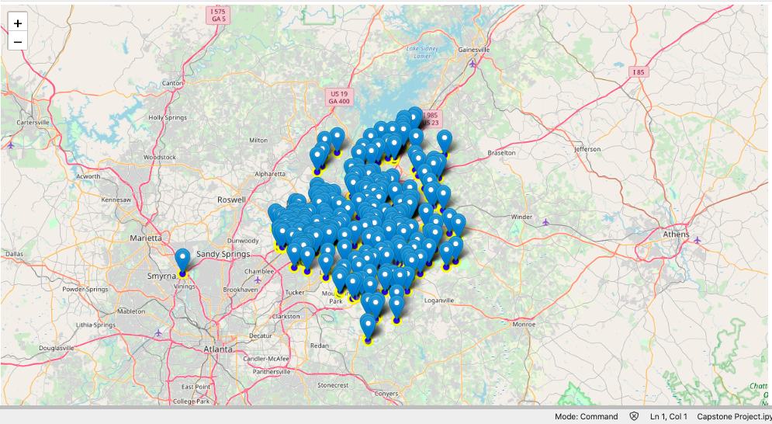
Visualization of Local Businesses in Gwinnett County

Slide 6
Result
The purpose of this analysis is to show that there are sufficient small businesses situated in Gwinnett and that they are well dispersed within the county. Being able to categorize, identify their locations/coordinates ad visualize these on the map, is a good start towards kicking off the business. Doing further analysis on this dataset, to identify their suitability and relevance to new prospects we consult for, was not considered as part of this project. This map make is easier for the team to easily identify and locate businesses to engage with.

Slide 7
Conclusion
My analysis shows that there are significant number of new businesses situated in Gwinnett county to start a pilot program. After identifying and classifying each business location, we see from the map that they are there are significant opportunities available to commence the pilot.
However, further analysis need to be done to ensure the businesses are in need of our services and currently do not use competing solutions.

