Slide 1

Price with a Smile: A Production-style Local Volatility Surface & Backtest
Jude Pereira

Slide 2
Project Overview
The project implements and backtests a Local Volatility (Dupire-type) pricing and hedging framework against a Black-Scholes sticky implied volatility baseline, using real market option quotes over multiple consecutive trading days.
The goal is to assess out-of-sample Δ-hedged P&L stability and pricing RMSE across models, verifying whether the local-volatility surface provides more consistent hedging performance than the simpler sticky-volatility approach.
The motivation was to build a realistic, end-to-end quant research project on local volatility that mirrors what a junior quant researcher might actually do day-to-day: cleaning market data, building arbitrage-free surfaces, calibrating models, pricing/hedging, and writing evidence-backed reports.

Slide 3

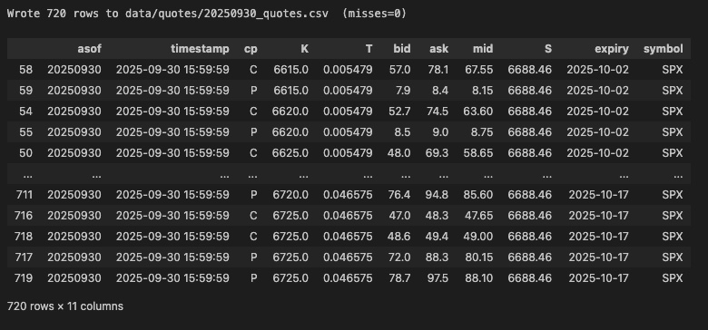

1. Wake the market up (collect quotes)
We start each day $t$ by pulling a grid of SPX option quotes (calls and puts).
Each row is
$$\left(cp ∈\left\{C, P\right\}, K, expiry, T, bid, ask, mid, S\right)$$
with $T= \frac{days to expiry}{365}$ recomputed from the calendar to avoid round-off drift. We drop crossed/degenerate quotes and keep those with positive mids and reasonable relative spreads.

Slide 4
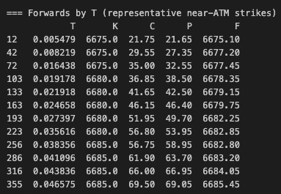


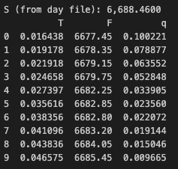

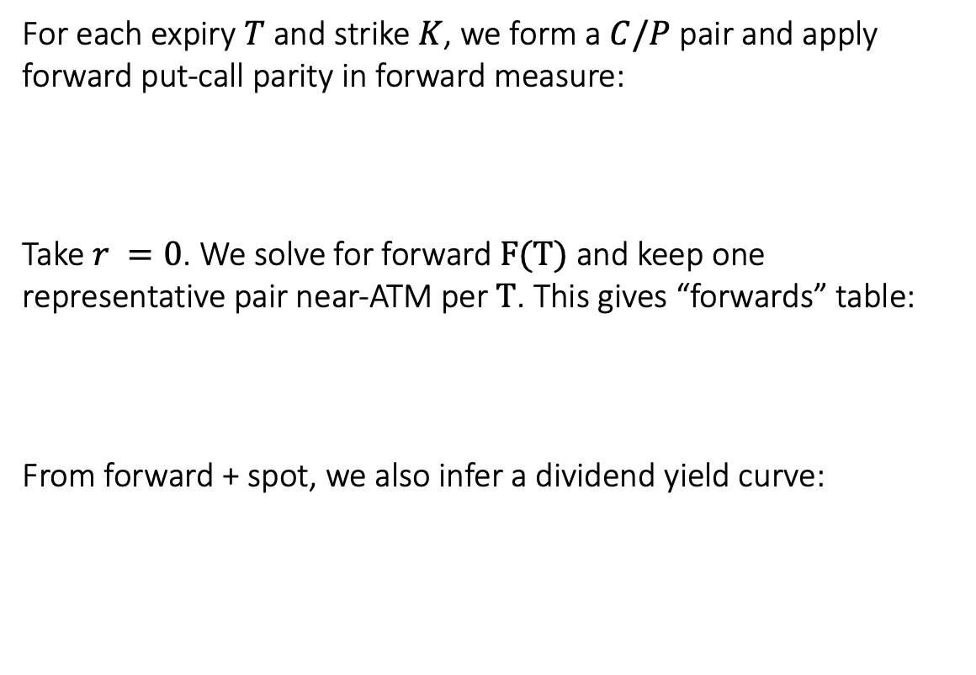
2. Ask the market what the forward is
For each expiry $T$ and strike $K$, we form a $C/P$ pair and apply forward put-call parity in forward measure:
Take $r =0$. We solve for forward $F(T)$ and keep one representative pair near-ATM per $T$. This gives “forwards” table:
From forward + spot, we also infer a dividend yield curve:

Slide 5



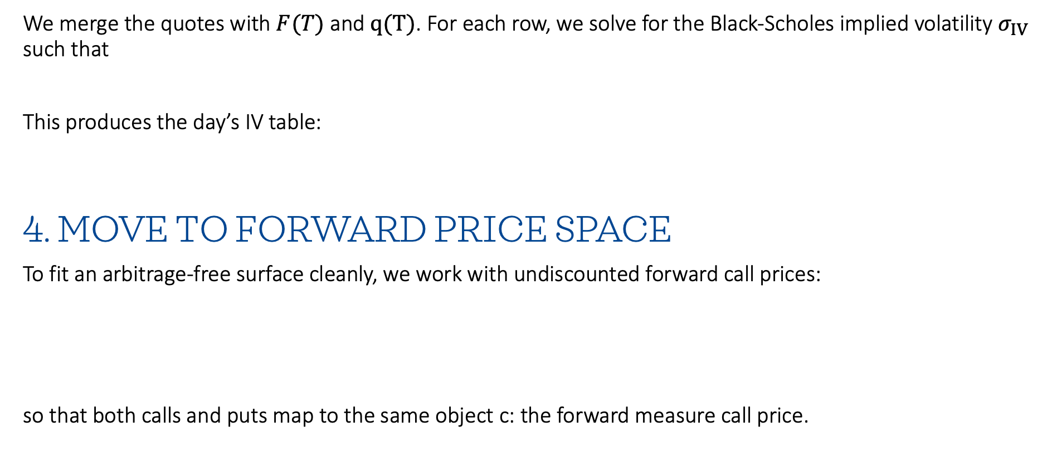
3. Speak the market’s language (implied vols)
We merge the quotes with $F(T)$ and $q(T)$. For each row, we solve for the Black-Scholes implied volatility $σ_{IV}$ such that
This produces the day’s IV table:
4. Move to forward price space
To fit an arbitrage-free surface cleanly, we work with undiscounted forward call prices:
so that both calls and puts map to the same object c: the forward measure call price.

Slide 6
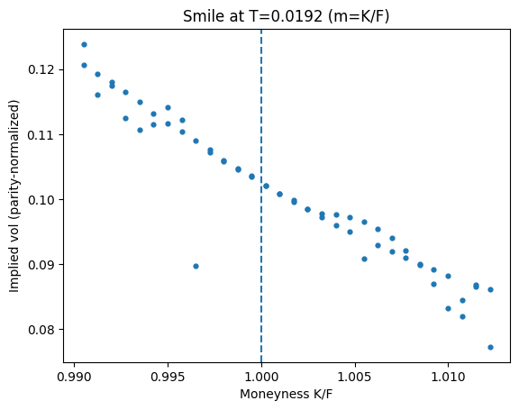
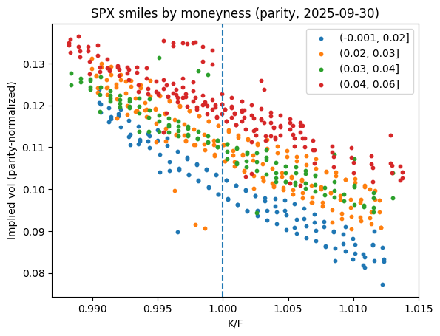
Implied volatility smiles

Slide 7





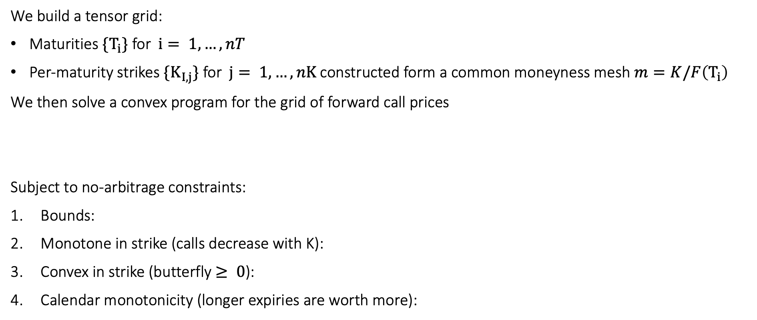
5. Fit an arbitrage-free price surface
We build a tensor grid:
Maturities $\{T_{i}\}$ for $i= 1,…,nT$
Per-maturity strikes $\{K_{I,j}\}$ for $j= 1,…,nK$ constructed form a common moneyness mesh $m=K/F\left(T_{i}\right)$
We then solve a convex program for the grid of forward call prices
Subject to no-arbitrage constraints:
Bounds:
Monotone in strike (calls decrease with K):
Convex in strike (butterfly $≥ 0$):
Calendar monotonicity (longer expiries are worth more):

Slide 8


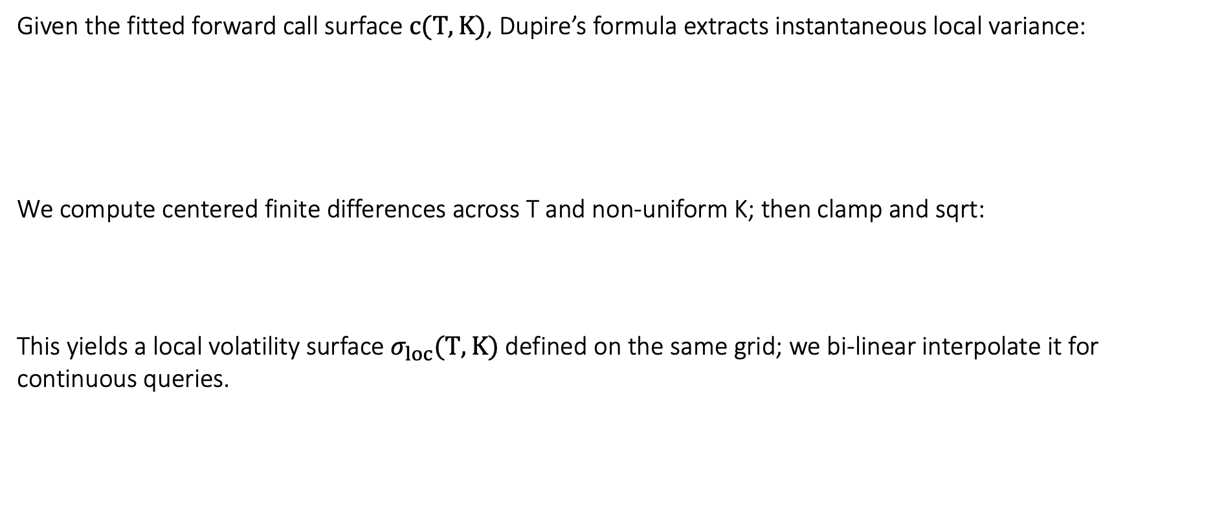
6. Differentiate the surface (Dupire local volatility)
Given the fitted forward call surface $c(T, K)$, Dupire’s formula extracts instantaneous local variance:
We compute centered finite differences across T and non-uniform K; then clamp and sqrt:
This yields a local volatility surface $σ_{loc}(T, K)$ defined on the same grid; we bi-linear interpolate it for continuous queries.

Slide 9





7. Price under local volatility
To price at spot $S_{0}$, under local volatility, we solve the (risk-neutral) PDE backward in time on a spot-time grid:
With terminal condition for call/put and standard boundary conditions. We use Crank-Nicolson time stepping and price calls/puts at $(t = 0, S_{0}).$
Greeks come from bump-and-reprice:

Slide 10
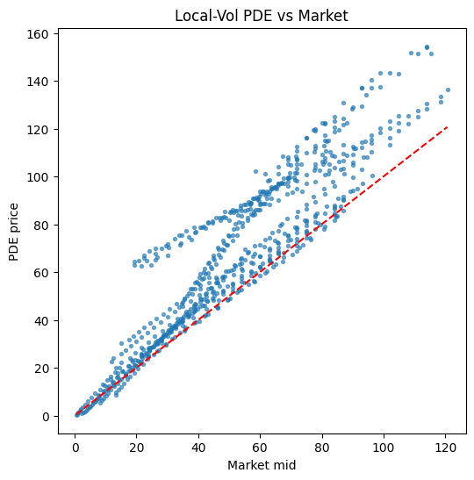
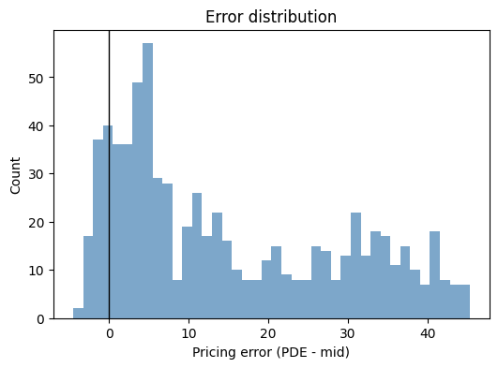
Pricing diagnostics

Slide 11
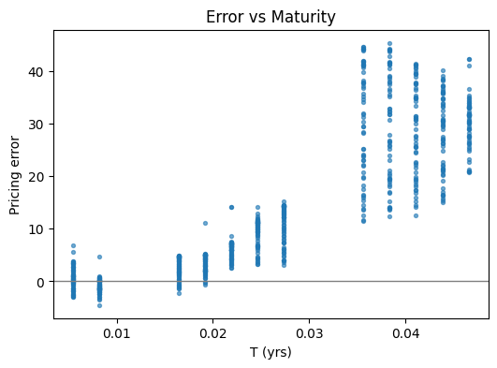
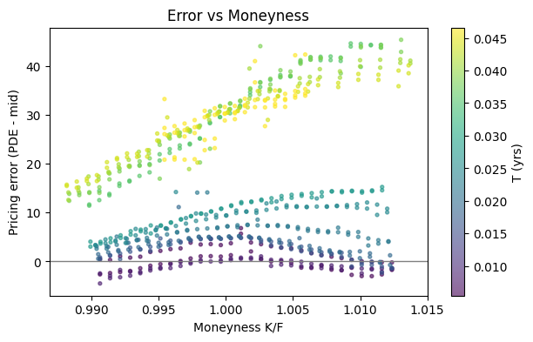
Pricing diagnostics

Slide 12
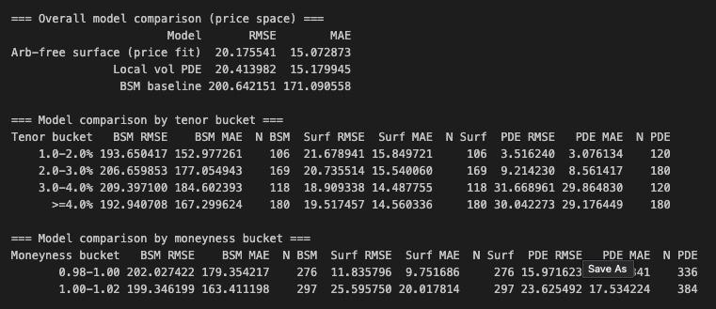
Model comparison

Slide 13
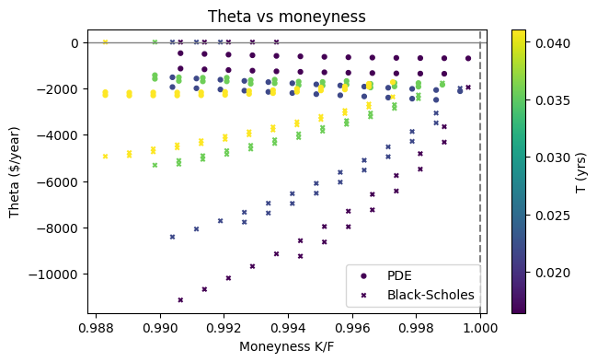
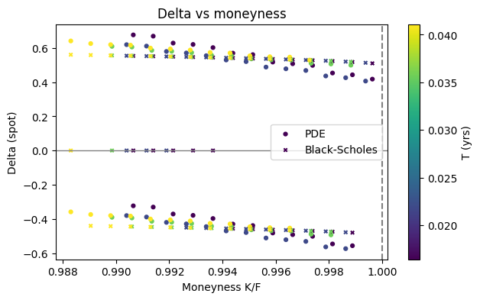
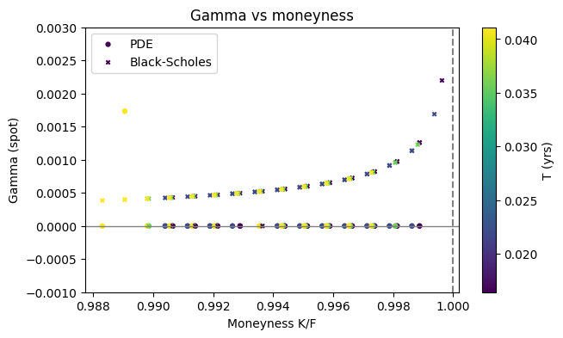
Greeks' diagnostics

Slide 14


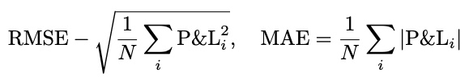
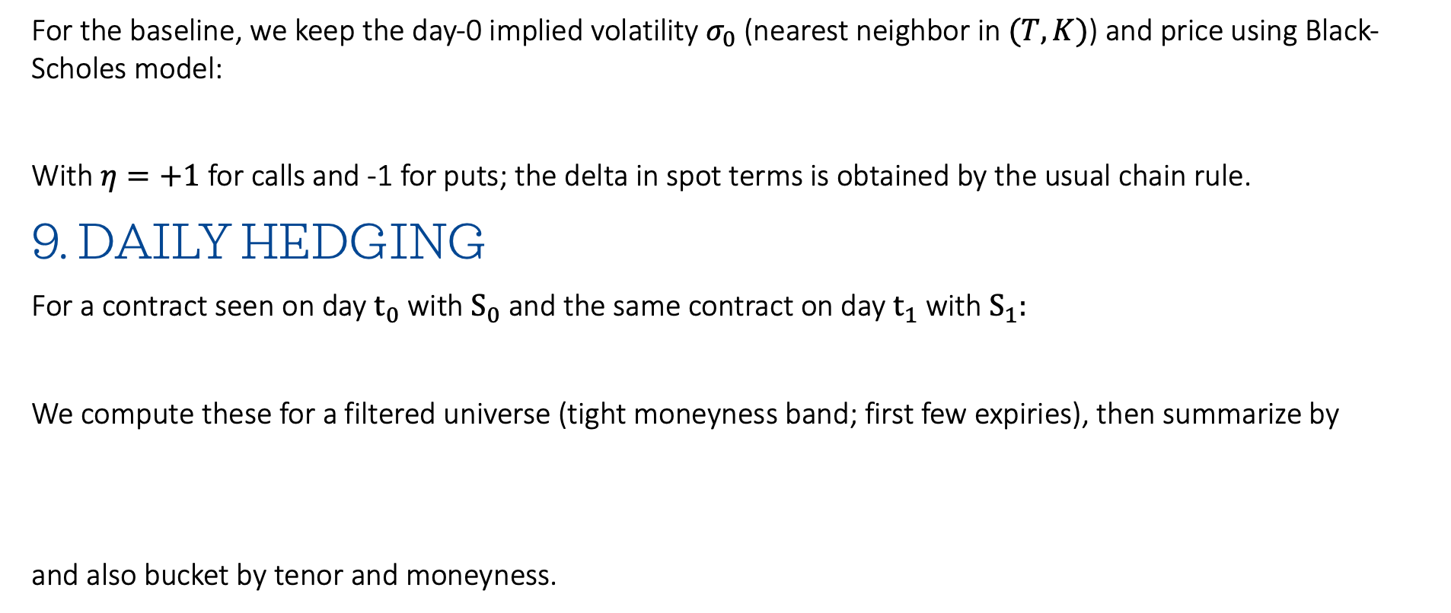
8. Baseline: Sticky-volatility Black-Scholes
For the baseline, we keep the day-0 implied volatility $σ_{0}$ (nearest neighbor in $(T,K)$) and price using Black-Scholes model:
With $η=+1$ for calls and -1 for puts; the delta in spot terms is obtained by the usual chain rule.
9. Daily hedging
For a contract seen on day $t_{0}$ with $S_{0}$ and the same contract on day $t_{1}$ with $S_{1}:$
We compute these for a filtered universe (tight moneyness band; first few expiries), then summarize by
and also bucket by tenor and moneyness.

Slide 15
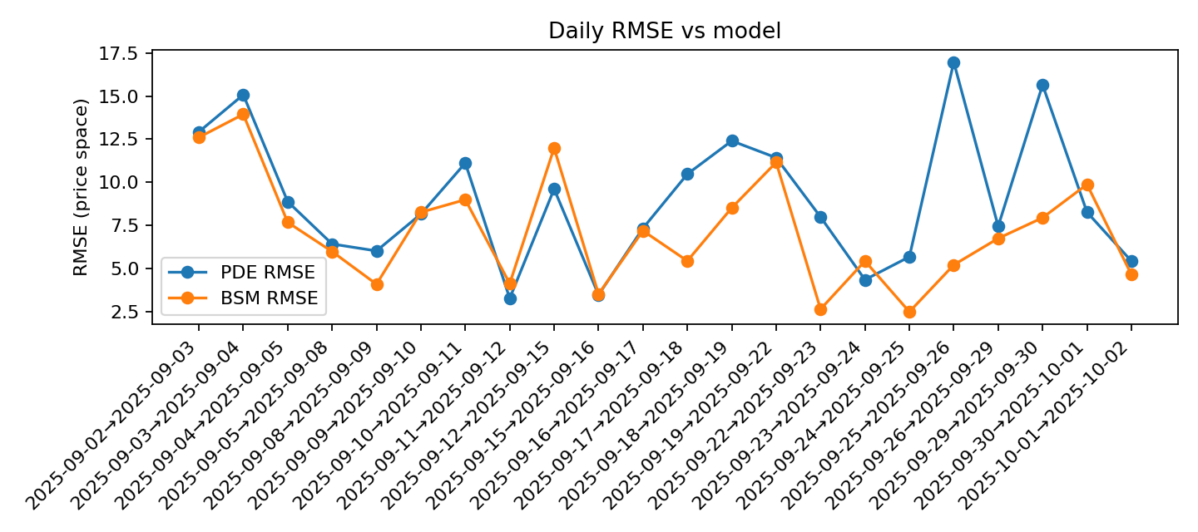
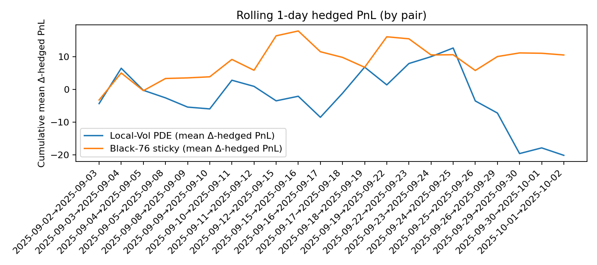
Delta hedging p&l (results with ASU hpc)

Slide 16
Thank you

