Slide 1

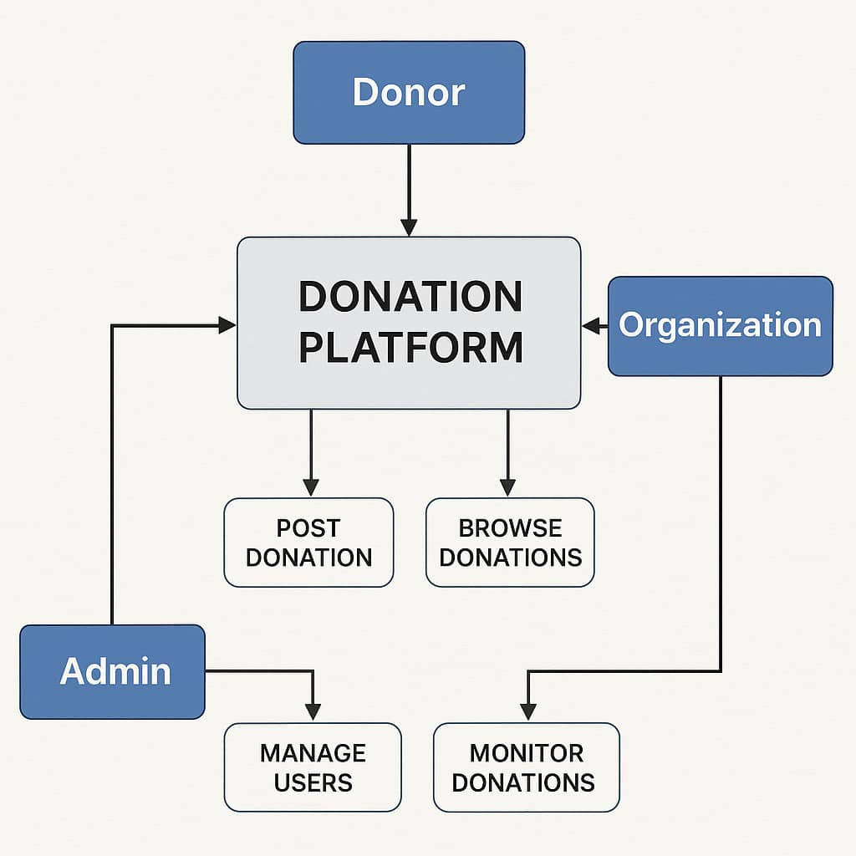
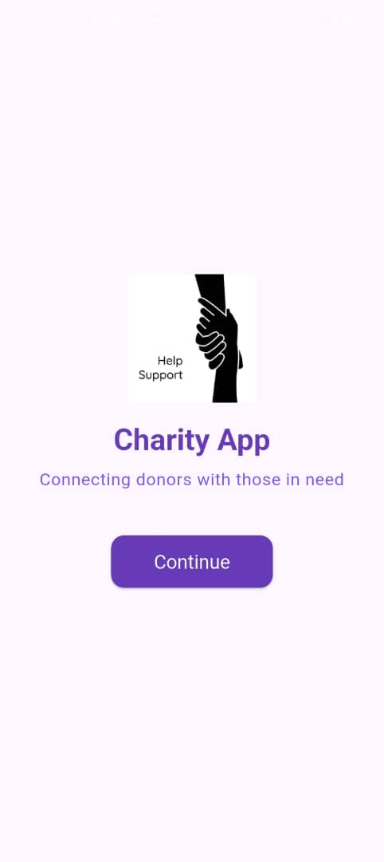
CHARITY BRIDGE
Muwonge Yuda, Ainebyoona Dativah, Kaladi Esther Asynut, Ayesiga Calvin Rodney , Asio Mary Immy Tembo
Charity Problem
Project Design
Results
Many individuals have items to donate, such as clothes, food, and books, but lack a convenient and reliable way to connect with those in need, especially vulnerable communities and charitable organizations
Project Objectives
To provide a user-friendly platform for individuals to donate items easily.
To connect donors with verified organizations and people in need.
To promote transparency and accountability in the donation process.
To increase access to essential items for vulnerable communities.
To reduce waste by encouraging reuse of valuable goods.
Project Requirements
Results
Step 1
This contains key components of the system like admin, donor, and organisation dashboard buttons
Step 2
Users create an account and log in securely
Step 3
Donors fill item details, upload an image and submit
Step 4
Admins monitor activity, manage users, and access donations
User Registration & Login – For donors, organizations, and admins.
Donation Management – Upload, view, and track donated items.
Database Integration – Store user and donation data securely.
Role-Based Access – Different features for donors, organizations, and admins.
Notifications – Inform users about donation status and updates.
Location Services – Help match donors with nearby recipients.
Responsive Design – Accessible on mobile and web platforms.
Conclusion
Our findings show that a digital donation platform significantly improves the ease and frequency of donations. Users found it easier to connect with recipients, and organizations reported better tracking and management of donated items.
The data supports our hypothesis: a centralized, user-friendly platform can enhance donation processes and community engagement. Increased user activity and positive feedback confirm that the system meets its goals of accessibility, transparency, and effectiveness.
Target Users
Future Work
Admnistrator
Organizations
Post and manage donations
Donors
Receive, track, and distribute donated items to people in need
Monitor platform activity, approve users, and ensure system security
Mobile App Launch: Extend the platform with a dedicated mobile application for broader accessibility.
AI-Based Matching: Integrate AI to suggest donations based on recipient needs and donor behavior.
Multilingual Support: Introduce multiple languages to cater to diverse communities
References
Bhatnagar, S. (2004). E-Government: From Vision to Implementation. SAGE Publications.
DiNucci, D. (1999). Fragmented future. Print, 53(4), 32–35.
Kotler, P., & Keller, K. L. (2016). Marketing Management (15th ed.). Pearson Education.
Ngugi, B., Pelowski, M., & Ogembo, J. G. (2010). M-Government for Development: Challenges and Opportunities. The Electronic Journal of Information Systems in Developing Countries, 48(1), 1–20.
Statista. (2024). Global online donation statistics. https://www.statista.com/statistics/online-donations-worldwide
United Nations. (2023). The role of ICT in achieving the SDGs. https://sdgs.un.org/publications/ict-for-development
World Bank. (2023). Digital Platforms and the Future of Donor Engagement. https://www.worldbank.org/digital-donations
Notes:
To change this poster, replace our sample content with your own. Or, if you'd rather start from a clean slate, press the New Slide button on the Home tab to insert a new page. Now enter your text and pictures in the empty placeholders. If you need more placeholders for titles, subtitles or body text, copy any of the existing placeholders, then drag the new one into place.

