Slide 1

College: The RPG
Schedule, Complete, Succeed

Slide 2

Choose your avatar and level up
Fully customizable alter-ego
Earn upgrades by meeting milestones
Your avatar’s success mirrors your own

Slide 3
Employ proven Agile techniques
Scrum process used to manage billion dollar projects adapted and customized to ensure your academic success
Customizable for individual and team goals.
Positive reinforcement has proven to be the most successful motivator.

Slide 4

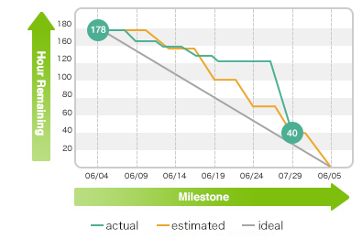
Pursue academic and life goals
Choose your tasks and projects
Schedule completion
Track your progress
This Photo by Unknown Author is licensed under CC BY-SA

Slide 5

Earn rewards!

Slide 6



Slide 7
Your privacy, guaranteed
We will never store personally identifiable information
Instead, we rely on anonymized, aggregate information to provide a baseline
Only you have access to the individual data used to personalize results
This Photo by Unknown Author is licensed under CC BY-NC-ND

Slide 8
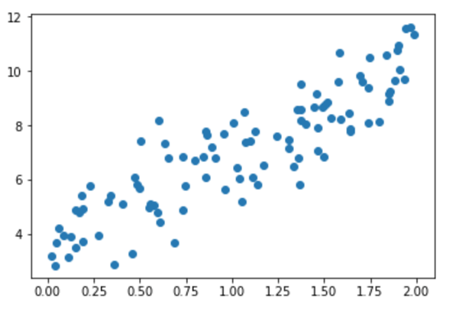
Customized scheduling algorithm
We provide estimated task completion times based on task, project, and class data.
Baselines are fully customizable
Schedule tasks to fit your needs

