Slide 1
Comparator ALU
Scott Maxa and Jude Battista

Slide 2
Instructions
and
or
xor
greater than
less than
equality
sum

Slide 3
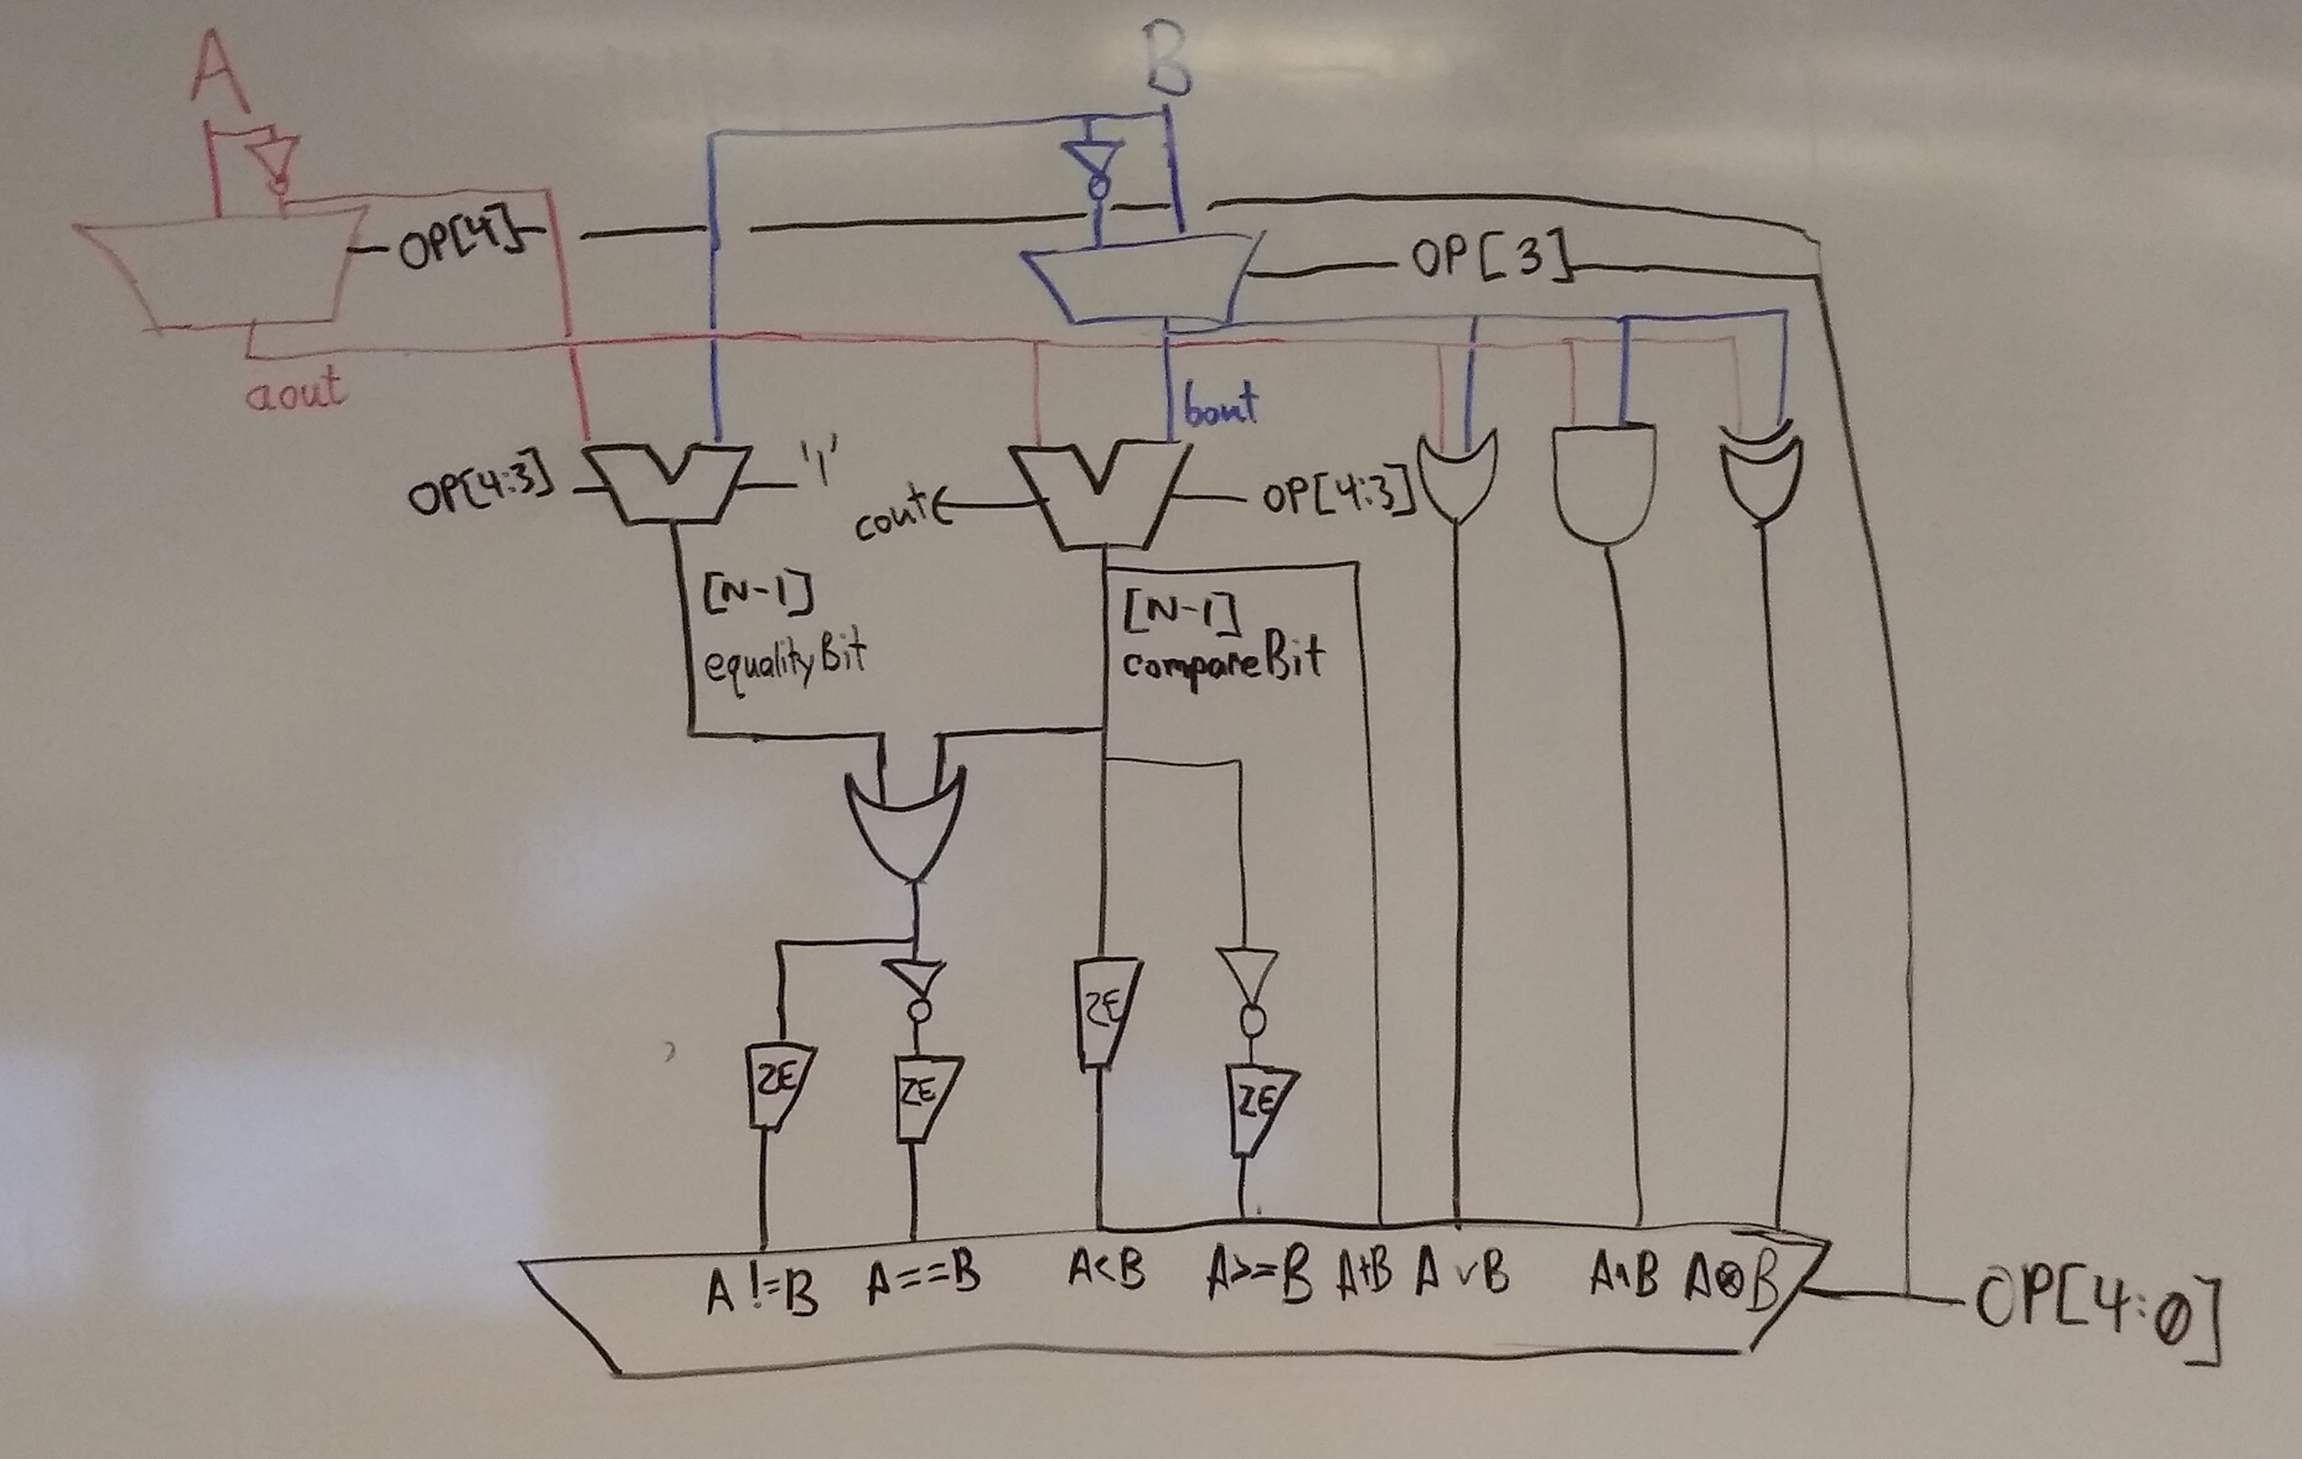

Slide 4
Opcodes
00XXX: A, B
01XXX: A, not B
10XXX: not A, B
11XXX: not A, not B
XX000: and
XX001: or
XX010: sum
XX011: less than
XX100: less than or equal to
XX101: equality
XX110: not equal
XX111: xor

Slide 5
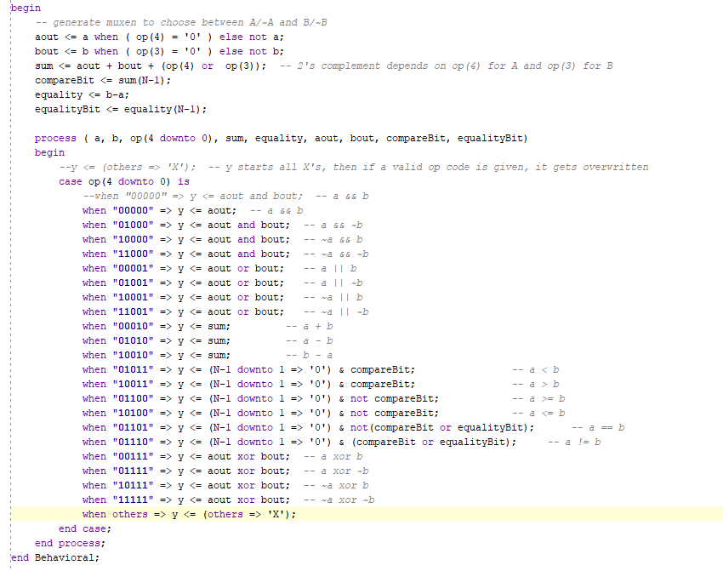

Slide 6
