Slide 1
MIPS 2
By: Jude Battista, Katherinne Cruz

Slide 2
MIPS instructions
la = load address
lb = load byte
sb = store byte
add
addi = add immediate
blt = branch less than (pseudoinstruction for slt and beq)
j =unconditional jump
jal = jump and link

Slide 3
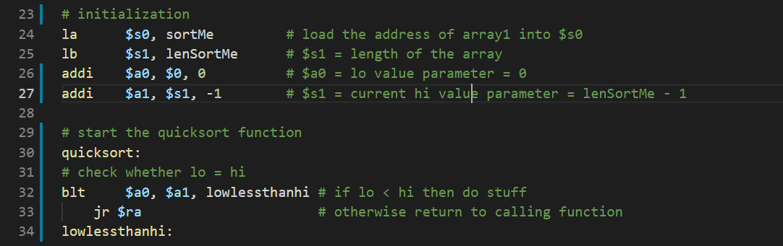
Assembly language listing of your program

Slide 4
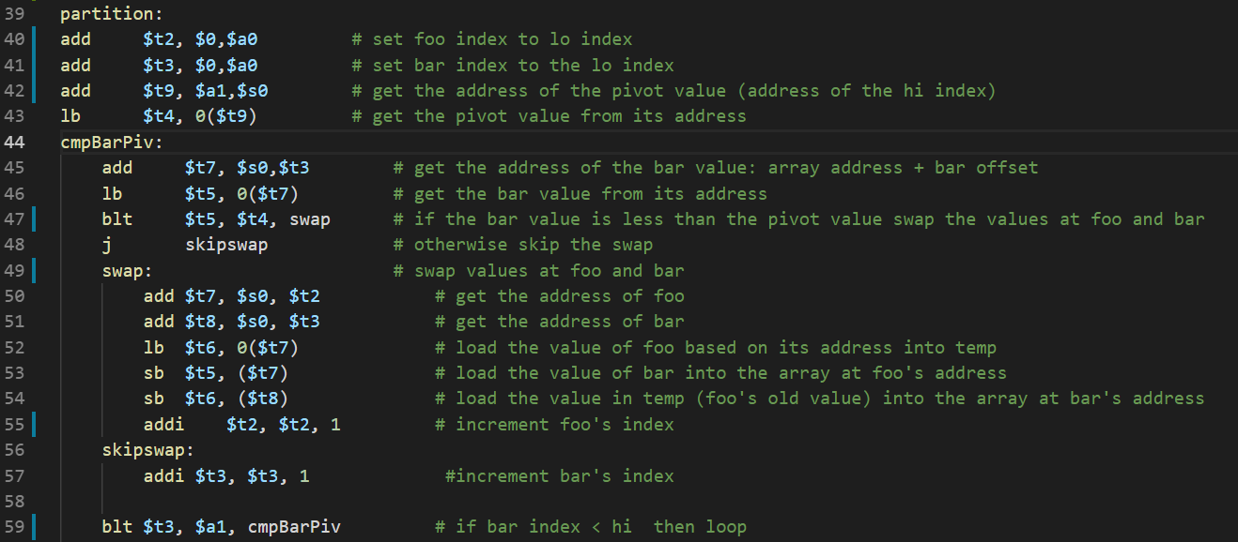
Assembly language listing of your program

Slide 5
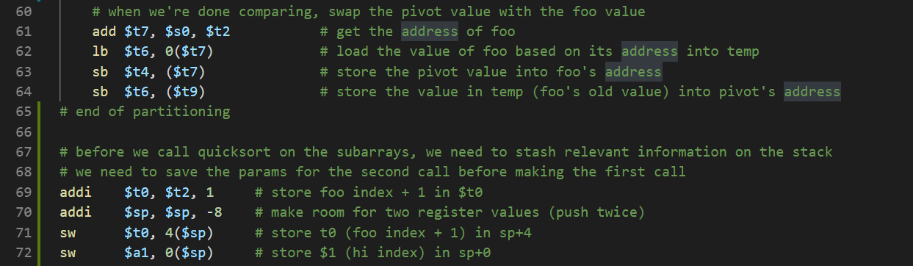

Slide 6
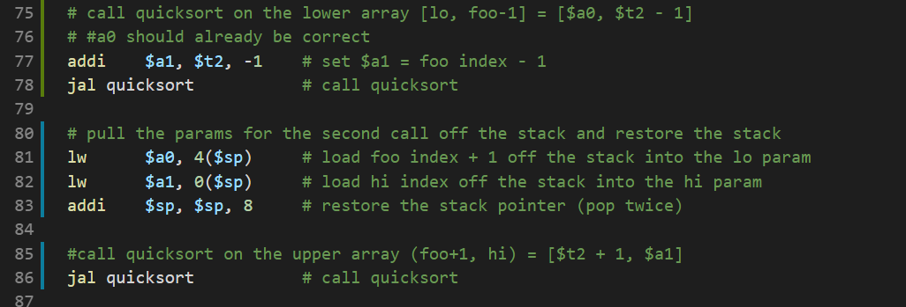

Slide 7
Demo

Slide 8
Analysis of your algorithm
What did you like / dislike about the MIPS instructions you used?
addi helped us a lot
pseudoinstructions
jal issues
How efficient was your algorithm?
Memory access
Do you think you might use this algorithm for your final project demonstration or will something like it be used for testing?
No

