Slide 1
Abstract Algebra I

Slide 2
What is Abstract Algebra???
https://www.youtube.com/watch?v=IP7nW_hKB7I
https://www.youtube.com/watch?v=P94M4jlrytQ

Slide 3
Chapter 0 (Zero)
Preliminaries

Slide 4
Properties of Integers
What is an axiom? – A property that we take to be true without proof. Sometimes we take something as an axiom if it cannot be proved from the usual properties (e.g. the usual properties of arithmetic, algebra, etc.).

Slide 5
The Well-Ordering Principle
(We take this as an axiom.)
Every nonempty set of positive integers contains a smallest member.

Slide 6
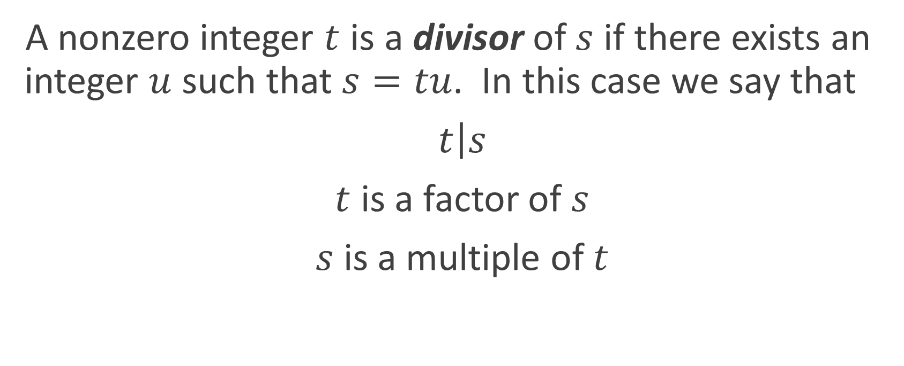
Divisibility
A nonzero integer $t$ is a divisor of $s$ if there exists an integer $u$ such that $s=tu$. In this case we say that
$\left.t\right|s$
$t$ is a factor of $s$
$s$ is a multiple of $t$

Slide 7
Prime Numbers
A prime is a positive integer greater than 1 whose only positive divisors are 1 and itself.

Slide 8
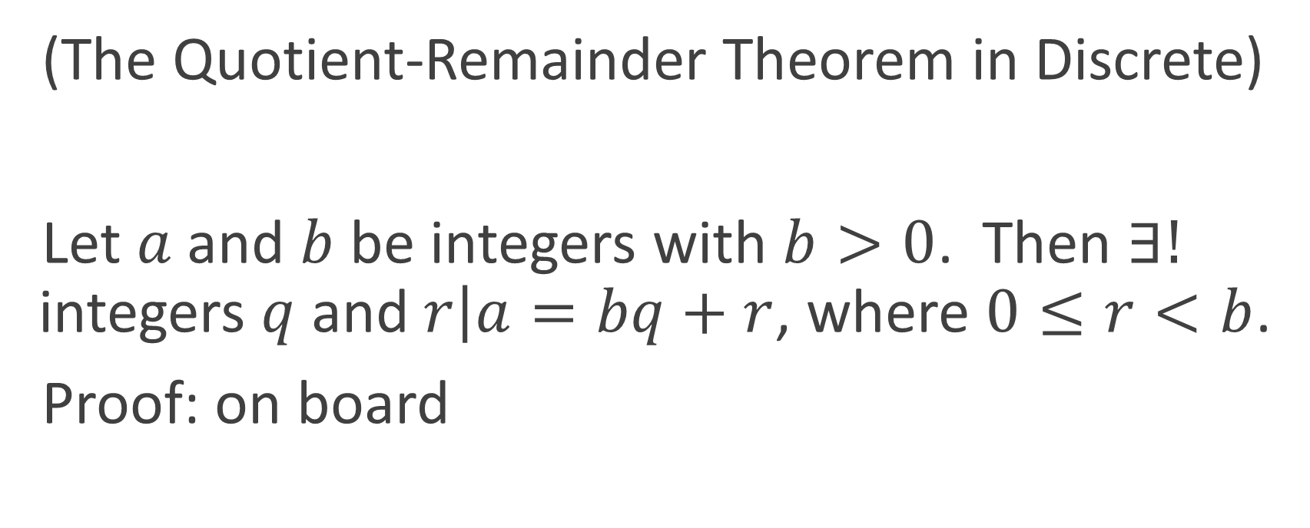
Theorem 0.1 The Division Algorithm
(The Quotient-Remainder Theorem in Discrete)
Let $a$ and $b$ be integers with $b>0$. Then $∃!$ integers $q$ and $r\left|a=bq+r\right.$, where $0≤r<b$.
Proof: on board

Slide 9
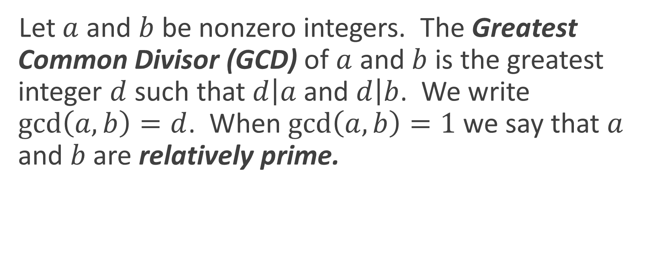
Greatest Common Divisor (GCD)
Let $a$ and $b$ be nonzero integers. The Greatest Common Divisor (GCD) of $a$ and $b$ is the greatest integer $d$ such that $d\left|a\right.$ and $d\left|b\right.$. We write $\gcd\left(a, b\right)=d$. When $\gcd\left(a, b\right)=1$ we say that $a$ and $b$ are relatively prime.

Slide 10
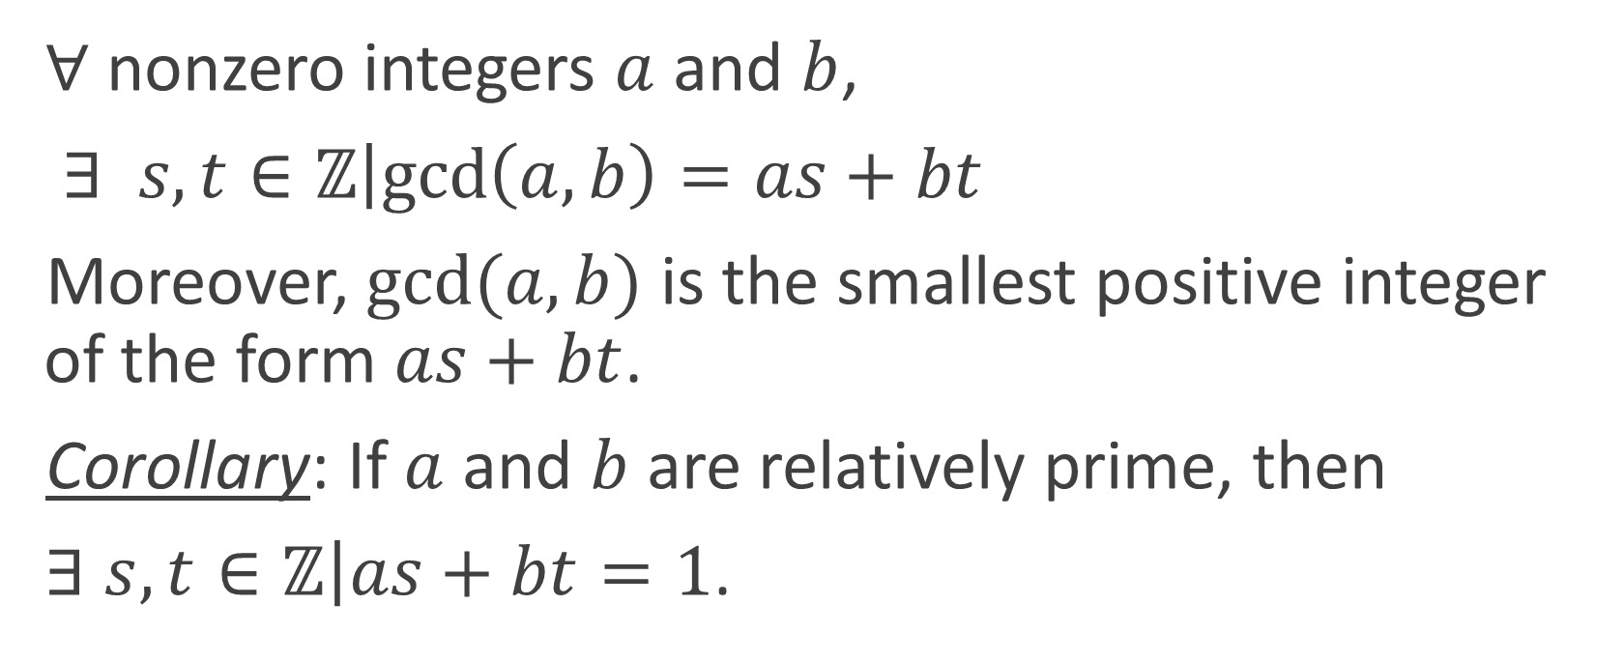
Theorem 0.2
$∀$ nonzero integers $a$ and $b$,
$∃ s,t∈ℤ\left|\gcd\left(a, b\right)=as+bt\right.$
Moreover, $gcd⁡(a, b)$ is the smallest positive integer of the form $as+bt$.
Corollary: If $a$ and $b$ are relatively prime, then
$∃$ $s,t∈ℤ\left|as+bt=1\right.$.

Slide 11
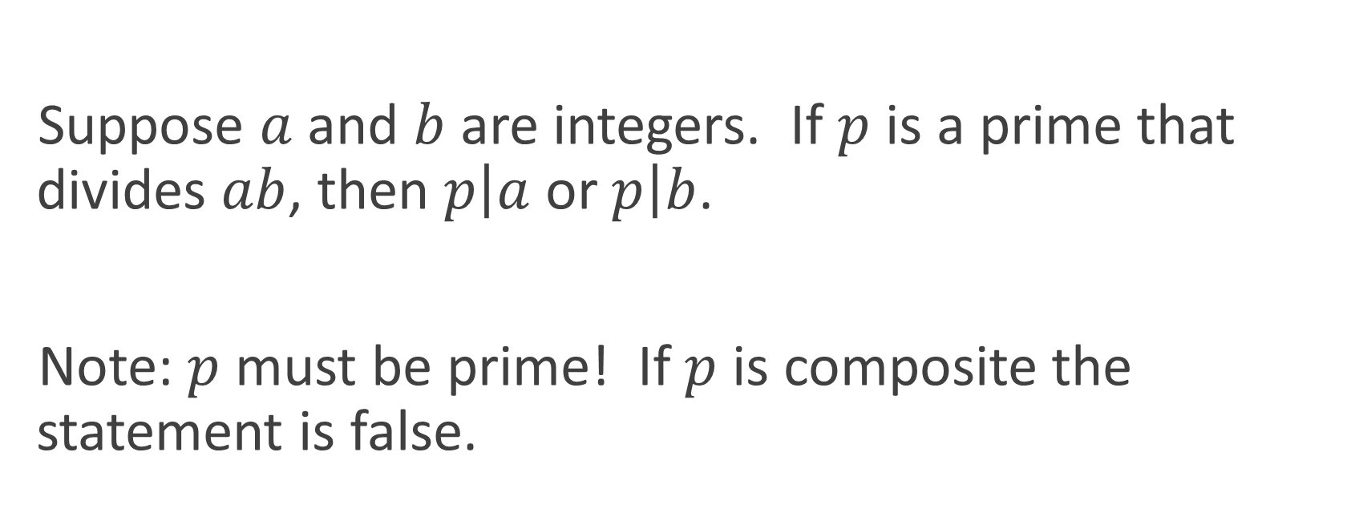
Euclid’s Lemma
Suppose $a$ and $b$ are integers. If $p$ is a prime that divides $ab$, then $p\left|a\right.$ or $p\left|b\right.$.
Note: $p$ must be prime! If $p$ is composite the statement is false.

Slide 12
Theorem 0.3 The Fundamental Theorem of Arithmetic
Every integer greater than 1 is a prime or a product of primes. This product is unique except for the order in which the factors appear.
Proof omitted. Who first discovered and proved this theorem??? (Hint: he’s a real “prince”.)

Slide 13
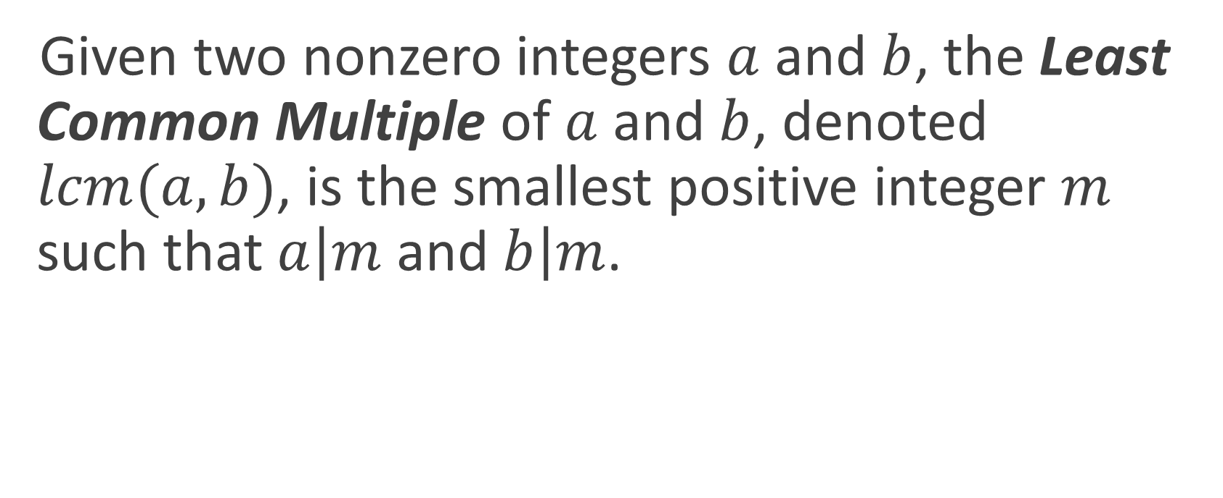
Least Common Multiple (LCM)
Given two nonzero integers $a$ and $b$, the Least Common Multiple of $a$ and $b$, denoted $lcm(a, b)$, is the smallest positive integer $m$ such that $a\left|m\right.$ and $b\left|m\right.$.

