Slide 1
Not Dead Yet
The Life and Afterlife
Of Electric Vehicles
Including a Practical Example
Jude Anthony
Hagerty High School National Honor Society
2009-11-13
Notes:
Thanks for inviting me to speak to you today. I'm here to talk about Electric Vehicles, or “EV”s, in general, and my electric car in particular.

Slide 2
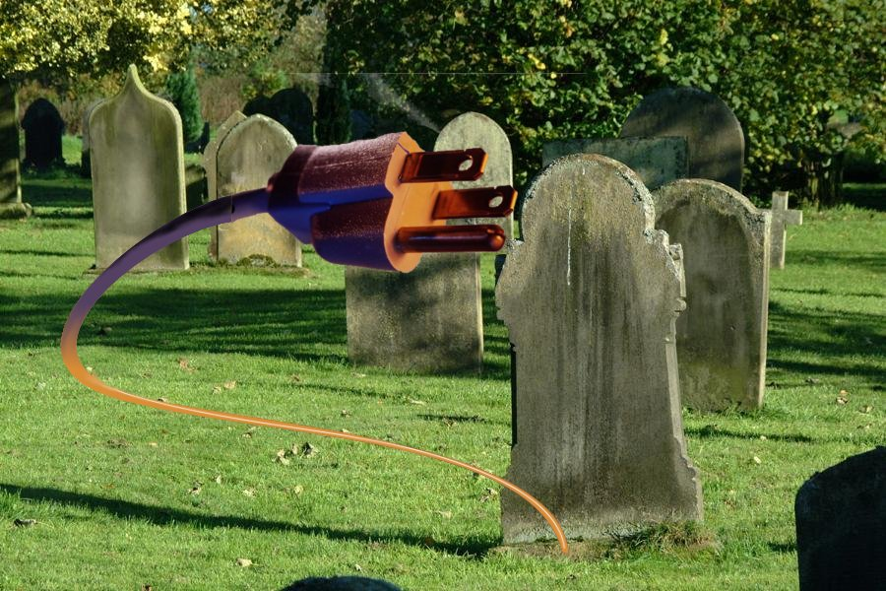
Who Killed the Electric Car?
Notes:
Movie
Good job
Evs in mid-1800s
Why replaced
Revived need
GM EV1
Crushed
Birth to deat
Other Evs
Ordinary conversions
RAV4-EV
Roadster
Prius owners recognize need
Myths preventing general acceptance

Slide 3
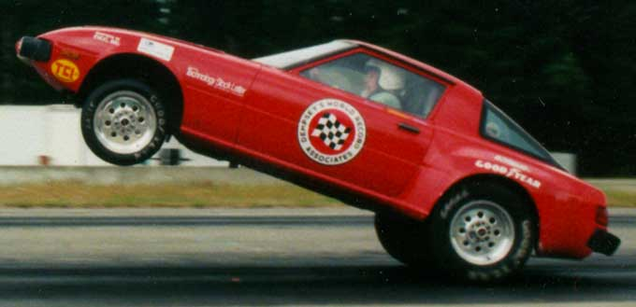
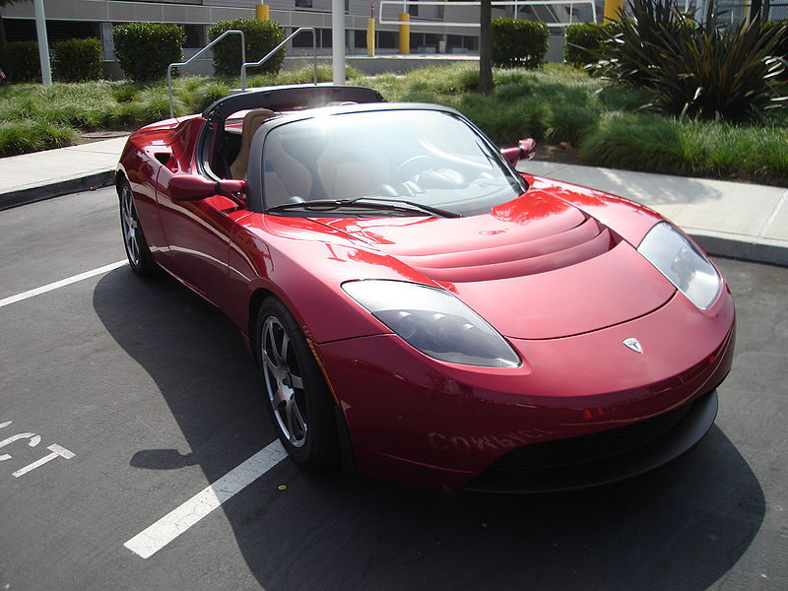
Myth 1: EVs Are Slow
Tell it to NEDRA
  Maniac Mazda
    11.2@108
  Killa-Cycle
    7.8@169
Tell it to Tesla
  Outruns a Carrera
BIG TORQUE
Notes:
NEDRA not golf carts!
Blowing away Vipers
Quickest motorcycle in the world
Tesla Roadster
Outruns Porche Carrera GT, GT3, and Lotus Exige
Big Torque

Slide 4
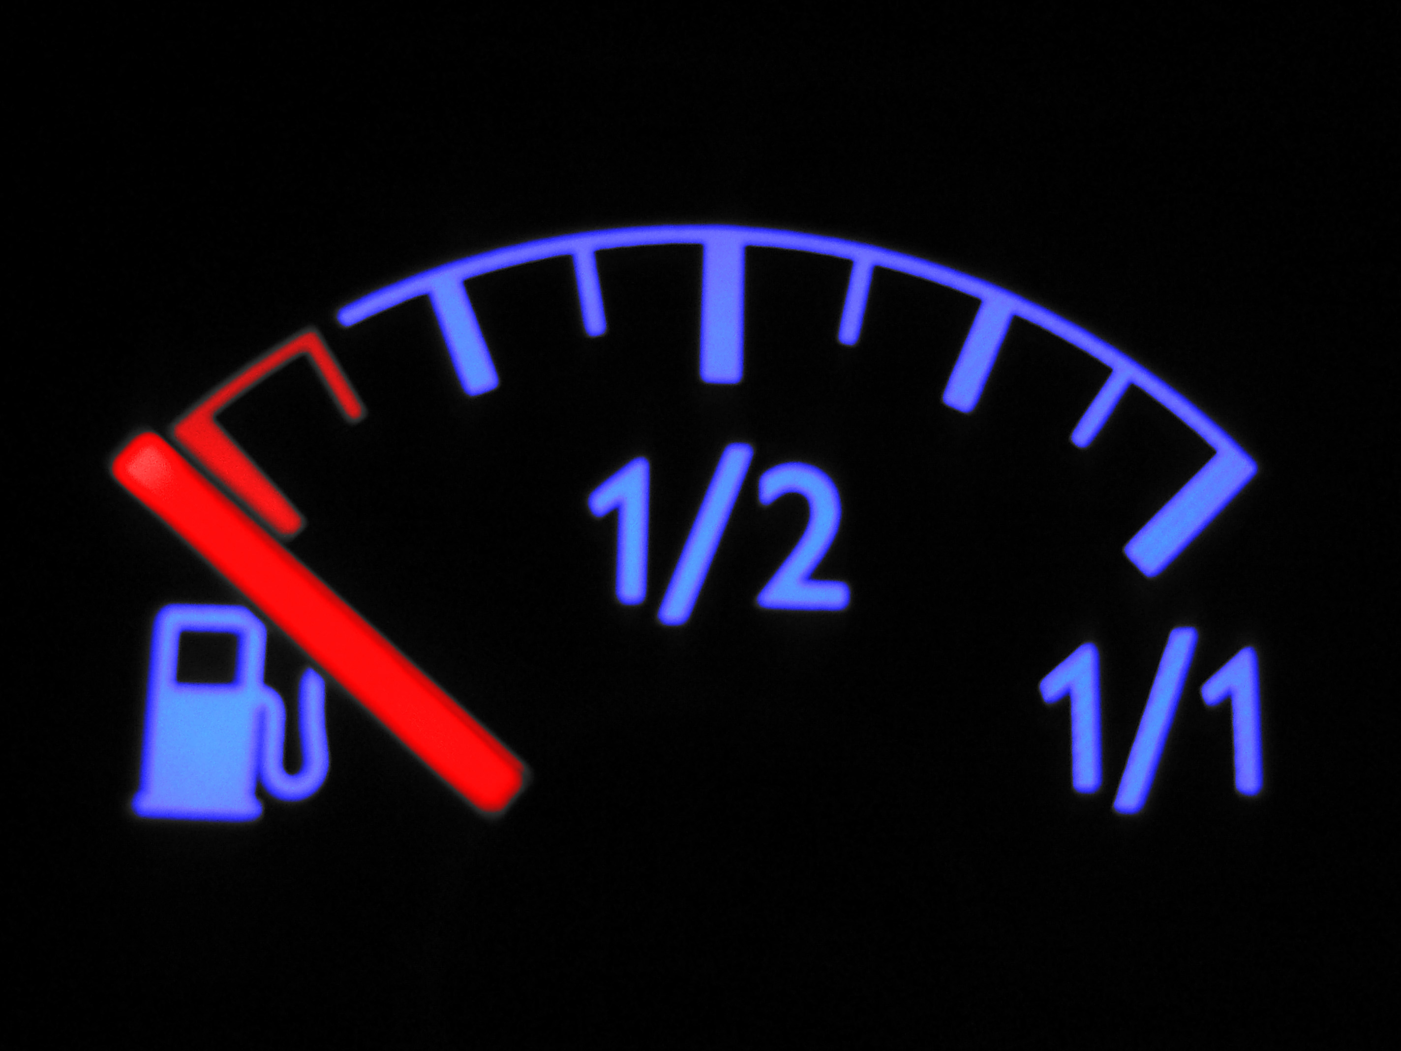
Myth 2: EVs Can't Go Far Enough
Notes:
Go to Vegas
Average commute: 16 miles
50 miles possible in home conversion
Filling stations everywhere
Commercial cars
Battery tech
NiMH / Texaco
Li-Ion expense
RAV4-EV
100 miles after 100,000 miles
Roadster
311 miles
Solectria Sunrise
375 miles.
Good enough
Hybrids eliminate the problem
Volt owners could wind up driving all-electric

Slide 5
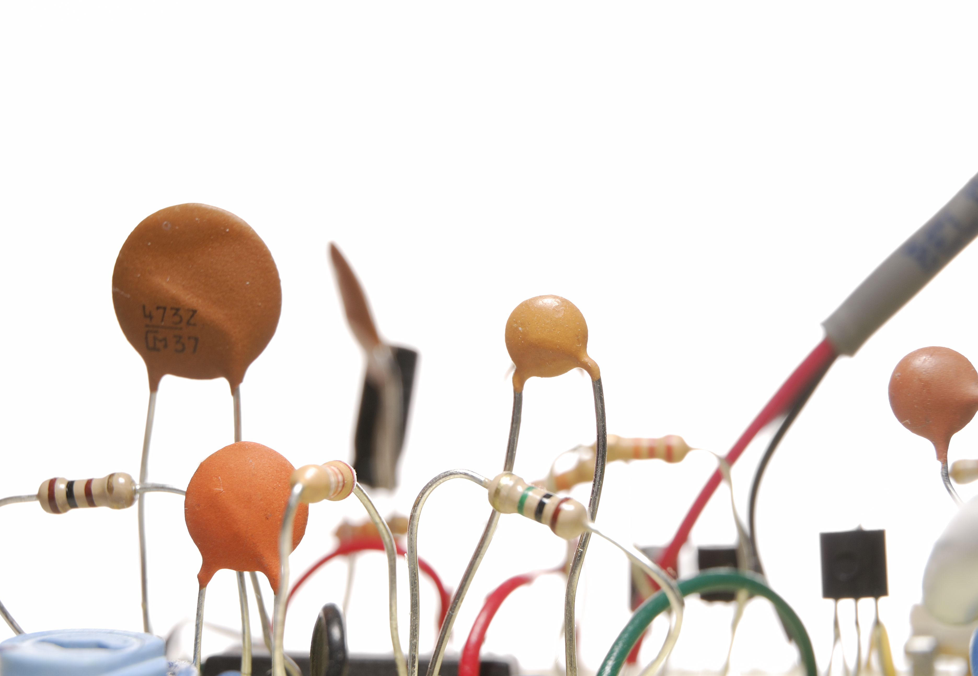
Myth 3: EVs Are Complicated
Notes:
Simplest possible machine
1800s tech
Batteries nearly same
Motors nearly same
Controller more efficient
Chopper, not resistor
Still an off-the-shelf part
Complex appearance of conversions?
Extra gauges, lights
Not professionals
Rolling science fair
If I can build one...

Slide 6
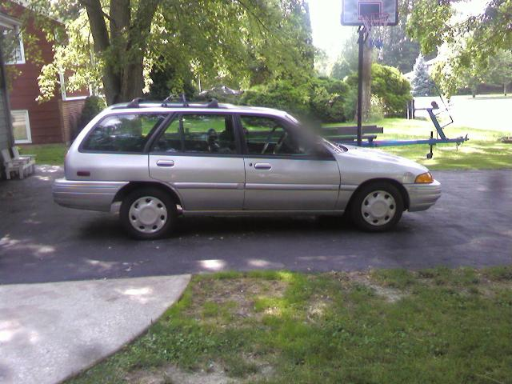
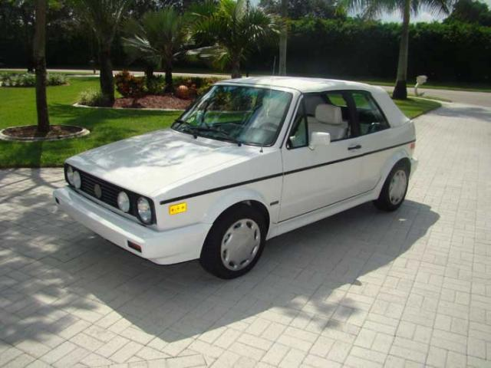
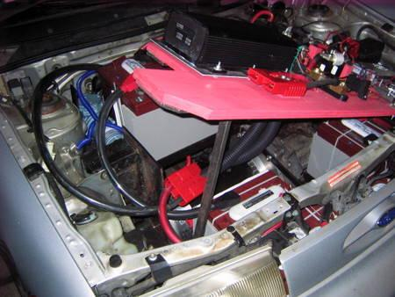
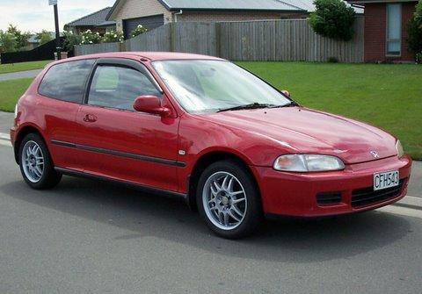
Reality
Notes:
Home builders have made fantastic Evs
BUT USUALLY
Inexpensive parts
Bad platforms
Old
Weight
Spaces
Aero
Limits the conversion
Commercial EV advantage (again)
Build to spec
Home converter picks one

Slide 7
So Why Build an EV?
Environmental
  Pollution
  Resources
Financial
Whatever interests the builder
Notes:
If it's limited from the start, why bother?
Every converter is different
These are the big ones

Slide 8
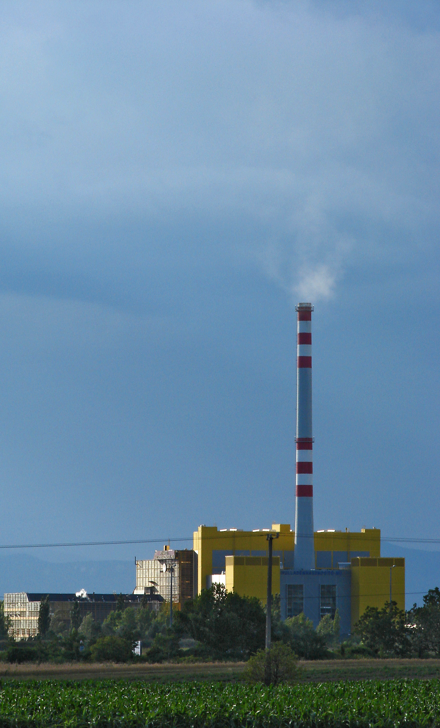

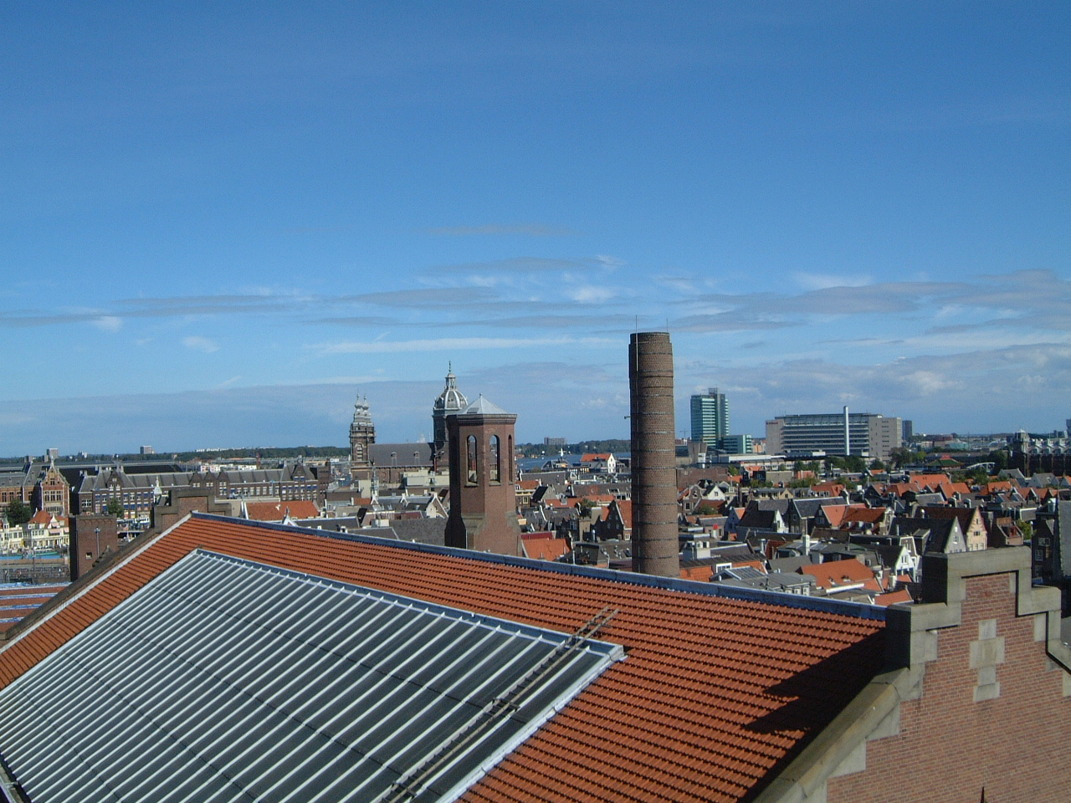
Pollution
Notes:
REDUCING CARBON FOOTPRINT
Moving it to the smokestacks
True, but twice as efficient!
Single source
Away from people
Clean up improves everybody
Alternatives available
Buy cleaner energy
Toxic batteries
99% recycled
ALL the lead
Advanced battery recycling picking up
Smaller carbon footprint

Slide 9

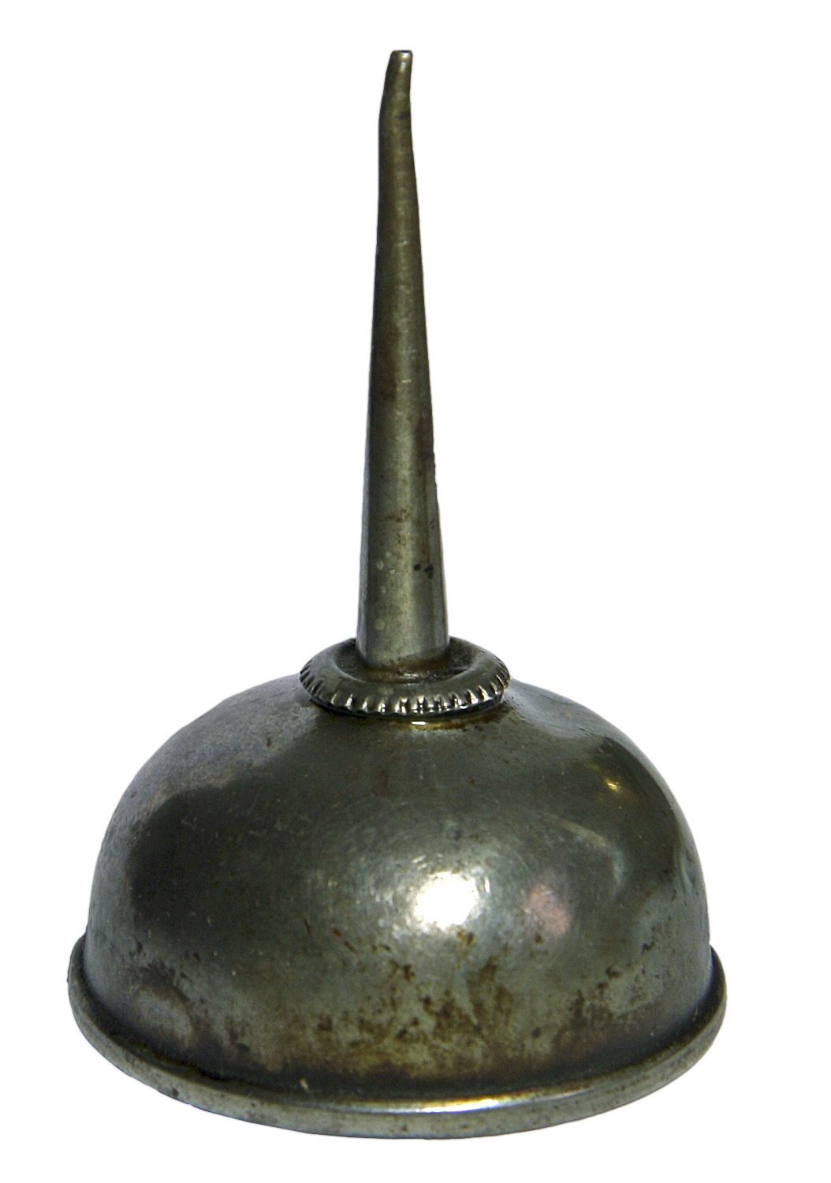



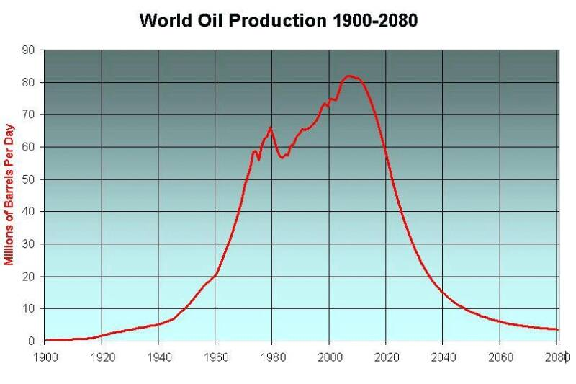

Resources
Notes:
SAVING RESOURCES
Many uses of oil
Plastic
Lubricants (vaseline)
Wax
Limited resource
Harder and harder to remove
“Peak Oil”
2010
WHY ARE WE BURNING IT?
Use it better with Evs
Twice as far at power station
Later, don't use it at all

Slide 10
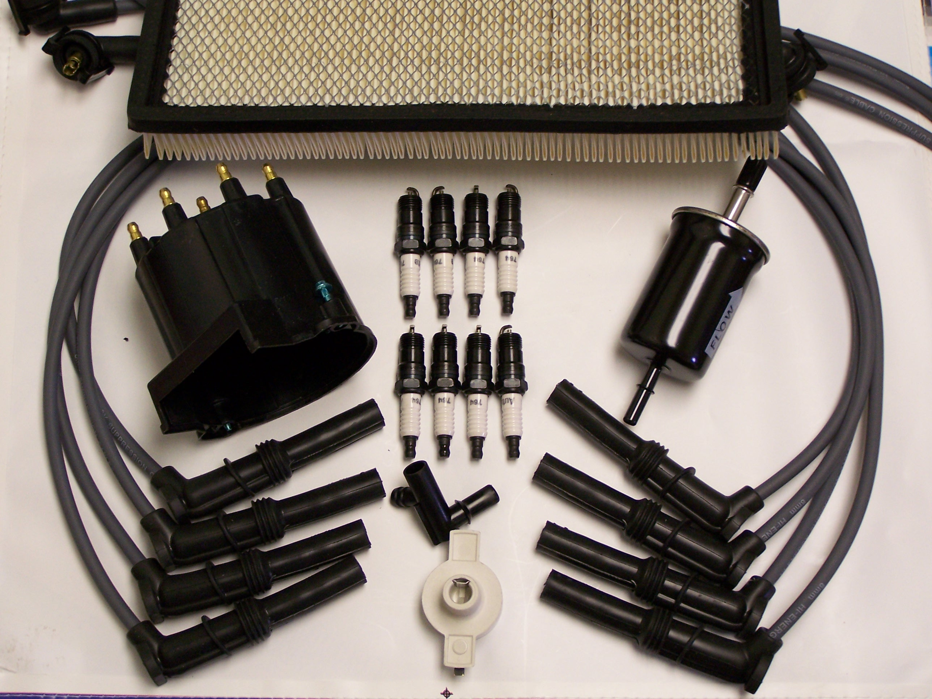
Financial
Notes:
SAVING MONEY
“How long until paid off?”
Assumes cheaper
Not what I care about
Lots of savings
Energy cost
Maintenance parts
Plugs
Wires
Filters
Complicated engine parts
Dizzy, catalytic converter, radiator
Maintenance
Oil changes
Tune ups
Possible expenses
Heavy conversions harder on suspension, tires
More attention to alignment
Batteries
Lead-acid replacement 3-5 years
Commercial cars avoid all
Final analysis: about 50% per mile
Operation not big cost
Takes a long time to make up purchase cost
Lasts that long!

Slide 11
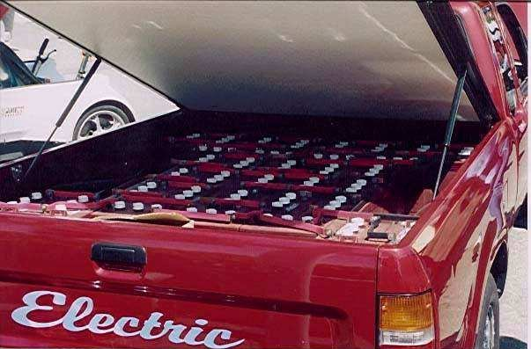
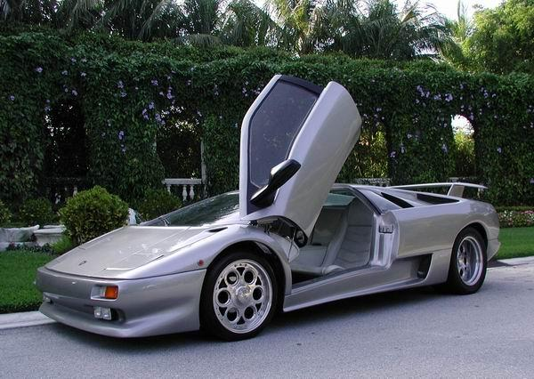
Other Reasons to Convert
Prove something
  Speed
  Range
  Testbed
Quiet
Audio
Cool
Reliability
  My reason!
Notes:
(Slide bullets.)

Slide 12
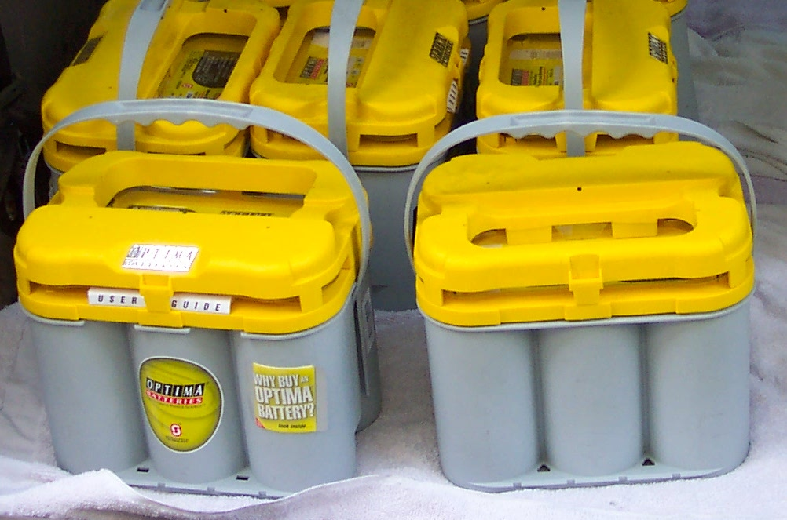
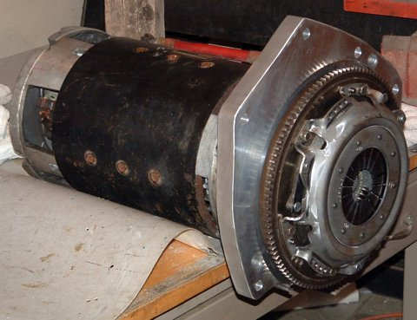
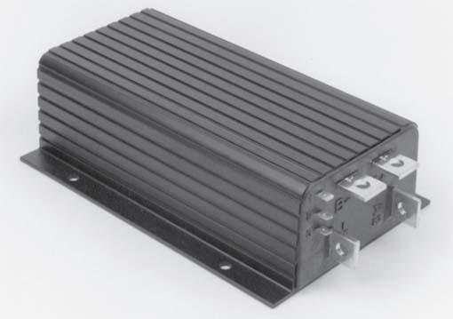
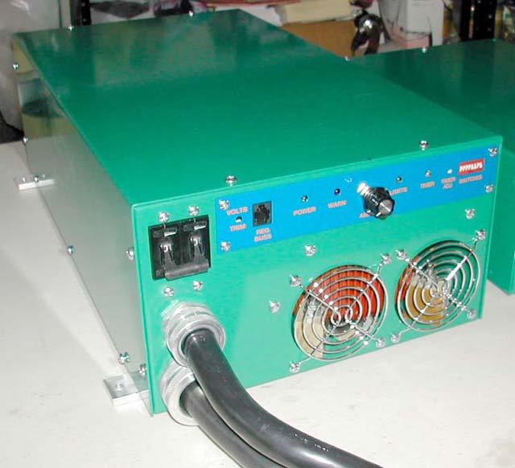
Initial Steps
Determine requirements
Choose components
  Batteries
  Motor
  Controller
Notes:
My one thing: reliability
Work and back
Kids to school
Grocery shopping
4-door car, hatchback
EV Calculator
Big car power
Big power batteries
300Wh / mile (normal 150Wh/mile)
Smaller range, same batteries
AGMs
Reliable under high power
Never leak
Picky about charging
Charger needs to be smart
Biggest widely-available motor
Cheap controller
Keep transmission
Mounting location!

Slide 13
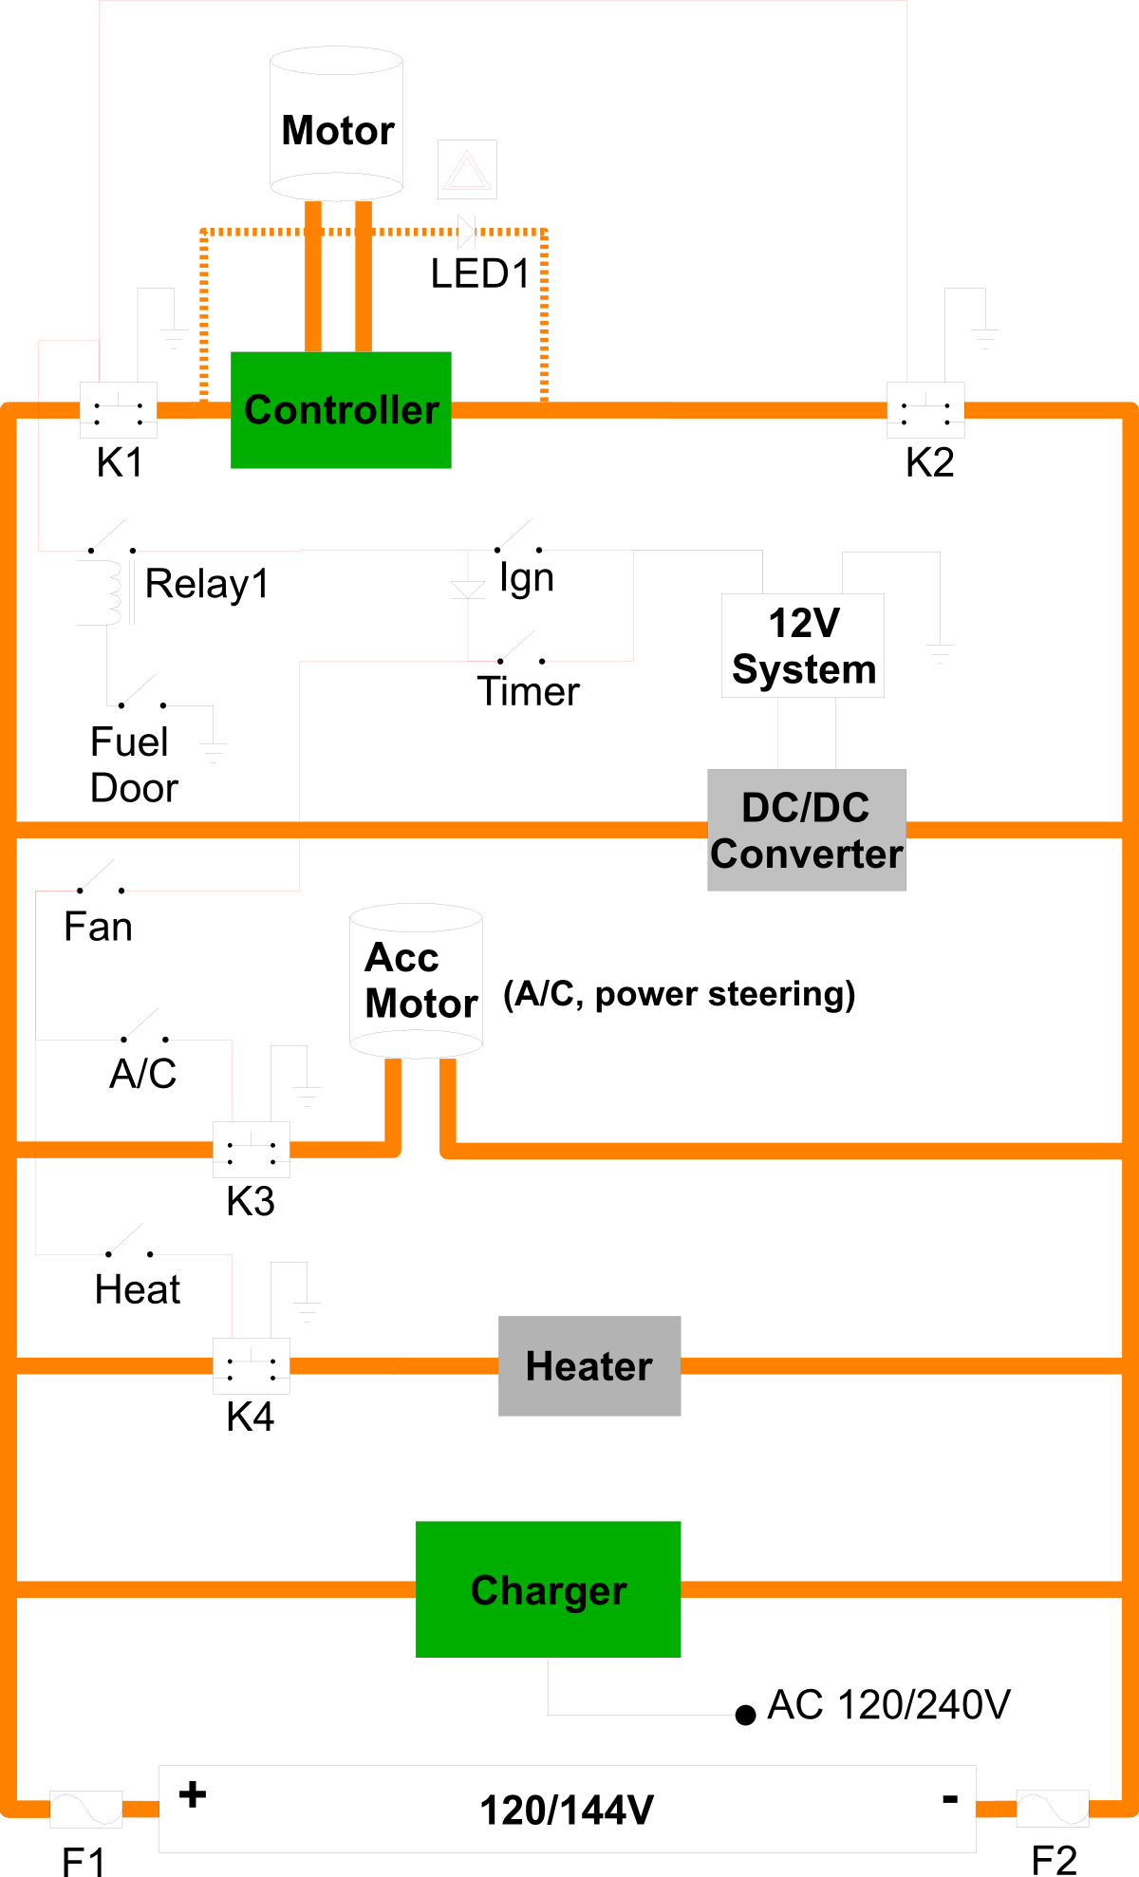
Plan
A diagram will help you figure out the other fiddly bits you'll need
  Fuses
  Switches
  Interfaces
Notes:
My diagram
Made for safety
Discovered DC/DC need
Creates parts list, connection ideas
Transfers ideas to brother

Slide 14
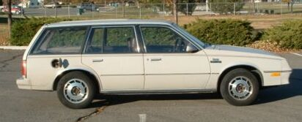
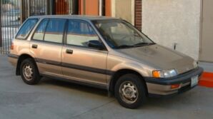
Obtain the Car and Parts
Old and Busted
New Hotness
Notes:
Find a car
Broken motor, perfect body
Figure out where to put stuff
Normally donor first
Used EV
Bad batteries
Bad charger
UGLY
Honda Civic Wagon
Fits requirements
Looks great
Back seats fold up for box
Charger in wheel well
Available at the time

Slide 15
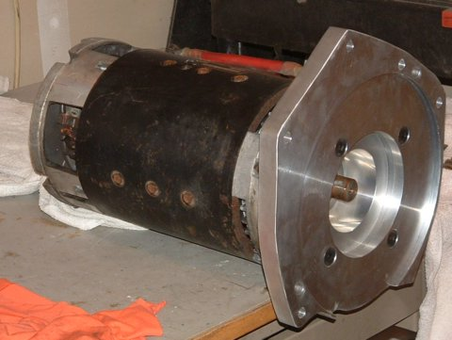
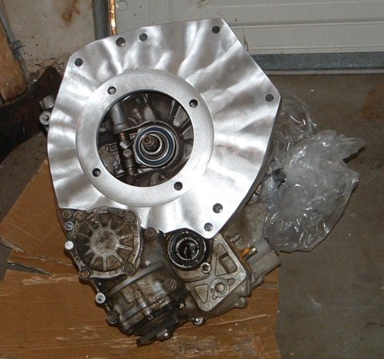
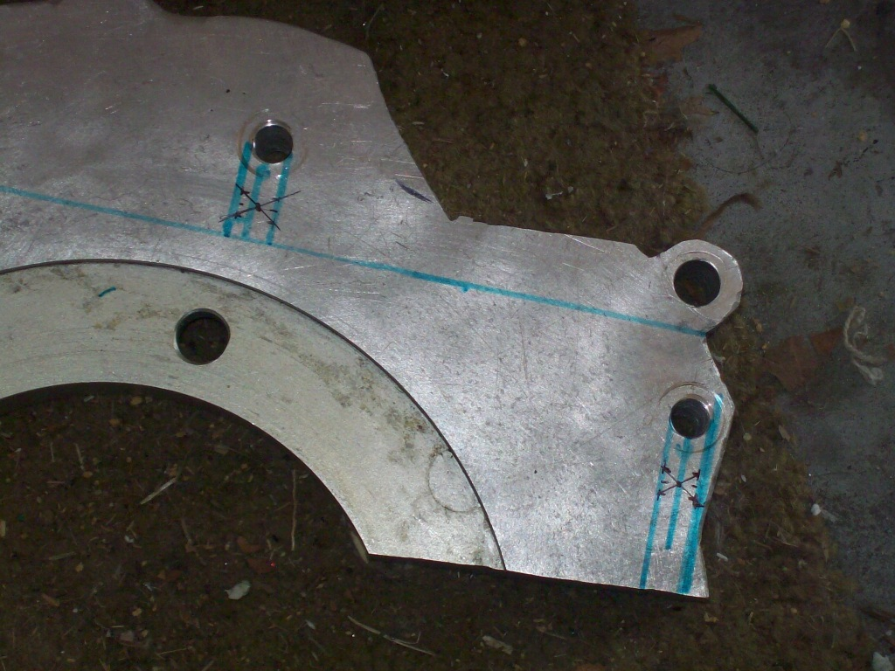
Assemble
Notes:
Oldsmobile parts
Motor
Controller
DC/DC
Gauge
Contactors
Fuses
Welding cable
Purchased parts
Charger and regulators
Safety
Heater
Adapter
Motor holes
Transmission holes
Coupler
Accurate machining
Mine kept clutch
So wife could drive
Third-gear automatic
Mounted motor directly where engine was
Mount from old adapter

Slide 16
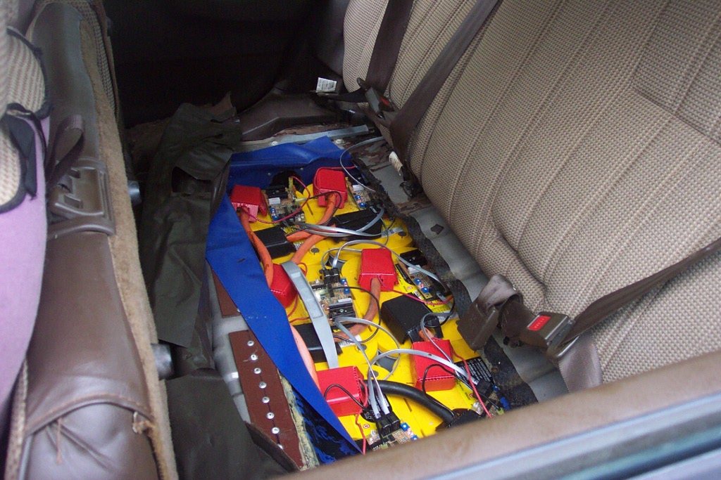
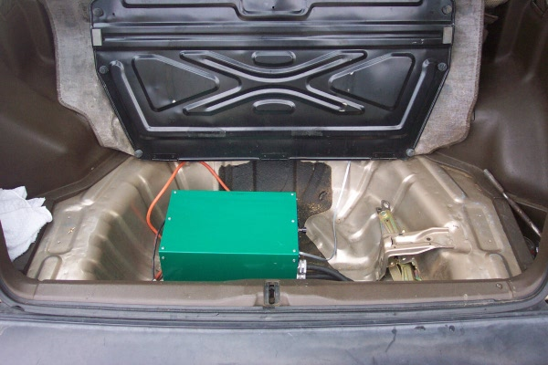
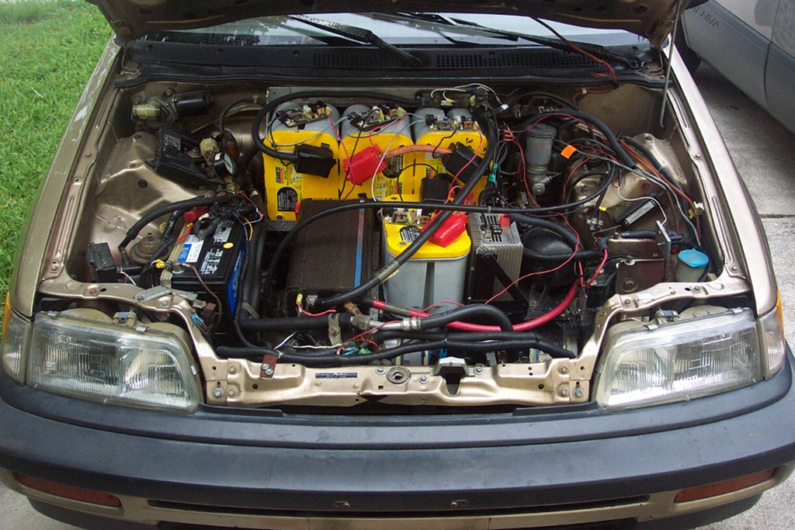
Assemble More
Notes:
Axle U-bolt
Rear battery box
Front battery frame
Component platform
Charger
Wiring
Throttle cable
Disorganized
Ready to go!
Backwards
Battery melting

Slide 17
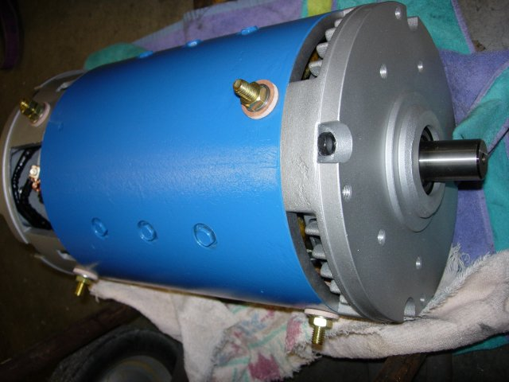
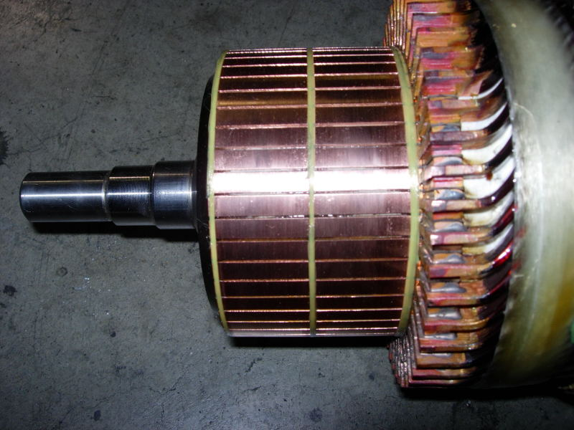
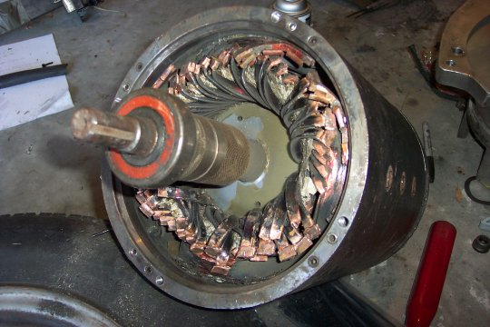
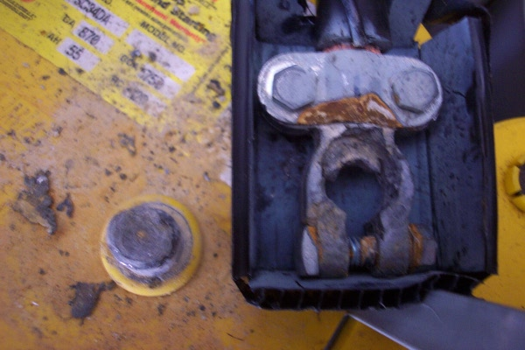
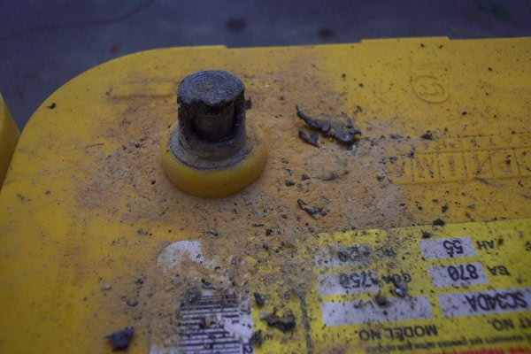
Break It
Notes:
Overrev disaster
Resulting battery disaster
Everything works at lower voltage
Driving again $1500 later
Still no rev limiter or tachometer
Not dead yet

Slide 18
References
EV Album
http://evalbum.com/
National Electric Drag Racing Association
http://www.nedra.com/
Average Commute
http://abcnews.go.com/Technology/Traffic/story?id=485098
Tesla record-breaking range
http://www.pcauthority.com.au/News/159181,tesla-breaks-land-record-for-electric-car-on-a-single-charge.aspx
Solectria Sunrise range
http://en.wikipedia.org/wiki/Solectria_Sunrise
Greenhouse gas emissions of US power stations generating for EVs
http://www.transportation.anl.gov/modeling_simulation/GREET/sample_results.html
CO2 emissions of coal stations generating for EVs
http://www.eia.doe.gov/cneaf/electricity/page/co2_report/co2report.html
EVs cheaper to run than gas cars
http://www1.eere.energy.gov/vehiclesandfuels/avta/light_duty/fsev/fsev_gas_elec2.html
EV cost comparison calculator
http://www.ccds.charlotte.nc.us/~jarrett/EV/cost.php
EV Calculator
http://www.evconvert.com/tools/evcalc/

