Slide 1
Message Queues in Software Engineering
An Introduction to Message Queues and Their Role in Modern Systems
Marwa Hawi
csc311:software engineering

Slide 2
What Are Message Queues?
A message queue is a form of asynchronous communication.
Used to exchange messages between distributed components or services.
It allows components to communication by sending and receiving message via a queue .
Message are stored until receiving service is ready to process them.
Visual: Simple diagram showing two services exchanging messages through it.

Slide 3
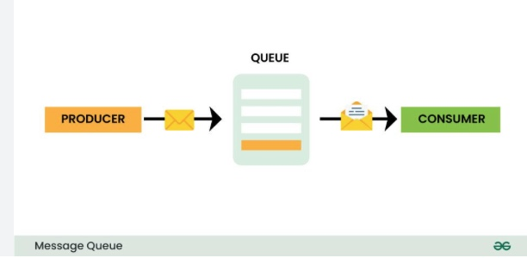

Slide 4
A real-world example of a message queue Both the sender and receiver of the email don't have to be online at the same time to communicate with each other. The sender sends an email, and the message is temporarily stored on the message server until the recipient comes online and reads the message.

Slide 5
Definition: A message queue is a communication method for distributed systems, allowing different components or services to communicate with each other .
Purpose: Ensure reliable message delivery and decouple system components.
Why Important: Scalable, fault-tolerant, and helps with asynchronous processing.

Slide 6
Message Queue Components
Producer: Sends a message to the queue.
Queue: Temporarily holds the messages.
Consumer: Reads and processes messages from the queue.
Broker: System that manages the message queues and delivery (e.g., RabbitMQ, Kafka, etc.)

Slide 7
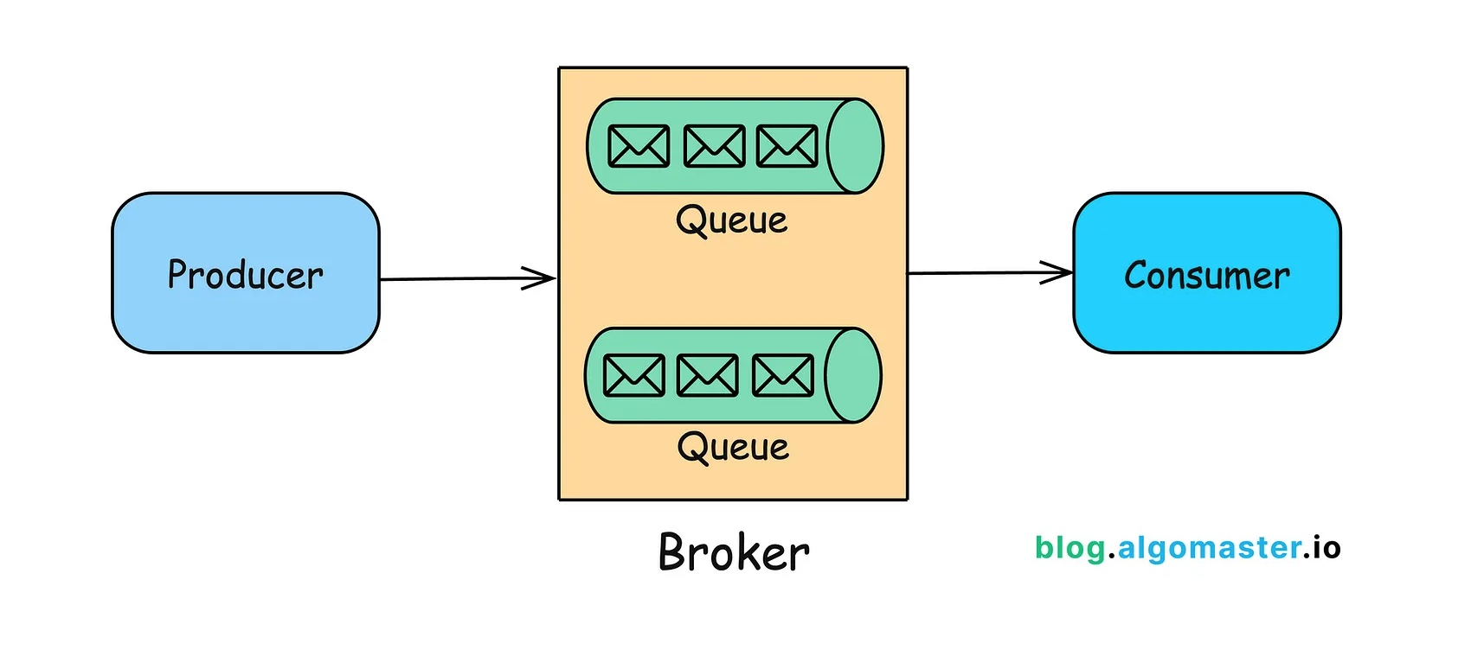
Core Components of a Message Queue

Slide 8
How Message Queues Work
Asynchronous Communication: Message producers don't need to wait for consumers to process the messages.
Decoupling: Systems are decoupled, so producers and consumers can work independently.
Queue as Buffer: Allows for smooth processing even when the consumer's processing rate is slower.

Slide 9
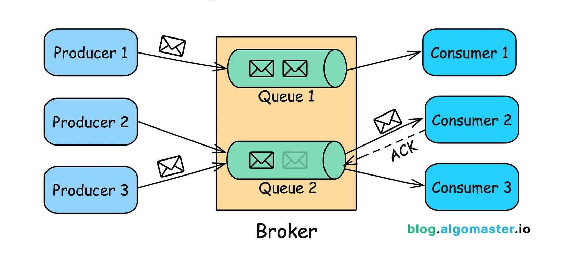

Slide 10
Types of Message Queues
Point-to-Point (Queue Model): One producer and one consumer (FIFO - First In First Out).
Publish/Subscribe (Topic Model): One producer and multiple consumers.
Use Case Examples:
Point-to-Point: Job scheduling.
Publish/Subscribe: Broadcasting events.

Slide 11
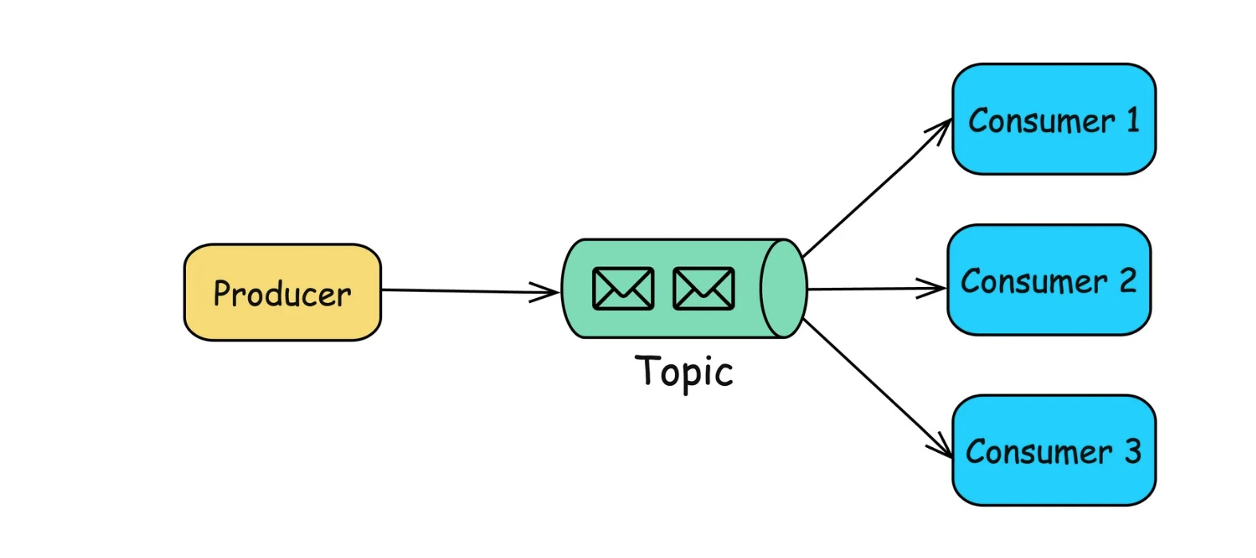
Publish/Subscribe (Pub/Sub) Queue

Slide 12
Benefits of Using Message Queues
Asynchronous Processing: Perform tasks in the background without blocking the main process.
Reliability: Messages are persisted until successfully delivered.
Scalability: Easily handle increased load by adding more consumers.
Fault Tolerance: Failures in consumers or producers don’t directly impact the system.

Slide 13
Popular Message Queue Systems
RabbitMQ: Popular for its flexibility and ease of use.
Apache Kafka: High-throughput, distributed, and fault-tolerant.
Amazon SQS: Managed message queue service on AWS.
ActiveMQ: Open-source and supports multiple protocols.

Slide 14
Use Cases of Message Queues
Microservices Communication: Microservices can communicate asynchronously without being tightly coupled.
Background Jobs: Offload time-consuming tasks (e.g., image processing, sending emails).

Slide 15
Distributed Systems: Manage communication between distributed components.
Order processing systems.
Email and notification servies.
Event-driven Architecture: Broadcast events (e.g., user registration event triggers a series of actions).
Problem: Events need to be propagated to multiple services or components, but direct communication would be inefficient.
Solution: Use a Pub/Sub message queue to broadcast events to all interested consumers, ensuring that all parts of the system receive the necessary updates.

Slide 16
Message Queue Design Patterns
Work Queues: Distribute work to a pool of workers.
Publish-Subscribe: Distribute events to multiple consumers.
Priority Queues: Ensure that important messages are processed first.

Slide 17
Challenges of Message Queues
Message Ordering: Ensuring messages are processed in the correct order.
Dead Letter Queues: Handling undelivered or failed messages.
Message Duplication: Avoiding message processing more than once.
Performance: Monitoring and scaling for high message volume.

Slide 18
Best Practices for Using Message Queues
Monitor Queue Depth: Ensure queues are not growing unbounded.
Implement Retry Mechanisms: Handle failures with retries.
Ensure Idempotency: Ensure that duplicate messages do not cause issues.
Use Acknowledgments: Ensure that messages are processed successfully before being deleted from the queue.

Slide 19
Case Study Example
Case Study Example
Scenario: E-commerce system using message queues to process orders.
Step 1: Customer places an order (Producer).
Step 2: Order is placed in the queue.
Step 3: Multiple consumers process the order, including payment processing, inventory update, and shipping.
Step 4: Asynchronous processing ensures fast response to the customer while backend operations complete.

Slide 20
Conclusion
Summary: Message queues provide scalability, reliability, and decoupling in distributed systems. They are a crucial tool in modern software architectures.
Used across industries for various purposes,from real-time data streaming to background jobs.
Final Thoughts: Understanding message queues is essential for building robust and scalable systems.

Slide 21
Any Question
Thank You

