Slide 1

Cross-impact Balance Analysis
Day One: Fundamental
Dr. Jude Kurniawan
ISIGET Project
Syllabus and materials for this CIB training and tutorials are influenced by lecture notes from Vanessa Schweizer and Wolfgang Weimer-Jehle

Slide 2
Agenda
Day One: Introduction
Fundamental of Cross-impact Balance Analysis
Introduction to Scenario Wizard
Day Two: Doing Research using CIB
Data collection
Data analysis and quality control
Day Three: Advanced CIB techniques
Multi-scale CIB
Stochastic CIB (Vanessa Schweizer)
CIB research presentation (Norman Kearney)

Slide 3
What are ‘scenarios’?
Scenarios are depictions of alternative futures
Benefits:
Scenario-as-a-service: Co-learning, performative effect
Scenario-as-a-product: Testing ‘what-if’ situations
Participants:
Expert panels, e.g., genius forecasting, cross-impact analysis
Stakeholders, e.g., participatory scenario planning

Slide 4
Why qualitative scenarios?
First, what are qualitative scenarios?
Stories:
Make more sense intuitively (e.g., Kahneman’s “characters” of System I and System II)
Have traditionally encoded information about how the world works (Lempert’s footnote comparing myth and scientific modelling)
However, System I can’t tell the difference between fact, fiction, and fantasy

Slide 5
Cross-impact balances
System analysis approach - A “system theoretic approach” to generating/evaluating qualitative scenarios
Because it is computational/algorithmic, it better addresses heuristics/biases that pose problems in thought experiments
Arbitrariness (Lempert)
Clinical (human expert) vs. actuarial (algorithmic) prediction (Meehl in Kahneman)
Futures are difficult to imagine – focus on ‘realistic’ futures

Slide 6
Why Cross-impact Balance Analysis
Coordination within systems-of-systems
Non–linear (bifurcations, tipping points, phase transitions)
Feedbacks and irreversibility
Present systems may not be attainable
Many uncertainties

Slide 7
Systems are complex
Proust et al. (2012) International Journal of Environmental Research and Public Health

Slide 8
Theoretical Foundation of CIB
Cross-impact Analysis (Gordon and Hayward, 1968)
Morphological Analysis (Ritchey, 1991)
Nash Equilibrium (1950)

Slide 9
Cross-impact Analysis
The occurrence of one event will modify the subsequent occurrence of other events
Matrix is solved by Monte Carlo

Slide 10
Morphological Analysis
Variables will unfold differently (different states)
Cross consistency assessment of a system
Defining consistency through elimination of inconsistent combinations

Slide 11
Morphological Analysis

Slide 12

Nash Equilibrium
No players can gain additional benefits from changing their decisions given that all other players’ decisions remain unchanged
https://youtu.be/ewu_7Dmj_18

Slide 13
CIB
Full matrix to document bidirectional influence
Variables (Descriptor) can unfold in different states (Variants)
Consistent scenarios are combinations of descriptor-variant
Consistency is measurable – impact scores

Slide 14
CIB Matrix
Descriptors
Variants
Judgment Section
Judgment Group

Slide 15
Generating scenarios for Somewhereland
Consider the variables A, B, C …
A
B
C
A directly influences B and C
B directly influences A and C
C directly influences A only

Slide 16
Cross-impact balances determine scenario consistency
Best practice: The Principle of Compensation
If alternative states for a variable are mutually exclusive and comprehensive, this implies that when one state is encouraged (+), alternatives are being discouraged (-).

Slide 17
Cross-impact Balance Analysis
Day One: Introduction to Scenario Wizard
Dr. Jude Kurniawan
ISIGET Project

Slide 18
Scenario Wizard
Application software for CIB analysis
Developed by ZIRIUS at the University of Stuttgart

Slide 19
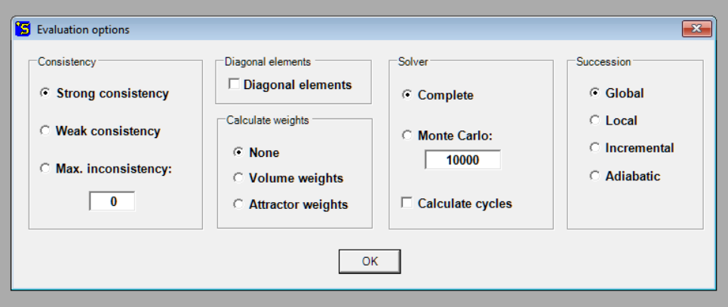
Evaluation Options

Slide 20
Consistency
Strong Consistency: Maximum impact scores of the descriptor impact balance
Weak Consistency: Positive or zero impact scores of the descriptor impact balance
Max. Inconsistency: Difference in max impact scores of the descriptor impact balance
Calculate Cycles: Find the number of cyclic solutions

Slide 21
Solver
Complete Solver:
All possible scenarios will be explored
May cause long computation in large matrices
Monte Carlo:
Not a complete exploration
Defined by the number of randomly chosen scenarios
Used for large matrix

Slide 22
Succession
Succession algorithm to search for consistent scenarios
Global: Adjust all inconsistent descriptor states towards the highest impact score
Local: Adjust only the descriptor states with the highest inconsistency
Incremental: Adjust all descriptor states toward the highest impact score but through jumping to the neighboring state
Abdiabatic: Only adjust the first inconsistent descriptor to the highest impact score; applicable when descriptors are ordered according to time scale

Slide 23
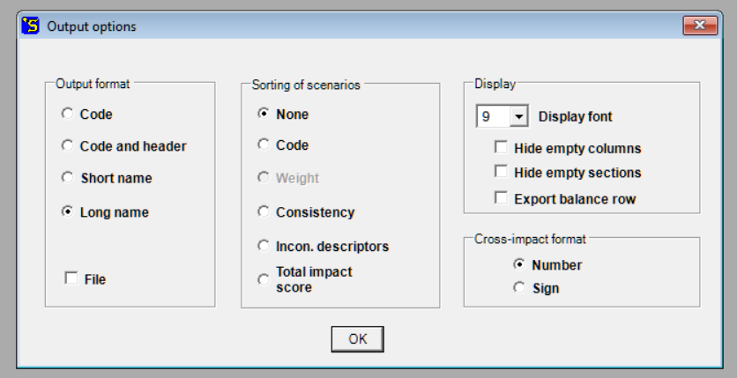
Output Options

Slide 24
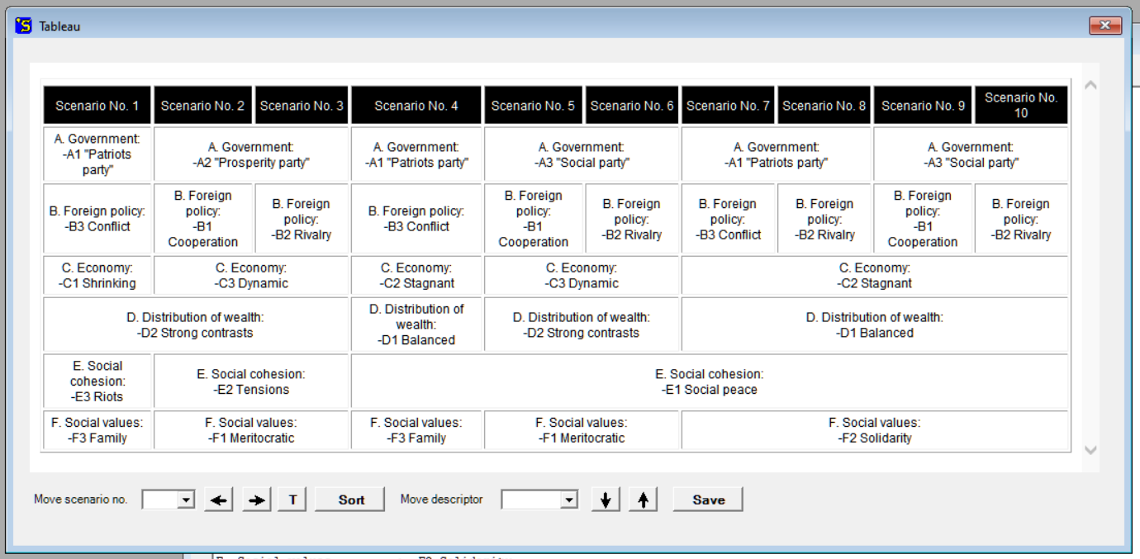
Consistent Scenarios

Slide 25
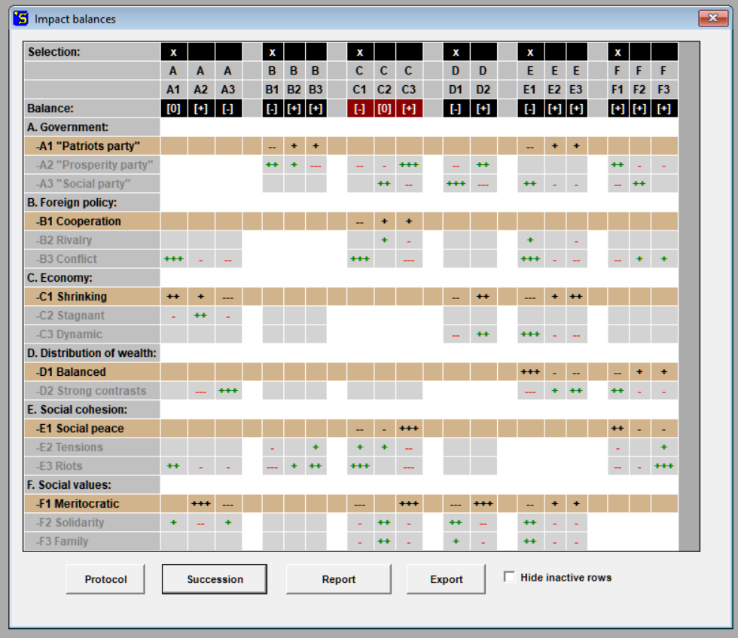

Slide 26
Tutorial
Load Somewhere Land tutorial
Set evaluation and output options
Find consistent scenarios
Change the settings in evaluation and/or output options
Find consistent scenarios and observe the changes
Create a new project with 2 descriptors with 2 variants
Edit structure of the matrix (define descriptors and variants)
Edit matrix (input influence judgments)

