Slide 1

Cross-impact Balance Analysis
Day Two: Doing Research using CIB
Dr. Jude Kurniawan
ISIGET Project
Syllabus and materials for this CIB training and tutorials are influenced by lecture notes from Vanessa Schweizer and Wolfgang Weimer-Jehle

Slide 2
Scenario Development Process
Identifying Scenario Variables
Driving forces that can be significant in the future within the study context
Developing Scenarios
Methods to develop alternative futures
Quality Control
Bias statistics
Types of analysis
Scenario groups
Stability test

Slide 3
Data for CIB Analysis
Descriptors and Variants (scenario variables)
Descriptors are variables that describe the system behaviour
Descriptors-variants are categorical data (ordinal or nominal)
Variants are the end-states for how descriptors unfold
Variants are mutually exclusive
Impact Judgments
Values describing pair-wise interactions
Either promoting, inhibiting, or no influence
Likert-scale (ordinal)

Slide 4
Identifying Descriptors and Variants
Methods to identify descriptors and variants:
Horizon Scanning
Delphi
Literature Review
Textual Analysis
Expert elicitations
Number of descriptor-variants:
Theoretically, unlimited
Depends on whether matrix will be tractable
For a large intractable matrix, multi-scale CIB can be used (Day Three)

Slide 5
Example of textual analysis
Create a dataset from scratch…
Read the reports line-by-line and extract statements…
For example:
future
“Having more EVs on the roads will reduce GHG emissions but increases electricity consumption”
2
1
GHG Emissions
3
EVs
Electricity Consumption

Slide 6
Eliciting Impact Judgments
Methods:
Textual analysis
Coding and scoring protocol
Avoid subjectivity
Expert elicitations
Experts response to a portion of the matrix
All responses are collated to complete the matrix
‘Anchoring’ problem
Participatory scenario planning
Hardly used in CIB (CIB is not intended for participatory)
Can be implemented, but how?
ISIGET Scenario Project

Slide 7
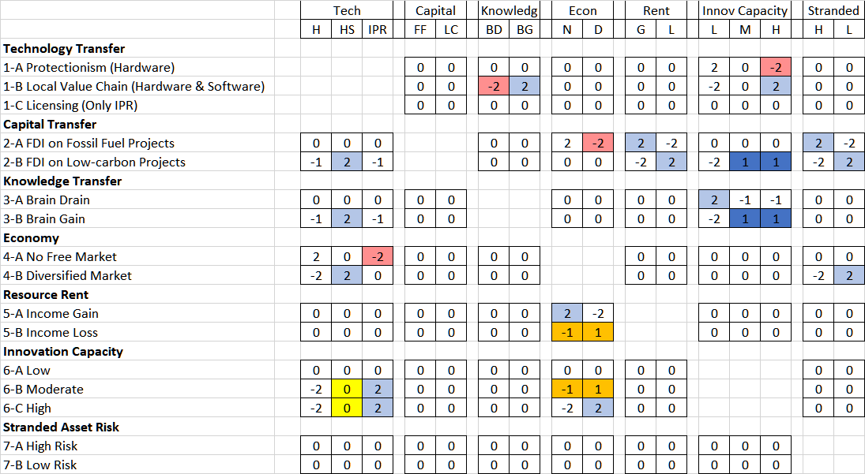
Principle of compensation

Slide 8
Expert elicitation:
Different expert participants provide judgments for a portion of the matrix
CA Matrix
(constructed matrix for Canada is based on collating expert influence judgments, e.g., expert participant for SD03 provided influence judgements for all the orange cells in the matrix)
SSP Matrix
Notes:
Expert participants provided influence judgment for how a variable X influence a variable Y.
Influence judgments were recorded in the corresponding matrix cells based on 7-point Likert scale
One expert participant provided influence judgment only for a portion of the matrix or per descriptor.
[Click]
For example, one participant would respond to the cells in ‘yellow’
In addition to providing influence judgment in numerical forms, expert participants provide reasons why they responded that way.
A total of 8 expert participants were consulted
7 provided complete responses
1 decided not to continue
Together with the influence judgments for the global SSPs, the elicited influence judgments based on 7 expert participants completed the CI matrix
Then, this matrix was subjected to CIB analysis to search for internally consistent scenario configuration

Slide 9
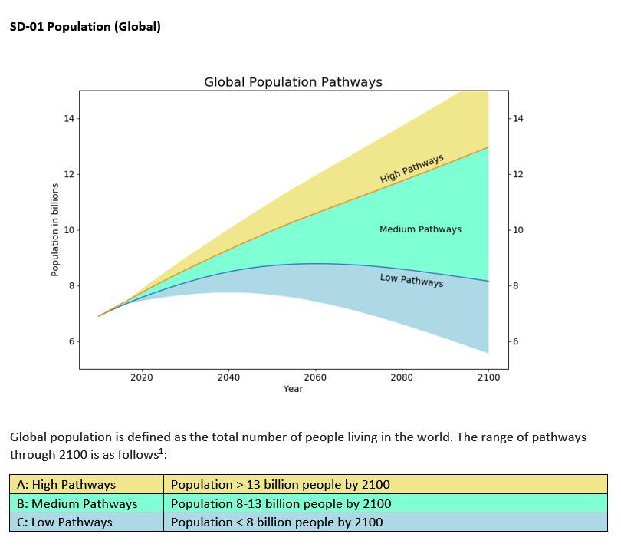
Anchoring
Orienting participant perspectives using pathway diagrams

Slide 10
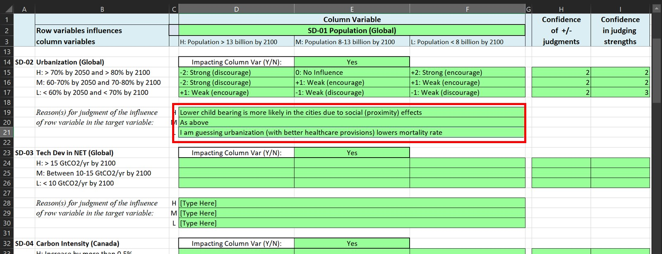
Collecting influence judgments and ‘verbal’ reasons

Slide 11
Quality controls
Visuals: Cross reference verbal reasons against judgment values
Typical problems: flipped signed, directly or inversely co-vary, indirect judgments
Standardization: If one state is promoted, other states will be discouraged
Bias statistics: Any descriptor-variants are promoted more frequently than others

Slide 12
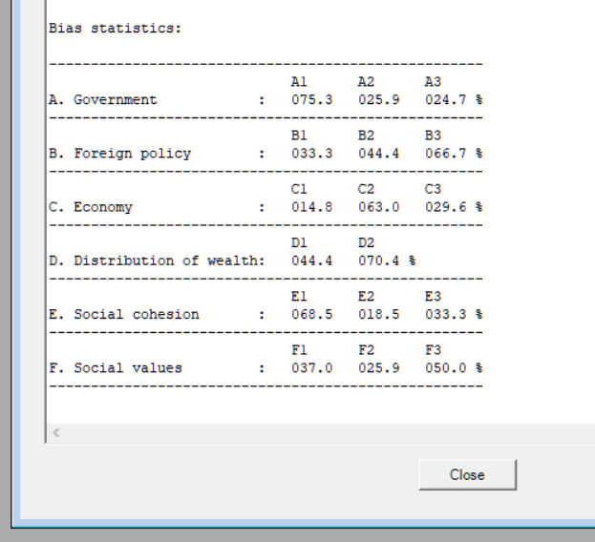
Bias statistics
Avoid >90% and <10%
Check influence judgments again
Bias can happen when relationship is ‘clear-cut’ or very intuitive

Slide 13
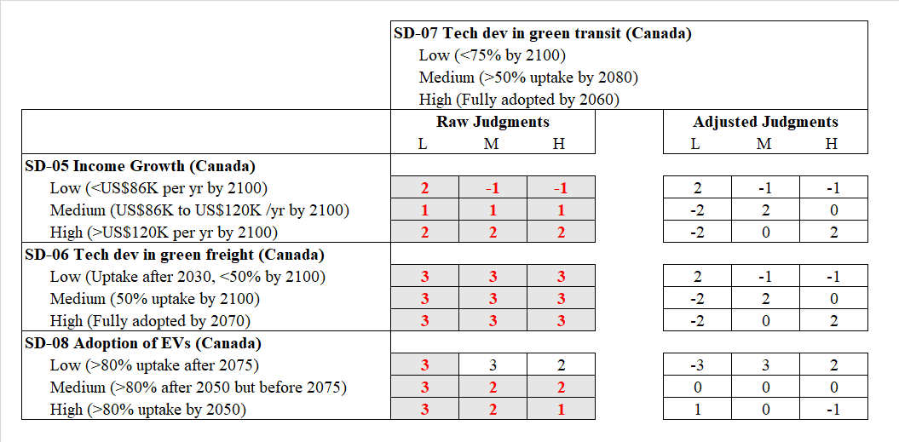
Adjusting judgments
For SD-05 (income growth) and SD-06 (technology development in green freight), expert commented that these two elements and SD-07 (technology development in green transit) co-vary. These judgments were adjusted to show co-variance relationship.
For SD-08 (adoption of EVs), expert explained that the relationship is likely determined by the consumer choice. The higher adoption rate of EVs means a weaker support for green transit; however, expert added that this link is not a ‘strong’ link. The judgment for the low pathway was corrected (flipped sign) to depict a weaker correlation.

Slide 14
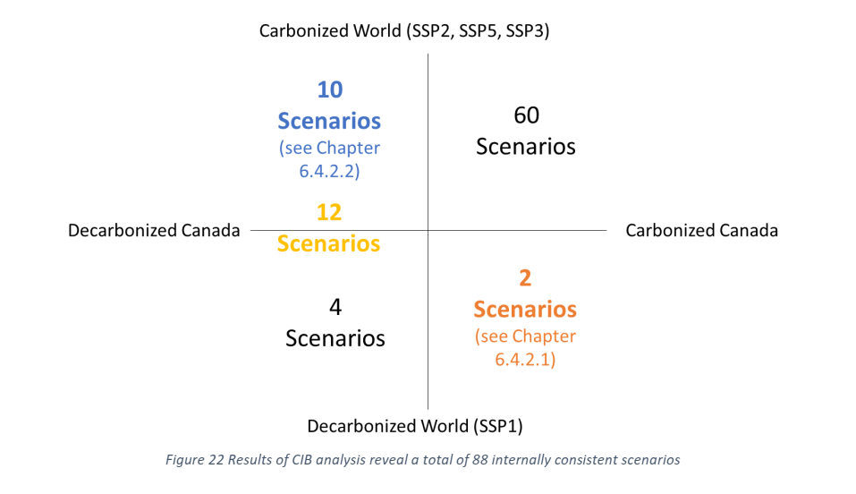
Types of analysis
Internally consistent scenarios
Grouping scenarios

Slide 15
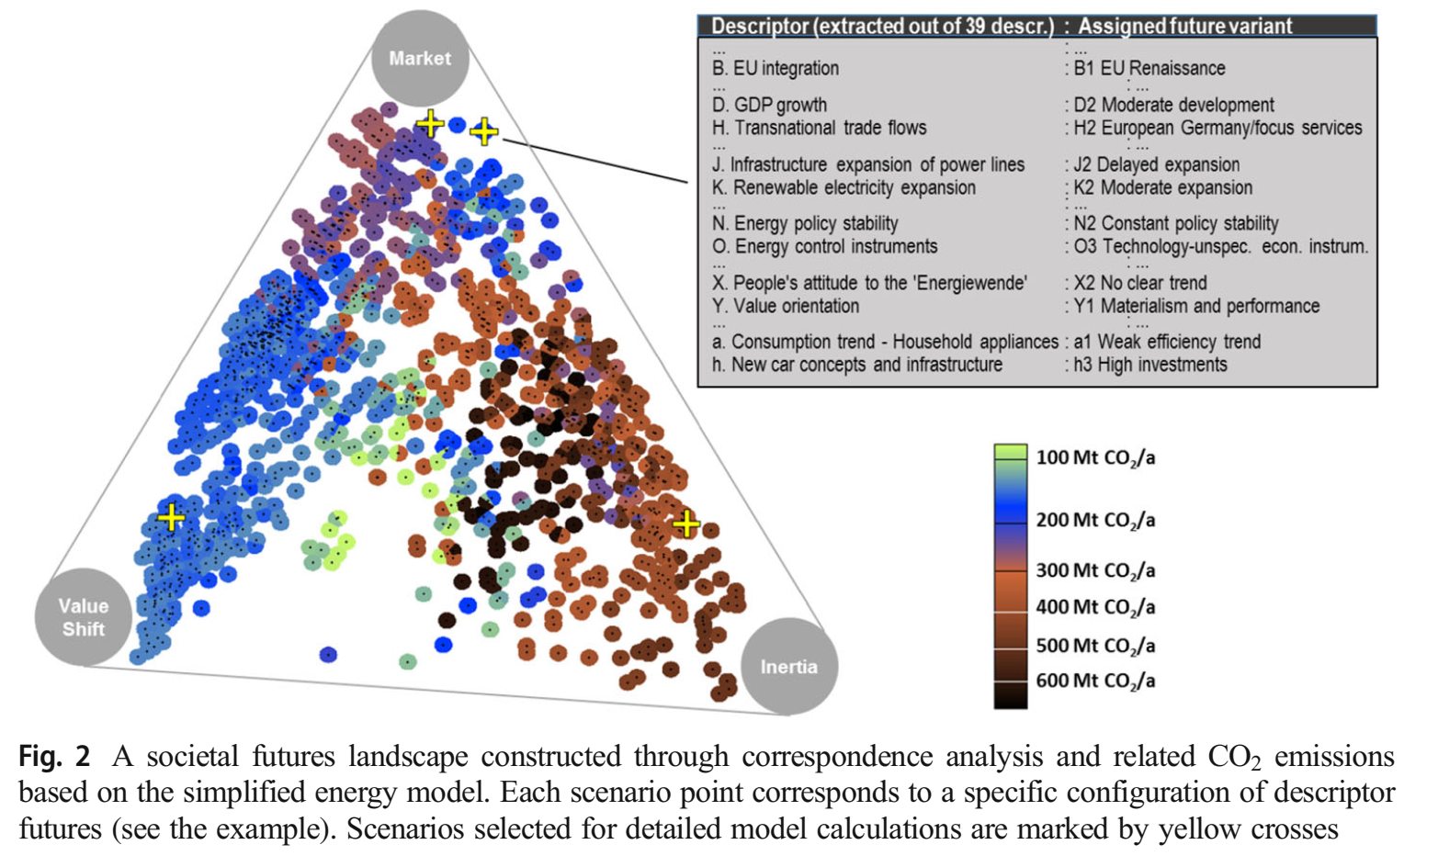

Slide 16
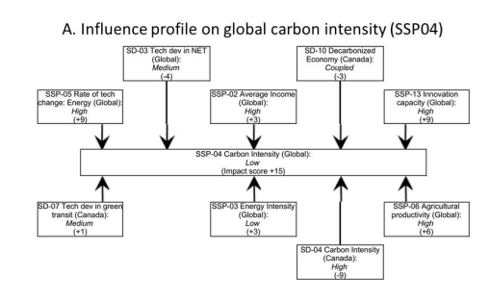
Stability test
How ‘stable’ are scenarios
Trace causal chains
Succession analysis
Full Transition #3
+
Perturbation
Status Quo #1
Status Quo #1
+
Perturbation
Full Transition #3

Slide 17
Cross-impact Balance Analysis
Day Two: Doing Research Tutorial
Dr. Jude Kurniawan
ISIGET Project
Syllabus and materials for this CIB training and tutorials are influenced by lecture notes from Vanessa Schweizer and Wolfgang Weimer-Jehle

Slide 18
Tutorial
Work in group to develop a project on any topic of your choice
Limit to 4-5 descriptors
Consensus on descriptor-variant list
Consensus on influence judgment
Develop scenarios
Check and correct bias statistics
Present consistent scenarios
Discuss these scenarios
Try playing with succession analysis
Present scenarios

