Slide 1
Springboard-DSC Program
Capstone Project 2
Predicting Mental Health Support Needs
By Jude M. Santos
October, 2024

Slide 2
Introduction
This project aims to identify groups likely to require mental health support by analyzing demographic data, mental health conditions, sentiment analysis, and psychological indicators. Stakeholders include mental health organizations and policymakers who can use these findings for effective resource allocation.

Slide 3
Approach
Data Source: Dataset sourced from Kaggle, combining online surveys and publicly available data.
Data Wrangling: Removed irrelevant features, created new features from 'Timestamp', and handled missing values with appropriate imputation methods.
Exploratory Analysis: Visualizations illustrated trends and key demographic patterns related to mental health.
Modeling: Baseline modeling with Logistic Regression, followed by advanced modeling using XGBoost, Random Forest and LightGBM.

Slide 4
Data Analysis and Visualization

Slide 5

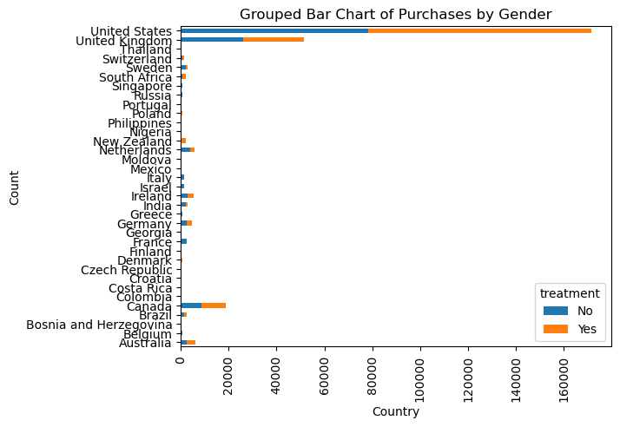
The U.S. had the highest representation, affecting insights on healthcare access and cultural attitudes.

Slide 6

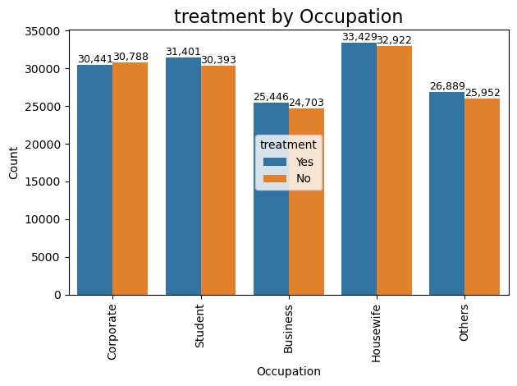
Higher treatment entries among housewives, indicating unique stressors in domestic roles.

Slide 7

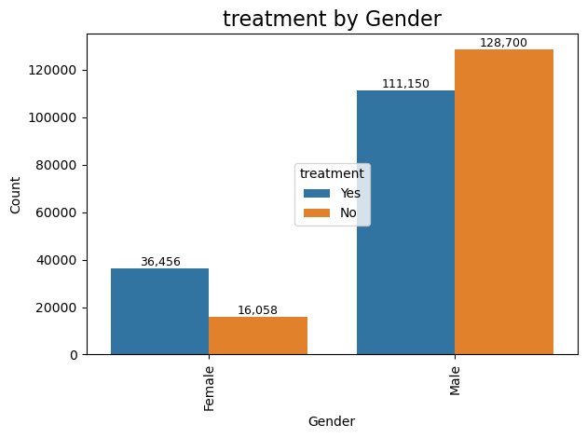
Gender disparities: Males less likely to seek treatment compared to females, highlighting social stigma.

Slide 8
Key Findings
XGBoost achieved highest scores in precision, recall, and F1 for class 1 predictions, indicating its effectiveness.
LightGBM and Random Forest maintained strong performance but fell short of XGBoost.
Important predictors included access to care, family history of mental health issues, and demographic factors.

Slide 9

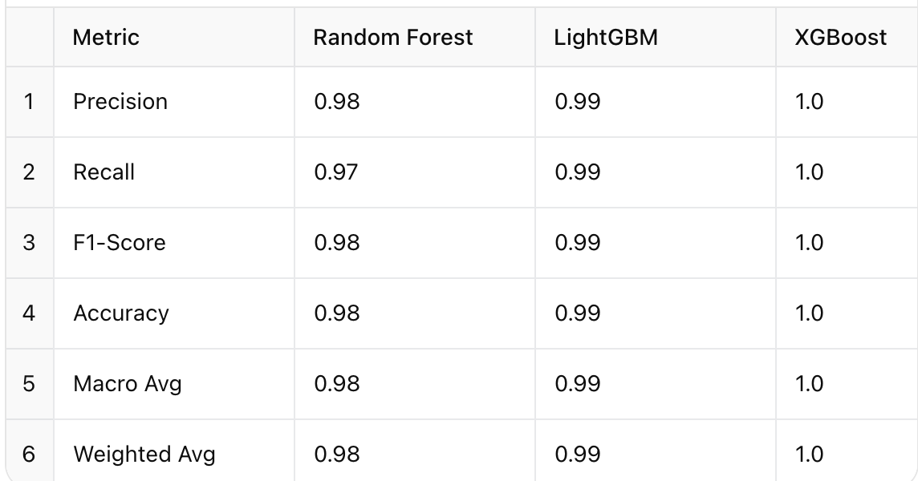
Model Performance
XGBoost achieved highest scores in precision, recall, and F1 for class 1 predictions, indicating its effectiveness.
LightGBM and Random Forest maintained strong performance but fell short of XGBoost.

Slide 10

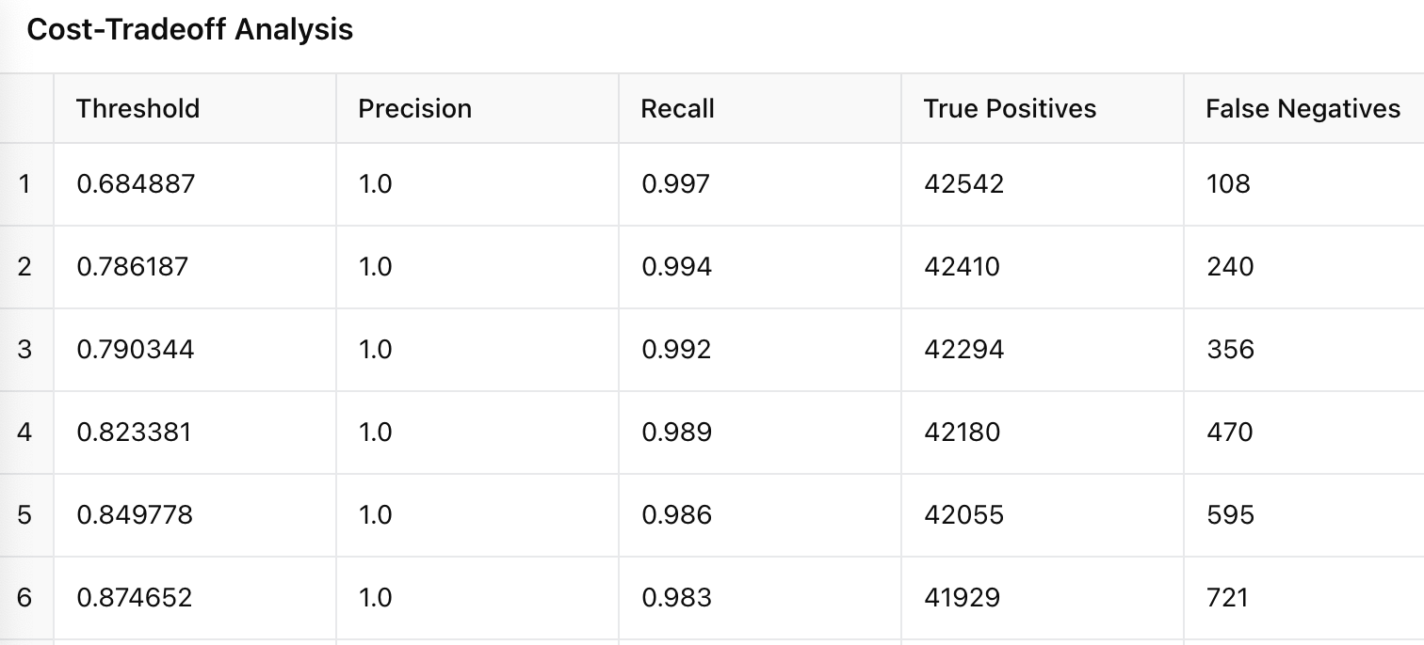
Cost-tradeoff Analysis
A lower threshold yields higher recall (0.997 at threshold 0.684) but increases false negatives.
If false negatives are costly (e.g., missed diagnoses), a lower threshold is preferable.
If false positives are more costly (e.g., unnecessary treatments), a higher threshold may be favored.

Slide 11
Conclusions & Future Work
The project successfully identified key predictors of mental health support needs, utilizing various data science techniques. Future work could include:
Incorporating additional datasets for deeper insights.
Testing sophisticated modeling techniques like deep learning.
Expanding the feature set to include temporal factors influencing mental health.

Slide 12
Recommendations
Adopt a threshold of 0.849 for optimal model deployment, balancing precision and recall.
Implement outreach programs for high-risk demographic groups.
Utilize predictive models for dynamic allocation of mental health resources.
Regularly update the model with new data and enhance it with real-time monitoring systems.

