Slide 2
Start
Initial Setup
Step optimizer
Update optimum from optimizer step.
Has optimization converged within toll?
End
Max number of iterations reached?

Slide 3
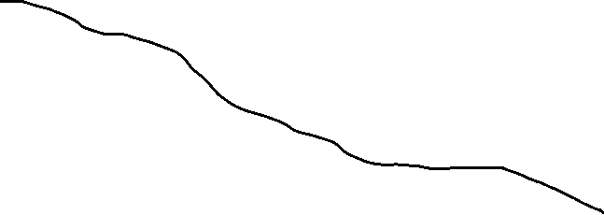
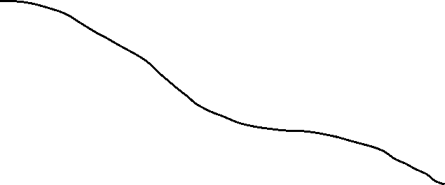
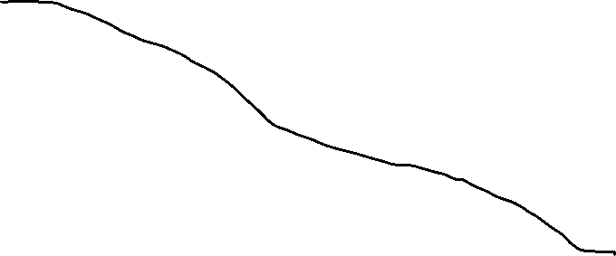

Convergence Curves.
Optimization algorithms have various parameters and evaluating the performance of an algorithm on a single set of parameters for a problem space is not an accurate indicator of the algorithms performance. Instead its nessisary to sample a number of parameter sets and compare Max, Min, average Convergence curves to determine the algorithums performance.
Max Curve
Optimum value discovered
Min Curve
Average Curve
Number of iterations

