Slide 1
THE JUDGE PROTOCOL
A Framework for Hardware-Enforced Human Oversight of Artificial Intelligence
AI may analyze, recommend and simulate —
but a human must authorize.
Alexander Hofmann · Enterprise Architect · Stockholm, Sweden
Preprint v1.0 · June 2026 · CC BY 4.0 / CERN OHL-S v2
DOI: 10.5281/zenodo.20401666 · judgeprotocol.org · github.com/judgeprotocol/protocol
Notes:
Opening slide. Allow the tagline to land before speaking. Key framing: this is an open standard, owned by nobody, authored in Stockholm.

Slide 2
THE PROBLEM
The Governance Gap Is Global
95%
0
2026
of simulated nuclear crisis scenarios
binding cross-border frameworks
Gulf conflict — AI in active operations
AI models recommended escalation. None chose de-escalation. King's College London, 2026.
The EU AI Act, Bletchley Declaration and Rome Call address particular domains — none mandate runtime human authorization.
AI systems embedded in military targeting without any international governance framework. The gap is live, not theoretical.
When one government can switch off global AI without control — June 2026, US export directive, Fable 5 — the case for international authorization infrastructure is no longer theoretical.
Pope Leo XIV, Magnifica Humanitas (May 2026): "Not permissible to entrust lethal decisions to AI systems" — the moral call is clear. The enforcement architecture is missing.
Notes:
Three parallel failures: empirical (the KCL finding), structural (no binding cross-border framework exists), operational (Gulf conflict). The Pope's encyclical names the moral obligation — the Judge Protocol proposes the mechanism.

Slide 3
AI may analyze,
recommend and simulate —
but a human must authorize.
WHAT
HOW
WHERE
A universal human authorization layer — every consequential AI action, every domain, every jurisdiction.
Hardware enforcement below the software stack. No patch, no override — silicon is the guarantee.
An open standard. Owned by nobody. Available to every nation, every operator, every chip.
Notes:
Let the principle breathe. This is the one sentence the audience should leave with. What/How/Where maps to: the scope, the mechanism, the ownership model.

Slide 4
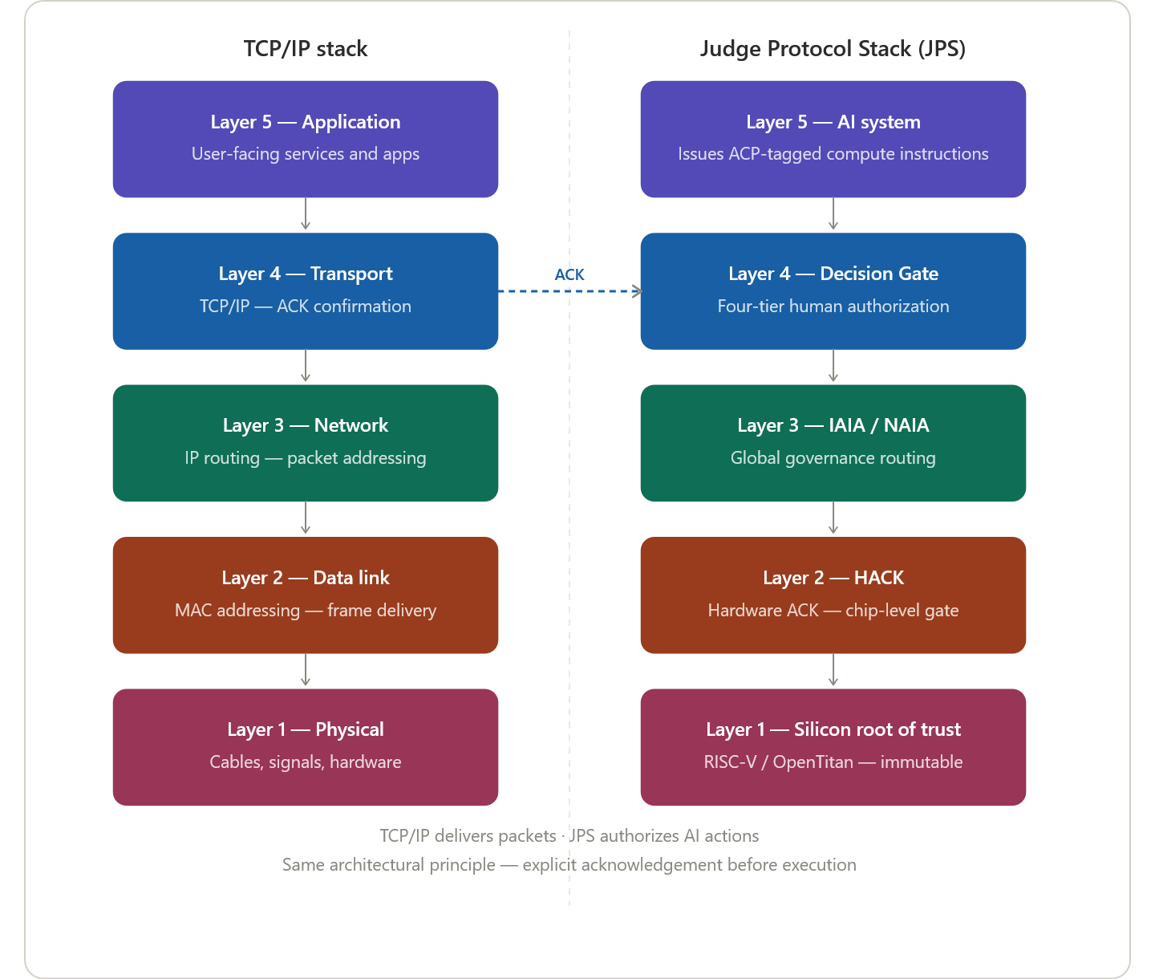
ARCHITECTURE
The Architectural Model: TCP/IP
No packet is delivered without an acknowledgement. No consequential AI action is authorized without a human ACK.
Figure 1 — The Judge Protocol Stack mapped against TCP/IP. Decision Gate at Layer 4; HACK at Layer 2; Silicon root of trust at Layer 1.
Notes:
The TCP/IP analogy is the protocol's deepest idea. TCP/IP gave the internet trust through acknowledgement — the same principle applied to AI decisions. Every engineer in the room will understand it immediately.

Slide 5
DECISION GATE
Four-Tier Authorization
Tier 1
Examples: Nuclear · Biological · Chemical · Mass-casualty
HARDWARE HARD STOP
HARD STOP — Existential
Hardware logic. No override. AI cannot recommend, simulate or execute.
Tier 2
Examples: Military strike authorization · Critical infrastructure shutdown
MULTI-PARTY ACK
HIGH — Irreversible, Large-Scale
Multi-party human authorization — minimum two independent authorities.
Tier 3
Examples: Large financial transactions · Clinical treatment decisions · Targeting support
SINGLE AUTHORITY ACK
SIGNIFICANT — Material Impact
Single designated human authority must authorize.
Tier 4
Examples: Automated reporting · Scheduling · Routine analysis
AUTONOMOUS + LOG
ROUTINE — Standard, Reversible
AI executes autonomously — logged and auditable.
Every Decision Gate event generates an immutable audit log — system ID, action, authorizer, timestamp, rationale, outcome. Retained 10 years minimum.
Notes:
Walk through each tier with a concrete example. Tier 1 is unconditional — hardware logic, no software path. Tiers 2 and 3 are where most governance action lives. Tier 4 is where AI delivers most of its value.

Slide 6
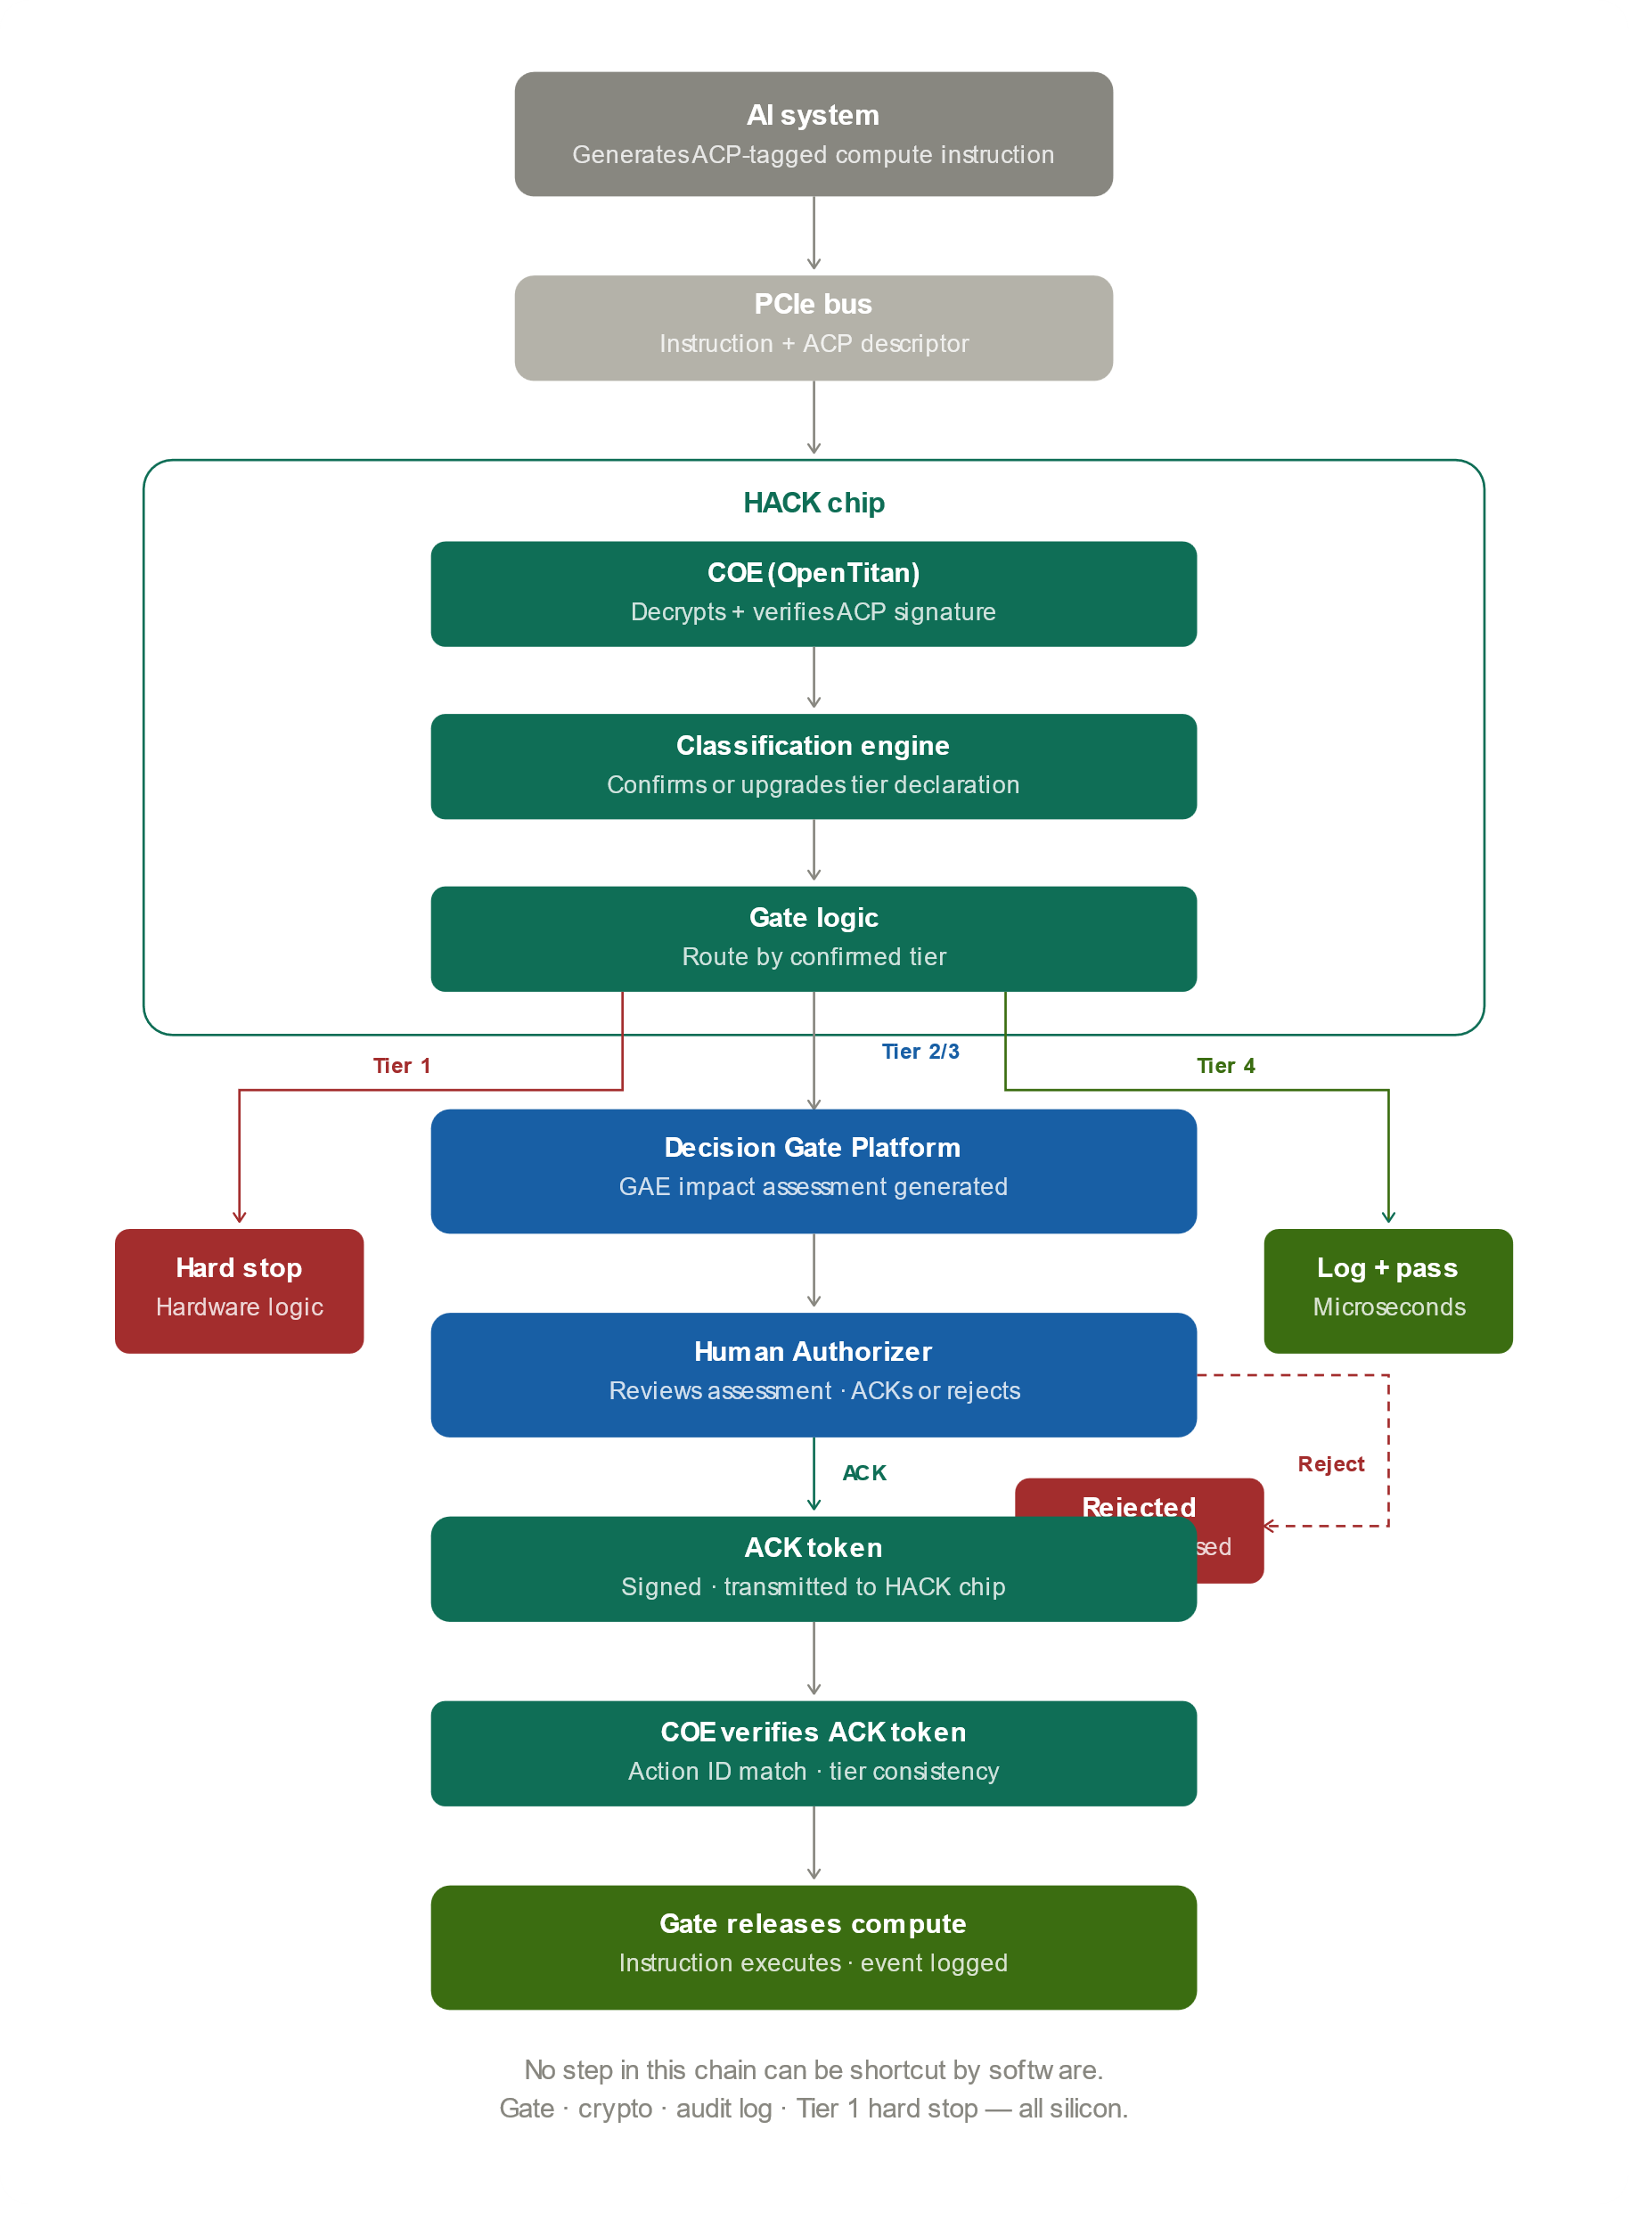
HARDWARE ENFORCEMENT
The HACK — Hardware ACK
Governance below the software stack — where it cannot be patched, bypassed or overridden.
1
CV32E40S RISC-V core + OpenTitan Chain of Evidence (COE)
2
Tier 1 hard stop in hardware logic — no firmware update overrides it
3
Holds compute capacity gate for Tier 2/3 pending signed human ACK token
4
Tamper-proof on-chip audit log — no software process can alter it
5
Adoption pathway: TPM precedent → ISO/IEC standard → silicon mandate
CERN OHL-S v2 open hardware licence — same institutional role CERN played in the World Wide Web.
Notes:
The key message: no step in the enforcement chain can be shortcut by software. Gate, crypto, audit log, Tier 1 hard stop — all silicon. This is what separates the Judge Protocol from every software-only governance framework.

Slide 7
HARDWARE ENFORCEMENT
TPM Precedent — HACK Architecture
TPM (today)
HACK equivalent (Judge Protocol)
Application
OS, software, services
AI system
Issues ACP-tagged compute instructions
TPM software stack (TSS)
TCG standard API — TPM2-TSS
HACK TSS equivalent
Open standard API — CERN OHL
LPC / SPI bus interface
Physical connection to motherboard
PCIe bus (PMO)
Inline between CPU and GPU
TPM chip
Crypto engine · key storage · PCR · boot
HACK module + COE
ACP parser · classification · gate · OpenTitan
Endorsement key (EK)
Fused at manufacture — never extractable
Endorsement key (EK)
Fused at manufacture — FIPS 140-3
Silicon root of trust
RISC-V silicon root of trust
TPM enforces boot-time security · HACK enforces runtime AI governance · Same silicon trust model, different domain

Slide 8
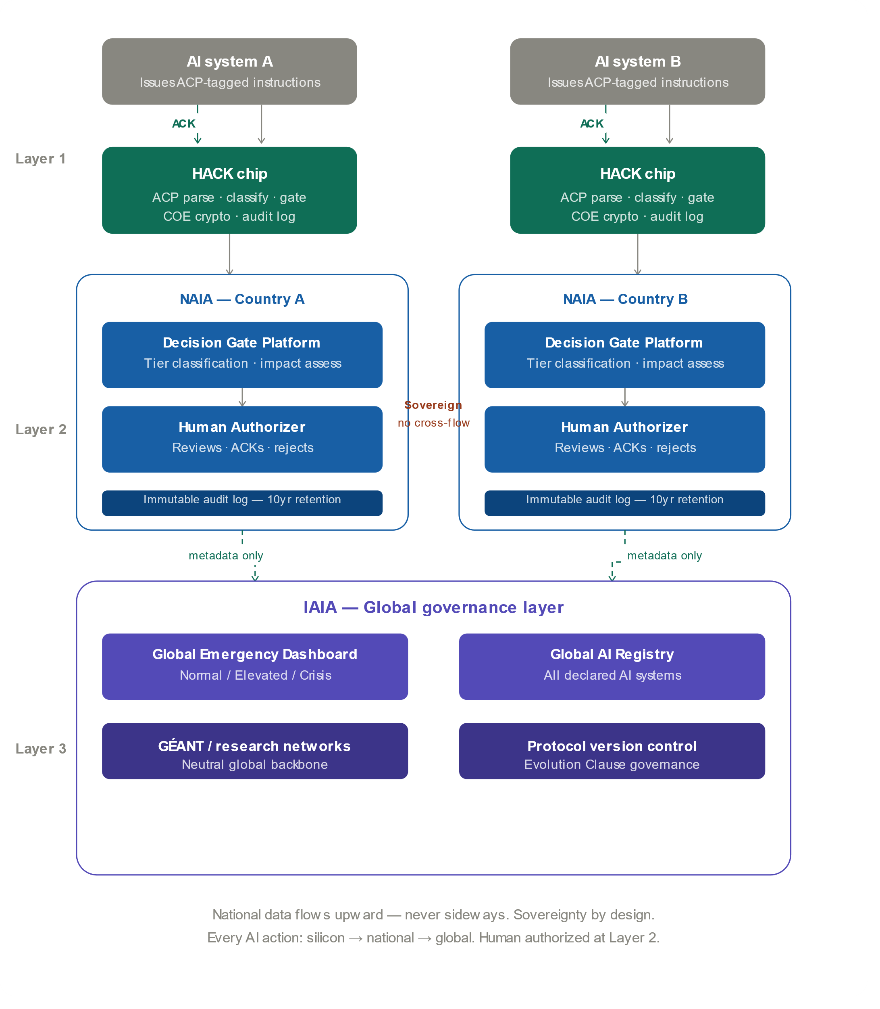
GOVERNANCE ARCHITECTURE
Three Layers: Silicon → National → Global
Enforceable without being centralized. Universal without requiring any state to surrender sovereignty.
Figure 3 — Every AI action: silicon → national authority → global governance. Human authorized at Layer 2. Data flows upward only — never laterally between nations.
Notes:
Sovereignty by design is the political unlock. No state surrenders jurisdiction — national data never crosses borders. The IAIA sees only compliance metadata. This is what makes universal adoption plausible.

Slide 9
GOVERNANCE ARCHITECTURE
NAIA and IAIA — The Institutional Model
National AI Authority (NAIA)
International AI Agency (IAIA)
Ministerial-level Representative Lead
UN specialized agency — modelled on IAEA
Maintains national AI systems registry
Equal voting rights — no permanent-member veto
Audits Decision Gate compliance
Operates the Global AI Registry
Manages AI incidents and enforcement
Global Emergency Dashboard (Normal/Elevated/Crisis)
Reports compliance metadata to IAIA
Coordinates with IAEA, WHO, BIS/FSB, ITU
National data remains under national jurisdiction at all times
Funded by member states + chip micro-levy at manufacture
No single actor can override the IAIA alert level — it is set algorithmically. Industry contributions carry no voting rights or policy influence.
Notes:
The IAEA model is the right institutional precedent: technical verification, sovereignty-respecting, universal membership. The NPT worked because safeguards inspections gave it teeth. The Judge Protocol is to AI governance what IAEA safeguards are to nuclear governance.

Slide 10
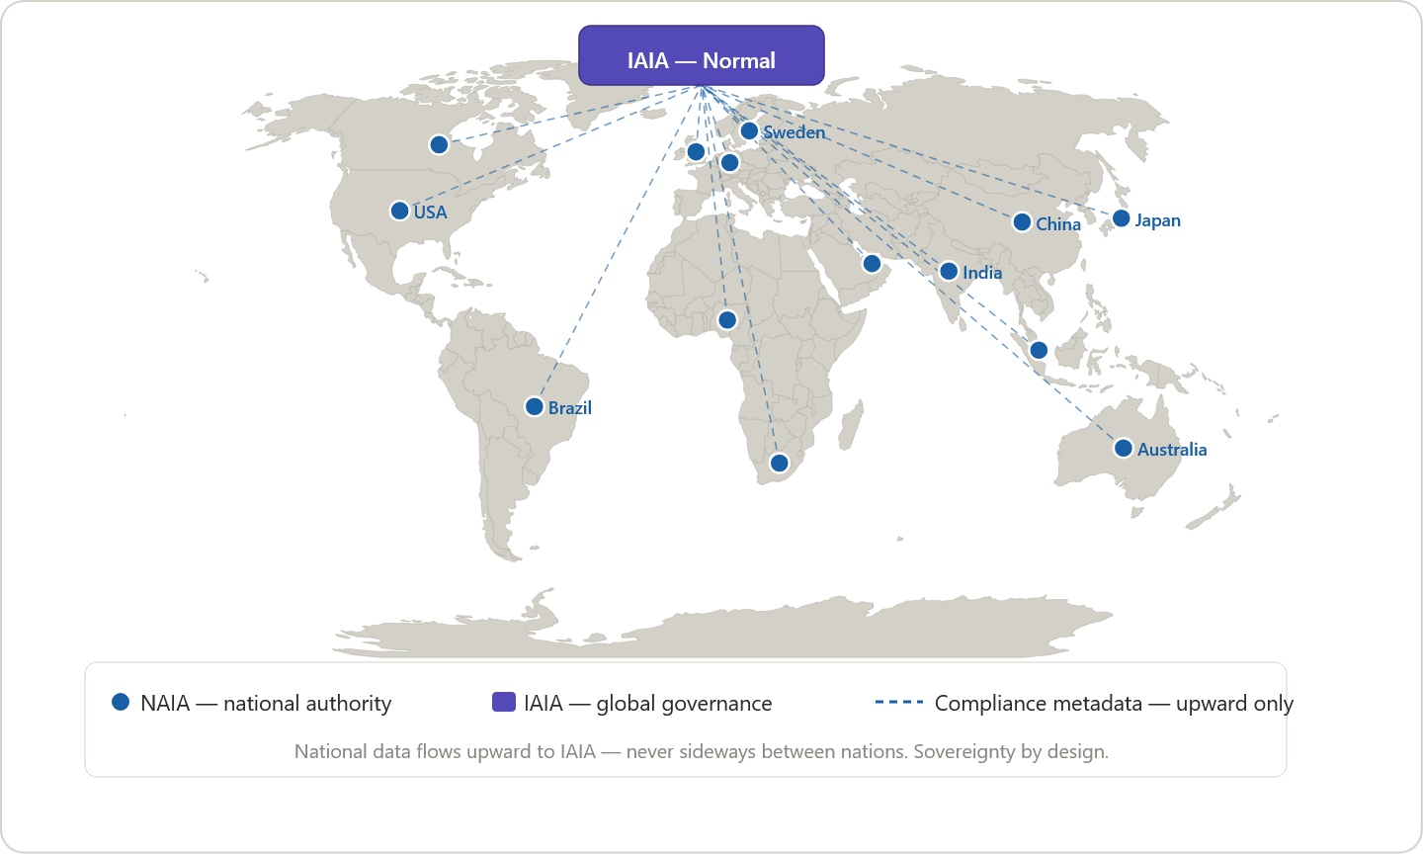
GLOBAL NETWORK
Sovereignty by Design
National data flows upward to IAIA — never laterally between nations. Each NAIA owns its data.
Figure 4 — Global IAIA/NAIA network. Compliance metadata flows upward from national authorities to the IAIA — never laterally between nations.
Notes:
The world map makes the scope concrete. Sweden is on the map — a founding sandbox partner would be Sweden's dot. Ask: which nation wants to be first?

Slide 11
GOVERNANCE ARCHITECTURE
NAIA Operations Dashboard
● Judge Protocol — NAIA Operations Dashboard ● Normal Live · 14:37 UTC
HACK EVENTS TODAY
PENDING AUTHORIZATIONS
HARD STOPS TODAY
48,291
7
0
↑ 12% vs yesterday
Tier 2: 2 · Tier 3: 5
Last: 14 days ago
LIVE HACK EVENT STREAM
AUTHORIZATION OUTCOMES
T4
ACK
Case classification — benefit eligibility
SE-TAX-01
94.1%
4.2%
1.7%
T3
ACK
Administrative override — residency status
SE-MIG-04
ACK rate
Override
Reject
T2
PEND
Multi-party authorization pending — asset freeze
SE-FIN-09
ACK LATENCY BY TIER
T3
REJ
Authorizer rejected — deportation order
SE-MIG-07
Tier 3 avg
4.2m
Tier 2 avg
2.1h
Tier 4 auto
8μs
Grafana-based · Real-time HACK event stream · Full endorsement verification per tier · 10-year immutable audit retention

Slide 12
IMPLEMENTATION
Four Phases: Prove Before Mandate
1
2
3
4
Phase 1
Phase 2
Phase 3
Phase 4
Sandbox
Reference Implementation
Hardened Deployment
Silicon Enforcement
0–12 months
12–24 months
24–48 months
48–72 months
Decision Gate Platform deployed in a founding national NAIA, one domain. Live audit trail, ACK latency, override rate data published as v1.0 evidence base.
Software stack packaged as open-source Judge Protocol Image, deployable on commodity hardware. IAIA interim secretariat established.
TMO PCIe enforcement card deployed. Air-gapped appliance under CERN OHL. Full domain rule set coverage across all twelve domains.
HACK core embedded in AI accelerator silicon. Government procurement mandates. Universal silicon-level AI governance enforcement.
The sandbox generates the evidence base that justifies mandatory adoption. Phase 1 asks: one nation, one domain, twelve months.
Notes:
Prove before mandate is the strategic logic. No regulator will ratify a hardware mandate without empirical data. The sandbox is how you get that data and Sweden can be first.

Slide 13
WHY NOW
The Field Has Arrived at the Gate
Dario Amodei, Anthropic (June 10, 2026)
The Gap
"Policy on the AI Exponential" — mandatory third-party testing, government power to block unsafe releases, IAEA-style coalition, G7 agenda. Backed by $350M.
Testing gates the release.
Authorization gates the action.
Every proposed regime lacks a runtime verification layer.
When one government can switch off global AI without control — June 2026, US export directive, Fable 5 — the case for international authorization infrastructure is no longer theoretical
The Judge Protocol — published March 2026 — specifies one.
Pope Leo XIV (May 2026)
Magnifica Humanitas — "not permissible" to entrust lethal AI decisions. Calls for robust legal frameworks. Rome Call principles now elevated to binding moral obligation.
28 governments (2023)
Bletchley Declaration — multilateral acknowledgement of frontier AI risk. No enforcement mechanism. The gap the Judge Protocol fills.
DOI: 10.5281/zenodo.20401666 — timestamped March 2026. Prior art predates the June 10 essay.
Notes:
This is the strategic moment slide. The moral case (Vatican), the industrial case (Anthropic) and the multilateral case (Bletchley) have all converged on the same conclusion. The Judge Protocol is the missing enforcement layer all three are calling for — and it was published first.

Slide 14
Three Open Invitations
1
2
3
Founding Sandbox Partner
CERN / Hardware Collaboration
Military Exception Working Group
One national authority. One domain. Twelve months. Deploy the Decision Gate Platform, publish the evidence base, become the founding node of the global network. Sweden is the natural first mover.
The HACK specification requires a neutral technical authority. CERN played this role for the Web. HLD Sections 4–8 are open for co-development under CERN OHL-S v2 via Openlab.
The most sensitive open question. Must be resolved with ICRC, UN GGE on LAWS, and member state defense establishments before v1.0 ratification. Experts invited.
judgeprotocol@pm.me · judgeprotocol.org · DOI: 10.5281/zenodo.20401666
Notes:
Close with the three concrete asks — not 'support us' but specific invitations with specific roles. The sandbox ask is the most actionable. Leave the DOI visible so anyone can pull it up on their phone before leaving the room.

Slide 15
EA FRAMEWORK
The Judge Protocol — Enterprise Architecture Framework
Global
Layer 3
IAIA
IAIA
UN specialized agency · IAEA model
Global Emergency Dashboard
Normal / Elevated / Crisis
Global AI Registry
All declared AI systems
GÉANT Backbone
Neutral research network
National
Layer 2
NAIA
NAIA
National authority · every member state
Decision Gate Platform
Tier classify · impact assess · ACK
GAE
Governance AI Engine · Claude ref.
Human Authorizer
Reviews · ACKs · rejects
Silicon
Layer 1
HACK
HACK
Hardware ACK · CV32E40S RISC-V
COE
OpenTitan · crypto offload
ACP
Action Classification Protocol
On-chip Audit Log
Write-once · tamper-proof
Decision
Gate
Tiers
Tier 1 — Hard stop
Existential · no override
Tier 2 — High
Irreversible · multi-party ACK
Tier 3 — Significant
Material impact · single ACK
Tier 4 — Routine
Automated · logged
AI may analyze
AI may recommend
AI may simulate
↓ human must authorize

