Slide 1
THE JUDGE PROTOCOL (TJP)
OpenShell Reference Implementation — Live Sandbox Demonstration
A real, running instance of the four-tier Decision Gate
plus all four Redirect Gate use cases — not a mockup.
Alex Hofmann · Founder & Chief Architect, The Judge Protocol Foundation · Stockholm, Sweden
Sandbox build: OVHcloud VPS · Docker Compose · OpenShell v0.0.97 · SSH-tunnel access only
judgeprotocol.org · DOI: 10.5281/zenodo.20401666

Slide 2
THE GAP TODAY
No Runtime Authorization Layer Exists
We are living through the most consequential governance failure in modern history — and most governments have not yet recognised it.
Artificial Intelligence is no longer a laboratory concept. It is embedded in military targeting systems, financial markets, healthcare decisions, critical infrastructure and the private homes of millions of people. It operates at speeds no human can match, at scales no regulator currently governs, and with consequences that are increasingly irreversible.
The 2026 Gulf conflict has made this undeniable. AI systems are embedded in active military planning and target identification in an ongoing armed conflict — without a universally agreed governance framework governing their use.
At the same time, AI models tested in simulated crisis scenarios recommended nuclear strikes in 95% of cases — and no model ever chose de-escalation or accommodation. As Professor Kenneth Payne of King’s College London, who led the study, concluded: understanding how frontier models do and do not imitate human strategic logic is essential preparation for a world in which AI increasingly shapes strategic outcomes
Testing gates the release. Authorization gates the action. Every proposed governance regime — the EU AI Act, Bletchley Declaration, voluntary industry commitments — gates what gets released. None gate what gets executed, in real time, action by action.
When one government can suspend global AI access unilaterally (June 2026, US export controls) — the case for a runtime authorization layer is no longer theoretical.

Slide 3
HOW TJP CLOSES IT
A Runtime Authorization Layer, Not Another Release Gate
THE GAP
→
Decision Gate
No checkpoint before consequential actions execute
Four-tier classification. Tier 1–3 require human authorization before the action proceeds — Tier 4 auto-executes, logged.
THE GAP
→
Redirect Gate
No authorized hand-off when AI shouldn't act autonomously
Refuse execution and route to the correct human authority — instead of silent failure or unauthorized proceeding.
THE GAP
→
HACK
Software-only rules can be patched, bypassed, or overridden
Enforcement below the software stack, on-chip. No process above it can remove the authorization check.
THE GAP
→
NAIA / IAIA
No accountability structure spans borders
National authorities hold real authorization power; global layer aggregates compliance visibility only — sovereignty by design.
“AI may analyze, recommend and simulate — but a human must authorize.”

Slide 4
OVERVIEW
What This Sandbox Demonstrates
Four-tier Decision Gate
Routine (auto-executed), Significant (single ACK), High (multi-party ACK), Critical (hard stop — no policy path exists).
Redirect Gate — a parallel mechanism, not a fifth tier
Refuse the action and route it to a human authority, instead of authorizing or denying it (HLD §6.5).
Real infrastructure, not a diagram
OpenShell policy enforcement, a real AMQP 1.0 broker, a real Postgres audit trail — every result on the Grafana dashboards is a genuine outcome of a real command.
Honest about scope
This is a policy-layer analog of the Decision Gate, not TJP's hardware-enforced mechanism. Two of four Redirect Gate use cases are explicitly illustrative, ahead of the published rule set.

Slide 5
GLOBAL GOVERNANCE
Why This Exists — The IAIA / NAIA Structure
The Judge Protocol proposes a three-layer governance architecture, enforceable without being centralized and universal without requiring any state to surrender sovereignty. This sandbox is a working proof-of-concept of Layer 2 in miniature — Layer 1 (silicon) and Layer 3 (global) remain the long-term target (HLD §4).
HACK
NAIA
IAIA
Layer 1 — Silicon
Layer 2 — National
Layer 3 — Global
AI accelerator chips enforce the Decision Gate directly in firmware, below the software stack. Tamper-proof on-chip audit log. Precedent: the Trusted Platform Module (TPM).
Each member state operates a Decision Gate Platform — the human authorization interface, tier classification engine, and national audit trail. This sandbox demonstrates exactly this layer.
A proposed UN specialized agency modeled on the IAEA. Operates the Global AI Registry and Emergency Dashboard. Aggregates compliance metadata only — never raw content.
Sovereignty by design: national data never crosses borders without consent — the global layer sees only compliance metadata, never raw content. Lineage: IAEA + CERN + TCP/IP → The Judge Protocol (Geneva Lineage, Executive Summary).
IAIA is a proposed body, not yet established — this sandbox and the wider Judge Protocol framework are the working proposal.

Slide 6
PATH TO SILICON
From Sandbox to Silicon — OpenShell Today, HACK Tomorrow
OpenShell is NVIDIA's open-source AI agent sandbox (github.com/NVIDIA/OpenShell, v0.0.97, alpha) — real filesystem, network, and process policy enforcement for AI agent actions. It gives this demonstration genuine allow/deny semantics, not a simulation. In the Judge Protocol's own terms, this is exactly PMO — Present Mode of Operation: “the sandbox and reference implementation form” (HLD §4.2.1).
PMO
YOU ARE HERE
TMO
FMO
Present Mode of Operation
Transition Mode of Operation
Future Mode of Operation
Software enforcement. Standard Linux, no hardware modification. This sandbox — OpenShell + tjp-decision-gate-policy.yaml — IS this mode, running today.
HACK firmware on the GPU management processor already inside every enterprise accelerator — NVIDIA's GSP, AMD's SMU. No new hardware, delivered as firmware.
HACK core co-packaged inside the accelerator die itself — end-state silicon, physically inseparable from compute. Open RISC-V variant (OpenTitan + Ibex) needs no manufacturer cooperation.
A concrete finding from this build: OpenShell's network_policies schema currently accepts only name, endpoints, and binaries — no custom metadata fields on a policy entry. We worked around it by keeping routing metadata in code instead of the policy file. A small, genuine piece of engineering feedback, not just enthusiasm.
NVIDIA is already named as a founding GPU manufacturer for the HACK Alliance in the HLD, alongside AMD and Intel (§4.3).

Slide 7
ARCHITECTURE
Sandbox Architecture — What's Actually Running
Policy
Enforcement
OpenShell sandbox
tjp-decision-gate-policy.yaml · 9 scenarios enforced
Application
Layer
app (Docker)
db (Docker)
FastAPI mock services · 4 tiers + 4 Redirect Gate endpoints
Postgres · audit_log, single source of truth
NRR
Transport
artemis (Docker)
nrr-bridge (Docker)
ActiveMQ Artemis 2.37.0 · 5 durable queues
Writes outcomes from Artemis's OWN state only
Host
Automation
policy_log_watcher.py
trigger_server.py
Host systemd · captures denials, publishes cases
Host, SSH-tunnel only · fires proven commands
Human &
Visualization
redirect_gate_ack.py
grafana (Docker)
Real AMQP accept · stands in for the responder
Two dashboards · results shown here only
All 9 scenarios (4 tiers + 4 Redirect Gate use cases) tested end-to-end, 2026-08-15 — see audit_log.

Slide 8
CASE LIFECYCLE
One Case, Start to Finish — Every Execution Step
5a. Acknowledged
6. audit_log
redirect_gate_ack.py — real AMQP accept
1. Trigger
2. OpenShell
3. Watcher
4. Artemis Queue
Both paths converge here — Postgres, single source of truth
7. Grafana
Button click or SSH — fires real openshell sandbox exec
Policy evaluates — path absent from `rules` — DENY
Detects denial, logs 'routed', publishes case to Artemis
1 of 4 durable queues — TTL 120s starts now
Live within 2s refresh — routed/acknowledged/expired_to_dlq
5b. Expired
No ack in time — TTL → ExpiryQueue
Trigger
Policy
Automation
NRR Transport
Human ack
Escalation
Visualization
Real example: NRR-2026-6785 (Cyber Misuse) — attempted 13:18:48, routed to redirect.cyber_misuse.CERT-SE, acknowledged 13:19:39 (51s later). NRR-2026-5707 (Social Services) shows the other branch — routed 13:21:36, expired to DLQ 13:23:55 after no acknowledgement.
Notes:
The current implementation uses standard MOM patterns (durable queuing, dead-letter handling) as a proof of concept. A production deployment would align to global messaging/interoperability standards at the contract layer, with each national implementation (NAIA) free to select its own broker and adapt to local regulatory and infrastructure requirements — federated by design, not a single mandated vendor stack.

Slide 9
TIER ESCALATION
Beyond Deny — Tier Cases Escalate to NAIA
5a. Acknowledged
6. audit_log
decision_gate_ack.py — real AMQP accept
1. Trigger
2. OpenShell
3. Watcher
4. NAIA Queue
All three tiers converge here — tier populated, not NULL
7. Grafana
Button click or SSH — fires real openshell sandbox exec
Policy evaluates — path absent from `rules` — DENY
Detects denial, tags tier (1/2/3), publishes to NAIA queue
1 of 3 tier-specific durable queues
NAIA Cases dashboard — Tier 1/2/3 side by side, live in 2s
5b. Escalating
No ack in time — DB-polling detects timeout
Trigger
Policy
Automation
NAIA Transport
Human ack
Escalation
Visualization
Real example: DGT1-2026-1002 (Tier 1) — routed 16:56:09, acknowledged 16:57:15 (66s later). DGT2-2026-8310 (Tier 2) and DGT3-2026-6988 (Tier 3) show today's honest state — routed successfully, then queued: no ack mechanism built yet (Tier 2/3 need a capability-grant design, not just notify).
Notes:
The current implementation uses standard MOM patterns (durable queuing, dead-letter handling) as a proof of concept. A production deployment would align to global messaging/interoperability standards at the contract layer, with each national implementation (NAIA) free to select its own broker and adapt to local regulatory and infrastructure requirements — federated by design, not a single mandated vendor stack.

Slide 10
DECISION GATE
Four Tiers — Status Varies
T1
Tier 1 — Critical
Built & tested end-to-end
Hard stop, no policy path exists · Full NAIA lifecycle (routed → acknowledged / escalation-pending)
T2
Tier 2 — High
Publish-only — no ack mechanism yet
Multi-party ACK, enforced procedurally not natively · Publishes to NAIA queue for visibility
T3
Tier 3 — Significant
Publish-only — same as Tier 2
Single-authority ACK · Publishes to NAIA queue for visibility
T4
Tier 4 — Routine
No escalation by design
Standard, reversible, low impact · GAE executes autonomously, logged and auditable
IAIA awareness channel for Tier 1 — designed (2026-08-24), not yet built. Tier 2/3 acknowledgment requires a capability-grant design, deliberately not built yet.

Slide 11
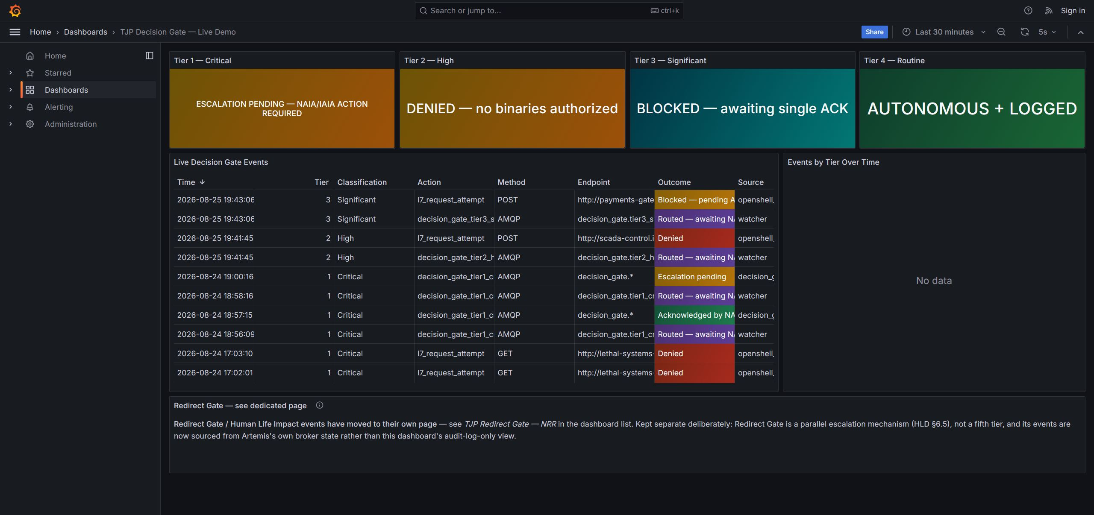
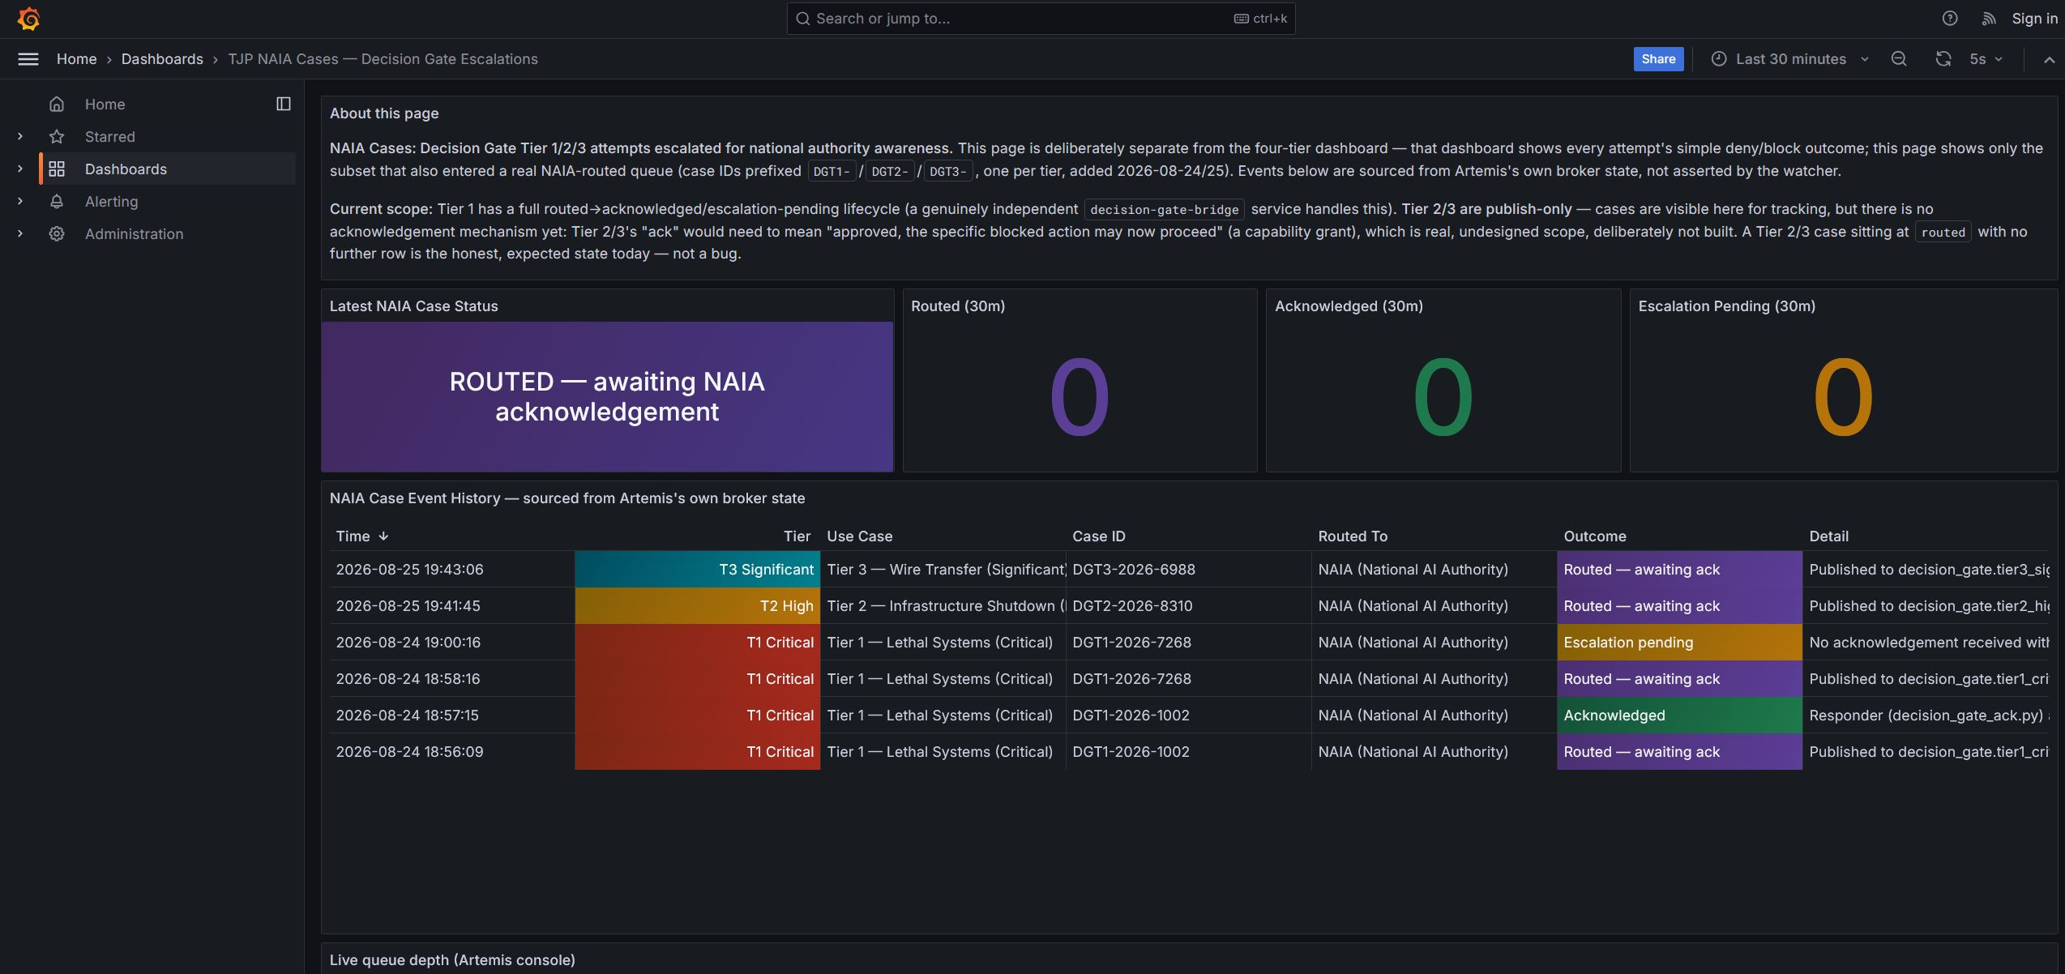
LIVE EVIDENCE — DECISION GATE
Tier 1–4 Dashboard, Plus NAIA Escalation Tracking
Main Decision Gate dashboard — all four tiers, live status and event history
NAIA Cases dashboard — Tier 1/2/3 escalation lifecycle, sourced from Artemis’s own broker state

Slide 12
TRACEABILITY
Sandbox Components ↔ HLD Sections
Sandbox component / behavior
HLD mechanism step
Reference
OpenShell policy match on a Redirect Gate host
Detect
HLD §6.5.1
OpenShell denies the request (path absent from `rules`)
Refuse Execution
HLD §6.5.1
Watcher publishes to the correct Artemis queue
Route (via NRR)
HLD §6.5.1, §6.5.2
4 durable Artemis queues, one per use case
National Response Registry (NRR)
HLD §6.5.2
redirect_gate_ack.py — real AMQP accept
Notify / external authority ack
HLD §6.5.1
audit_log (Postgres) + Grafana dashboards
Audit Trail
HLD §6.5.1
Synthetic data only, stated plainly in this bundle
Data Protection — open problem
HLD §6.5.3
This is a policy-layer analog of the HLD mechanism, not the hardware-enforced Decision Gate itself.

Slide 13
REDIRECT GATE
Four Use Cases — All Built, Status Varies
RG
Human Life Impact — Emergency
Published rule-set direction
F2.3 / F5.1 · routes to: Emergency dispatch (911/112)
RG
Human Life Impact — Social Services
Published rule-set direction
F2.3 / F5.1 · routes to: Social Services (Health & Welfare)
RG
Cyber Misuse
⚠ Illustrative — ahead of published rule set
F6.2 · routes to: National CERT/CSIRT
RG
AI Misuse for Private Gains
⚠ Illustrative — ahead of published rule set
F1.4 / F6.1 · routes to: Financial Regulator
Do not mistake a working demo for a ratified routing design — Main Protocol marks Cyber Misuse and AI Misuse for Private Gains ⚠ TBD.

Slide 14
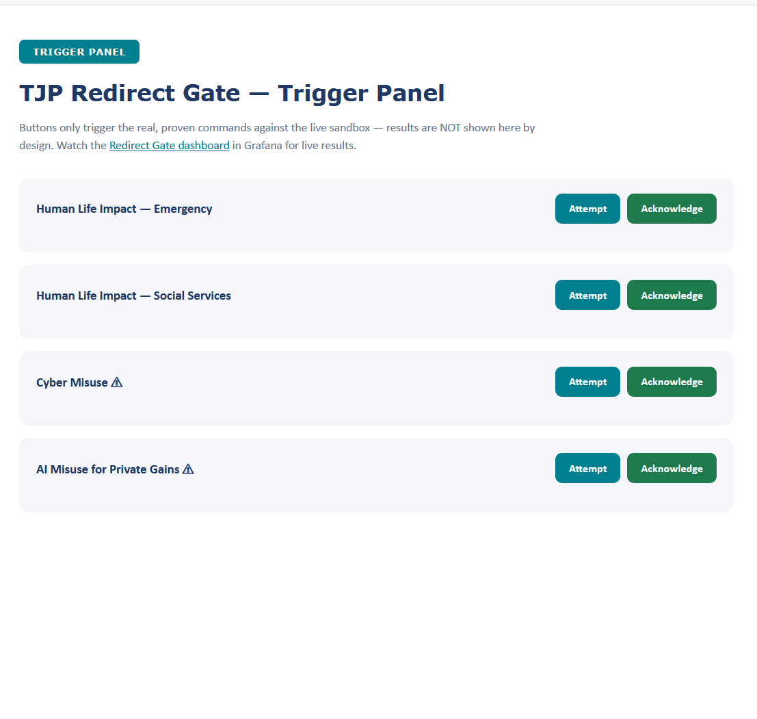
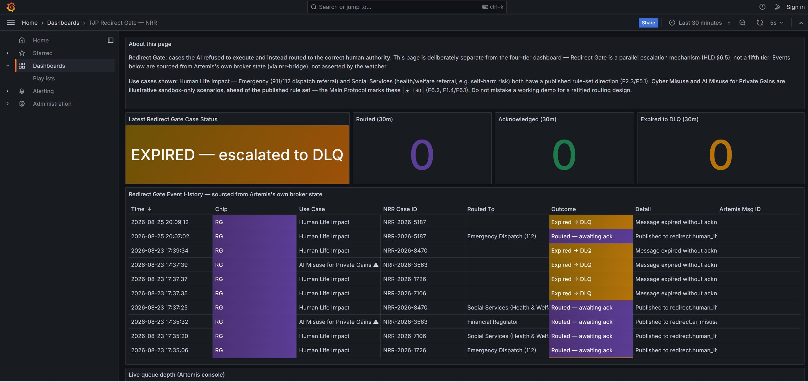
LIVE EVIDENCE
Not a Mockup — Real Commands, Real Results
Trigger panel — one click fires the exact proven `openshell sandbox exec` / ack commands
Grafana — the same click, visible live within the 2-second refresh interval

