Slide 1

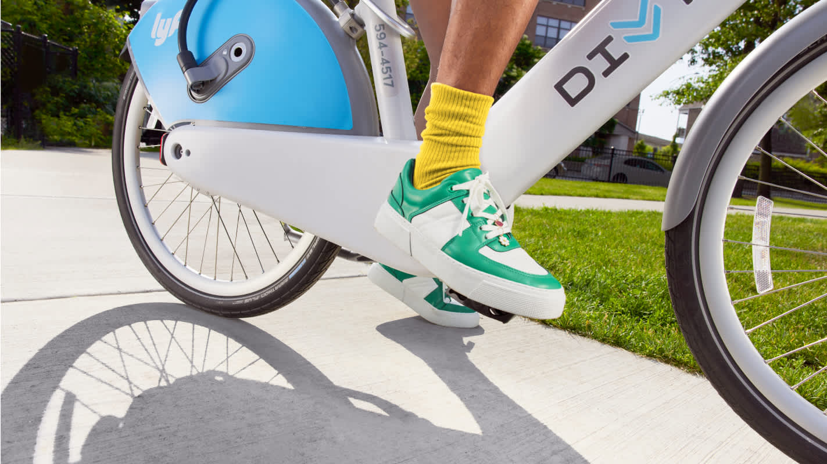

Slide 2
About Cyclistic
Cyclistic is an imaginary bike-sharing company. My assignment is to work as a data analyst on the marketing team to provide information of differences between casual riders and annual riders for the marketing team to come up with new strategy to increase annual members.
Cyclist is a virtual company, but the data I am dealing with comes from real-world company called 'Divvy,' which is based in Chicago.
Goal
-Understand how casual riders and annual members use Cyclistic bikes differently so it could help marketing team to maximalize the number of annual memberships.
Key stakeholders
-Cyclistic executive team
-Lily Moreno: Director of Marketing
Notes:
Cyclistic is an imaginary bike-sharing company. My assignment is to work as a data analyst on the marketing team to provide information of differences between casual riders and annual riders for marketing team to come up with new strategy to increase annual members.
Cyclist is a virtual company, but the data I am dealing with comes from real-world company called 'Divvy,' which is based in Chicago.

Slide 3

I used R studio to analyse the data to bring out the insight.
The library I used were tidyverse and lubridate.
Notes:
First, I installed the package “readr” to get the file from my computer. Because they were big 12 files from 202309 to 202408, I decided to use R and load all of them. Here is the code I use to do that.

Slide 4

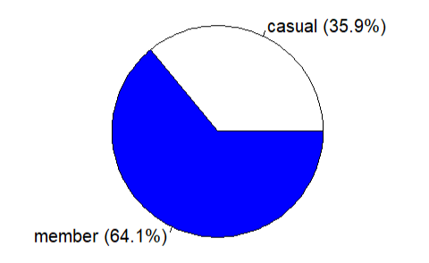

Data: 2023.09~2024.08
(12 mois)
total riders
:5698376
This analysis is based on 12 months of data, from September 2023 to August 2024. During this period, there were about 5.7 million rides in total. Among them, 64.1% were by annual members, and 35.9% were by casual riders. Specifically, there were about 2 million rides by casual users and 3.6 million rides by members. This large volume of data ensures that our analysis is robust and representative.
Total casual riders
:2038986
total member riders
:3651457

Slide 5
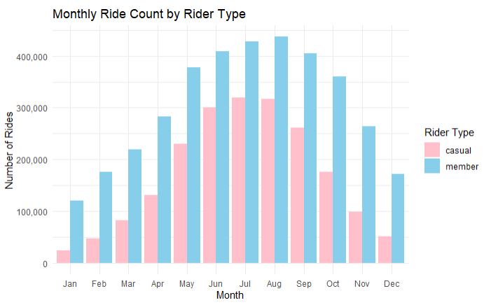
Month differences (casual and annual member)
Casual riders show strong seasonality, peaking during summer months (June–August), indicating that they likely use bikes for leisure or tourism.
Members ride consistently throughout the year, though they also peak in summer, suggesting that there are some seasonal influence.
Insight: Seasonal promotions or tourist-targeted marketing could attract more casual users to subscribe during summer we can offer this and maybe a promotion if they were a seasonal member last year, then they will be more likely to comeback every summer.

Slide 6
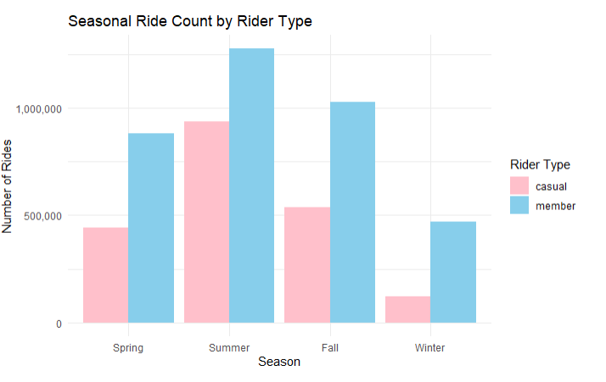
Seasonal differences (casual and annual member)
Summer is the peak season for both user types, but casual riders are significantly more active in summer than other seasons.
Members maintain usage in spring and fall, and a significant number ride in winter.
Insight: During winter and spring, we see a significant drop in ridership. I believe that in these tougher seasons, people may need more than just discounts to stay motivated. my recommendation is to create a campaign called 'Eco-Protector’. Riders can be recognized and rewarded, adding emotional and social value beyond financial incentives. To strengthen motivation, company can also offer a visible badge or a certification that riders can proudly showcase. This could also generate advertising benefits, as people may share their badges on their social media platforms." This approach encourages greater participation even in challenging weather conditions."

Slide 7
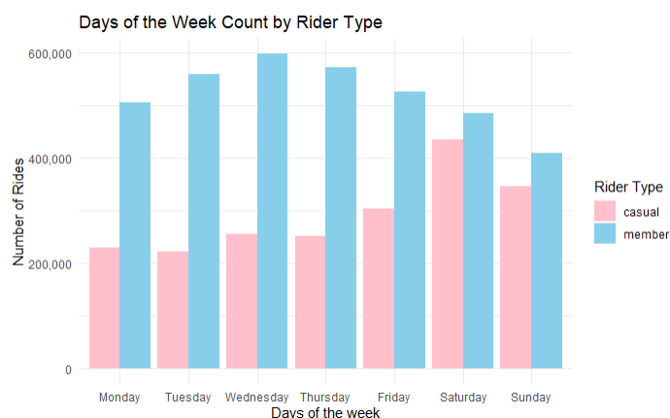
Day differences (casual and annual member)
Casual riders ride more on weekends, especially Saturdays and Sundays, confirming their preference for recreational use.
Members ride more evenly across all days, with higher usage on weekdays, likely due to commuting.
Insight: Data shows that casual riders mainly ride on weekends. To encourage weekday usage, I recommend a 'Ride 2 Weekends, Get 1 Weekday Free' promotion, similar to the familiar 2+1 supermarket deals. This incentive would lower the barrier for casual riders to try biking on weekdays. A positive experience during a weekday could motivate them to incorporate biking into their daily routines, ultimately increasing overall ridership

Slide 8
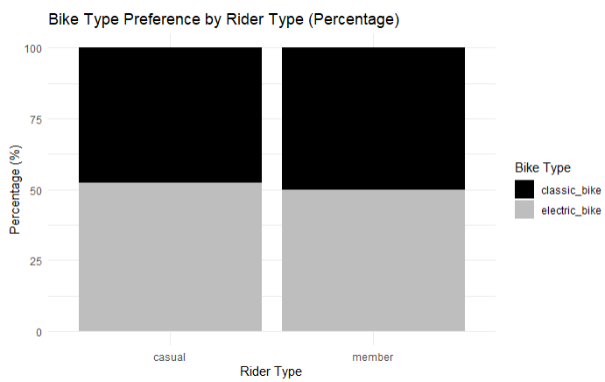
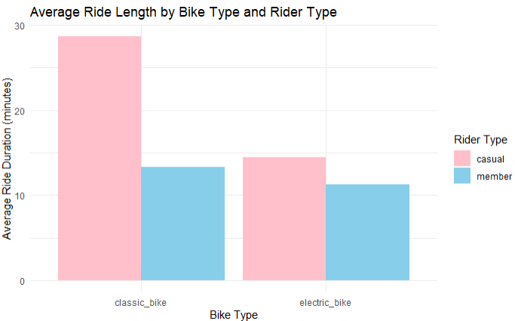
Bike type difference (casual and annual member)
Casual riders use electric bikes slightly more than classic bikes suggesting they may prefer easier, more comfortable rides.
Members show a more balanced preference, using both types extensively.
Insight: Offer electric bike upgrades to casual riders could attract them to become a member and commute in bike.

Slide 9
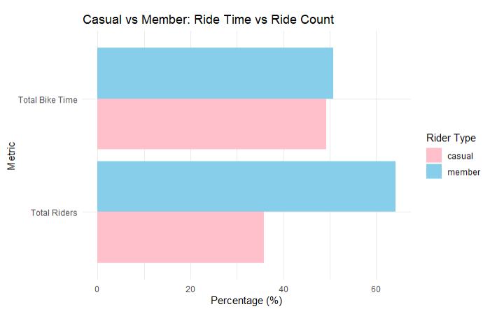
Rider Length difference (casual and annual member)
Casual riders collectively ride longer than members, despite having fewer rides. This suggests longer, more leisurely trips.
The data suggests that casual riders view biking as a leisure or tourism activity rather than a means of daily transportation. This opens opportunities to design longer-ride promotions, seasonal memberships, and experience-focused marketing campaigns to better meet their needs and convert them into loyal customers

Slide 10
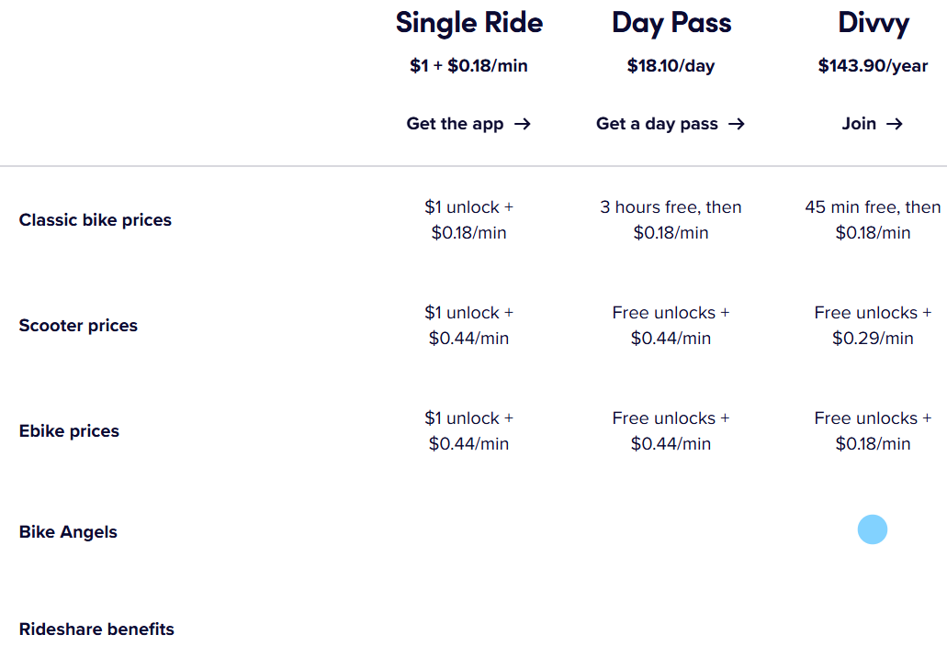
Data limitations
First of all, I would like to mention that access to more detailed data could have enabled a deeper and more refined analysis. Due to data privacy policies, it was not possible to distinguish between single-ride users and day-pass users. The dataset only categorized riders into 'members' and 'casual riders,' and included data only related to bike usage, excluding other options like scooters. Therefore, some potential insights related to different pricing plans or vehicle types could not be explored.

Slide 11
Conclusion
Key Strategic Proposals Based on Data Analysis
Ride More and Save More (Slide 5)
Encourage frequent riding with cost-saving promotions.
Launch "Eco-Protector" Campaign (Slide 6)
Motivate riders during cold seasons by promoting environmental values, not just discounts.
2+1 Rider Promotion (Slide 7)
Offer weekday incentives to weekend riders to increase weekday usage.

