Slide 1
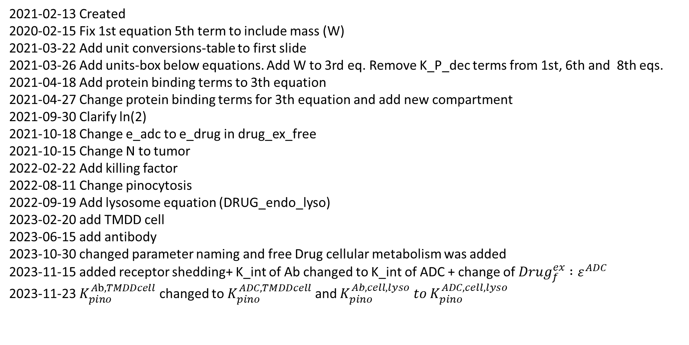
Logistic PK PD equations explained (ADC In-Vivo: Cytosol Effect: Cytotoxic)
2021-02-13 Created
2020-02-15 Fix 1st equation 5th term to include mass (W) 2021-03-22 Add unit conversions-table to first slide
2021-03-26 Add units-box below equations. Add W to 3rd eq. Remove K_P_dec terms from 1st, 6th and 8th eqs.
2021-04-18 Add protein binding terms to 3th equation
2021-04-27 Change protein binding terms for 3th equation and add new compartment
2021-09-30 Clarify ln(2)
2021-10-18 Change e_adc to e_drug in drug_ex_free
2021-10-15 Change N to tumor
2022-02-22 Add killing factor
2022-08-11 Change pinocytosis
2022-09-19 Add lysosome equation (DRUG_endo_lyso) 2023-02-20 add TMDD cell
2023-06-15 add antibody
2023-10-30 changed parameter naming and free Drug cellular metabolism was added
2023-11-15 added receptor shedding+ K_int of Ab changed to K_int of ADC + change of ${Drug}_{f}^{ex} :ε^{ADC }$ 2023-11-23 $K_{pino}^{Ab, TMDDcell}$ changed to $K_{pino}^{ADC, TMDDcell}$ and ${K_{pino}^{Ab,cell,lyso} to K}_{pino}^{ADC,cell,lyso}$
Notes:
No pinocytosis of shedded antigen bound to adc or Ab included + V_C1_Ag is used: no difference between V_C1_AG_f and _b
+ Non-specific deconjugation from ADC bound to shedded Ag and free drug caused by the clearance of ADC bound to shedded Ag is not yet included in the model to make it less complicated: The parameter Ag_b containes both (shedded) antigen bound to ADC and (shedded) antigen bound to mAb (non-specific decon. of free drug and free durg by clearance would only occur from the Ag_b-ADC species, which is not separately)
Pinocytosis and internalization of ADC and Ab is assumed to be not different between ADC and Ab.

Slide 2
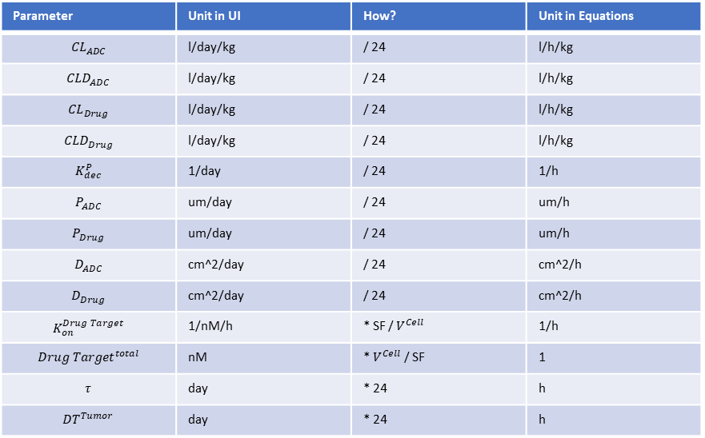
Logistic PK PD equations explained (ADC In-Vivo: Cytosol Effect: Cytotoxic)
2023-12-13 Linear tumor growth
Parameter | Unit in UI | How? | Unit in Equations
$${CL}_{ADC}$$ | l/day/kg | / 24 | l/h/kg
$${CLD}_{ADC}$$ | l/day/kg | / 24 | l/h/kg
$${CL}_{Drug}$$ | l/day/kg | / 24 | l/h/kg
$${CLD}_{Drug}$$ | l/day/kg | / 24 | l/h/kg
$$K_{dec}^{P}$$ | 1/day | / 24 | 1/h
$$P_{ADC}$$ | um/day | / 24 | um/h
$$P_{Drug}$$ | um/day | / 24 | um/h
$$D_{ADC}$$ | cm^2/day | / 24 | cm^2/h
$$D_{Drug}$$ | cm^2/day | / 24 | cm^2/h
$$K_{on}^{Drug Target}$$ | 1/nM/h | * SF / $V^{Cell}$ | 1/h
$${Drug Target}^{total}$$ | nM | * $V^{Cell}$ / SF | 1
$$τ$$ | day | * 24 | h
$${DT}^{Tumor}$$ | day | * 24 | h

Slide 3
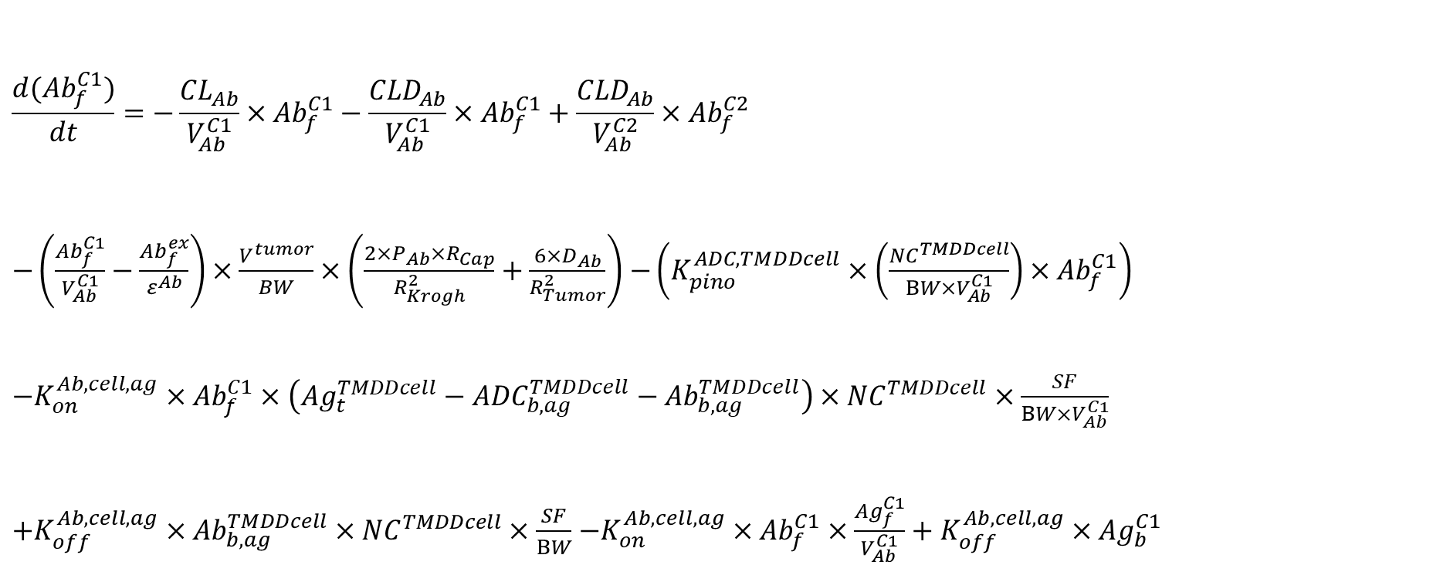
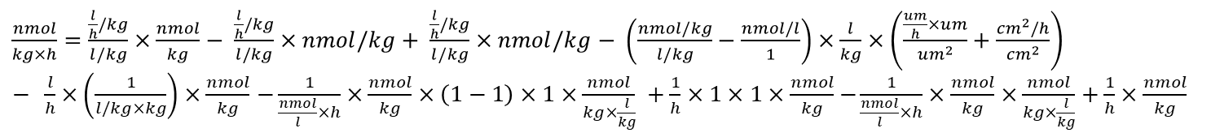
Amount of Antibody (nmol/kg) in central compartment
$$\frac{d({Ab}_{f}^{C1})}{dt}=−\frac{{CL}_{Ab}}{V_{Ab}^{C1}}×{Ab}_{f}^{C1}−\frac{{CLD}_{Ab}}{V_{Ab}^{C1}}×{Ab}_{f}^{C1}+\frac{{CLD}_{Ab}}{V_{Ab}^{C2}}×{Ab}_{f}^{C2}$$ $−\left(\frac{{Ab}_{f}^{C1}}{V_{Ab}^{C1}}−\frac{{Ab}_{f}^{ex}}{ε^{Ab}}\right)×\frac{V^{tumor}}{BW}×\left(\frac{2×P_{Ab}×R_{Cap}}{R_{Krogh}^{2}}+\frac{6×D_{Ab}}{R_{Tumor}^{2}}\right)$ $−\left(K_{pino}^{ADC, TMDDcell}×\left(\frac{{NC}^{TMDDcell}}{BW×V_{Ab}^{C1}}\right)×{Ab}_{f}^{C1}\right)$ $−K_{on}^{Ab,cell,ag}×{Ab}_{f}^{C1}×\left({Ag}_{t}^{TMDDcell}−{ADC}_{b,ag}^{TMDDcell}−{Ab}_{b,ag}^{TMDDcell}\right)×{NC}^{TMDDcell}×\frac{SF}{BW×V_{Ab}^{C1}}$ $+K_{off}^{Ab,cell,ag}×{Ab}_{b,ag}^{TMDDcell}×{NC}^{TMDDcell}×\frac{SF}{BW}$ $−K_{on}^{Ab,cell,ag}×{Ab}_{f}^{C1}×\frac{{Ag}_{f}^{C1}}{V_{Ab}^{C1}}+K_{off}^{Ab,cell,ag}×{Ag}_{b}^{C1}$
To clearance of Ab
From peripheral space
To peripheral space
To tumor extracellular space
To pinocytosis into cells without effect
To binding to receptor of cells without effect
From binding to receptor of cells without effect
To binding to shedded receptor
From unbinding of shedded receptor in C1
Units:
$\frac{nmol}{kg×h}=\frac{\frac{l}{h}/kg}{l/kg}×\frac{nmol}{kg}− \frac{\frac{l}{h}/kg}{l/kg}×nmol/kg+ \frac{\frac{l}{h}/kg}{l/kg}×nmol/kg− \left(\frac{nmol/kg}{l/kg}−\frac{nmol/l}{1}\right)×\frac{l}{kg}×\left(\frac{\frac{um}{h}×um}{{um}^{2}}+\frac{{cm}^{2}/h}{{cm}^{2}}\right)$ $− \frac{l}{h}×\left(\frac{1}{l/kg×kg}\right)×\frac{nmol}{kg}$ $−\frac{1}{\frac{nmol}{l}×h}×\frac{nmol}{kg}×\left(1−1\right)×1×\frac{nmol}{kg×\frac{l}{kg}} +\frac{1}{h}×1×1×\frac{nmol}{kg}$ $−\frac{1}{\frac{nmol}{l}×h}×\frac{nmol}{kg}×\frac{nmol}{kg×\frac{l}{kg}}+\frac{1}{h}×\frac{nmol}{kg}$

Slide 4
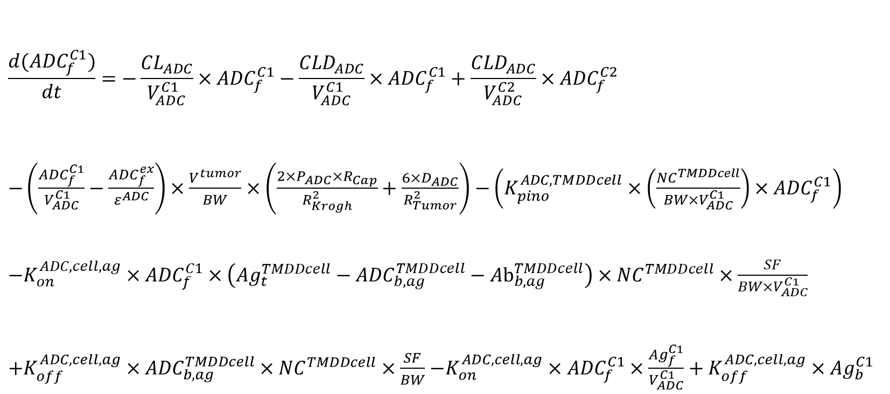
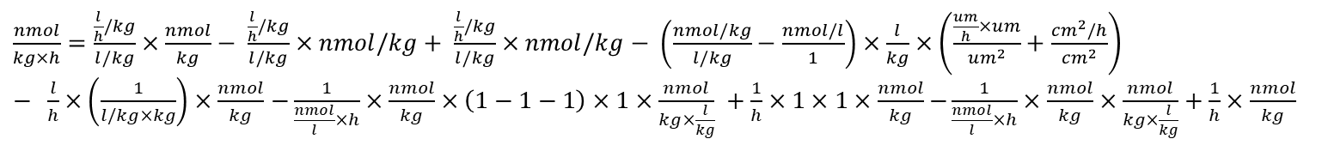
Amount of ADC (nmol/kg) in central compartment
$$\frac{d({ADC}_{f}^{C1})}{dt}=−\frac{{CL}_{ADC}}{V_{ADC}^{C1}}×{ADC}_{f}^{C1}−\frac{{CLD}_{ADC}}{V_{ADC}^{C1}}×{ADC}_{f}^{C1}+\frac{{CLD}_{ADC}}{V_{ADC}^{C2}}×{ADC}_{f}^{C2}$$ $−\left(\frac{{ADC}_{f}^{C1}}{V_{ADC}^{C1}}−\frac{{ADC}_{f}^{ex}}{ε^{ADC}}\right)×\frac{V^{tumor}}{BW}×\left(\frac{2×P_{ADC}×R_{Cap}}{R_{Krogh}^{2}}+\frac{6×D_{ADC}}{R_{Tumor}^{2}}\right)$ $−\left(K_{pino}^{ADC, TMDDcell}×\left(\frac{{NC}^{TMDDcell}}{BW×V_{ADC}^{C1}}\right)×{ADC}_{f}^{C1}\right)$ $−K_{on}^{ADC,cell,ag}×{ADC}_{f}^{C1}×\left({Ag}_{t}^{TMDDcell}−{ADC}_{b,ag}^{TMDDcell}−{Ab}_{b,ag}^{TMDDcell}\right)×{NC}^{TMDDcell}×\frac{SF}{BW×V_{ADC}^{C1}}$ $+K_{off}^{ADC,cell,ag}×{ADC}_{b,ag}^{TMDDcell}×{NC}^{TMDDcell}×\frac{SF}{BW}$ $−K_{on}^{ADC,cell,ag}×{ADC}_{f}^{C1}×\frac{{Ag}_{f}^{C1}}{V_{ADC}^{C1}}+K_{off}^{ADC,cell,ag}×{Ag}_{b}^{C1}$
To clearance of ADC
To peripheral space
From peripheral space
To tumor extracellular space
To pinocytosis into cells without effect
To binding to receptor of cells without effect
From binding to receptor of cells without effect
From unbinding of shedded receptor in C1
To binding to shedded receptor
Units:
$\frac{nmol}{kg×h}=\frac{\frac{l}{h}/kg}{l/kg}×\frac{nmol}{kg}− \frac{\frac{l}{h}/kg}{l/kg}×nmol/kg+ \frac{\frac{l}{h}/kg}{l/kg}×nmol/kg− \left(\frac{nmol/kg}{l/kg}−\frac{nmol/l}{1}\right)×\frac{l}{kg}×\left(\frac{\frac{um}{h}×um}{{um}^{2}}+\frac{{cm}^{2}/h}{{cm}^{2}}\right)$ $− \frac{l}{h}×\left(\frac{1}{l/kg×kg}\right)×\frac{nmol}{kg}$ $−\frac{1}{\frac{nmol}{l}×h}×\frac{nmol}{kg}×\left(1−1−1\right)×1×\frac{nmol}{kg×\frac{l}{kg}} +\frac{1}{h}×1×1×\frac{nmol}{kg}$ $−\frac{1}{\frac{nmol}{l}×h}×\frac{nmol}{kg}×\frac{nmol}{kg×\frac{l}{kg}}+\frac{1}{h}×\frac{nmol}{kg}$

Slide 5
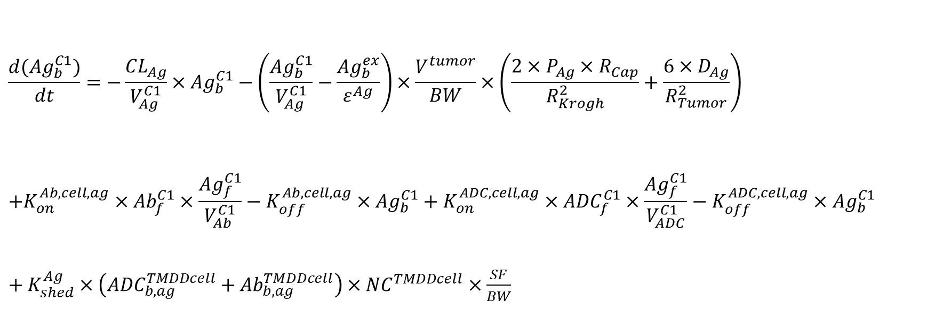
Amount of shedded receptor (nmol/kg) bound to ADC/mAb in central compartment
${only info not for the code:Ag}_{b}^{C1}$ ${=Ab}_{b,ag}^{C1}+{ADC}_{b,ag}^{C1}$
$$\frac{d({Ag}_{b}^{C1})}{dt}=−\frac{{CL}_{Ag}}{V_{Ag}^{C1}}×{Ag}_{b}^{C1}−\left(\frac{{Ag}_{b}^{C1}}{V_{Ag}^{C1}}−\frac{{Ag}_{b}^{ex}}{ε^{Ag}}\right)×\frac{V^{tumor}}{BW}×\left(\frac{2×P_{Ag}×R_{Cap}}{R_{Krogh}^{2}}+\frac{6×D_{Ag}}{R_{Tumor}^{2}}\right) \\ +K_{on}^{Ab,cell,ag}×{Ab}_{f}^{C1}×\frac{{Ag}_{f}^{C1}}{V_{Ab}^{C1}}−K_{off}^{Ab,cell,ag}×{Ag}_{b}^{C1}+K_{on}^{ADC,cell,ag}×{ADC}_{f}^{C1}×\frac{{Ag}_{f}^{C1}}{V_{ADC}^{C1}}−K_{off}^{ADC,cell,ag}×{Ag}_{b}^{C1}$$ ${+ K}_{shed}^{Ag}×\left({ADC}_{b,ag}^{TMDDcell}+{Ab}_{b,ag}^{TMDDcell}\right)×{NC}^{TMDDcell}$ $×\frac{SF}{BW}$
To clearance of bound shedded receptor
To tumor extracellular space
From binding to shedded receptor (Ab)
To unbinding of shedded receptor (Ab)
From binding to shedded receptor (ADC)
To unbinding of shedded receptor (ADC)
From shedding antigen bound to antibody and ADC of TMDD cell
Units:
$\frac{nmol}{kg×h}=\frac{\frac{l}{h}/kg}{l/kg}×\frac{nmol}{kg}− \left(\frac{nmol/kg}{l/kg}−\frac{nmol/l}{1}\right)×\frac{l}{kg}×\left(\frac{\frac{um}{h}×um}{{um}^{2}}+\frac{{cm}^{2}/h}{{cm}^{2}}\right)$ $+\frac{1}{\frac{nmol}{l}×h}×\frac{nmol}{kg}×\frac{nmol}{kg×\frac{l}{kg}}−\frac{1}{h}×\frac{nmol}{kg}+\frac{1}{\frac{nmol}{l}×h}×\frac{nmol}{kg}×\frac{nmol}{kg}×\frac{nmol}{kg×\frac{l}{kg}}−\frac{1}{h}×\frac{nmol}{kg}$ $$+\frac{1}{h}×(1+1)×1\frac{nmol}{kg}$$
Notes:
V_C1_Ag is used: no difference between V_C1_AG_f and _b

Slide 6
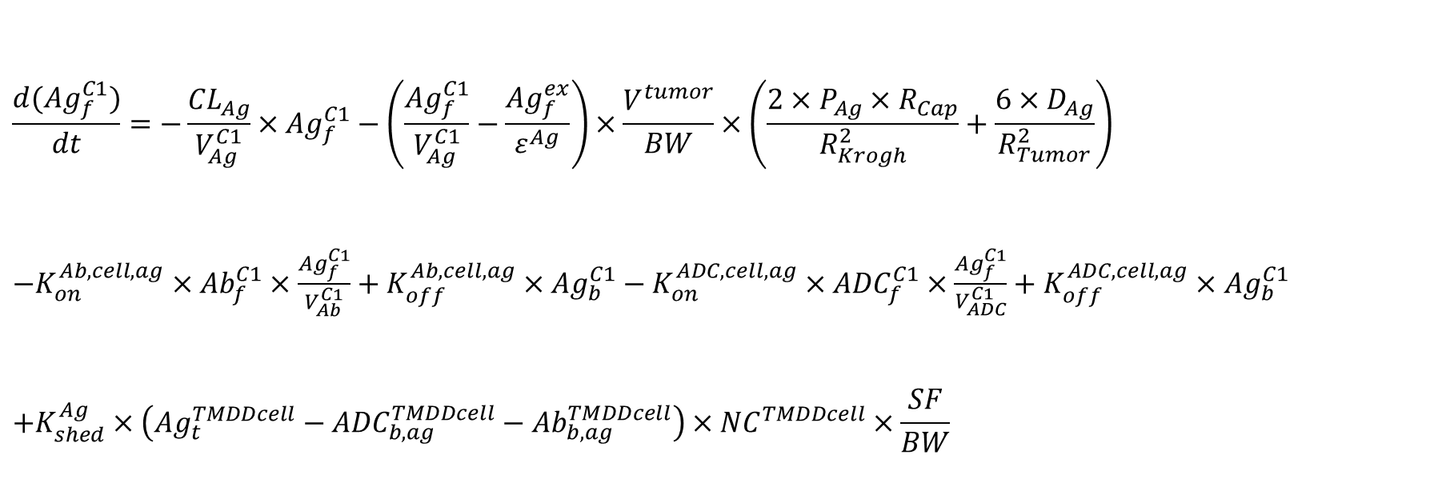
Amount of shedded receptor (nmol/kg) free in central compartment
$$\frac{d({Ag}_{f}^{C1})}{dt}=−\frac{{CL}_{Ag}}{V_{Ag}^{C1}}×{Ag}_{f}^{C1}−\left(\frac{{Ag}_{f}^{C1}}{V_{Ag}^{C1}}−\frac{{Ag}_{f}^{ex}}{ε^{Ag}}\right)×\frac{V^{tumor}}{BW}×\left(\frac{2×P_{Ag}×R_{Cap}}{R_{Krogh}^{2}}+\frac{6×D_{Ag}}{R_{Tumor}^{2}}\right)$$ $−K_{on}^{Ab,cell,ag}×{Ab}_{f}^{C1}×\frac{{Ag}_{f}^{C1}}{V_{Ab}^{C1}}+K_{off}^{Ab,cell,ag}×{Ag}_{b}^{C1}−K_{on}^{ADC,cell,ag}×{ADC}_{f}^{C1}×\frac{{Ag}_{f}^{C1}}{V_{ADC}^{C1}}+K_{off}^{ADC,cell,ag}×{Ag}_{b}^{C1}$ $$+K_{shed}^{Ag}×\left({Ag}_{t}^{TMDDcell}−{ADC}_{b,ag}^{TMDDcell}−{Ab}_{b,ag}^{TMDDcell}\right)×{NC}^{TMDDcell}×\frac{SF}{BW}$$
To clearance of free shedded antigen
To tumor extracellular space
From unbinding of shedded receptor (Ab)
To binding to shedded receptor (ADC)
From unbinding of shedded receptor (ADC)
From shedding free antigen of TMDD cell
Units:
$\frac{nmol}{kg×h}=\frac{\frac{l}{h}/kg}{l/kg}×\frac{nmol}{kg}− \left(\frac{nmol/kg}{l/kg}−\frac{nmol/l}{1}\right)×\frac{l}{kg}×\left(\frac{\frac{um}{h}×um}{{um}^{2}}+\frac{{cm}^{2}/h}{{cm}^{2}}\right)$ $−\frac{1}{\frac{nmol}{l}×h}×\frac{nmol}{kg}×\frac{nmol}{kg×\frac{l}{kg}}+\frac{1}{h}×\frac{nmol}{kg}−\frac{1}{\frac{nmol}{l}×h}×\frac{nmol}{kg}×\frac{nmol}{kg×\frac{l}{kg}}+\frac{1}{h}×\frac{nmol}{kg}$ $$+\frac{1}{h}×(1−1−1)×1\frac{nmol}{kg}$$
Notes:
V_C1_Ag is used: no difference between V_C1_AG_f and _b

Slide 7



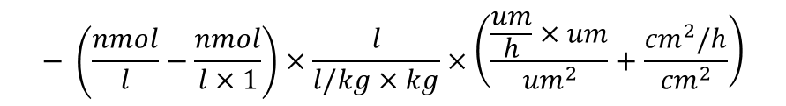



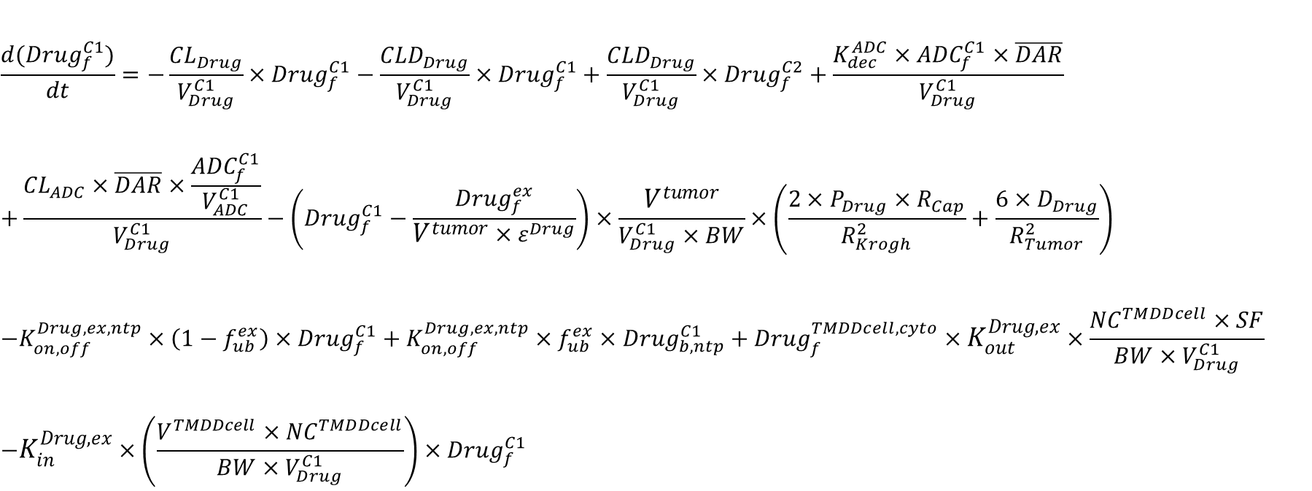

Concentration of drug (nM) in central compartment
$$\frac{d({Drug}_{f}^{C1})}{dt}=−\frac{{CL}_{Drug}}{V_{Drug}^{C1}}×{Drug}_{f}^{C1}−\frac{{CLD}_{Drug}}{V_{Drug}^{C1}}×{Drug}_{f}^{C1}+\frac{{CLD}_{Drug}}{V_{Drug}^{C1}}×{Drug}_{f}^{C2}+\frac{K_{dec}^{ADC}×{ADC}_{f}^{C1}×\overline{DAR}}{V_{Drug}^{C1}} \\ +\frac{{CL}_{ADC}×\overline{DAR}×\frac{{ADC}_{f}^{C1}}{V_{ADC}^{C1}}}{V_{Drug}^{C1}}−\left({Drug}_{f}^{C1}−\frac{{Drug}_{f}^{ex}}{{V^{tumor}×ε}^{Drug}}\right)×\frac{V^{tumor}}{V_{Drug}^{C1}×BW}×\left(\frac{2×P_{Drug}×R_{Cap}}{R_{Krogh}^{2}}+\frac{6×D_{Drug}}{R_{Tumor}^{2}}\right) \\ −K_{on,off}^{Drug,ex,ntp}×\left(1−f_{ub}^{ex}\right)×{Drug}_{f}^{C1}+K_{on,off}^{Drug,ex,ntp}×f_{ub}^{ex}×{Drug}_{b, ntp}^{C1}+{Drug}_{f}^{TMDDcell,cyto}×K_{out}^{Drug,ex}×\frac{{NC}^{TMDDcell}×SF}{BW×V_{Drug}^{C1}} \\ −K_{in}^{Drug,ex}×\left(\frac{V^{TMDDcell}×{NC}^{TMDDcell}}{BW×V_{Drug}^{C1}}\right)×{Drug}_{f}^{C1}$$
To clearance of drug
To peripheral space
From peripheral space
From non-specific deconjugation of ADC
From clearance of ADC
To tumor extracellular space
To and from protein binding
From efflux from cells without effect
To influx into cells without effect
$$−\frac{\frac{l}{h}/kg}{l/kg}×\frac{nmol}{l}$$
$$−\frac{\frac{l}{h}/kg}{l/kg}×\frac{nmol}{l}$$
$$+\frac{\frac{l}{h}/kg}{l/kg}×\frac{nmol}{l}$$
$$+\frac{\frac{1}{h}×\frac{nmol}{kg}×1}{l/kg}$$
$$+\frac{\frac{l}{h}/kg×1×\frac{nmol/kg}{l/kg}}{l/kg}$$
Units:
$$\frac{nmol}{l×h}=$$
$$− \left(\frac{nmol}{l}−\frac{nmol}{l×1}\right)×\frac{l}{l/kg×kg}×\left(\frac{\frac{um}{h}×um}{{um}^{2}}+\frac{{cm}^{2}/h}{{cm}^{2}}\right)$$
$−\frac{1}{h}×\frac{nmol}{l}+\frac{1}{h}×1×\frac{nmol}{l}$ $+\frac{1}{h}×1×\frac{1×nmol}{kg×\frac{l}{kg}}−\frac{1}{h}×\frac{l×1}{kg×\frac{l}{kg}}×\frac{nmol}{l}$
Notes:
Non-specific deconjugation from ADC bound to shedded Ag and free drug caused by the clearance of ADC bound to shedded Ag is not yet included in the model to make it less complicated: The parameter Ag_b containes both (shedded) antigen bound to ADC and (shedded) antigen bound to mAb (non-specific decon. of free drug and free durg by clearance would only occur from the Ag_b-ADC species, which is not separately)

Slide 8
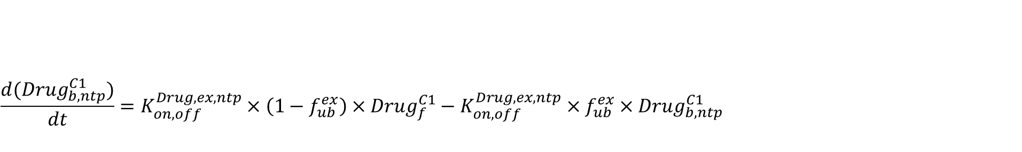
Concentration (nM) of drug bound to unspecific protein in central compartment/plasma
$$\frac{d({Drug}_{b,ntp}^{C1})}{dt}=K_{on,off}^{Drug,ex,ntp}×\left(1−f_{ub}^{ex}\right)×{Drug}_{f}^{C1}−K_{on,off}^{Drug,ex,ntp}×f_{ub}^{ex}×{Drug}_{b, ntp}^{C1}$$
To unspecific protein binding
To unspecific protein unbinding
Units:
$$\frac{nmol}{l×h}=\frac{1}{h}×1×\frac{nmol}{l}−\frac{1}{h}×1×\frac{nmol}{l}$$

Slide 9
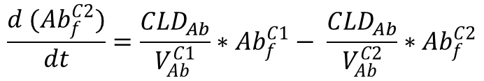



Amount of Antibody (nmol/kg) in peripheral compartment
$$\frac{d ({Ab}_{f}^{C2})}{dt}=\frac{{CLD}_{Ab}}{V_{Ab}^{C1}}∗{Ab}_{f}^{C1}− \frac{{CLD}_{Ab}}{V_{Ab}^{C2}}∗{Ab}_{f}^{C2}$$
From central space
To central space
Units:
$$\frac{nmol}{kg×h}=$$
$$\frac{\frac{l}{h}/kg}{l/kg}×\frac{nmol}{kg}$$
$$− \frac{\frac{l}{h}/kg}{l/kg}×nmol/kg$$

Slide 10
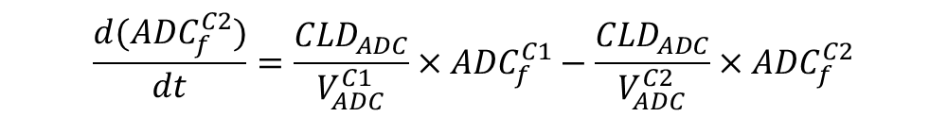
Amount of ADC (nmol/kg) in peripheral compartment
$$\frac{d({ADC}_{f}^{C2})}{dt}=\frac{{CLD}_{ADC}}{V_{ADC}^{C1}}×{ADC}_{f}^{C1}−\frac{{CLD}_{ADC}}{V_{ADC}^{C2}}×{ADC}_{f}^{C2}$$
From central space
To central space
Units:
$$\frac{nmol}{kg×h}=$$
$$\frac{\frac{l}{h}/kg}{l/kg}×\frac{nmol}{kg}$$
$$− \frac{\frac{l}{h}/kg}{l/kg}×nmol/kg$$

Slide 11
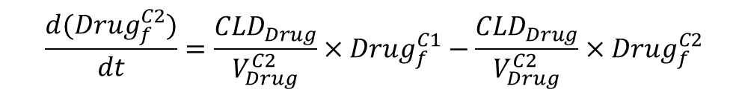



Concentration of drug (nM) in peripheral compartment
$$\frac{d({Drug}_{f}^{C2})}{dt}=\frac{{CLD}_{Drug}}{V_{Drug}^{C2}}×{Drug}_{f}^{C1}−\frac{{CLD}_{Drug}}{V_{Drug}^{C2}}×{Drug}_{f}^{C2}$$
From central space
To central space
Units:
$$\frac{\frac{l}{h}/kg}{l/kg}×\frac{nmol}{l}$$
$$−\frac{\frac{l}{h}/kg}{l/kg}×\frac{nmol}{l}$$
$$\frac{nmol}{l×h}=$$

Slide 12



Average drug-to-antibody ratio
$$\frac{d(\overline{DAR})}{dt}=−K_{dec}^{ADC}×\overline{DAR}$$
Due to non-specific deconjugation of ADC
Units:
$$\frac{1}{h}=$$
$$\frac{1}{h}×1$$

Slide 13
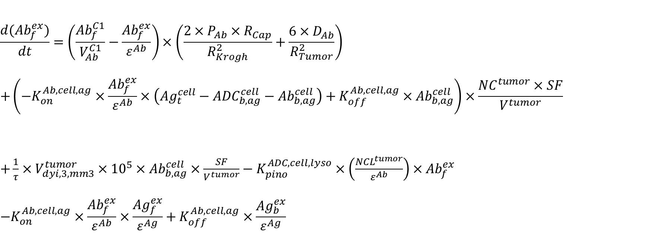
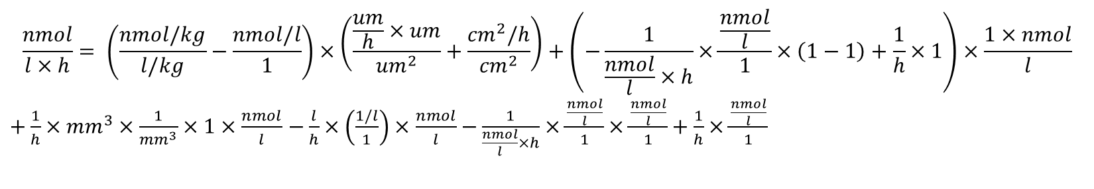
Concentration (nM) of Antibody in media space
$$\frac{d({Ab}_{f}^{ex})}{dt}=\left(\frac{{Ab}_{f}^{C1}}{V_{Ab}^{C1}}−\frac{{Ab}_{f}^{ex}}{ε^{Ab}}\right)×\left(\frac{2×P_{Ab}×R_{Cap}}{R_{Krogh}^{2}}+\frac{6×D_{Ab}}{R_{Tumor}^{2}}\right) \\ +\left(−K_{on}^{Ab,cell,ag}×\frac{{Ab}_{f}^{ex}}{ε^{Ab}}×\left({Ag}_{t}^{cell}−{ADC}_{b,ag}^{cell}−{Ab}_{b,ag}^{cell}\right)+K_{off}^{Ab,cell,ag}×{Ab}_{b,ag}^{cell}\right)×\frac{{NC}^{tumor}×SF}{V^{tumor}}$$ $+\frac{1}{τ}×V_{dyi,3,mm3}^{tumor}×{10}^{5}×{Ab}_{b,ag}^{cell}×\frac{SF}{V^{tumor}}−K_{pino}^{ADC,cell,lyso}×\left(\frac{{NCL}^{tumor}}{ε^{Ab}}\right)×{Ab}_{f}^{ex}$ $${−K}_{on}^{Ab,cell,ag}×\frac{{Ab}_{f}^{ex}}{ε^{Ab}}×\frac{{Ag}_{f}^{ex}}{ε^{Ag}}+K_{off}^{Ab,cell,ag}×\frac{{Ag}_{b}^{ex}}{ε^{Ag}}$$
From central space
Binding and unbinding of Ab to receptors (Ag) on tumor cell
From intracellular content of dying cells
To pinocytosis
Binding and unbinding of Ab to shedded receptors
$$\frac{nmol}{l×h}= \left(\frac{nmol/kg}{l/kg}−\frac{nmol/l}{1}\right)×\left(\frac{\frac{um}{h}×um}{{um}^{2}}+\frac{{cm}^{2}/h}{{cm}^{2}}\right)+\left(−\frac{1}{\frac{nmol}{l}×h}×\frac{\frac{nmol}{l}}{1}×\left(1−1\right)+\frac{1}{h}×1\right)×\frac{1×nmol}{l}$$ $+\frac{1}{h}×{mm}^{3}×\frac{1}{{mm}^{3}}×1×\frac{nmol}{l}$ $−\frac{l}{h}×\left(\frac{1/l}{1}\right)×\frac{nmol}{l}$ $−\frac{1}{\frac{nmol}{l}×h}×\frac{\frac{nmol}{l}}{1}×\frac{\frac{nmol}{l}}{1}+\frac{1}{h}×\frac{\frac{nmol}{l}}{1}$
Units:

Slide 14
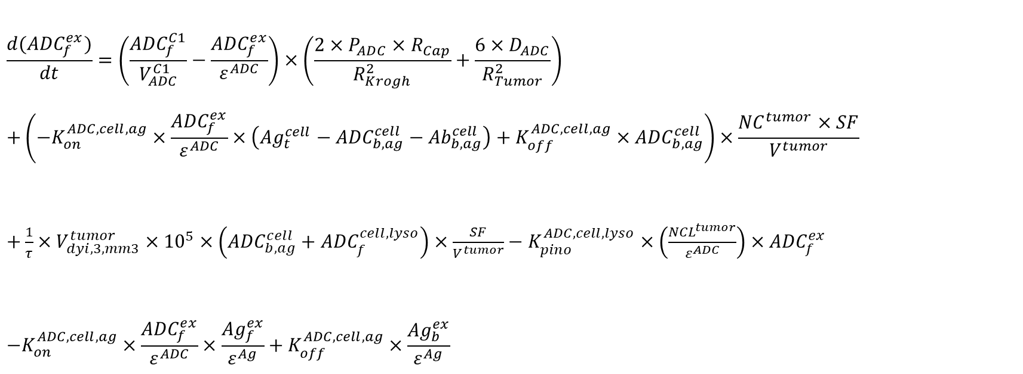
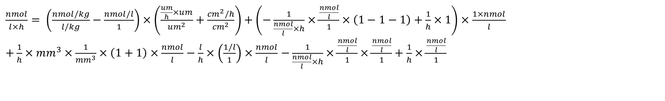
Concentration (nM) of ADC in media space
$$\frac{d({ADC}_{f}^{ex})}{dt}=\left(\frac{{ADC}_{f}^{C1}}{V_{ADC}^{C1}}−\frac{{ADC}_{f}^{ex}}{ε^{ADC}}\right)×\left(\frac{2×P_{ADC}×R_{Cap}}{R_{Krogh}^{2}}+\frac{6×D_{ADC}}{R_{Tumor}^{2}}\right) \\ +\left(−K_{on}^{ADC, cell,ag}×\frac{{ADC}_{f}^{ex}}{ε^{ADC}}×\left({Ag}_{t}^{cell}−{ADC}_{b,ag}^{cell}−{Ab}_{b,ag}^{cell}\right)+K_{off}^{ADC, cell,ag}×{ADC}_{b,ag}^{cell}\right)×\frac{{NC}^{tumor}×SF}{V^{tumor}}$$ $+\frac{1}{τ}×V_{dyi,3,mm3}^{tumor}×{10}^{5}×\left({ADC}_{b,ag}^{cell}+{ADC}_{f}^{cell,lyso}\right)×\frac{SF}{V^{tumor}}−K_{pino}^{ADC,cell,lyso}×\left(\frac{{NCL}^{tumor}}{ε^{ADC}}\right)×{ADC}_{f}^{ex}$
$${−K}_{on}^{ADC,cell,ag}×\frac{{ADC}_{f}^{ex}}{ε^{ADC}}×\frac{{Ag}_{f}^{ex}}{ε^{Ag}}+K_{off}^{ADC,cell,ag}×\frac{{Ag}_{b}^{ex}}{ε^{Ag}}$$
From central space
Binding and unbinding of ADC to receptors on tumor cell
From intracellular content of dying cells
To pinocytosis
Binding and unbinding of ADC to shedded receptor
$\frac{nmol}{l×h}= \left(\frac{nmol/kg}{l/kg}−\frac{nmol/l}{1}\right)×\left(\frac{\frac{um}{h}×um}{{um}^{2}}+\frac{{cm}^{2}/h}{{cm}^{2}}\right)+\left(−\frac{1}{\frac{nmol}{l}×h}×\frac{\frac{nmol}{l}}{1}×\left(1−1−1\right)+\frac{1}{h}×1\right)×\frac{1×nmol}{l}$ $+\frac{1}{h}×{mm}^{3}×\frac{1}{{mm}^{3}}×\left(1+1\right)×\frac{nmol}{l}−\frac{l}{h}×\left(\frac{1/l}{1}\right)×\frac{nmol}{l}$ $−\frac{1}{\frac{nmol}{l}×h}×\frac{\frac{nmol}{l}}{1}×\frac{\frac{nmol}{l}}{1}+\frac{1}{h}×$ $\frac{\frac{nmol}{l}}{1}$
Units:

Slide 15
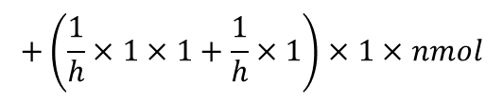


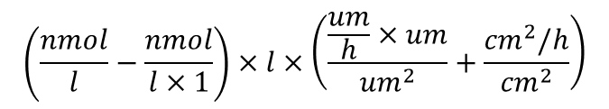


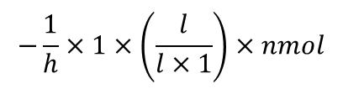
Amount (nmol) of drug in media space
$$\frac{d({Drug}_{f}^{ex})}{dt}=\left({Drug}_{f}^{C1}−\frac{{Drug}_{f}^{ex}}{{V^{tumor}×ε}^{Drug}}\right)×V^{tumor}×\left(\frac{2×P_{Drug}×R_{Cap}}{R_{Krogh}^{2}}+\frac{6×D_{Drug}}{R_{Tumor}^{2}}\right)+K_{dec}^{ADC}×\frac{{ADC}_{f}^{ex}}{ε^{ADC }}×\overline{DAR}×V^{tumor} \\ +\left(K_{dec}^{ADC}×{ADC}_{b,ag}^{cell}×\overline{DAR}+K_{out}^{Drug,ex}×{Drug}_{f}^{cell,cyto}\right)×{NC}^{tumor}×SF \\ −K_{in}^{Drug,ex}×{NC}^{tumor}×\left(\frac{V^{cell}}{{V^{tumor}×ε}^{Drug}}\right)×{Drug}_{f}^{ex}+\frac{1}{τ}×V_{dyi,3,mm3}^{tumor}×{10}^{5}×\left({Drug}_{f}^{cell,cyto}+{Drug}_{b,dt}^{cell,cyto}+{Drug}_{f}^{cell,lyso}\right)×SF$$
From central space
From non-specific deconjugation of ADC
Non-specific deconj. of ADC
Efflux of drug from the cell
From cells
To influx into cells
From intracellular content of dying cells
$$\frac{nmol}{h}=$$
$$\left(\frac{nmol}{l}−\frac{nmol}{l×1}\right)×l×\left(\frac{\frac{um}{h}×um}{{um}^{2}}+\frac{{cm}^{2}/h}{{cm}^{2}}\right)$$
$$+\frac{1}{h}×\frac{nmol}{l}×1×l$$
$$+\left(\frac{1}{h}×1×1+\frac{1}{h}×1\right)×1×nmol$$
Units:
$$−\frac{1}{h}×1×\left(\frac{l}{l×1}\right)×nmol$$
$$+\frac{1}{h}×{mm}^{3}×\frac{1}{{mm}^{3}}×\left(1+1\right)×nmol$$
Notes:
Non-specific deconjugation from ADC bound to shedded Ag is not yet included in the model to make it less complicated: The parameter Ag_b containes both (shedded) antigen bound to ADC and (shedded) antigen bound to mAb (non-specific decon. of free durg would only occur from the Ag_b-ADC species, which is not separately)

Slide 16

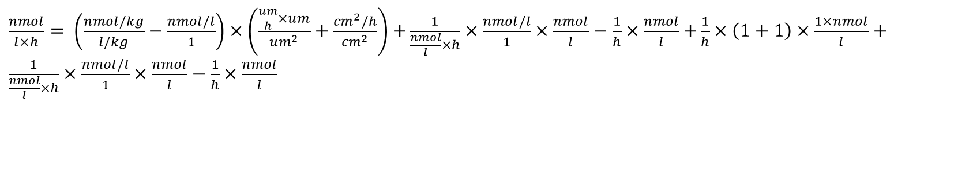
Concentration (nM) of target molecules bound to ADC/mAb in media space
${only info not for the code:Ag}_{b}^{ex}$ ${=Ab}_{b,ag}^{ex}+{ADC}_{b,ag}^{ex}$
$$\frac{d\left({Ag}_{b}^{ex}\right)}{dt}=\left(\frac{{Ag}_{b}^{C1}}{V_{Ag}^{C1}}−\frac{{Ag}_{b}^{ex}}{ε^{Ag}}\right)×\left(\frac{2×P_{Ag}×R_{Cap}}{R_{Krogh}^{2}}+\frac{6×D_{Ag}}{R_{Tumor}^{2}}\right)+K_{on}^{Ab,cell,ag}×\frac{{Ab}_{f}^{ex}}{ε^{Ab}}×\frac{{Ag}_{f}^{ex}}{ε^{Ag}}−K_{off}^{Ab,cell,ag}×\frac{{Ag}_{b}^{ex}}{ε^{Ag}}$$
$$+K_{shed}^{Ag}×\left({Ab}_{b,ag}^{cell}+{ADC}_{b,ag}^{cell}\right)×\frac{{NC}^{tumor}×SF}{V^{tumor}}{+K}_{on}^{ADC,cell,ag}×\frac{{ADC}_{f}^{ex}}{ε^{ADC}}×\frac{{Ag}_{f}^{ex}}{ε^{Ag}}−K_{off}^{ADC,cell,ag}×\frac{{Ag}_{b}^{ex}}{ε^{Ag}}$$
From central space
From binding to shedded receptor (Ab)
To unbinding of shedded receptor (Ab)
From shedded antigen bound to Ab and ADC
From binding to shedded receptor (ADC)
To unbinding of shedded receptor (ADC)
$\frac{nmol}{l×h}= \left(\frac{nmol/kg}{l/kg}−\frac{nmol/l}{1}\right)×\left(\frac{\frac{um}{h}×um}{{um}^{2}}+\frac{{cm}^{2}/h}{{cm}^{2}}\right)$ $+\frac{1}{\frac{nmol}{l}×h}×\frac{nmol/l}{1}×\frac{nmol}{l}−\frac{1}{h}×\frac{nmol}{l}$ $+\frac{1}{h}×\left(1+1\right)×\frac{1×nmol}{l}+\frac{1}{\frac{nmol}{l}×h}×\frac{nmol/l}{1}×\frac{nmol}{l}−\frac{1}{h}×\frac{nmol}{l}$
Units:

Slide 17

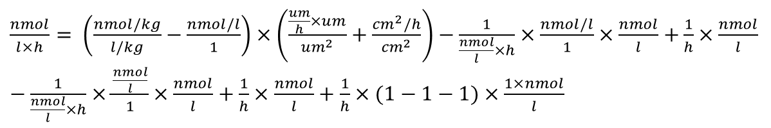
Concentration (nM) of free target molecules in media space
$$\frac{d\left({Ag}_{f}^{ex}\right)}{dt}=\left(\frac{{Ag}_{f}^{C1}}{V_{Ag}^{C1}}−\frac{{Ag}_{f}^{ex}}{ε^{Ag}}\right)×\left(\frac{2×P_{Ag}×R_{Cap}}{R_{Krogh}^{2}}+\frac{6×D_{Ag}}{R_{Tumor}^{2}}\right)−K_{on}^{Ab,cell,ag}×\frac{{Ab}_{f}^{ex}}{ε^{Ab}}×\frac{{Ag}_{f}^{ex}}{ε^{Ag}}+K_{off}^{Ab,cell,ag}×\frac{{Ag}_{b}^{ex}}{ε^{Ag}} \\ {−K}_{on}^{ADC,cell,ag}×\frac{{ADC}_{f}^{ex}}{ε^{ADC}}×\frac{{Ag}_{f}^{ex}}{ε^{Ag}}+K_{off}^{ADC,cell,ag}×\frac{{Ag}_{b}^{ex}}{ε^{Ag}}+K_{shed}^{Ag}×\left({Ag}_{t}^{cell}−{ADC}_{b,ag}^{cell}−{Ab}_{b,ag}^{cell}\right)×\frac{{NC}^{tumor}×SF}{V^{tumor}}$$
From unbinding of shedded receptor (Ab)
From central space
To binding to shedded receptor (Ab)
To binding to shedded receptor (ADC)
From unbinding of shedded receptor (ADC)
From shedded free antigen
$\frac{nmol}{l×h}= \left(\frac{nmol/kg}{l/kg}−\frac{nmol/l}{1}\right)×\left(\frac{\frac{um}{h}×um}{{um}^{2}}+\frac{{cm}^{2}/h}{{cm}^{2}}\right)−\frac{1}{\frac{nmol}{l}×h}×\frac{nmol/l}{1}×\frac{nmol}{l}$ $+\frac{1}{h}×\frac{nmol}{l}$ $−\frac{1}{\frac{nmol}{l}×h}×\frac{\frac{nmol}{l}}{1}×\frac{nmol}{l}+\frac{1}{h}×\frac{nmol}{l}+\frac{1}{h}×(1−1−1)×\frac{1×nmol}{l}$
Units:

Slide 18


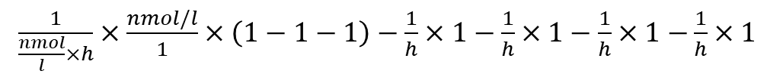

Number of Antibody molecules bound to binding target on a single cell
$K_{int}^{ADC,cell} is used for both ADC and Ab$
$$\frac{d({Ab}_{b,ag}^{cell})}{dt}=K_{on}^{Ab,cell,ag}×\frac{{Ab}_{f}^{ex}}{ε^{Ab}}×\left({Ag}_{t}^{cell}−{ADC}_{b,ag}^{cell}−{Ab}_{b,ag}^{cell}\right)−K_{off}^{Ab,cell,ag}×{Ab}_{b,ag}^{cell}−K_{int}^{ADC,cell}×{Ab}_{b,ag}^{cell}$$ $−\frac{ln⁡(2)}{{DT}^{tumor}}×{Ab}_{b,ag}^{cell}$ $−{K_{shed}^{Ag}×Ab}_{b,ag}^{cell}$
From binding to receptor from free ADC
To unbinding from receptor
To internalization into cell
To dilution as cells grow and divide
Shedded Antigen bound to Ab
Units:
$$\frac{1}{h}=$$
$\frac{1}{\frac{nmol}{l}×h}×\frac{nmol/l}{1}×\left(1−1−1\right)−\frac{1}{h}×1−\frac{1}{h}×1−\frac{1}{h}×1$ $−\frac{1}{h}×1$

Slide 19

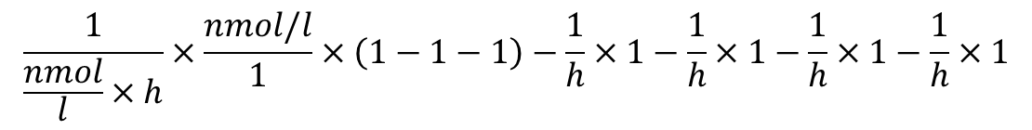
Number of ADC molecules bound to binding target on a single cell
$$\frac{d({ADC}_{b,ag}^{cell})}{dt}=K_{on}^{ADC, cell,ag}×\frac{{ADC}_{f}^{ex}}{ε^{ADC}}×\left({Ag}_{t}^{cell}−{ADC}_{b,ag}^{cell}−{Ab}_{b,ag}^{cell}\right)−K_{off}^{ADC, cell,ag}×{ADC}_{b,ag}^{cell}−K_{int}^{ADC,cell}×{ADC}_{b,ag}^{cell}$$ $−\frac{ln⁡(2)}{{DT}^{tumor}}×{ADC}_{b,ag}^{cell}$ $−{K_{shed}^{Ag}×ADC}_{b,ag}^{cell}$
From binding to receptor 1 from free ADC
To unbinding from receptor 1
To internalization into cell
To dilution as cells grow and divide
Shedded Antigen bound to Ab
Units:
$$\frac{1}{h}=$$
$$\frac{1}{\frac{nmol}{l}×h}×\frac{nmol/l}{1}×\left(1−1−1\right)−\frac{1}{h}×1−\frac{1}{h}×1−\frac{1}{h}×1−\frac{1}{h}×1$$

Slide 20

${only info not for the code:Ag}_{f}^{cell}$ $={Ag}_{cell}^{t}−\left({Ab}_{b,ag}^{ex}+{ADC}_{b,ag}^{ex}\right)$ and $K_{int}^{ADC,cell} is used for both ADC and Ab$
$$\frac{d({Ag}_{t}^{cell})}{dt}={−K}_{int}^{ADC,cell}×\left({ADC}_{b,ag}^{cell}+{Ab}_{b,ag}^{cell}\right){−K}_{shed}^{Ag}×\left({ADC}_{b,ag}^{cell}+{Ab}_{b,ag}^{cell}+\left({Ag}_{t}^{cell}−{ADC}_{b,ag}^{cell}−{Ab}_{b,ag}^{cell}\right)\right)$$
$${+K}_{int}^{ADC,cell}×\left({ADC}_{b,ag}^{cell}+{Ab}_{b,ag}^{cell}\right){+ K}_{shed}^{Ag}×\left({ADC}_{b,ag}^{cell}+{Ab}_{b,ag}^{cell}+\left({Ag}_{t}^{cell}−{ADC}_{b,ag}^{cell}−{Ab}_{b,ag}^{cell}\right)\right)$$
Number of receptor molecules on a single cell
To internalization of bound receptors (ADC + Ab)
Shedded of bound and free receptors
Equal to synthesis rate
Units:
$\frac{1}{h}=−\frac{1}{h} ×(1+1)$ $− \frac{1}{h}×(1+1+(1−1−1))+\frac{1}{h} ×(1+1)+$ $\frac{1}{h}×(1+1+(1−1−1))$
Notes:
Ag_cell_t in the end = zero change but code should be inserted because synthesis rate could be possibly changed in the near future.

Slide 21






Number of ADC molecules internalized in endosomal/lysosomal space on a single cell
$$\frac{d({ADC}_{f}^{cell,lyso})}{dt}=K_{int}^{ADC,cell}×{ADC}_{b,ag}^{cell} \\ −K_{deg}^{ADC}×{ADC}_{f}^{cell,lyso}+K_{pino}^{ADC,cell,lyso}×\frac{{ADC}_{f}^{ex}}{ε^{ADC }×SF}−\frac{ln⁡(2)}{{DT}^{tumor}}×{ADC}_{f}^{cell,lyso}$$
From internalization into cell
To degradation
From pinocytosis
To dilution as cells grow and divide
$$\frac{1}{h}=$$
$$\frac{1}{h}×1$$
$$−\frac{1}{h}×1$$
$$+\frac{l}{h}×\frac{nmol/l}{1×nmol}$$
$$−\frac{1}{h}×1$$
Units:
Notes:
# Eq. 11
dADC_Cell_lysod <- K_ADC_int * ADC_Cell_b - K_ADC_deg * ADC_Cell_lyso -
0.693 / DT_Tumor * ADC_Cell_lyso +
K_pino * V_Cell / E_ADC * (ADC_ex_f / SF)

Slide 22






$$\frac{d({Drug}_{f}^{cell,lyso})}{dt}=K_{deg}^{ADC}×{ADC}_{f}^{cell,lyso}×\overline{DAR}−K_{out}^{Drug, lyso}×\left(\frac{V^{cell}}{V^{cell,lyso}}\right)×{Drug}_{f}^{cell,lyso} \\ +K_{in}^{Drug, lyso}×{Drug}_{f}^{cell,cyto}−\frac{ln⁡(2)}{{DT}^{tumor}}×{Drug}_{f}^{cell,lyso}$$
Number of unbound drug molecules in endosomal/lysosomal space on a single cell
From degradation of ADC
To cytosol
From cytosol
To dilution as cells grow and divide
Units:
$$\frac{1}{h}=$$
$$\frac{1}{h}×(1+1)$$
$$−\frac{1}{h}×\left(\frac{l}{l}\right)×1$$
$$+\frac{1}{h}×1$$
$$−\frac{1}{h}×1$$

Slide 23

Free drug, number of molecules (1) per cell
$$\frac{d({Drug}_{f}^{cell,cyto})}{dt}=+K_{out}^{Drug, lyso}×\left(\frac{V^{cell}}{V^{cell,lyso}}\right)×{Drug}_{f}^{cell,lyso}−K_{in}^{Drug, lyso}×{Drug}_{f}^{cell,cyto}−K_{out}^{Drug,ex}×{Drug}_{f}^{cell,cyto}$$ $−K_{on}^{Drug,cyto,dt}×{Drug}_{f}^{cell,cyto}×\left({DrugTarget}_{t}^{cell,cyto}−{Drug}_{b,dt}^{cell,cyto}\right)$ $−K_{met}^{Drug}×{Drug}_{f}^{cell,cyto}$ $$+K_{off}^{Drug,cyto,dt}×{Drug}_{b,dt}^{cell,cyto}+ K_{in}^{Drug,ex}×\left(\frac{V^{cell}}{V^{tumor}×ε^{Drug}}\right)×\frac{{Drug}_{f}^{ex}}{SF}−\frac{ln⁡(2)}{{DT}^{tumor}}×{Drug}_{f}^{cell,cyto}$$
From and to lysosome
To efflux
To binding to drug target
To metabolism
From unbinding from drug target
From influx
To dilution as cells grow and divide
$$\frac{1}{h}=\frac{1}{h}×\left(\frac{l}{l}\right)×1 −\frac{1}{h}×1−\frac{1}{h}×1−\frac{1}{h}×1×(1−1)−\frac{1}{h}×1+\frac{1}{h}×1+\frac{1}{h}×\left(\frac{l}{l×1}\right)×\frac{nmol}{nmol}−\frac{1}{h}×1$$
Units:

Slide 24





Bound drug, number of molecules (1) per cell
$$\frac{d({Drug}_{b,dt}^{cell,cyto})}{dt}=K_{on}^{Drug,cyto,dt}×{Drug}_{f}^{cell,cyto}×\left({DrugTarget}_{t}^{cell,cyto}−{Drug}_{b,dt}^{cell,cyto}\right) \\ −K_{off}^{Drug,cyto,dt}×{Drug}_{b,dt}^{cell,cyto}−\frac{ln⁡(2)}{{DT}^{tumor}}×{Drug}_{b,dt}^{cell,cyto}$$
From binding to drug target
To unbinding from drug target
To dilution as cells grow and divide
Units:
$$\frac{1}{h}=$$
$$\frac{1}{h}×1×(1−1)$$
$$−\frac{1}{h}×1$$
$$−\frac{1}{h}×1$$

Slide 25


Number of ADC molecules bound to binding target on a single cell without effect, in central compartment/plasma
$$\frac{d({ADC}_{b,ag}^{TMDDcell})}{dt}=K_{on}^{ADC,cell,ag}×\left({Ag}_{t}^{TMDDcell}−{ADC}_{b,ag}^{TMDDcell}−{Ab}_{b,ag}^{TMDDcell}\right)×\frac{{ADC}_{f}^{C1}}{V_{ADC}^{C1}}$$
$−K_{off}^{ADC,cell,ag}×{ADC}_{b,ag}^{TMDDcell}−{ K}_{int}^{ADC,TMDDcell}×{ADC}_{b,ag}^{TMDDcell}$ $−{ K}_{shed}^{Ag}×{ADC}_{b,ag}^{TMDDcell}$
From binding to receptor
Shedded Antigen bound to Ab
To unbinding from receptor
To Internalization
into TMDD cell
Units:
$\frac{1}{h}=\frac{1}{\frac{nmol}{l}×h}×(1−1−1)×\frac{nmol/kg}{l/kg}−\frac{1}{h}×1−\frac{1}{h}×1$ $−\frac{1}{h}×1$

Slide 26

Number of Antibody molecules bound to binding target on a single cell without effect, in central compartment/plasma
$$\frac{d({Ab}_{b,ag}^{TMDDcell})}{dt}=K_{on}^{Ab,cell,ag}×\left({Ag}_{t}^{TMDDcell}−{ADC}_{b,ag}^{TMDDcell}−{Ab}_{b,ag}^{TMDDcell}\right)×\frac{{Ab}_{f}^{C1}}{V_{Ab}^{C1}}−K_{off}^{Ab,cell,ag}×{Ab}_{b,ag}^{TMDDcell} \\ −K_{int}^{ADC,TMDDcell}×{Ab}_{b,ag}^{TMDDcell}−{K_{shed}^{Ag}×Ab}_{b,ag}^{TMDDcell}$$
$K_{int}^{ADC,TMDDcell} is used for both ADC and Ab$
From binding to receptor from free ADC
To unbinding from receptor
To internalization into cell
Shedded Antigen bound to Ab
$$\frac{1}{h}=$$
Units:
$\frac{1}{\frac{nmol}{l}×h}×\left(1−1−1\right)×\frac{nmol/kg}{l/kg}−\frac{1}{h}×1−\frac{1}{h}×1−\frac{1}{h}×1$ $−\frac{1}{h}×1$

Slide 27

Number of receptor molecules on a single cell without effect, in central compartment/plasma
$$\frac{d({Ag}_{t}^{TMDDcell})}{dt}=−K_{int}^{ADC,TMDDcell}×\left({ADC}_{b,ag}^{TMDDcell}+{Ab}_{b,ag}^{TMDDcell}\right){−K}_{shed}^{Ag}×\left({ADC}_{b,ag}^{TMDDcell}+{Ab}_{b,ag}^{TMDDcell}+\left({Ag}_{t}^{TMDDcell}−{ADC}_{b,ag}^{TMDDcell}−{Ab}_{b,ag}^{TMDDcell}\right)\right)$$
$$+K_{int}^{ADC,TMDDcell}×\left({ADC}_{b,ag}^{TMDDcell}+{Ab}_{b,ag}^{TMDDcell}\right){+ K}_{shed}^{Ag}×\left({ADC}_{b,ag}^{TMDDcell}+{Ab}_{b,ag}^{TMDDcell}+\left({Ag}_{t}^{TMDDcell}−{ADC}_{b,ag}^{TMDDcell}−{Ab}_{b,ag}^{TMDDcell}\right)\right)$$
${only info not for the code:Ag}_{f}^{TMDDcell}$ $={Ag}_{cell}^{TMDDt}−\left({Ab}_{b,ag}^{TMDDcell}+{ADC}_{b,ag}^{TMDDcell}\right)$ and $K_{int}^{ADC,TMDDcell} is used for both ADC and Ab$
To internalization of bound receptors (ADC +Ab)
Shedding of bound and free receptors
Equal to synthesis rate
Units:
$\frac{1}{h}=−\frac{1}{h} ×(1+1)$ $− \frac{1}{h}×(1+1+(1−1−1))+\frac{1}{h} ×(1+1)$ $+$ $\frac{1}{h}×(1+1+(1−1−1))$
Notes:
Ag_cell_t in the end = zero change but code should be inserted because synthesis rate could be possibly changed in the near future.

Slide 28


Number of ADC molecules in lysosomal space of non-effect (TMDD) cells
$$\frac{d({ADC}_{f}^{TMDDcell,lyso})}{dt}=K_{int}^{ADC,TMDDcell}×{ADC}_{b,ag}^{TMDDcell}−K_{deg}^{ADC,TMDDcell}×{ADC}_{f}^{TMDDcell,lyso}+K_{pino}^{ADC,TMDDcell}×\frac{{ADC}_{f}^{C1}}{SF×V_{ADC}^{C1}}$$
From internalization into cell without effect
To degradation
From pinocytosis
$$\frac{1}{h}=\frac{1}{h}×1−\frac{1}{h}×1+\frac{l}{h}×\frac{\frac{nmol}{kg}}{nmol×\frac{l}{kg}}$$
Units:

Slide 29

Number of unbound Drug molecules in lysosomal space on a single cell without effect
$$\frac{d({Drug}_{f }^{TMDDcell,lyso})}{dt}=−K_{out}^{Drug, lyso}×\left(\frac{V^{TMDDcell}}{V^{TMDDcell,lyso}}\right)×{Drug}_{f}^{TMDDcell,lyso}$$ $+K_{in}^{Drug, lyso}×{Drug}_{f}^{TMDDcell,cyto}$ $+ K_{deg}^{ADC,TMDDcell}×{ADC}_{f}^{TMDDcell,lyso}×\overline{DAR}$
To cytosol
From cytosol
From degradation of ADC
Units:
$\frac{1}{h}=− \frac{1}{h}×\left(\frac{l}{l}\right)×1 + \frac{1}{h}×1+ \frac{1}{h}×1$ $×1$

Slide 30

Number of unbound drug molecules in cytosol on a single cell without effect
$$\frac{d({Drug}_{f}^{TMDDcell,cyto})}{dt}=K_{in}^{Drug,ex}×V^{TMDDcell}×\frac{{Drug}_{f}^{C1}}{SF}−K_{out}^{Drug,ex}×{Drug}_{f}^{TMDDcell,cyto}$$ $+K_{out}^{Drug,lyso}×\left(\frac{V^{TMDDcell}}{V^{TMDDcell,lyso}}\right)×{Drug}_{f}^{TMDDcell,lyso}−K_{in}^{Drug,lyso}×{Drug}_{f}^{TMDDcell,cyto}$ $−K_{met}^{Drug}×{Drug}_{f}^{TMDDcell,cyto}$
From influx into cell
To efflux from cell
From lysosomal compartment
To lysosomal compartment
To metabolism
$\frac{1}{h}= \frac{1}{h}×l×\frac{\frac{nmol}{l}}{nmol} − \frac{1}{h}×1+\frac{1}{h}×\left(\frac{l}{l}\right)×1−\frac{1}{h}×1$ $−\frac{1}{h}×1$
Units:

Slide 31







Tumor volume
$$V_{mm3}^{tumor}=V_{pro,mm3}^{tumor}+V_{dyi,1,mm3}^{tumor}+V_{dyi,2,mm3}^{tumor}+V_{dyi,3,mm3}^{tumor}$$
Logistic (Thomas Rysiok)
$$t_{l}=\ln\left(\frac{{Drug}_{f}^{cell,cyto}×SF}{V^{cell}}\right)−\ln\left({EC}_{50}\right)$$
$$LOGI= \frac{k_{g}}{1+{(\frac{k_{g}}{k_{z}}−1)×e}^{−k_{r}×k_{g}×t_{l}}}$$
$$\frac{d(V_{pro,mm3}^{tumor})}{dt}=\left(\frac{\frac{\ln\left(2\right)}{{DT}^{tumor}}×\left(1−\frac{V_{pro,mm3}^{tumor}}{V_{max}^{tumor}}\right)}{{\left(1+{\left(\frac{\ln\left(2\right)}{{DT}^{tumor}}×\frac{V_{pro,mm3}^{tumor}}{k_{lin}}\right)}^{ψ}\right)}^{\frac{1}{ψ}}}−R_{Kill}\right)∙V_{pro,mm3}^{tumor}$$
$$R_{kill}=k_{kill, max}×{\left(\frac{\ln\left(2\right)}{{DT}^{tumor}}\right)}^{f_DT_kill}×LOGI$$
$$\frac{d(V_{dyi,1,mm3}^{tumor})}{dt}=R_{Kill}∙V_{pro,mm3}^{tumor}− \frac{1}{τ} ∙V_{dyi,1,mm3}^{tumor}$$
$$\frac{d(V_{dyi,2,mm3}^{tumor})}{dt}=\frac{1}{τ} ∙(V_{dyi,1,mm3}^{tumor}−V_{dyi,2,mm3}^{tumor})$$
$$\frac{d(V_{dyi,3,mm3}^{tumor})}{dt}=\frac{1}{τ} ∙(V_{dyi,2,mm3}^{tumor}−V_{dyi,3,mm3}^{tumor})$$

