Slide 1
Digital Twins in Manufacturing and the Use of Models
Alexander Hellwig, Judith Michael, Jérôme Pfeiffer, Bernhard Rumpe, Henrik Thillmann, and Andreas Wortmann
ER 2025 Forum track
Alexander Hellwig
Software Engineering
RWTH Aachen
http://www.se-rwth.de/
Farbe!
Notes:
Vorlage: Breitformat v20, 20. August 2021

Slide 2
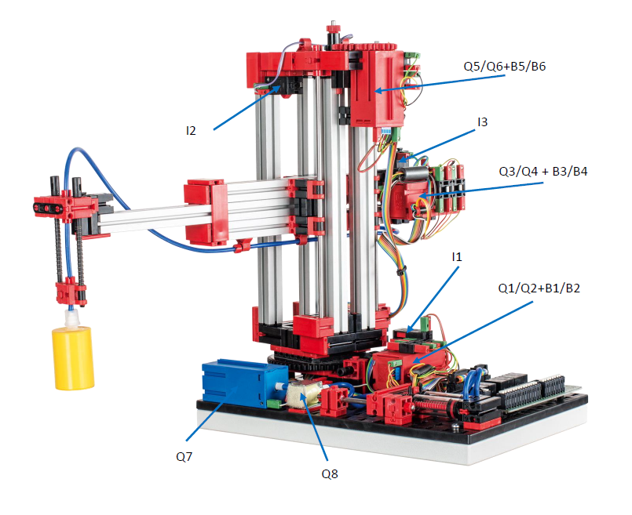
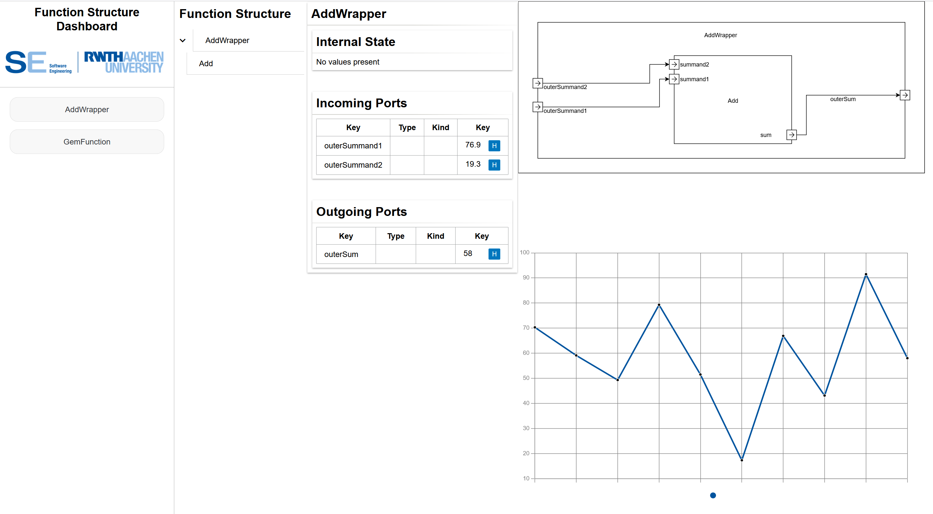
Introduction
When building a cyber-physical system and accompanying Digital Twin, many modeling languages can be used
(At least) two kinds of model reuse arrise
Models of the Actual System reused for the Digital Twin
Reuse of models in a later life cycle phases of the AS or DT
This paper investigates:
What properties do models for DT Engineering in manufacturing have and
how do these properties change with reuse
OCL
OCL
OCL
OCL
OCL
SysMLv2
CD
...
Actual System
Digital Twin

Slide 3
Faceted Classification System
Faceted classification:
Each model or modeling technique is classified along multiple facets
Multiple foci of one facet can be applied to one model
Example:
Exclusive Foci: Purpose
Descriptive models
Predictive models
Prescriptive models
Multiple Foci: Modeled subject
Software
Hardware
Interaction between AS and DT
Interaction with the environment
Identified Facets:
Purpose
Modeled subject
Life cycle phase (next slide)
Type
Executability
Notation
Level of abstraction
Functional aspect
Domain
Extensibility
Formality

Slide 4
Detail: Life cycle phases
Lifecycle phase
Actual System
(1) AS Design
(2) AS Construction
(3) AS Operation
(4) AS End-of-life
Digital Twin
(1) DT Requirement analysis
(2) DT Design
(3) DT Construction
(4) DT Test
(5) DT Release
(6) DT Operation
Test
Req.
▪▪▪
▪▪▪
▪▪▪
▪▪▪
▪▪▪
▪▪▪
Release
Constr.
▪▪▪
▪▪▪
▪▪▪
▪▪▪
Digital Twin Development
Digital Twin
Operation
Design
Operate
Design
Construction
Operation
End-of-life
Actual System

Slide 5
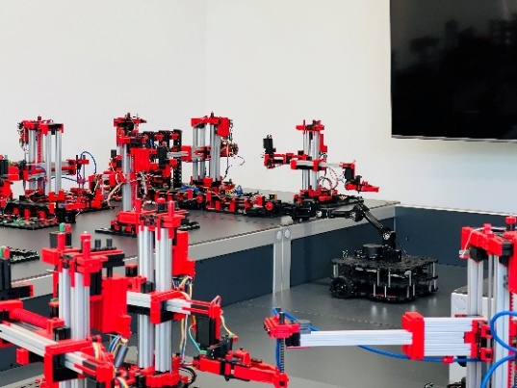
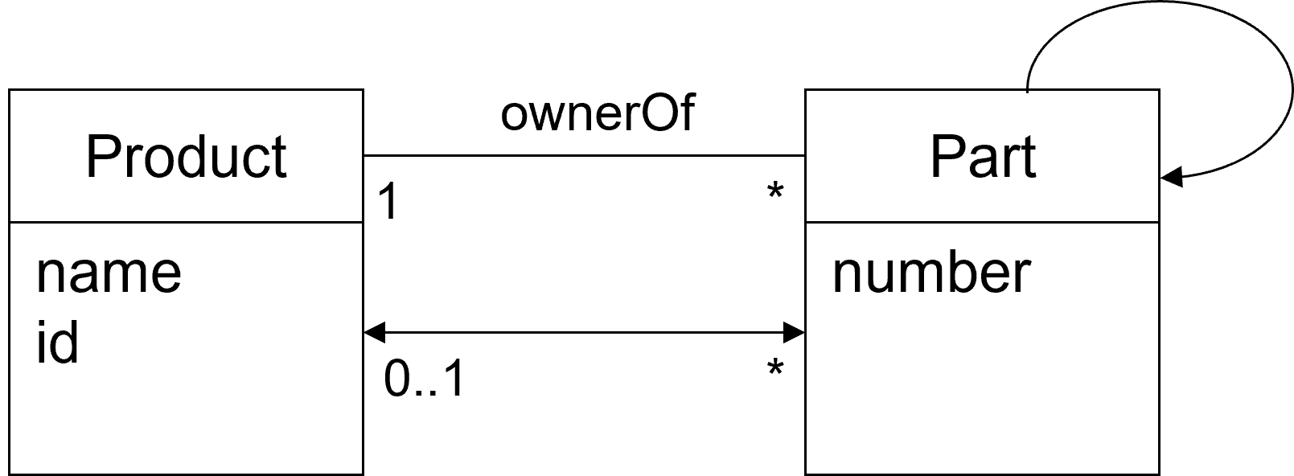
Fischertechnik Production Line: Model reuse between AS and DT
Reuse of models in between AS and DT can change foci of some facets
A Class diagram used during AS Design is descriptive of the domain
Through evolution it can be reused to describe the schema for a Digital Shadow, becoming prescriptive during DT Operation
Actual System
Legend
extensible
textual
extensibility
notation
defined semantics
descriptive
formality
purpose
transformed
hardware, software, env. interaction
executability
aspect of
DT/AS
data model
CIM
coupling,
digital representation,
tools
type
domain
manufacturing
Actual System CD4Analysis
modeled
subject
level of
abstraction

Slide 6
Discussion + Limitations
What is the classification good for:
Identify overlap in used modeling languages
Identify missing modeling languages
Identify reuse of existing models
Limitations
We are not domain experts in manufactoring
This is an inital proposal for a classification, a full literature review is needed for an exhaustive list of relevant facets
See the paper for:
A full description of the facets and foci
the application of the classicication to two case studies
Fischertechnik Production Line
5-Axis Milling machine
More details on changing foci

Slide 7
Sketch story: Short presentations of all papers (10 minutes per paper, including questions)
Introduction(from abstract):
Research gap: What kinds of model are useful in DT Engineering along the lifecycle
Solution approach: (initial) faceted classification to label models in dt engineering (manufactoring)
Evaluation: Applied classification to two manufacturing dts
Classification
Why use facetts
What did we include
Keep short, since only 10 minutes
Evaluation on Fischertechnik
Show that it works: figure with Fischertechnik facets
Show reader, that this is usefull
Reader has role DT developer
Emphasis on reuse of models in other phases
Categories/Facets -> find new modeling languages
Limitations
No comprehensive literature review
We are not domain experts
Backup slides
[x] Full classification
[x] Classification applied to 5 axis, Fischertechnik
[] References
Are in paper, not needed here

Slide 8
Backup/Discussion: All Foci/Facets
Purpose
Descriptive models
Predictive models
Prescriptive models
Type
Structure
Architecture model
Data model
Ontology model
Behavior
Discrete
Continuous
Executability
Not executable
Interpreted
Transformed
Notation
Textual
Graphical
Projectional
Modeled subject
Software
Hardware
Interaction between AS and DT
Interaction with the environment
Level of abstraction
Computation-independent model
Platform-independent model
Platform-specific model

Slide 9
Backup/Discussion: All Foci/Facets
Functional aspect
Digital Coupling
AS state
Communication
State data handling
Twinning
Protocols
Digital Representation
Data model
Operational data storage
Master & reference data
Physical entity models
Temporal
Tools
Analysis
Simulation
Presentation
Functional aspect(cont.)
Functional output
Digital twin output
Configuration & control
User interface
Domain
mechanics
electricity
civil engineering
chemistry
hydraulics
kinematics
material science
...

Slide 10
Backup/Discussion: All Foci/Facets
Life cycle phase
Actual System
AS Design
AS Construction
AS Operation
AS End-of-life
Digital Twin
DT Requirement analysis
DT Design
DT Construction
DT Test
DT Release
DT Operation
Extensibility
Extensible
Not extensible
Formality
Formally defined syntax
Formally defined semantics
Informal

Slide 11
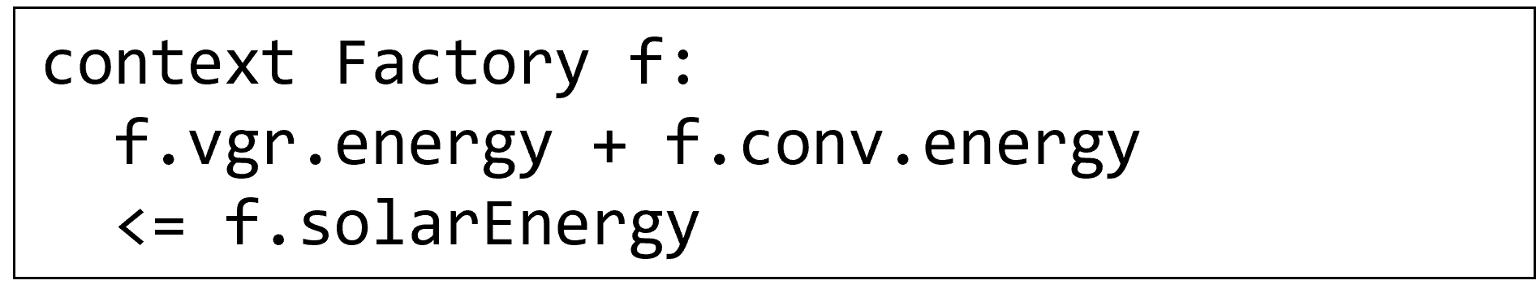

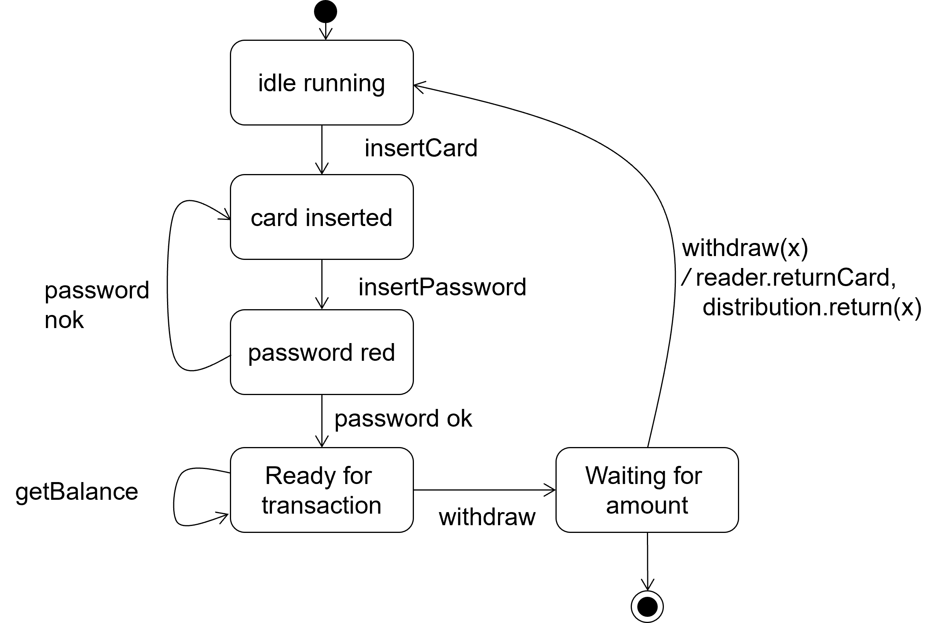
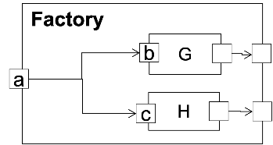
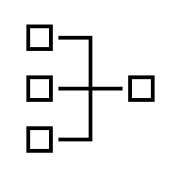
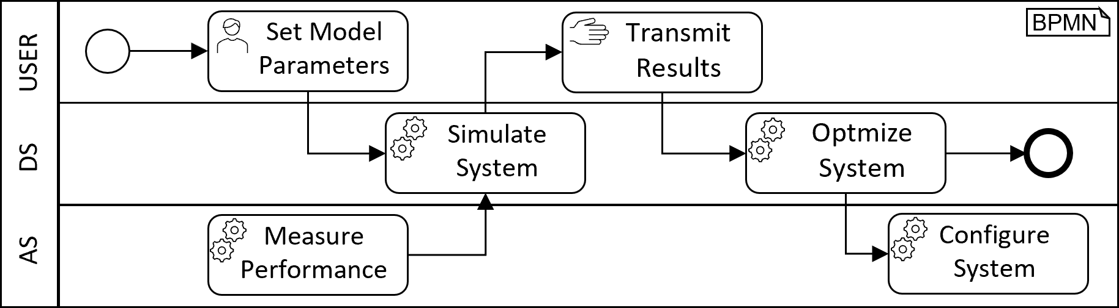
Backup: Full Fischertechnik DT Classification
Legend
extensible
textual
extensible
textual
extensibility
notation
defined semantics
descriptive
defined semantics
prescriptive
formality
purpose
transformed
hardware, software, env. interaction
transformed,
interpreted
hardware, software
aspect of
DT/AS
executability
data model
data model
PSM
CIM
type
domain
coupling,
digital representation,
tools
manufacturing
digital representation,
tools
manufacturing
modeled
subject
level of
abstraction
Actual System
Actual System CD4Analysis
Actual System OCL/P
extensible
textual
extensible
textual
extensible
textual
non extensible
graphical
defined syntax & semantics
prescriptive
defined semantics
prescriptive
defined semantics
prescriptive
informal
prescriptive
transformed
software
transformed
hardware, software, env. interaction
transformed
hardware, software, env. interaction
interpreted
hardware, software, env. /internal interaction
structure
behavior
PIM
structure
descrete behavior
discrete behavior
PIM
PSM
user interface
EIS
coupling, tools
coupling, tools
coupling, tools, functional output
PSM
manufacturing
manufacturing
manufacturing
Digital Twin GUI-Model
Actual System MontiArc
Actual System MC Statechart
Digital Twin BPMN

Slide 12
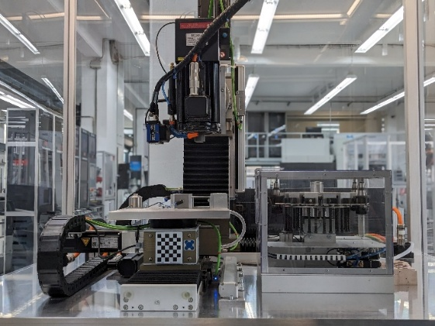
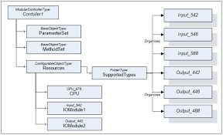
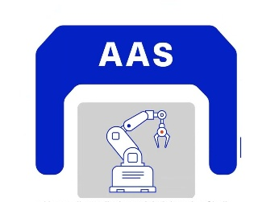
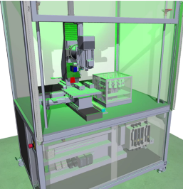
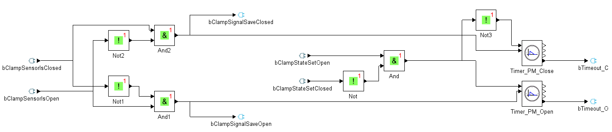
Backup: Full 5-Axis DT Classification
Legend
non extensible
textual,
graphical
non extensible
textual,
graphical
extensibility
notation
informal
descriptive
informal
descriptive
formality
purpose
interpreted
interaction
interpreted
hardware, software, interaction
executability
aspect of
DT/AS
data model
PSM
data model
PSM
type
domain
communication
manufacturing
operational data storage
manufacturing
modeled
subject
level of
abstraction
Actual System
OPC UA
AAS
non extensible
graphical
non extensible
graphical
extensible
textual
extensible
textual
informal
descriptive
informal
descriptive
defined syntax & semantics
prescriptive
defined syntax & semantics
prescriptive
interpreted
hardware
interpreted
hardware
transformed
software
transformed
software
discrete behavior
PSM
discrete behavior
PSM
data model
PIM
structure,
behavior
PIM
simulation
manufacturing
simulation
manufacturing
coupling, tools
manufacturing
user interface
EIS
Block diagram
3D model/CAD
Digital Shadow CD
GUI-Model

Slide 13
Backup: DT Lifecycle
Release
Plan
Test
▪▪▪
▪▪▪
▪▪▪
▪▪▪
▪▪▪
▪▪▪
Steer
▪▪▪
▪▪▪
▪▪▪
▪▪▪
Deploy
Digital Twin Development
Digital Twin
Operation
Build
Design
Analyse

