Slide 1

A Multi-stage Dynamic Game-Theoretic Approach for Multi-Workflow Scheduling on
Heterogeneous Virtual Machines from Multiple
Infrastructure-as-a-Service Clouds
Yuandou Wang Jiajia Jiang Yunni Xia
College of computer science, Chongqing University, CN
SCC 2018
June 28, 2018
Notes:
Good afternoon, ladies and gentleman! Thank you all coming to listen to my presentation. Due to the administrative processing of VISA application, I cannot arrive at Seattle, USA in time. Thus, I prepared an audio embedded PPT for you.
Today, I will present our paper entitled “a multi-stage dynamic game-theoretic approach for multi-workflow scheduling on heterogeneous virtual machine from multiple infrastructure-as-a-service clouds” for you.

Slide 2
01
Introduction
02
Related Work
03
Model & Formulation
04
The MDGT Method
content
05
Case Study
Notes:
In this presentation, five main parts are included, which are, the introduction, related work, model & formulation, the Multi-stage Dynamic Game-Theoretic (MDGT) method and case study.

Slide 3
PPT模板下载：www.1ppt.com/moban/ 行业PPT模板：www.1ppt.com/hangye/
节日PPT模板：www.1ppt.com/jieri/ PPT素材下载：www.1ppt.com/sucai/
PPT背景图片：www.1ppt.com/beijing/ PPT图表下载：www.1ppt.com/tubiao/
优秀PPT下载：www.1ppt.com/xiazai/ PPT教程： www.1ppt.com/powerpoint/
Word教程： www.1ppt.com/word/ Excel教程：www.1ppt.com/excel/
资料下载：www.1ppt.com/ziliao/ PPT课件下载：www.1ppt.com/kejian/
范文下载：www.1ppt.com/fanwen/ 试卷下载：www.1ppt.com/shiti/
教案下载：www.1ppt.com/jiaoan/ PPT论坛：www.1ppt.cn
1
INTRODUCTION
Notes:
Recently, various scientific fields employ workflows to analyze large amounts of data and to perform complex simulations and experiments efficiently. A process in such scientific applications can be modeled as a workflow by dividing it into smaller and simpler tasks. These tasks can then be distributed to multiple computing resources. They usually present graphical interfaces to combine different technologies along with efficient methods for using them, and thus increase the efficiency of scientists. They are usually represented as directed graphs with their nodes representing discrete computational components and the edges representing connections along which data and results can communicate among components. They have different types and usually their execution needs computing platforms with different QoS requirements, e.g. most completion time,
load balancing, economics.
On the other hand, cloud computing is recognized as a promising solution and paradigm for providing a flexible, on-demand computing infrastructure over the Internet for large-scale scientific-workflow-based applications.

Slide 4

INTRODUCTION
1
Research：
Multi-objective workflow Scheduling on Multi-Clouds with meeting various QoS requirements, e.g., reducing make-span, total cost and maximum system fairness.
Challenge:
It’s one of NP-complete problem.
Large scale workflows have large amount of task applications.
Virtual machines with various cloud providers need different QoS requirements.
Why to use game theoretic-based model?
Some QoS requirements exist conflicts and confrontations, e.g., performance and cost.
To reduce the complexity of the real-time multiple workflows scheduling via multi-stage dynamic game.
6,000
Notes:
One of the most challenging NP-complete problems that researchers try to address is how to schedule large-scale scientific applications to distributed and heterogeneous computational nodes, e.g., IaaS clouds, such that quantitative objective functions such as process make-span are optimized, and certain execution constraints such as communication cost and storage requirements are considered and fulfilled. From the end-users perspective, a low make-span is always preferred, whereas from the systems perspective system-level efficiency and fairness are often considered as a good motivation such that the scientific applications and tasks are supposed to be fairly distributed among computational resources in order to avoid hot spots and performance bottle-necks. However, a careful investigation into related work shows that only a few schemes are able to deal with both perspectives, such as optimizing user objectives (e.g., make-span) while fulfilling other constraints, and providing a good fair workload distribution among physical computational resources of clouds.
The primary aim of the paper is therefore to propose a multi-objective scheduling method to address the real-time workflow scheduling problem on multiple IaaS cloud. Specifically, we consider a multi-objective optimization workflow scheduling approach based on dynamic game-theoretic model. It aims at reducing workflow make-spans, reducing cost, and maximizing system fairness in terms of workload distribution among heterogeneous VMs.
We conduct extensive case studies as well based on various well-known scientific workflow templates and heterogeneous VMs created on real-world third-party commercial IaaS clouds, i.e., Amazon, Tencent, and Ali clouds. Experimental results clearly suggest that our proposed approach outperforms traditional ones by achieving lower workflow make-spans, lower cost, and better system fairness.

Slide 5
PPT模板下载：www.1ppt.com/moban/ 行业PPT模板：www.1ppt.com/hangye/
节日PPT模板：www.1ppt.com/jieri/ PPT素材下载：www.1ppt.com/sucai/
PPT背景图片：www.1ppt.com/beijing/ PPT图表下载：www.1ppt.com/tubiao/
优秀PPT下载：www.1ppt.com/xiazai/ PPT教程： www.1ppt.com/powerpoint/
Word教程： www.1ppt.com/word/ Excel教程：www.1ppt.com/excel/
资料下载：www.1ppt.com/ziliao/ PPT课件下载：www.1ppt.com/kejian/
范文下载：www.1ppt.com/fanwen/ 试卷下载：www.1ppt.com/shiti/
教案下载：www.1ppt.com/jiaoan/ PPT论坛：www.1ppt.cn
2
RELATED WORK
Notes:
Along with rapidly growing data and computational requirements of large-scale workflow applications, scheduling multiple workflows in distributed systems has become an important and challenging research topic. In this section, we briefly cover a part of the important or relevant related work.

Slide 6
RELATED WORK
2
2.1 Multi-objective workflow scheduling
Traditional algorithms
MOHEFT (Durillo et al. [12]), DVFS+PSO (Yassa et al. [13])
Evolution algorithms
GA (Khajemohammadi et al. [14]), EMO (Zhu et al. [15]), ACO (Chen et al. [16]), PSM (Padmaveni et al. [17])
Pareto-optimal-based Methods
PFOA (Zheng et al. [18]), PF+GA (Hou et al. [19]), BHO (Ebadifard et al. [20])
2.2 Game-theoretic-based scheduling
BOSS (Fard et al. [21]), GMO (Duan et al. [22], Sujana et al. [23]).
6,000
Notes:
The optimization model for workflow (single or multiple) scheduling aim at finding tradeoffs among multiple quantitative objectives, e.g., make-span, cost, reliability, energy consumption, security, or load balancing. Some traditional algorithms, evolution algorithms and pareto-optimal-based methods are proposed to solve the problem. Such as …（PPT上）
Recently, game theory models and methodologies are widely applied to the multi-constraint process scheduling on cloud social, economic and resource scheduling problems. Some researchers applied the game-theoretic-based scheduling for workflow. Such as …（PPT上）
In this paper, the multi-stage dynamic game theory is applied to deal with the conflicts and competition among multiple optimization objectives for the multi-workflow scheduling problem.

Slide 7
PPT模板下载：www.1ppt.com/moban/ 行业PPT模板：www.1ppt.com/hangye/
节日PPT模板：www.1ppt.com/jieri/ PPT素材下载：www.1ppt.com/sucai/
PPT背景图片：www.1ppt.com/beijing/ PPT图表下载：www.1ppt.com/tubiao/
优秀PPT下载：www.1ppt.com/xiazai/ PPT教程： www.1ppt.com/powerpoint/
Word教程： www.1ppt.com/word/ Excel教程：www.1ppt.com/excel/
资料下载：www.1ppt.com/ziliao/ PPT课件下载：www.1ppt.com/kejian/
范文下载：www.1ppt.com/fanwen/ 试卷下载：www.1ppt.com/shiti/
教案下载：www.1ppt.com/jiaoan/ PPT论坛：www.1ppt.cn
3
MODEL & FORMULATION
Notes:
In this section, we first present the problem description and formulation of multi-objective workflow scheduling over heterogeneous cloud VMs. Then, we propose a finite multi-stage game model to reconcile multiple objectives and introduce a dynamic game-theoretic-based algorithm to reduce make-span, optimize system fairness and reduce the total cost.

Slide 8
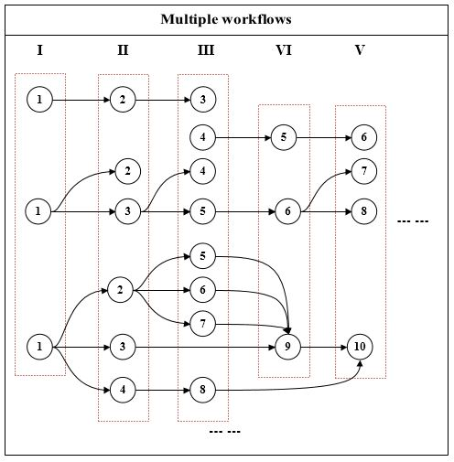
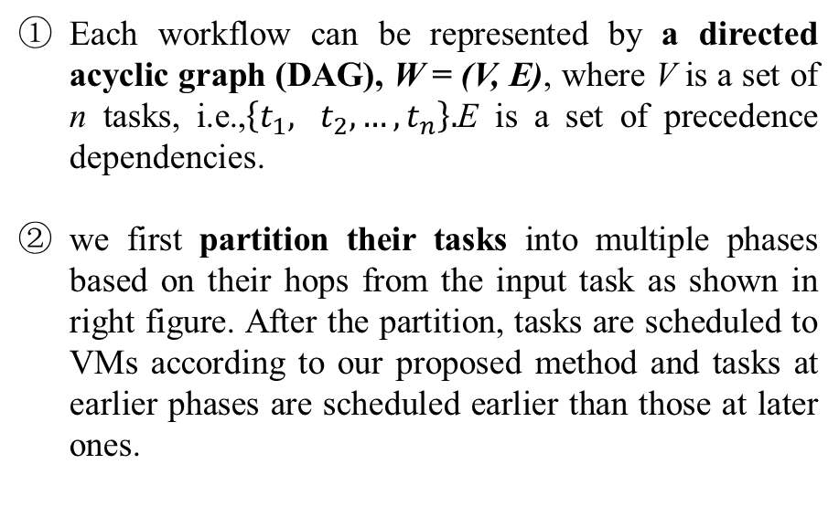
MODEL & FORMULATION
3
Workflows
6,000
Each workflow can be represented by a directed acyclic graph (DAG), W = (V, E), where V is a set of n tasks, i.e.,$\left\{t_{1}, t_{2},\right.…, \left.t_{n}\right\}.$E is a set of precedence dependencies.
we first partition their tasks into multiple phases based on their hops from the input task as shown in right figure. After the partition, tasks are scheduled to VMs according to our proposed method and tasks at earlier phases are scheduled earlier than those at later ones.
Notes:
In this study, we consider that scientific computational processes can be described by multiple workflows, which are supposed to be scheduled into heterogeneous VMs created over multiple IaaS CSPs. Each workflow can be represented by a directed acyclic graph (DAG).
When multiple workflows are ready for execution, we first partition …（PPT上）

Slide 9
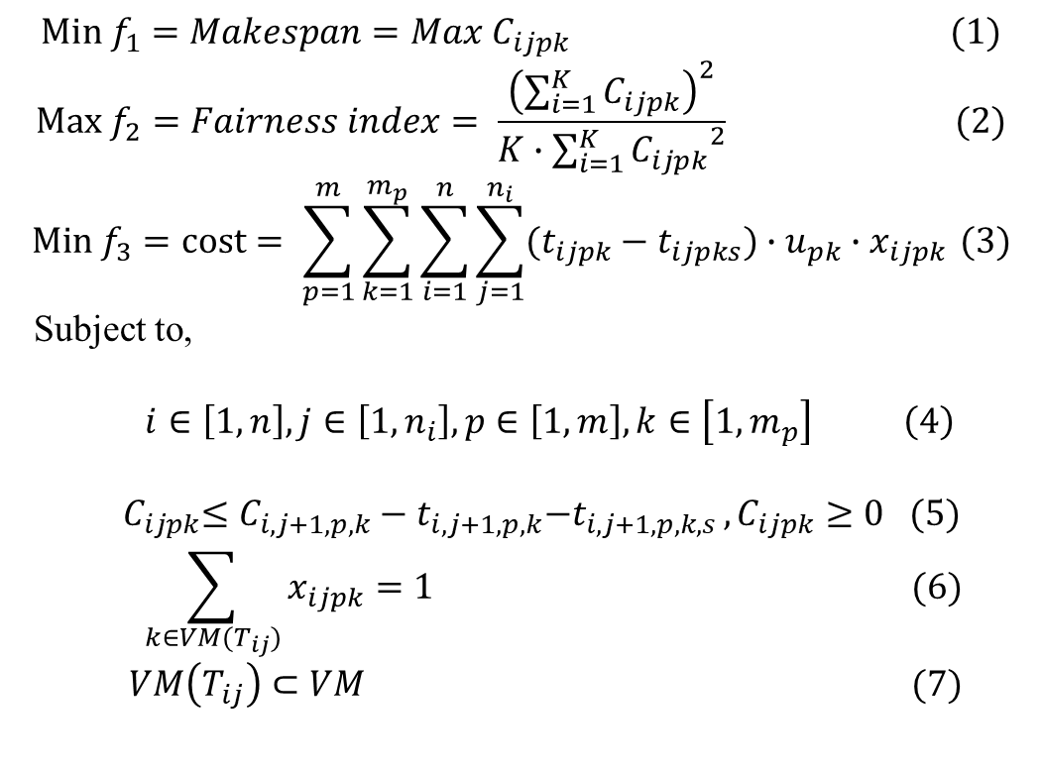
MODEL & FORMULATION
3
3.1 Problem Formulation
Hypotheses:
VMs are created on multiple CSPs;
Each task can be executed by only one VM;
The task execution duration is the interval between the task setup time and the task cutting time;
The dynamic game is finite since the number of workflows and tasks are bounded. The game is thus able to end with infinitely many moves and every player has finitely available choices at every moment.
$$Min f_{1}=Makespan=Max C_{ijpk} (1)$$
$$Max f_{2}=Fairness index= \frac{{\left(\sum_{i=1}^{K}{C_{ijpk}}\right)}^{2}}{K∙\sum_{i=1}^{K}{{C_{ijpk}}^{2}}} (2)$$
$$Min f_{3}=cost= \sum_{p=1}^{m}{\sum_{k=1}^{m_{p}}{\sum_{i=1}^{n}{\sum_{j=1}^{n_{i}}{(t_{ijpk}−t_{ijpks})∙u_{pk}∙x_{ijpk }}}}}(3)$$
Subject to,
$$i∈\left[1,n\right],j∈\left[1, n_{i}\right], p∈\left[1,m\right], k∈\left[1, m_{p}\right] \left(4\right)$$
$${ C}_{ijpk}≤{C_{i,j+1,p,k}−t}_{i,j+1,p,k}{−t}_{i,j+1,p,k,s }, C_{ijpk}≥0 (5)$$
$$\sum_{k∈VM(T_{ij})}{x_{ijpk}=1} (6)$$
$$VM\left(T_{ij}\right)⊂VM (7)$$
Notes:
Note that reducing make-span, i.e., the time required to execute all workflows, usually contradicts with cost reduction and thus we consider game-theoretic approaches to reconcile such conflicting optimization aims.
The following hypotheses are stipulated to facilitate the development of the game-theoretic-based method.
Based on the above hypotheses, we can formulate the problem into a multi-stage dynamic game-theoretic model.
F1 is to reduce the most completion time, that is, the make-span.
F2 is to maximize the system fairness in terms of workload distribution among heterogeneous cloud virtual machines.
F3 is to minimize the total cost.

Slide 10

MODEL & FORMULATION
3
3.2 the Proposed Dynamic Model
$$G\left(h^{l}\right)=\left\{p_{1}, {p_{2},p}_{3};{{\{S}_{1}^{l}\}}_{l=0}^{L}, {{\{S}_{2}^{l}\}}_{l=0}^{L}, {{\{S}_{3}^{l}\}}_{l=0}^{L};u_{1},u_{2},u_{3}\right\} \left(8\right)$$
$$\sum_{l=1}^{L}{u^{l}(S_{1}^{l},S_{2}^{l}, S_{3}^{l},h^{l−1})}≥\sum_{l=1}^{L}{u^{l}\left(S_{1}^{∗},S_{2}^{∗}, S_{3}^{∗},h^{l−1}\right)} (9)$$
6,000
Notes:
The optimization objectives can be seen as players in the multi-stage dynamic game model, and the players are usually assumed to be fully rational.
The game equilibrium solutions can be obtained as the optimal results. It is assumed that players take actions sequentially and the choice of the former player has an effect on the selection of the latter because the latter can observe the action of the former. The condition upon which the later makes a choice is denoted as hl. The utility functions of the first/second/third player correspond to make-span (u1 = f1), the utility function of the second player is the second objective function which corresponds to, fairness (u2 = f2), and the total cost (u3 = f3), respectively. Consequently, the multi-stage dynamic game formulation for the problem can be described as Eq.(8). And the approximate equilibriums can be defined as Eq.(9)

Slide 11
PPT模板下载：www.1ppt.com/moban/ 行业PPT模板：www.1ppt.com/hangye/
节日PPT模板：www.1ppt.com/jieri/ PPT素材下载：www.1ppt.com/sucai/
PPT背景图片：www.1ppt.com/beijing/ PPT图表下载：www.1ppt.com/tubiao/
优秀PPT下载：www.1ppt.com/xiazai/ PPT教程： www.1ppt.com/powerpoint/
Word教程： www.1ppt.com/word/ Excel教程：www.1ppt.com/excel/
资料下载：www.1ppt.com/ziliao/ PPT课件下载：www.1ppt.com/kejian/
范文下载：www.1ppt.com/fanwen/ 试卷下载：www.1ppt.com/shiti/
教案下载：www.1ppt.com/jiaoan/ PPT论坛：www.1ppt.cn
4
THE MDGT METHOD
Notes:
According to earlier discussions, each sequential game is represented by a game tree with game length of L + 1, shown as Fig. 3. To determine the optimal behaviors of players, we employ the sub-game perfectness in the finite multistage game with perfect information. A multi-stage dynamic game with perfect information may have multiple Nash equilibriums some of which are with no credible threats or promises.

Slide 12
THE MDGT METHOD
4
How to solve the model?
Backward Induction? Nope.
Challenging:
The large amount of task applications will provide a huge game tree;
It’s a static method. the final utilities priori to real-time assignment.
6,000
Notes:
The sub-game perfect Nash equilibrium (SPNE) is those able to pass credibility tests. The SPNE solution can be found through a standard procedure by the backward induction method. However, the standard procedure requires a traverse through the game tree and unfortunately such tree for the multi-VM multi-workflow problem is extremely large. We therefore consider approximate equilibrium solutions with reduced complexity.

Slide 13
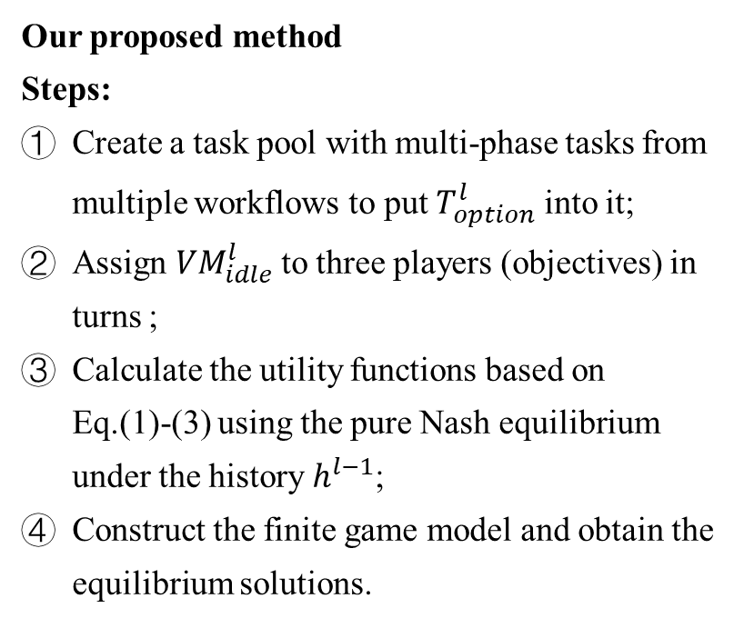
THE MDGT METHOD
3
Our proposed method
Steps:
Create a task pool with multi-phase tasks from multiple workflows to put $T_{option}^{l}$ into it;
Assign ${VM}_{idle}^{l}$ to three players (objectives) in turns ;
Calculate the utility functions based on Eq.(1)-(3) using the pure Nash equilibrium under the history $h^{l−1}$;
Construct the finite game model and obtain the equilibrium solutions.
Notes:
In this paper, we introduce a multi-stage dynamic game-theoretic (MDGT) algorithm, Algorithm 1, to obtain the approximate equilibrium solutions. In this algorithm, during each stage l of the implementation of the workflow planning, a dynamic-game theory-based real-time scheduling method is triggered so that the tasks can be assigned to the most suitable VMs based on the real-time cloud environment. The aim of the scheduling layer is to map optional tasks to the most appropriate VMs. The algorithm repeatedly handles each stage until all tasks are scheduled and the major steps within each stage are as follows:
Step 1: ppt上
Step 2: 同上
Step 3:同上
Step 4:同上

Slide 14
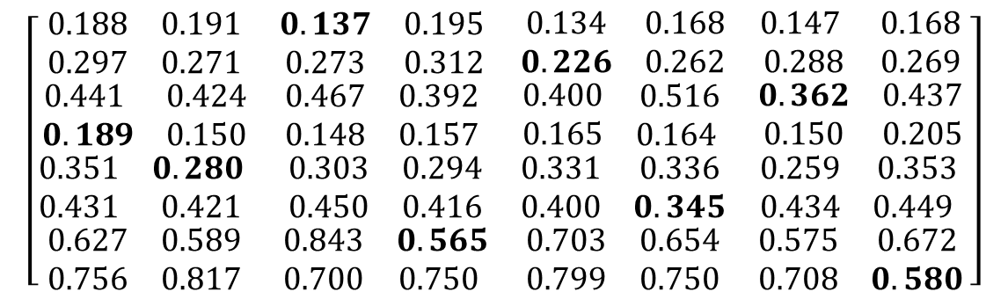
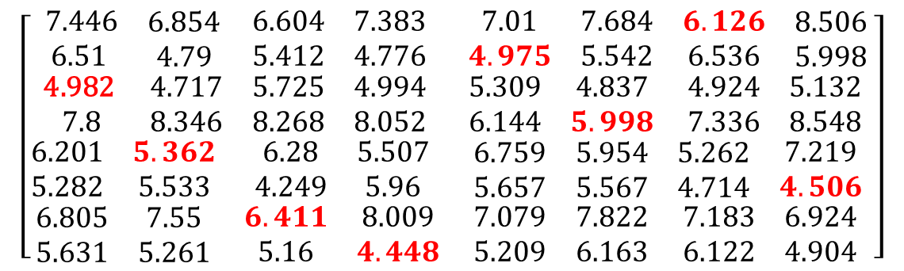
THE MDGT METHOD
4
At each stage : calculate the utilities
Tasks
$$\left[\begin{matrix}\begin{matrix}\begin{matrix}\begin{matrix}7.446 \\ \text{6.51} \end{matrix} & \begin{matrix}6.854 \\ 4.79\end{matrix}\end{matrix} & \begin{matrix}\begin{matrix}6.604 \\ 5.412\end{matrix} & \begin{matrix}7.383 \\ 4.776\end{matrix}\end{matrix} \\ \begin{matrix}\begin{matrix}\text{4.982} \\ 7.8\end{matrix} & \begin{matrix}4.717 \\ 8.346\end{matrix}\end{matrix} & \begin{matrix}\begin{matrix}5.725 \\ 8.268\end{matrix} & \begin{matrix}4.994 \\ 8.052\end{matrix}\end{matrix}\end{matrix} & \begin{matrix}\begin{matrix}\begin{matrix}7.01 \\ 4.975\end{matrix} & \begin{matrix}7.684 \\ 5.542\end{matrix}\end{matrix} & \begin{matrix}\begin{matrix}6.126 \\ 6.536\end{matrix} & \begin{matrix}8.506 \\ 5.998\end{matrix}\end{matrix} \\ \begin{matrix}\begin{matrix}5.309 \\ 6.144\end{matrix} & \begin{matrix}4.837 \\ 5.998\end{matrix}\end{matrix} & \begin{matrix}\begin{matrix}4.924 \\ 7.336\end{matrix} & \begin{matrix}5.132 \\ 8.548\end{matrix}\end{matrix}\end{matrix} \\ \begin{matrix}\begin{matrix}\begin{matrix}6.201 \\ 5.282\end{matrix} & \begin{matrix}5.362 \\ 5.533\end{matrix}\end{matrix} & \begin{matrix}\begin{matrix}6.28 \\ 4.249\end{matrix} & \begin{matrix}5.507 \\ 5.96\end{matrix}\end{matrix} \\ \begin{matrix}\begin{matrix}6.805 \\ 5.631\end{matrix} & \begin{matrix}7.55 \\ 5.261\end{matrix}\end{matrix} & \begin{matrix}\begin{matrix}6.411 \\ 5.16\end{matrix} & \begin{matrix}8.009 \\ 4.448\end{matrix}\end{matrix}\end{matrix} & \begin{matrix}\begin{matrix}\begin{matrix}6.759 \\ 5.657\end{matrix} & \begin{matrix}5.954 \\ 5.567\end{matrix}\end{matrix} & \begin{matrix}\begin{matrix}5.262 \\ 4.714\end{matrix} & \begin{matrix}7.219 \\ 4.506\end{matrix}\end{matrix} \\ \begin{matrix}\begin{matrix}7.079 \\ 5.209\end{matrix} & \begin{matrix}7.822 \\ 6.163\end{matrix}\end{matrix} & \begin{matrix}\begin{matrix}7.183 \\ 6.122\end{matrix} & \begin{matrix}6.924 \\ 4.904\end{matrix}\end{matrix}\end{matrix}\end{matrix} \right]$$
Make-span
(file, /+2/6)
VMs
Tasks
$$\left[\begin{matrix}\begin{matrix}\begin{matrix}\begin{matrix}0.188 \\ \text{0.297}\end{matrix} & \begin{matrix}0.191 \\ 0.271\end{matrix}\end{matrix} & \begin{matrix}\begin{matrix}0.137 \\ 0.273\end{matrix} & \begin{matrix}0.195 \\ 0.312\end{matrix}\end{matrix} \\ \begin{matrix}\begin{matrix}\text{0.441} \\ 0.189\end{matrix} & \begin{matrix}0.424 \\ 0.150\end{matrix}\end{matrix} & \begin{matrix}\begin{matrix}0.467 \\ 0.148\end{matrix} & \begin{matrix}0.392 \\ 0.157\end{matrix}\end{matrix}\end{matrix} & \begin{matrix}\begin{matrix}\begin{matrix}0.134 \\ 0.226\end{matrix} & \begin{matrix}0.168 \\ 0.262\end{matrix}\end{matrix} & \begin{matrix}\begin{matrix}0.147 \\ 0.288\end{matrix} & \begin{matrix}0.168 \\ 0.269\end{matrix}\end{matrix} \\ \begin{matrix}\begin{matrix}0.400 \\ 0.165\end{matrix} & \begin{matrix}0.516 \\ 0.164 \end{matrix}\end{matrix} & \begin{matrix}\begin{matrix}0.362 \\ 0.150\end{matrix} & \begin{matrix}0.437 \\ 0.205\end{matrix}\end{matrix}\end{matrix} \\ \begin{matrix}\begin{matrix}\begin{matrix}0.351 \\ 0.431\end{matrix} & \begin{matrix}0.280 \\ 0.421\end{matrix}\end{matrix} & \begin{matrix}\begin{matrix}0.303 \\ 0.450\end{matrix} & \begin{matrix}0.294 \\ 0.416\end{matrix}\end{matrix} \\ \begin{matrix}\begin{matrix}0.627 \\ 0.756\end{matrix} & \begin{matrix}0.589 \\ 0.817\end{matrix}\end{matrix} & \begin{matrix}\begin{matrix}0.843 \\ 0.700\end{matrix} & \begin{matrix}0.565 \\ 0.750 \end{matrix}\end{matrix}\end{matrix} & \begin{matrix}\begin{matrix}\begin{matrix}0.331 \\ 0.400\end{matrix} & \begin{matrix}0.336 \\ 0.345\end{matrix}\end{matrix} & \begin{matrix}\begin{matrix}0.259 \\ 0.434\end{matrix} & \begin{matrix}0.353 \\ 0.449 \end{matrix}\end{matrix} \\ \begin{matrix}\begin{matrix}0.703 \\ 0.799\end{matrix} & \begin{matrix}0.654 \\ 0.750\end{matrix}\end{matrix} & \begin{matrix}\begin{matrix}0.575 \\ 0.708\end{matrix} & \begin{matrix}0.672 \\ 0.580\end{matrix}\end{matrix}\end{matrix}\end{matrix} \right]$$
Cost
(file, /+2/6)
VMs
Notes:
Particularly, I will present the way to calculate the pure Nash strategies at each stage. Firstly, we calculate the currently minimum make-span, cost and maximum fairness in terms of workload, respectively. The assignment of each player at each stage provides a sum, such as make-span is 42.808, cost is 2.68 and the workload is 18.

Slide 15
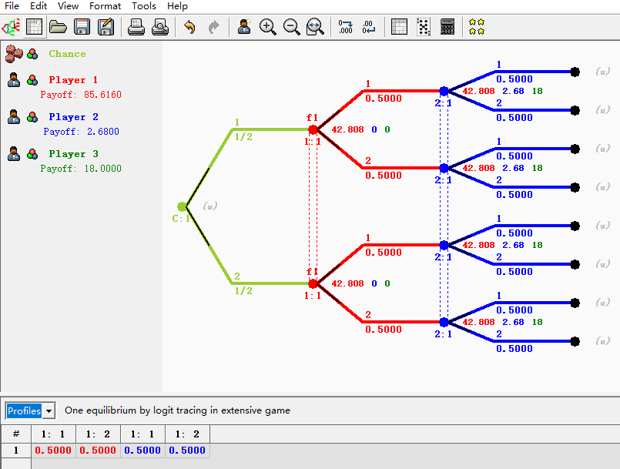

THE MDGT METHOD
4
Calculate the utilities using pure Nash equilibrium
Tasks
6,000
Workload
$$\left[\begin{matrix}\begin{matrix}\begin{matrix}\begin{matrix}5 \\ \text{5} \end{matrix} & \begin{matrix}6 \\ 6\end{matrix}\end{matrix} & \begin{matrix}\begin{matrix}4 \\ 6\end{matrix} & \begin{matrix}3 \\ 6\end{matrix}\end{matrix} \\ \begin{matrix}\begin{matrix}\text{2} \\ 4\end{matrix} & \begin{matrix}6 \\ 2\end{matrix}\end{matrix} & \begin{matrix}\begin{matrix}6 \\ 4\end{matrix} & \begin{matrix}2 \\ 4\end{matrix}\end{matrix}\end{matrix} & \begin{matrix}\begin{matrix}\begin{matrix}5 \\ 4\end{matrix} & \begin{matrix}4 \\ 6\end{matrix}\end{matrix} & \begin{matrix}\begin{matrix}2 \\ 2\end{matrix} & \begin{matrix}6 \\ 4\end{matrix}\end{matrix} \\ \begin{matrix}\begin{matrix}6 \\ 5\end{matrix} & \begin{matrix}2 \\ 3\end{matrix}\end{matrix} & \begin{matrix}\begin{matrix}5 \\ 5\end{matrix} & \begin{matrix}6 \\ 2\end{matrix}\end{matrix}\end{matrix} \\ \begin{matrix}\begin{matrix}\begin{matrix}2 \\ 2\end{matrix} & \begin{matrix}2 \\ 5\end{matrix}\end{matrix} & \begin{matrix}\begin{matrix}3 \\ 5\end{matrix} & \begin{matrix}2 \\ 3\end{matrix}\end{matrix} \\ \begin{matrix}\begin{matrix}2 \\ 4\end{matrix} & \begin{matrix}2 \\ 2\end{matrix}\end{matrix} & \begin{matrix}\begin{matrix}2 \\ 5\end{matrix} & \begin{matrix}3 \\ 5\end{matrix}\end{matrix}\end{matrix} & \begin{matrix}\begin{matrix}\begin{matrix}4 \\ 4\end{matrix} & \begin{matrix}3 \\ 5\end{matrix}\end{matrix} & \begin{matrix}\begin{matrix}6 \\ 6\end{matrix} & \begin{matrix}4 \\ 6\end{matrix}\end{matrix} \\ \begin{matrix}\begin{matrix}5 \\ 4\end{matrix} & \begin{matrix}6 \\ 2\end{matrix}\end{matrix} & \begin{matrix}\begin{matrix}3 \\ 5\end{matrix} & \begin{matrix}2 \\ 3\end{matrix}\end{matrix}\end{matrix}\end{matrix} \right]$$
VMs
Notes:
Then, save the strategies of players and calculate its pure Nash equilibrium solution. A clear calculating process example of one equilibrium by logit in extensive game is shown as above picture. And after each stage, we will instantly deploy our assignments for virtual machines.

Slide 16
PPT模板下载：www.1ppt.com/moban/ 行业PPT模板：www.1ppt.com/hangye/
节日PPT模板：www.1ppt.com/jieri/ PPT素材下载：www.1ppt.com/sucai/
PPT背景图片：www.1ppt.com/beijing/ PPT图表下载：www.1ppt.com/tubiao/
优秀PPT下载：www.1ppt.com/xiazai/ PPT教程： www.1ppt.com/powerpoint/
Word教程： www.1ppt.com/word/ Excel教程：www.1ppt.com/excel/
资料下载：www.1ppt.com/ziliao/ PPT课件下载：www.1ppt.com/kejian/
范文下载：www.1ppt.com/fanwen/ 试卷下载：www.1ppt.com/shiti/
教案下载：www.1ppt.com/jiaoan/ PPT论坛：www.1ppt.cn
5
CASE STUDY
Notes:
In this section, we conduct extensive case study based on 5 well-known scientific workflow templates and real-world third-party commercial clouds, i.e., Amazon EC2, Tencent, and Ali Clouds. Every task in all workflows implements a GaussCLegendre calculation procedure with 8M of digits through executing the Super-Pi program on VMs. We create heterogeneous VMs on these clouds and expose them to the scheduling algorithms.

Slide 17
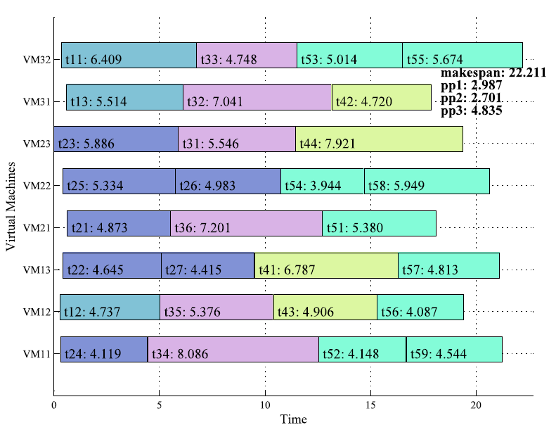
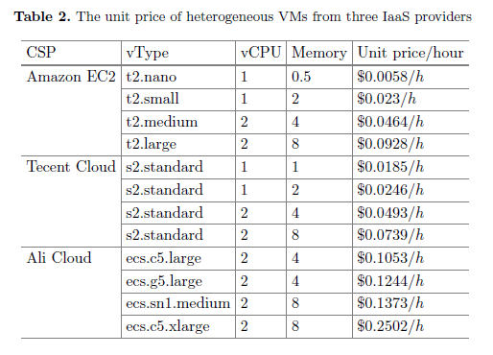
CASE STUDY
5
6,000
Notes:
Table 2 shows the price-per-unit-time of such VMs with different resource configurations. A resulting scheduling scheme generated by our proposed method is shown in right figure. In this case study, the make-span is 22.211, the cost of provider 1 is 2.987, provider 2 is 2.701, and provider 3 is 4.835, and the system fairness is approximately 0.96.

Slide 18
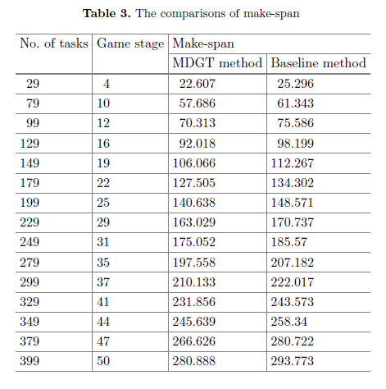
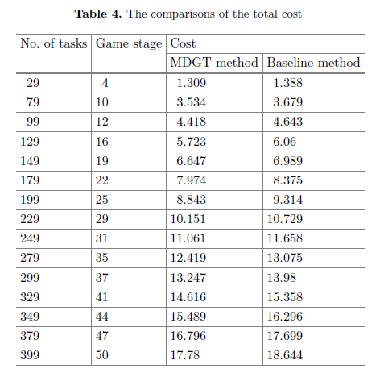
CASE STUDY
5
Make-span
Cost
6,000
Notes:
Further more, we compare our proposed method with a traditional non-game-theoretic algorithm proposed in [25]. Note that: (1) we notice several other game-theoretic scheduling algorithms, e.g., [22,23,26], but find out that they are intended for different problems and based on different architectural configurations and resource constraints. We are therefore unable to compare them with our proposed method, (2) other non-game-theoretic methods can be found in, e.g., [5,27]. However, our tests show that their performance is actually very close to that of the baseline one, (3) we are pretty aware of the fact that meta-heuristic algorithms, e.g., PSO and GA-based ones, could well be promising options. However, we do not implement them and compare them with our proposed method because we consider scientific applications to be time-critical and meta-heuristic algorithms are with high time complexity.
Tables 3 and 4 present the comparisons of make-span and cost, respectively. As the total number of tasks from five workflows increases, the number of game stage increases. And our proposed MDGT method performs better than the baseline method.

Slide 19
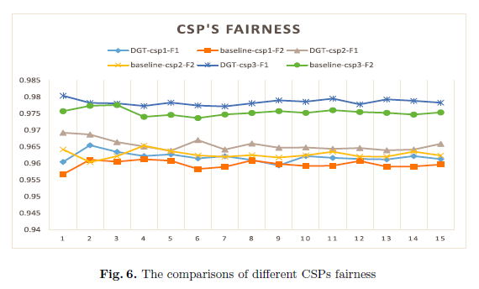
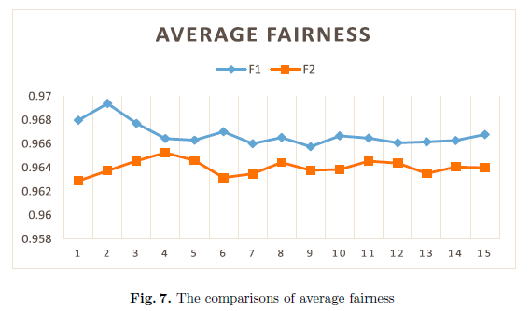
CASE STUDY
5
Fairness
6,000
Notes:
In Fig. 6, we show the comparisons of fairness indexes with different IaaS cloud service providers. The curves represents that our method outperforms the baseline method. Similarly, the results in Fig. 7 show that the MDGT method performs better than baseline method on the average fairness.

Slide 20
SUMMARY
6
In this paper,
We studied multi-objective multi-workflow scheduling problem over heterogeneous VMs created on multi-Clouds.
We introduce a multi-stage dynamic game-theoretic (MDGT) scheduling approach, which is featured by optimization among make-span, system fairness and total cost.
We conduct extensive experiments based on well-know scientific workflow templates and real-world third-party commercial IaaS clouds.
Experimental results demonstrate that our approach outperforms traditional baseline ones.
Notes:
To sum up, we studied multi-objective multi-workflow scheduling problem over heterogeneous VMs created on multi-Clouds platforms and introduce a multi-stage dynamic game-theoretic (MDGT) scheduling approach. The proposed method is featured by approximation algorithm for identifying equilibrium solutions aiming at optimizing both workflow make-span, system fairness and the total cost. In addition, we conduct extensive experiments based on various well-kwon scientific workflow templates and real-world third-party commercial IaaS clouds. Experimental results demonstrate that our approach outperforms traditional baseline ones.

