Slide 1
A Christian Home
TALMIDO / CHAPTER 10
A home that welcomes Christ
Prayer, love, and faith in everyday life.
Talmido 10 / pp. 56–60
1
Notes:
Allow 12–15 minutes. Welcome different family structures and living situations. A Christian home is defined by its life in Christ, not its size, wealth, or furnishings.
Source: Our Sacramental Life, Sixth Grade, June 2026, Sunday School of the North American Dioceses of the Malankara Orthodox Syrian Church. User-supplied curriculum. Teaching summaries and practice questions are paraphrased. Printed pp. 56–60.

Slide 2
The home extends the life of the Church
Faith is lived beyond the church building.
Families pray and give thanks together.
Daily love makes our faith visible.
Talmido 10 / p. 56
2
Notes:
The lesson calls the family the smallest unit of the Church. Emphasize that children can practice faith through kindness and prayer in varied household circumstances.
Source: Our Sacramental Life, Sixth Grade, June 2026, Sunday School of the North American Dioceses of the Malankara Orthodox Syrian Church. User-supplied curriculum. Teaching summaries and practice questions are paraphrased. Printed p. 56.

Slide 3
Why bless a home?
We dedicate our home and life to God.
We ask for His presence and protection.
We renew our commitment to live in His love.
Talmido 10 / pp. 56–57
3
Notes:
A house blessing is not a substitute for loving conduct. Explain annual renewal as part of the curriculum’s practice, with local arrangements guided by the parish priest.
Source: Our Sacramental Life, Sixth Grade, June 2026, Sunday School of the North American Dioceses of the Malankara Orthodox Syrian Church. User-supplied curriculum. Teaching summaries and practice questions are paraphrased. Printed pp. 56–57.

Slide 4
Prepare simply and prayerfully
Make space for prayer.
Prepare the items the priest requests.
Prayer and charity matter more than luxury.
Talmido 10 / p. 57
4
Notes:
The curriculum describes a table with white cloth, water, candles, cross, and incense, with room to pray facing east. Coordinate actual arrangements with the priest. The lesson emphasizes spiritual preparation, fasting, prayer, and charity.
Source: Our Sacramental Life, Sixth Grade, June 2026, Sunday School of the North American Dioceses of the Malankara Orthodox Syrian Church. User-supplied curriculum. Teaching summaries and practice questions are paraphrased. Printed p. 57.

Slide 5
What happens at a house blessing?
The household gathers for prayer.
We hear the Gospel and share the Church’s faith.
Blessed water and the cross mark the home.
Talmido 10 / pp. 57–60
5
Notes:
The order includes Kauma, hymns, Gospel, prayers, blessing and sprinkling water, marking doorposts with the cross, Creed, incense, and benediction. Present the overall meaning instead of a rigid how-to ritual.
Source: Our Sacramental Life, Sixth Grade, June 2026, Sunday School of the North American Dioceses of the Malankara Orthodox Syrian Church. User-supplied curriculum. Teaching summaries and practice questions are paraphrased. Printed pp. 57–60.

Slide 6
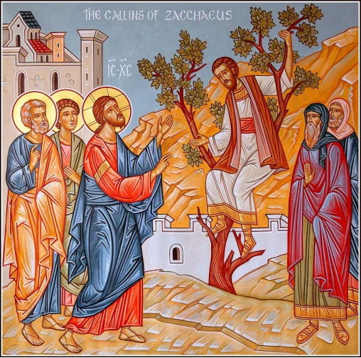
Zacchaeus welcomes Jesus
Zacchaeus wants to see Jesus.
Jesus comes to his home.
A changed heart leads to generous action.
Talmido 10 / p. 58
6
Notes:
Retell Luke 19: Zacchaeus climbs a tree, Jesus welcomes him, and he promises half his goods to the poor and fourfold repayment for fraud. Emphasize repentance, restitution, and welcome. Image: Zacchaeus icon reproduced in the curriculum, printed p. 58.
Source: Our Sacramental Life, Sixth Grade, June 2026, Sunday School of the North American Dioceses of the Malankara Orthodox Syrian Church. User-supplied curriculum. Teaching summaries and practice questions are paraphrased. Printed p. 58.

Slide 7
Signs that help us remember
Blessed water points us toward God’s blessing.
The cross marks our belonging to Christ.
We pray for the living and the departed.
Talmido 10 / pp. 59–60
7
Notes:
The curriculum connects marked doorposts with Passover in Exodus 12 and recalls God’s protection of Noah and others. Explain these as biblical connections in the prayers, not a guarantee that a household will never face hardship.
Source: Our Sacramental Life, Sixth Grade, June 2026, Sunday School of the North American Dioceses of the Malankara Orthodox Syrian Church. User-supplied curriculum. Teaching summaries and practice questions are paraphrased. Printed pp. 59–60.

Slide 8
Keep the blessing alive each day
Give thanks together.
Forgive and work through disagreements.
Share what you have with someone in need.
Talmido 10 / pp. 56, 60
8
Notes:
New application grounded in the lesson. Ask students to choose one realistic habit for the coming week. Do not require private family disclosures or suggest children are responsible for solving adult conflict.
Source: Our Sacramental Life, Sixth Grade, June 2026, Sunday School of the North American Dioceses of the Malankara Orthodox Syrian Church. User-supplied curriculum. Teaching summaries and practice questions are paraphrased. Printed pp. 56, 60.

Slide 9
Chapter 10 quick quiz
1. Why do we ask for a house blessing?
2. How did Zacchaeus show a changed heart?
3. Name one habit of a Christian home.
Talmido 10 / pp. 56–60
9
Notes:
Pause before the answer slide. These are newly written curriculum-based practice questions. Accept equivalent meaning.
Source: Our Sacramental Life, Sixth Grade, June 2026, Sunday School of the North American Dioceses of the Malankara Orthodox Syrian Church. User-supplied curriculum. Teaching summaries and practice questions are paraphrased. Printed pp. 56–60.

Slide 10
Answers and one idea to remember
1. To dedicate our home and life to God.
2. He gave to the poor and promised repayment.
3. Prayer, gratitude, forgiveness, or generosity.
A Christian home lives Christ’s love.
Talmido 10 / pp. 56–60
10
Notes:
For detail: Zacchaeus promised half his goods to the poor and fourfold repayment for fraud. End by asking for one small, kind action students can practice this week.
Source: Our Sacramental Life, Sixth Grade, June 2026, Sunday School of the North American Dioceses of the Malankara Orthodox Syrian Church. User-supplied curriculum. Teaching summaries and practice questions are paraphrased. Printed pp. 56–60.

