Slide 1
Holy Confession
TALMIDO / CHAPTER 8
Returning to our loving Father
Repentance, forgiveness, and a new beginning.
Talmido 8 / pp. 47–50
1
Notes:
Allow 12–15 minutes. Keep discussion about the lesson and fictional examples. Never ask children to confess personal sins to the class.
Source: Our Sacramental Life, Sixth Grade, June 2026, Sunday School of the North American Dioceses of the Malankara Orthodox Syrian Church. User-supplied curriculum. Teaching summaries and practice questions are paraphrased. Printed pp. 47–50.

Slide 2
Sin wounds our relationship with God
The lesson compares sin to spiritual sickness.
God wants to heal and restore us.
Confession is a return to His love.
Talmido 8 / p. 47
2
Notes:
Explain that spiritual sickness is an image for sin and our need for healing. Do not equate physical illness or disability with moral failure.
Source: Our Sacramental Life, Sixth Grade, June 2026, Sunday School of the North American Dioceses of the Malankara Orthodox Syrian Church. User-supplied curriculum. Teaching summaries and practice questions are paraphrased. Printed p. 47.

Slide 3
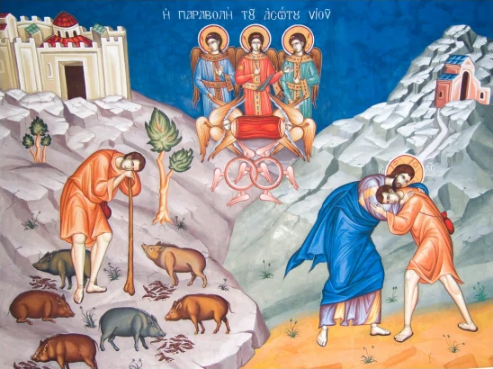
The father welcomes his son
The prodigal son turns back toward home.
His father receives him with love.
Repentance means turning back to God.
Talmido 8 / p. 47
3
Notes:
Briefly retell the prodigal son: leaving, recognizing his need, returning, and being welcomed. The lost sheep likewise shows joy over repentance; see Luke 15:7. Image: prodigal son icon reproduced in the supplied curriculum, printed p. 47.
Source: Our Sacramental Life, Sixth Grade, June 2026, Sunday School of the North American Dioceses of the Malankara Orthodox Syrian Church. User-supplied curriculum. Teaching summaries and practice questions are paraphrased. Printed p. 47.

Slide 4
God forgives; the priest ministers
God is the source of forgiveness.
The priest is a witness and spiritual guide.
Christ entrusted a ministry of forgiveness to the Apostles.
Talmido 8 / p. 48
4
Notes:
Discuss John 20:23 as the lesson’s foundation. Ordained ministry continues through apostolic succession and the laying on of hands. A priest does not replace God; he ministers within Christ’s Church.
Source: Our Sacramental Life, Sixth Grade, June 2026, Sunday School of the North American Dioceses of the Malankara Orthodox Syrian Church. User-supplied curriculum. Teaching summaries and practice questions are paraphrased. Printed p. 48.

Slide 5
Prepare with honesty
Examine your thoughts, words, and actions.
Be sorry and willing to change.
You may write reminders before confession.
Talmido 8 / pp. 48–49
5
Notes:
Use a quiet examination of conscience privately. Explain that honesty matters more than impressive words. Ask one’s priest for guidance on preparation and frequency. Do not collect students’ written examinations.
Source: Our Sacramental Life, Sixth Grade, June 2026, Sunday School of the North American Dioceses of the Malankara Orthodox Syrian Church. User-supplied curriculum. Teaching summaries and practice questions are paraphrased. Printed pp. 48–49.

Slide 6
Repentance becomes action
Ask forgiveness when you hurt someone.
Try to repair the harm.
Forgive others and ask God for help to grow.
Talmido 8 / pp. 49–50
6
Notes:
Being forgiven does not make every consequence disappear. Repair might include correcting a rumor or returning something. Forgiveness does not mean hiding harm or avoiding help from a trusted adult.
Source: Our Sacramental Life, Sixth Grade, June 2026, Sunday School of the North American Dioceses of the Malankara Orthodox Syrian Church. User-supplied curriculum. Teaching summaries and practice questions are paraphrased. Printed pp. 49–50.

Slide 7
Confession belongs to our life in Christ
It renews our commitment to God.
It helps restore relationships.
It supports preparation for Holy Communion.
Talmido 8 / p. 50
7
Notes:
Connect confession with renewing baptismal commitments and with peace before the Eucharist. Preparation and frequency should follow guidance from the student’s priest or spiritual father.
Source: Our Sacramental Life, Sixth Grade, June 2026, Sunday School of the North American Dioceses of the Malankara Orthodox Syrian Church. User-supplied curriculum. Teaching summaries and practice questions are paraphrased. Printed p. 50.

Slide 8
A chance to begin again
Someone spreads an unkind rumor.
Later, they realize the harm they caused.
What would sincere repentance look like?
Talmido 8 / pp. 49–50
8
Notes:
New classroom application. Possible answers: stop repeating the rumor, tell the truth to those misled, apologize, ask God’s forgiveness, and seek guidance. Do not ask whether students have done this.
Source: Our Sacramental Life, Sixth Grade, June 2026, Sunday School of the North American Dioceses of the Malankara Orthodox Syrian Church. User-supplied curriculum. Teaching summaries and practice questions are paraphrased. Printed pp. 49–50.

Slide 9
Chapter 8 quick quiz
1. Who is the source of forgiveness?
2. How can we prepare for confession?
3. Is repentance only saying “sorry”? Explain.
Talmido 8 / pp. 48–50
9
Notes:
Pause for answers. These are newly written curriculum-based questions. Accept meaning, not exact wording.
Source: Our Sacramental Life, Sixth Grade, June 2026, Sunday School of the North American Dioceses of the Malankara Orthodox Syrian Church. User-supplied curriculum. Teaching summaries and practice questions are paraphrased. Printed pp. 48–50.

Slide 10
Answers and one idea to remember
1. God; the priest ministers as witness and guide.
2. Examine ourselves honestly and desire change.
3. No. We turn back to God and try to repair harm.
God welcomes us back into His love.
Talmido 8 / pp. 47–50
10
Notes:
Finish with the father’s welcome in the prodigal son. Repentance involves real effort and trust in God’s mercy, not despair or public shame.
Source: Our Sacramental Life, Sixth Grade, June 2026, Sunday School of the North American Dioceses of the Malankara Orthodox Syrian Church. User-supplied curriculum. Teaching summaries and practice questions are paraphrased. Printed pp. 47–50.

