Slide 1
Anointing of the Sick
TALMIDO / CHAPTER 9
Christ cares for the whole person
Prayer, healing, and the love of the Church.
Talmido 9 / pp. 51–55
1
Notes:
Allow 12–15 minutes. Be sensitive to students with sick or grieving family members. Do not promise that a sacrament guarantees physical recovery.
Source: Our Sacramental Life, Sixth Grade, June 2026, Sunday School of the North American Dioceses of the Malankara Orthodox Syrian Church. User-supplied curriculum. Teaching summaries and practice questions are paraphrased. Printed pp. 51–55.

Slide 2
God does not abandon us in suffering
We live in a world marked by suffering.
Illness is not proof of a person’s sin.
Christ meets us with compassion.
Talmido 9 / pp. 51–52
2
Notes:
Avoid blaming a sick person. The curriculum places suffering in the fallen condition of the world and presents Christ as healer. Students may need reassurance that illness is not their fault.
Source: Our Sacramental Life, Sixth Grade, June 2026, Sunday School of the North American Dioceses of the Malankara Orthodox Syrian Church. User-supplied curriculum. Teaching summaries and practice questions are paraphrased. Printed pp. 51–52.

Slide 3
Healing is more than physical recovery
We bring body and soul before God.
We seek strength, peace, and healing.
The Church supports the whole person.
Talmido 9 / pp. 51–53
3
Notes:
The lesson includes physical, spiritual, mental, and emotional needs. God’s care is present even when an illness continues. Encourage medical care alongside prayer.
Source: Our Sacramental Life, Sixth Grade, June 2026, Sunday School of the North American Dioceses of the Malankara Orthodox Syrian Church. User-supplied curriculum. Teaching summaries and practice questions are paraphrased. Printed pp. 51–53.

Slide 4
A sacrament for those who are sick
Holy Unction is another name for this sacrament.
It is not only for the moment of death.
It may be received again when needed.
Talmido 9 / pp. 52–53
4
Notes:
Explain unction as anointing. Refer students and families to their priest for pastoral guidance. Avoid treating the rite as a last resort or as a replacement for treatment.
Source: Our Sacramental Life, Sixth Grade, June 2026, Sunday School of the North American Dioceses of the Malankara Orthodox Syrian Church. User-supplied curriculum. Teaching summaries and practice questions are paraphrased. Printed pp. 52–53.

Slide 5
Prayer and anointing
Scripture, hymns, and prayers are offered.
The priest prays and anoints with holy oil.
James 5:14–15 connects prayer and anointing.
Talmido 9 / pp. 53–54
5
Notes:
The curriculum describes the priest placing a hand on the head, an opportunity for confession, and anointing the forehead and chest with olive oil (zythe). This is distinct from Holy Chrism. Paraphrase Scripture rather than inventing a quotation.
Source: Our Sacramental Life, Sixth Grade, June 2026, Sunday School of the North American Dioceses of the Malankara Orthodox Syrian Church. User-supplied curriculum. Teaching summaries and practice questions are paraphrased. Printed pp. 53–54.

Slide 6
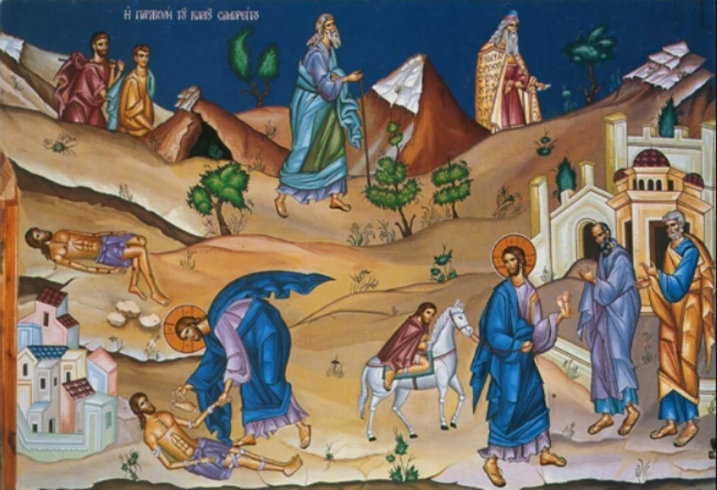
The Good Samaritan: compassion in action
He sees the wounded man.
He stops and cares for him.
Love becomes practical help.
Talmido 9 / pp. 54–55
6
Notes:
Retell the Good Samaritan briefly. The curriculum’s Church interpretation sees Christ in the compassionate Samaritan and the Church in the inn. Identify this as a spiritual reading of the parable. Image: Good Samaritan icon reproduced in the curriculum, printed p. 54.
Source: Our Sacramental Life, Sixth Grade, June 2026, Sunday School of the North American Dioceses of the Malankara Orthodox Syrian Church. User-supplied curriculum. Teaching summaries and practice questions are paraphrased. Printed pp. 54–55.

Slide 7
We can care for people who are sick
Pray for them.
Offer company and encouragement.
Support the care they need.
Talmido 9 / p. 55
7
Notes:
Age-appropriate actions include a card, a kind message, or a family-approved visit. Respect rest, privacy, and health precautions. Prayer complements medical care.
Source: Our Sacramental Life, Sixth Grade, June 2026, Sunday School of the North American Dioceses of the Malankara Orthodox Syrian Church. User-supplied curriculum. Teaching summaries and practice questions are paraphrased. Printed p. 55.

Slide 8
How could you help?
A friend is away from school because of illness.
They feel lonely and left out.
Name one kind action you could take.
Talmido 9 / p. 55
8
Notes:
New classroom application. Examples: send a message, share class notes, make a card, or include them remotely when appropriate. Do not speculate about the illness or demand private details.
Source: Our Sacramental Life, Sixth Grade, June 2026, Sunday School of the North American Dioceses of the Malankara Orthodox Syrian Church. User-supplied curriculum. Teaching summaries and practice questions are paraphrased. Printed p. 55.

Slide 9
Chapter 9 quick quiz
1. What is another name for this sacrament?
2. Is it only for someone near death?
3. Name one way we can care for the sick.
Talmido 9 / pp. 52–55
9
Notes:
Allow students to answer before advancing. These are newly written curriculum-based practice questions.
Source: Our Sacramental Life, Sixth Grade, June 2026, Sunday School of the North American Dioceses of the Malankara Orthodox Syrian Church. User-supplied curriculum. Teaching summaries and practice questions are paraphrased. Printed pp. 52–55.

Slide 10
Answers and one idea to remember
1. Holy Unction.
2. No. It is for the sick and may be repeated.
3. Pray, encourage, visit appropriately, or help.
Christ’s compassion calls us to care.
Talmido 9 / pp. 51–55
10
Notes:
Accept suitable practical examples. Reaffirm that prayer and medical care belong together and that ongoing illness does not mean weak faith.
Source: Our Sacramental Life, Sixth Grade, June 2026, Sunday School of the North American Dioceses of the Malankara Orthodox Syrian Church. User-supplied curriculum. Teaching summaries and practice questions are paraphrased. Printed pp. 51–55.

