Slide 1
CoTour
An urban game app
For tourists to visit a city and find important integrity points.

Slide 2

Project overview
CoTour:
a location-based game
Keywords:
Mobile storytelling, Place, Space, location-based game, city exploration, Memento.

Slide 3
The goal:
Insert one to two sentences about the goal of the project.
Project overview
The problem:
Nowadays, it is very likely that a visitor or a tourist experiences a new environment only by observing the physical structure of the spaces missing a more complete comprehension of the place which considers cultural understanding of the community.
Considering the critical distinction between “space” and “place” it is vital to upgrade new opportunities for visitors to interact the place.
In addressing this issue, an engagement which intensify the real identity and culture of the environment is required.
Developing a sense of place through digital storytelling is the main aim of this project. Citizens play a key role to this aim as their thoughtful contributions confer a more effective and compelling perception of the place.
consequently the visitor will be stimulated and encouraged by these stories embodied in the spaces to foster his understanding and make a memento of his visit by saving them.

Slide 4
Project overview
My role:
Lead UX designer, UX researcher, etc.
Responsibilities:
List the responsibilities you had throughout the project - e.g., user research, wireframing, prototyping, etc.

Slide 5
User research
Personas
Problem statements
User journey maps
Understanding
the user

Slide 6
User research: summary
Write a short paragraph describing your user research.
This can include the type of research you conducted, assumptions that you made going into the research, and how your assumptions changed after conducting research.
Visitors who intend to experience new urban environment. Locals who intend to have active participation in their living environment.

Slide 7
User research: pain points
1
2
3
4
Pain point
Pain point
Pain point
Pain point
Write one to two sentences reflecting on the pain point listed above and how it will guide designs moving forward.
Write one to two sentences reflecting on the pain point listed above and how it will guide designs moving forward.
Write one to two sentences reflecting on the pain point listed above and how it will guide designs moving forward.
Write one to two sentences reflecting on the pain point listed above and how it will guide designs moving forward.

Slide 8
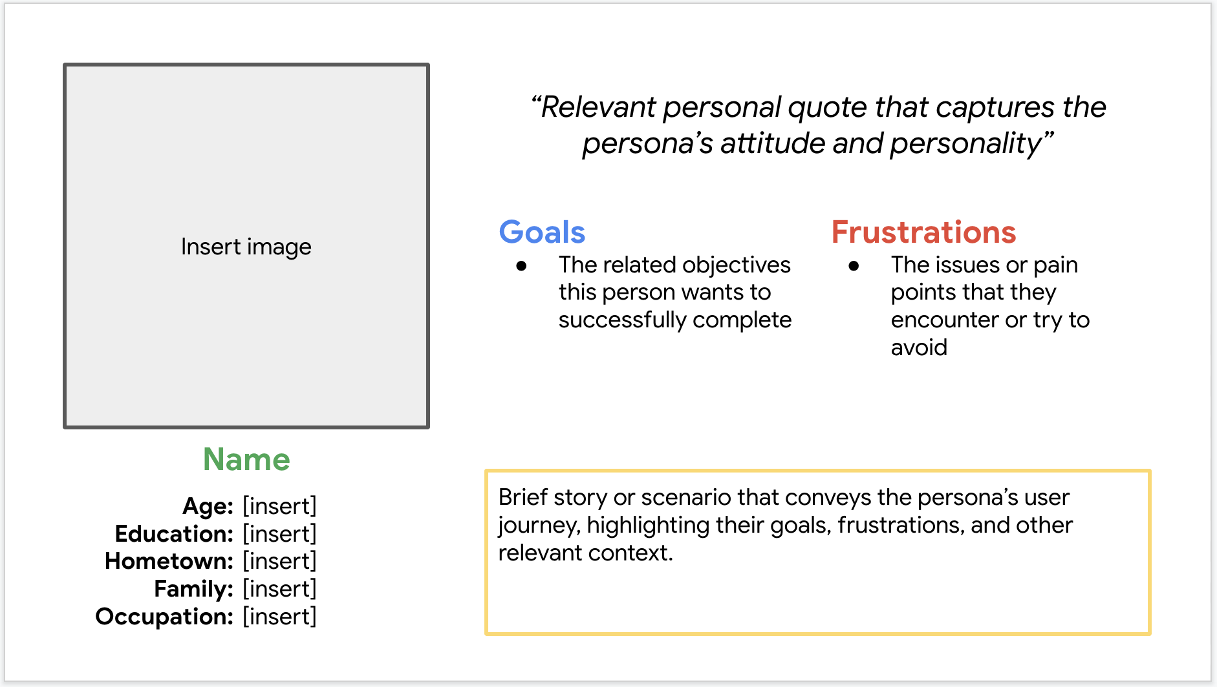
Persona: Name
Problem statement:
[User name] is a [user characteristics]
who needs [user need]
because [insight].

Slide 9
User journey map
[Your notes about goals and thought process]
Image of user journey map

Slide 10
Paper wireframes
Digital wireframes
Low-fidelity prototype
Usability studies
Starting
the design

Slide 11
Paper wireframes
[Your notes about goals and thought process]
Image of paper wireframes including five different versions of the same screen and one image of the new, refined version

Slide 12
Digital wireframes
Description of the element and its benefit to the user
[Your notes about goals and thought process]
Insert first wireframe example that demonstrates design thinking aligned with user research
Description of the element and its benefit to the user

Slide 13
Digital wireframes
Description of the element and its benefit to the user
[Your notes about goals and thought process]
Insert second wireframe example that demonstrates design thinking aligned with user research
Description of the element and its benefit to the user

Slide 14
Low-fidelity prototype
[Link to low-fidelity prototype and brief description of the user flow]
Screenshot of prototype with connections or prototype GIF

Slide 15
Usability study: findings
Write a short introduction to the usability studies you conducted and your findings.
Round 1 findings
Round 2 findings
1
Insert finding
1
Insert finding
2
Insert finding
2
Insert finding
3
Insert finding
3
Insert finding

Slide 16
Refining
the design
Mockups
High-fidelity prototype
Accessibility

Slide 17
Mockups
Before usability study
After usability study
[Your notes about goals and thought process]
Image of selected screen before usability study
Image of selected screen after usability study

Slide 18
Mockups
Before usability study
After usability study
[Your notes about goals and thought process]
Image of selected screen before usability study
Image of selected screen after usability study

Slide 19
Mockups
Main mockup screen for display
Main mockup screen for display
Main mockup screen for display
Main mockup screen for display

Slide 20
High-fidelity prototype
[Link to high-fidelity prototype]
Screenshot of prototype with connections or prototype GIF

Slide 21
Accessibility considerations
1
2
3
Insert one to two sentence summaries describing each accessibility consideration applied in your designs.
Insert one to two sentence summaries describing each accessibility consideration applied in your designs.
Insert one to two sentence summaries describing each accessibility consideration applied in your designs.

Slide 22
Going forward
Takeaways
Next steps

Slide 23
Takeaways
Impact:
Insert one to two sentences summarizing the impact of your designs. In the real world, you’d include data like number of downloads or sign ups, but since this is a course project, you can include a positive quote from a peer or study participant.
What I learned:
Insert a few sentences summarizing what you learned throughout the project.

Slide 24
Next steps
1
2
3
Insert a few sentences summarizing the next steps you would take with this project and why.
Insert a few sentences summarizing the next steps you would take with this project and why.
Insert a few sentences summarizing the next steps you would take with this project and why.

Slide 25
Insert a few sentences summarizing the next steps you would take with this project and why. Feel free to organize next steps in a bullet point list.
Let’s connect!
Insert a brief sentence or two about contacting you and/or reviewing more of your work.
Provide your contact information here. This might include your email address, phone number, and website or link to other professional platforms.

Slide 26
Thank you!

