Slide 1
Convex Hull
2012/10/23
Notes:
Add intro topics

Slide 2
Convex vs. Concave
A polygon P is convex if for every pair of points x and y in P, the line xy is also in P; otherwise, it is called concave.
x
P
x
y
P
y
concave
convex

Slide 3
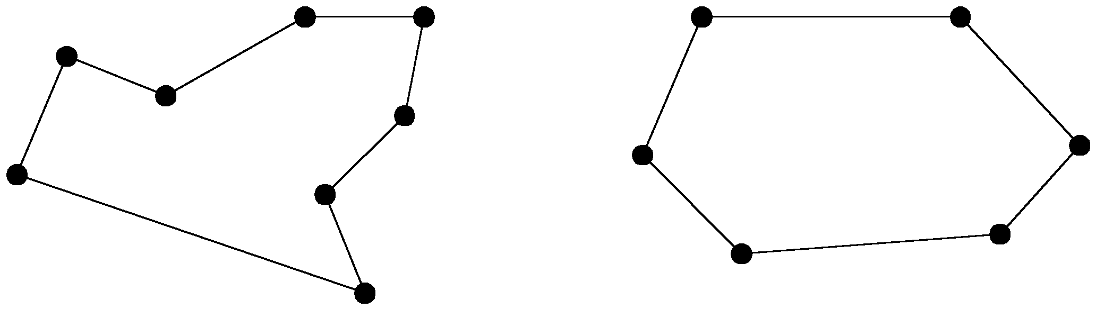
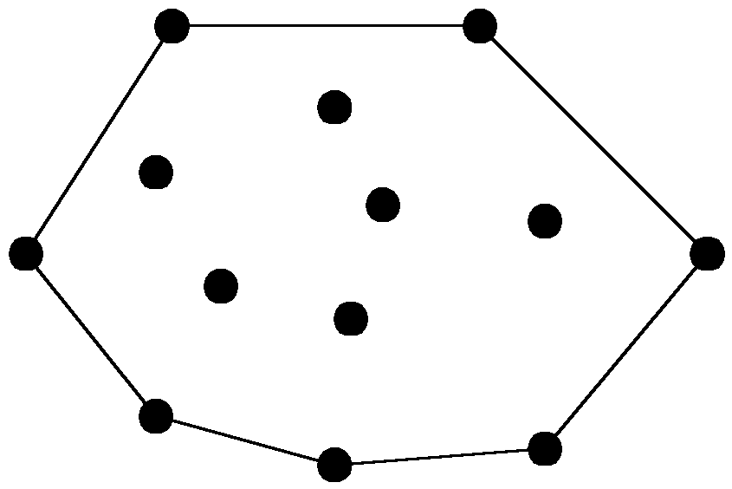
The convex hull problem
concave polygon:
convex polygon:
The convex hull of a set of planar points is the smallest convex polygon containing all of the points.

Slide 4
Graham’s Scan
Start at point guaranteed to be on the hull. (the point with the minimum y value)
Sort remaining points by polar angles of vertices relative to the first point.
Go through sorted points, keeping vertices of points that have left turns and dropping points that have right turns.
Notes:
Positive cross product is right turn, negative is left turn

Slide 5
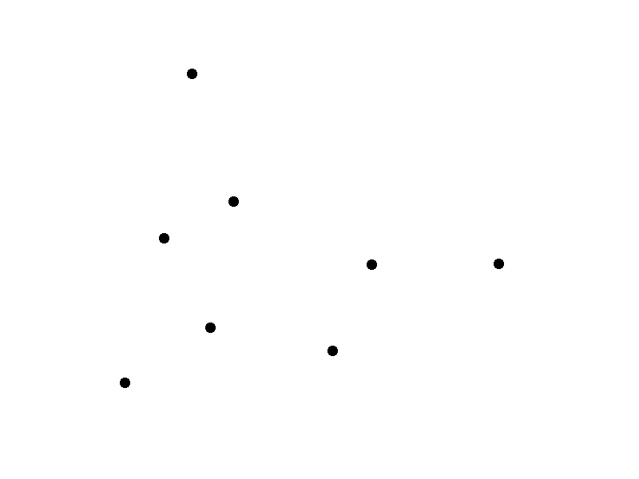
Graham’s Scan

Slide 6
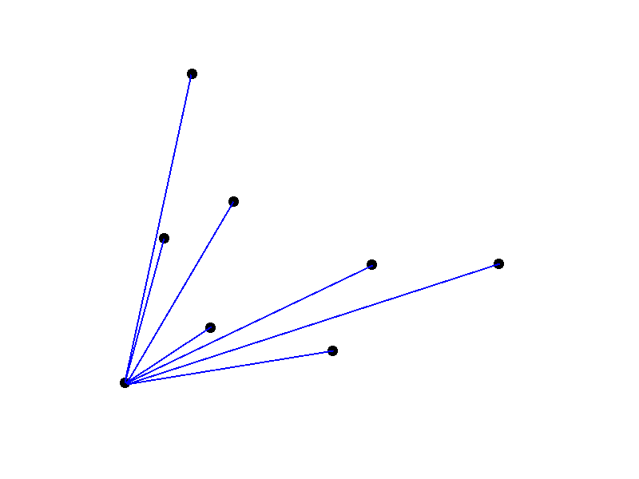
Graham’s Scan

Slide 7
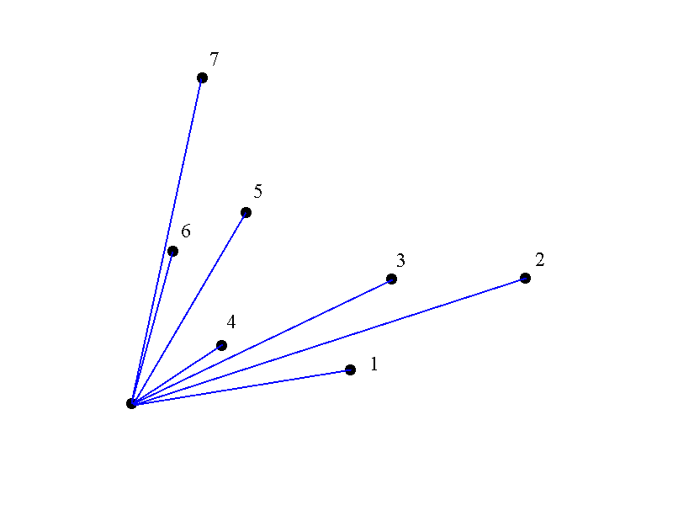
Graham’s Scan

Slide 8
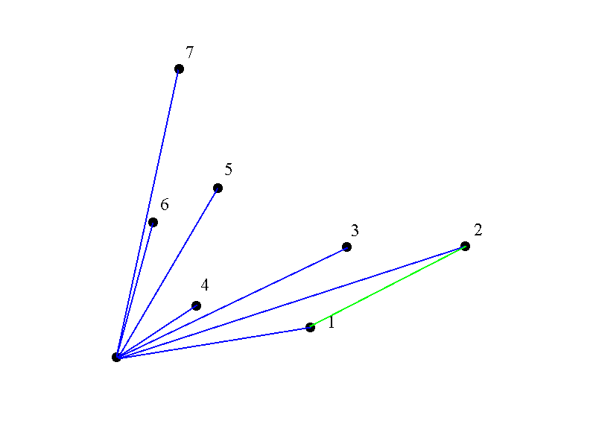
Graham’s Scan

Slide 9
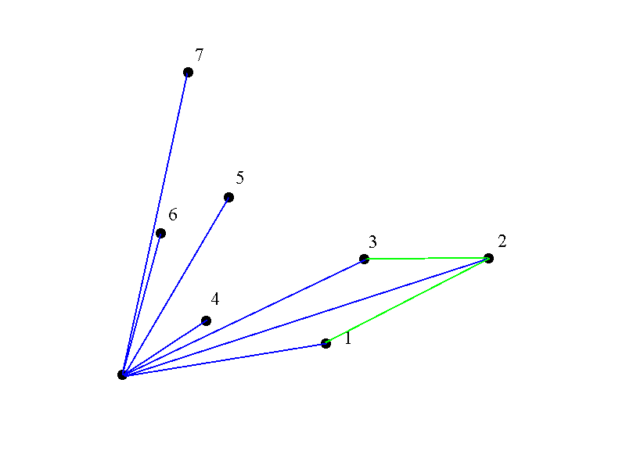
Graham’s Scan

Slide 10
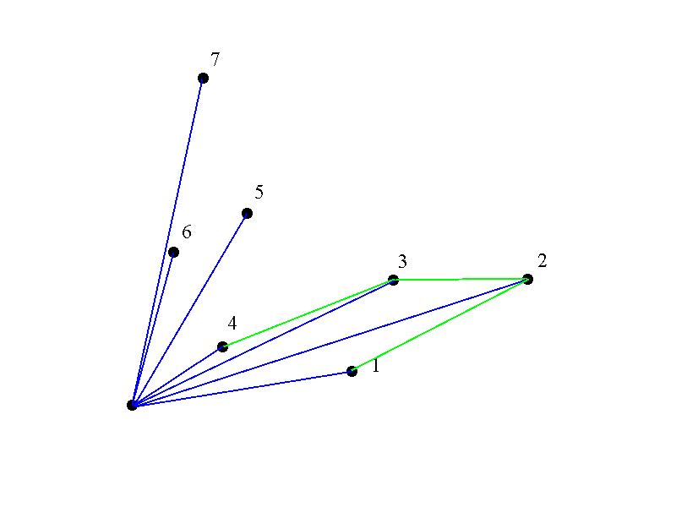
Graham’s Scan

Slide 11
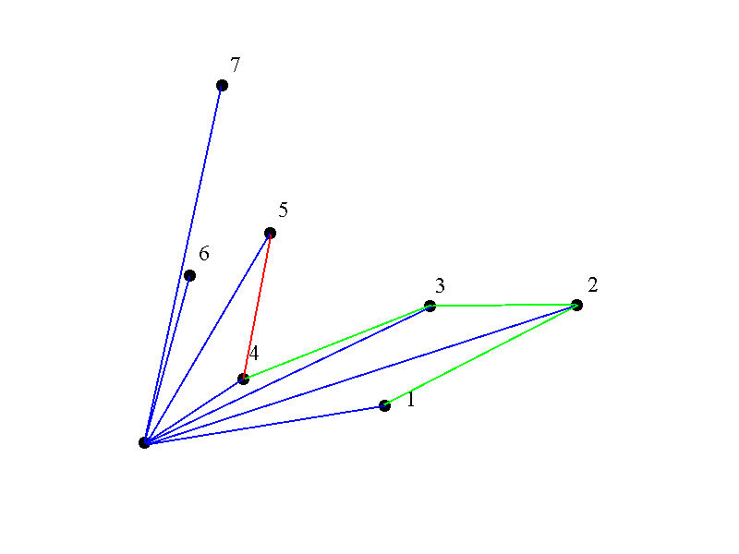
Graham’s Scan

Slide 12
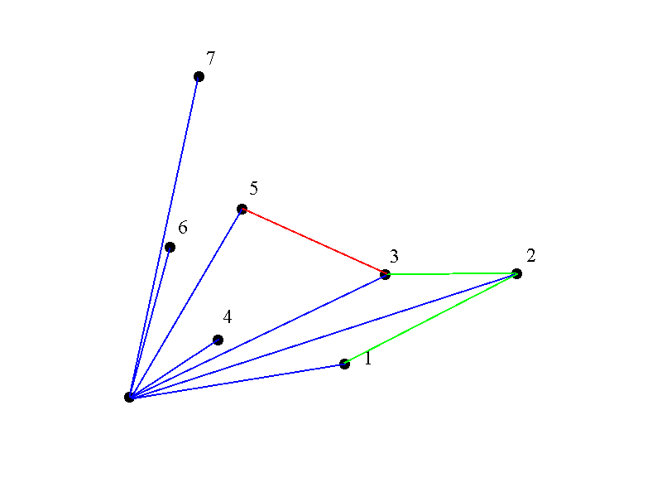
Graham’s Scan

Slide 13
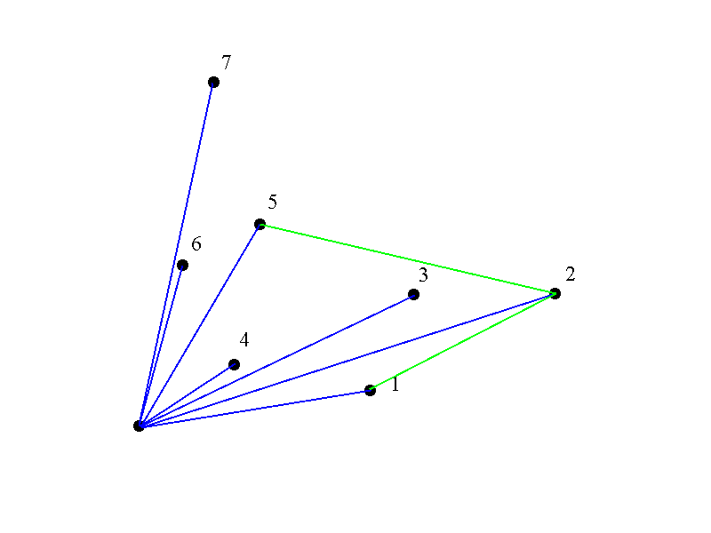
Graham’s Scan

Slide 14
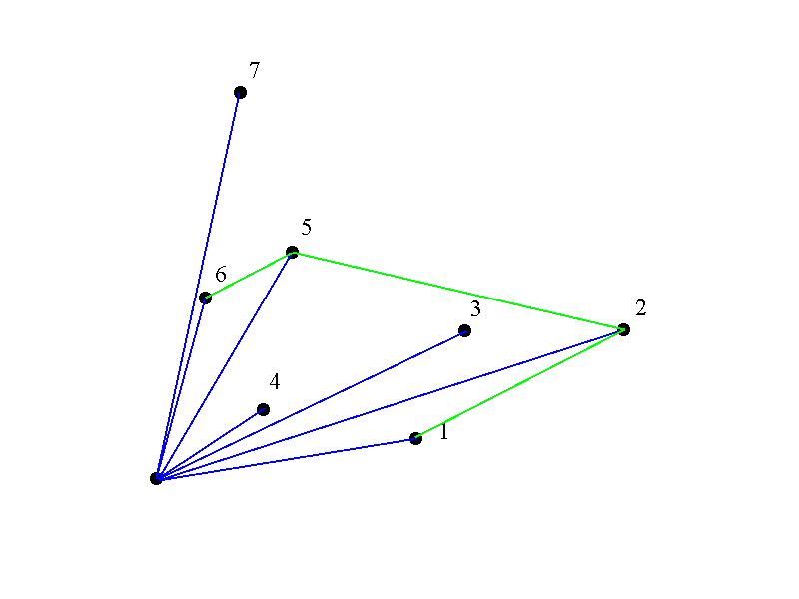
Graham’s Scan

Slide 15
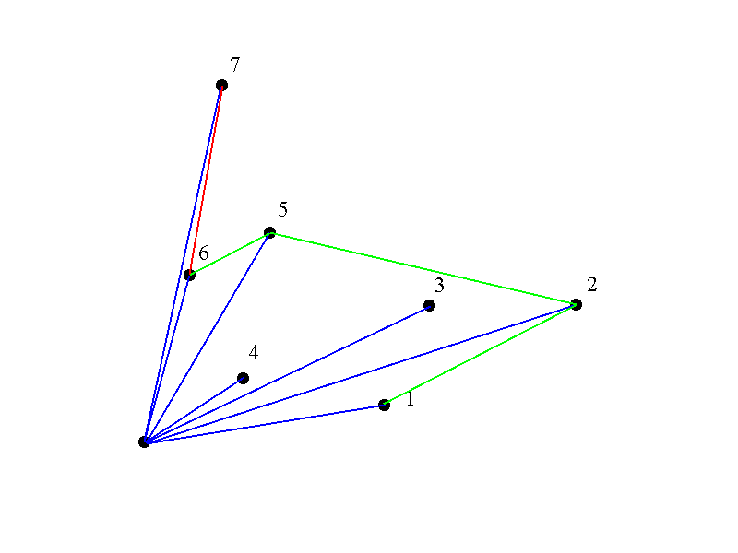
Graham’s Scan

Slide 16

Graham’s Scan

Slide 17
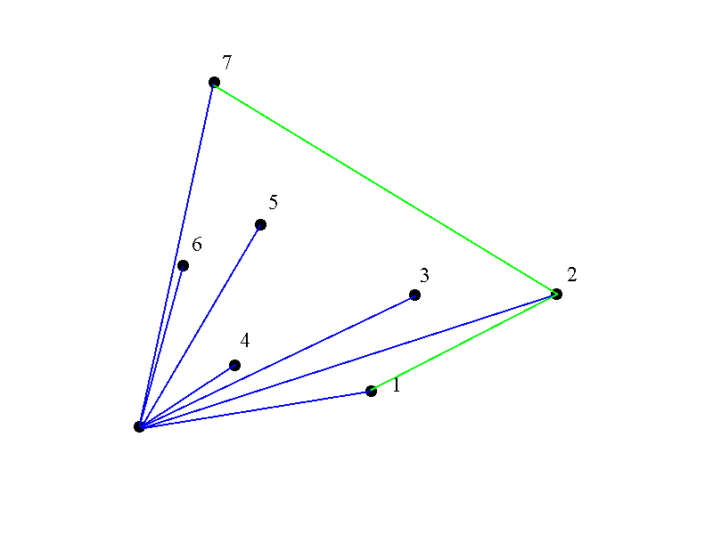
Graham’s Scan

Slide 18
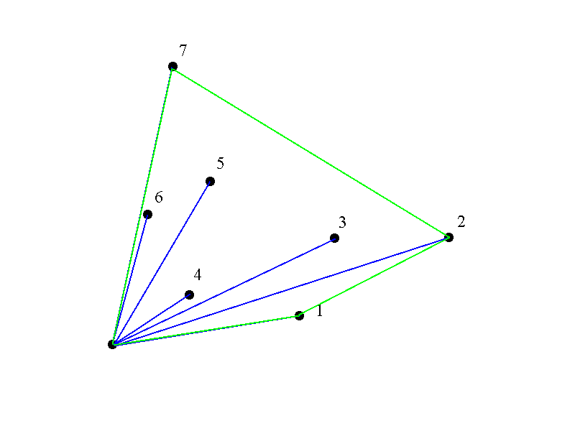
Graham’s Scan

Slide 19
Graham’s Runtime
Graham’s scan is O(n log n) due to initial sort of angles.

Slide 20
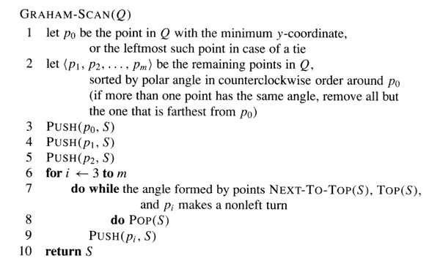
A more detailed algorithm

Slide 21
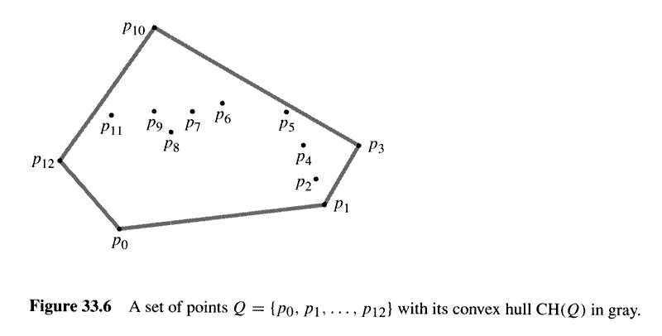

Slide 22
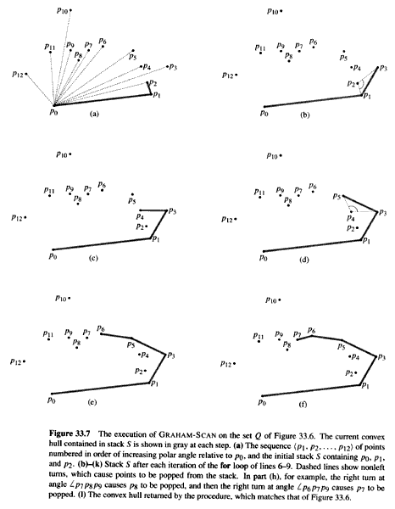
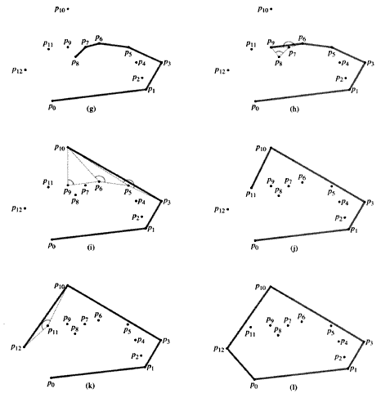

Slide 23
Convex Hull by Divide-and-Conquer
First, sort all points by their x coordinate.
  – ( O(n log n) time)
Then divide and conquer:
  – Find the convex hull of the left half of points.
  – Find the convex hull of the right half of points.
  – Merge the two hulls into one.

Slide 24
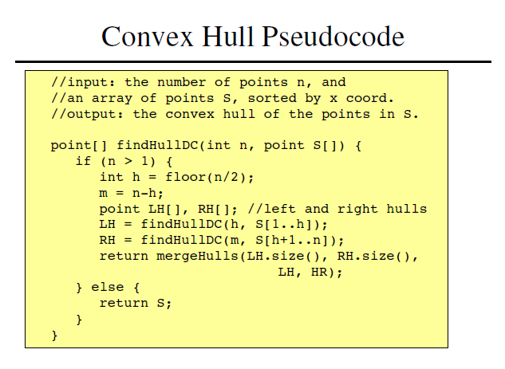

5
Hull of S by exhaustive search;

Slide 25
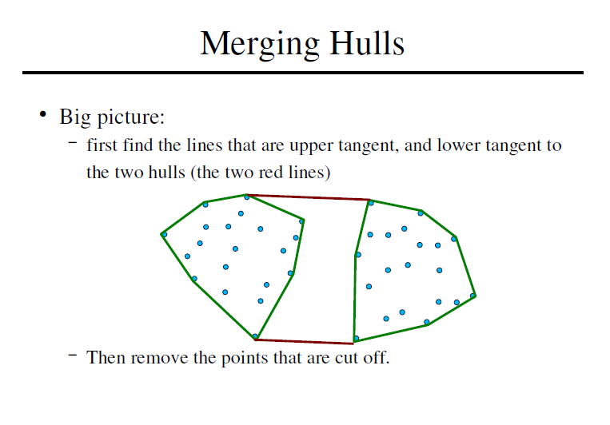

Slide 26
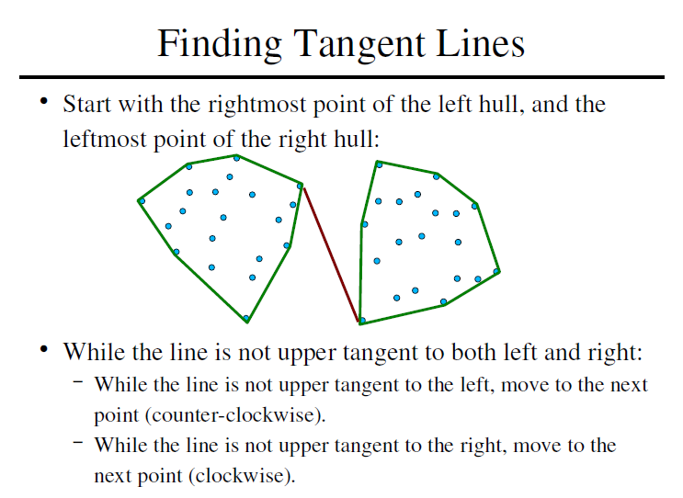

Slide 27
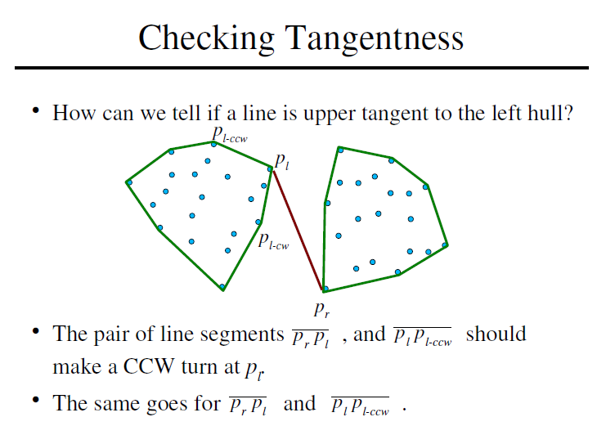

Slide 28
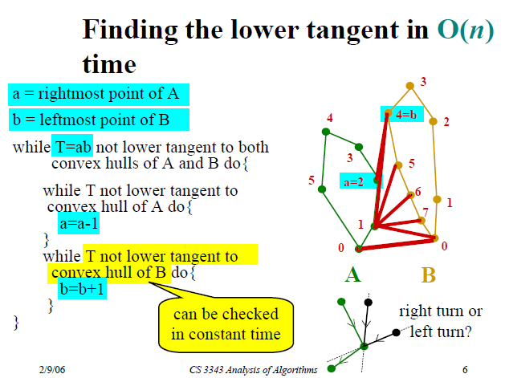

Slide 29
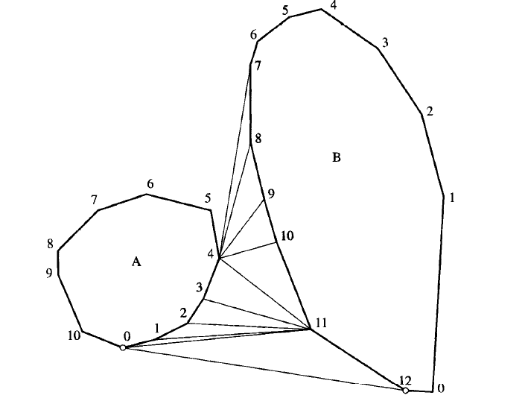
Lower Tangent Example
Initially, T=(4, 7) is only a lower tangent for A. The A loop does not execute, but the B loop increments b to 11.
But now T=(4, 11) is no longer a lower tangent for A, so the A loop decrements a to 0.
T=(0, 11) is not a lower tangent for B, so b is incremented to 12.
T=(0, 12) is a lower tangent for both A and B, and T is returned.

Slide 30
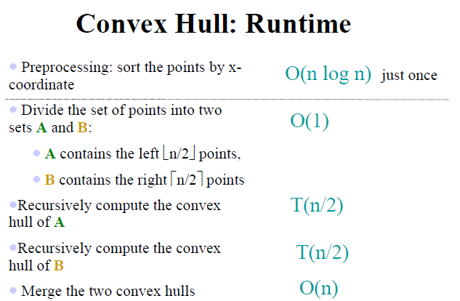


Slide 31
Q&A

