Slide 1
Voronoi Diagram and Delaunay Triangulation

Slide 2
Voronoi Diagram
To find the nearest neighbors of points in the plane
p1
p2
L12

Slide 3
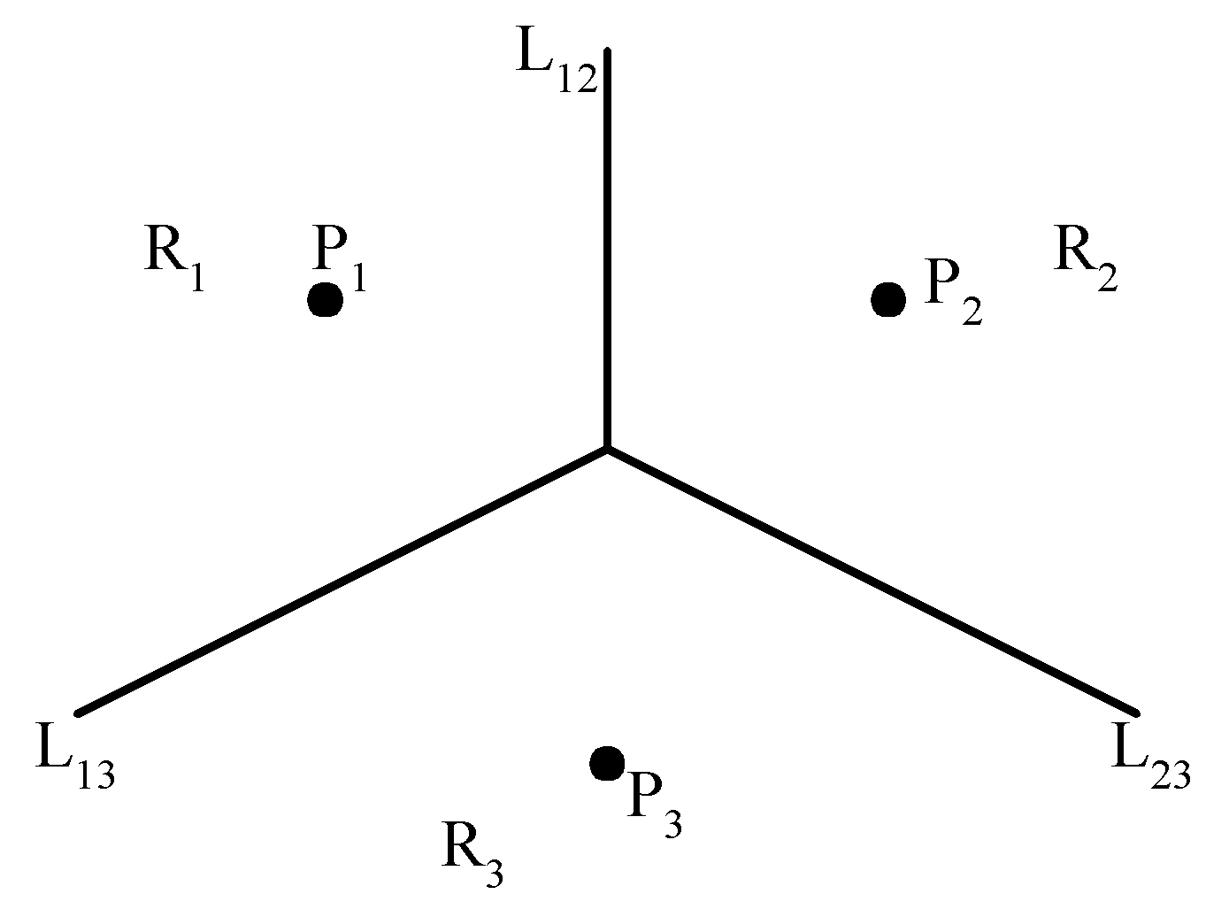
The Voronoi diagram problem
E.g. The Voronoi diagram for three points
Each L_{ij} is perpendicular bisector of the line connecting the pair of points

Slide 4


Slide 5
Applications
「資料分群與樣式辨認（Data Clustering and Pattern Recognition）」
應用Voronoi Diagram於臺北盆地地下水模式參數最佳化之研究
採用二維Voronoi網路(Voronoi diagram)模型, 從微觀角度分析氧化鋅非線性電阻片中的電流、溫度和熱應力的分布
Simulation of polycrystalline structure with Voronoi diagram

Slide 6
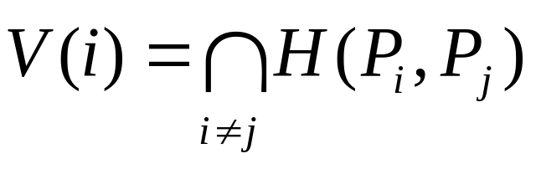
The Voronoi diagram problem
Def : Given two points P_{i}, P_{j} ∈ S, let H(P_{i},P_{j}) denote the half plane containing P_{i}. The Voronoi polygon associated with P_{i} is defined as

Slide 7
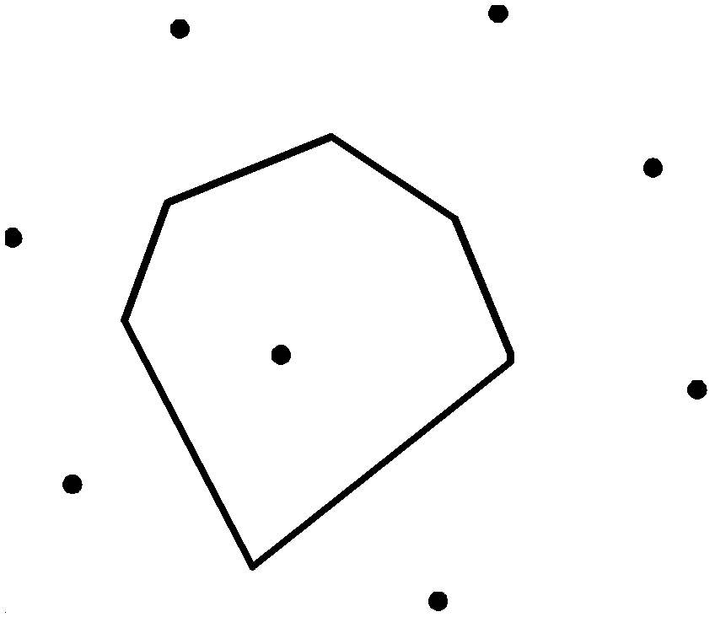
The Voronoi Polygram

Slide 8
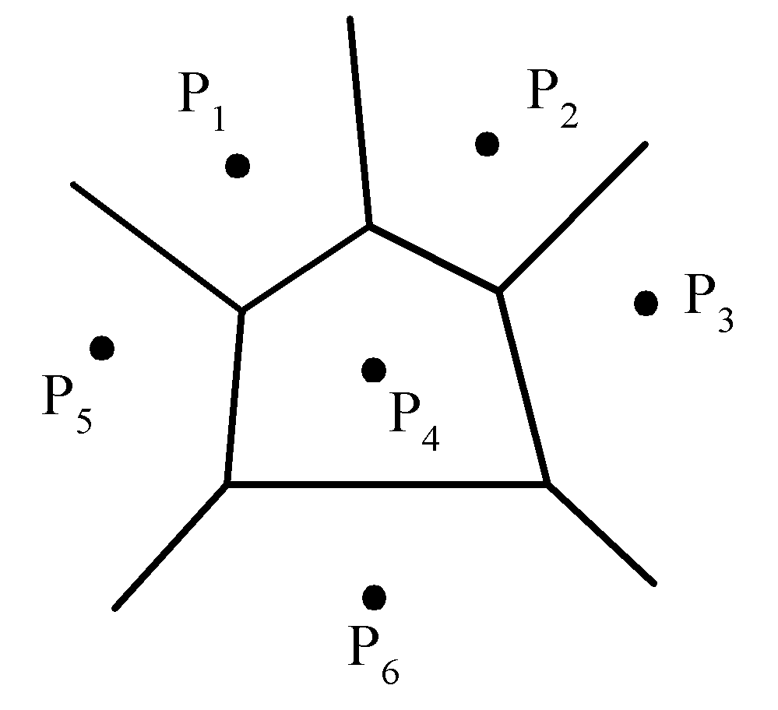
The Voronoi diagram problem
Given a set of n points, the Voronoi diagram consists of all the Voronoi polygons of these points.
E.g. A Voronoi diagram of 6 points:
The vertices of the Voronoi diagram are called Voronoi points and its segments are called Voronoi edges.

Slide 9
Voronoi Diagram
1644: informal use by Descartes
1850: Dirichlet used 2-dimensional and 3-dimensional Voronoi diagrams in his study of quadratic forms
1854: British physician John Snow used a Voronoi diagram in 1854 to illustrate how the majority of people who died in the Soho cholera epidemic lived closer to the infected Broad Street pump than to any other water pump.

Slide 10
Voronoi Diagram
1908: Voronoi diagrams are named after Russian mathematician Georgy Fedoseevich Voronoi (or Voronoy) who defined and studied the general n-dimensional case.
Voronoi diagrams are used in geophysics and meteorology to analyze spatially distributed data

Slide 11
Voronoi: Russian
Delaunay: French

Slide 12
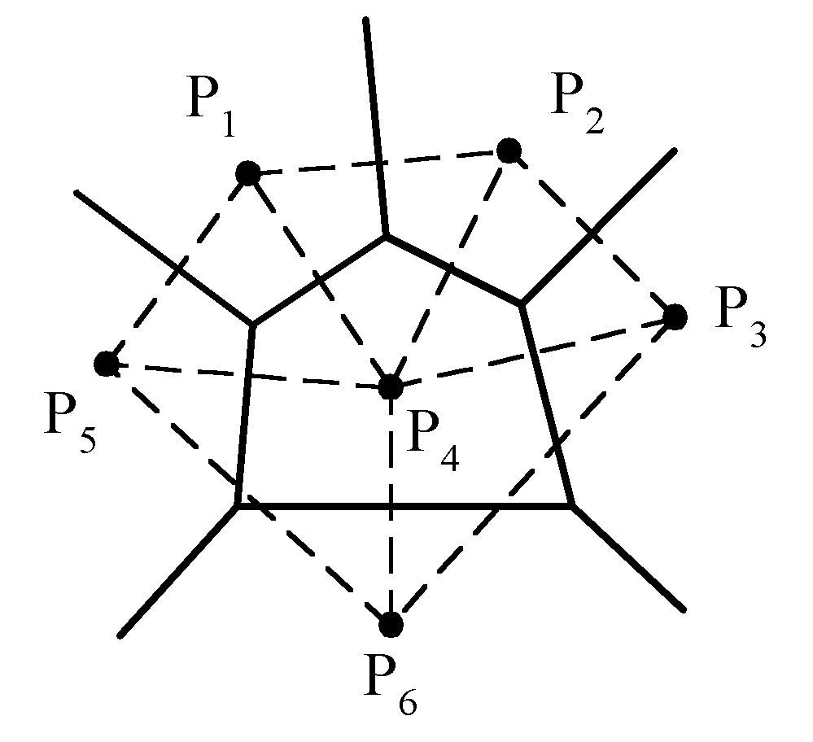
The Voronoi diagram problem
A Delaunay triangulation:

Slide 13
Divide-and-Conquer approach
Input : A set S of n planar points.
Output : The Voronoi diagram of S.
Step 1 If S contains less than 4 point, solve directly and return.
Step 2 Find a median line L perpendicular to the X-axis which divides S into S_{L} and S_{R} such that S_{L} (S_{R}) lies to the left(right) of L and the sizes of S_{L} and S_{R} are equal.

Slide 14
Divide-and-Conquer approach
Step 3 Construct Voronoi diagrams of S_{L} and S_{R} recursively. Denote these Voronoi diagrams by VD(S_{L}) and VD(S_{R}).
Step 4 Construct a dividing piece-wise linear hyperplane HP which is the locus of points simultaneously closest to a point in S_{L} and a point in S_{R}. Discard all segments of VD(S_{L}) which lie to the right of HP and all segments of VD(S_{R}) that lie to the left of HP. The resulting graph is the Voronoi diagram of S.

Slide 15
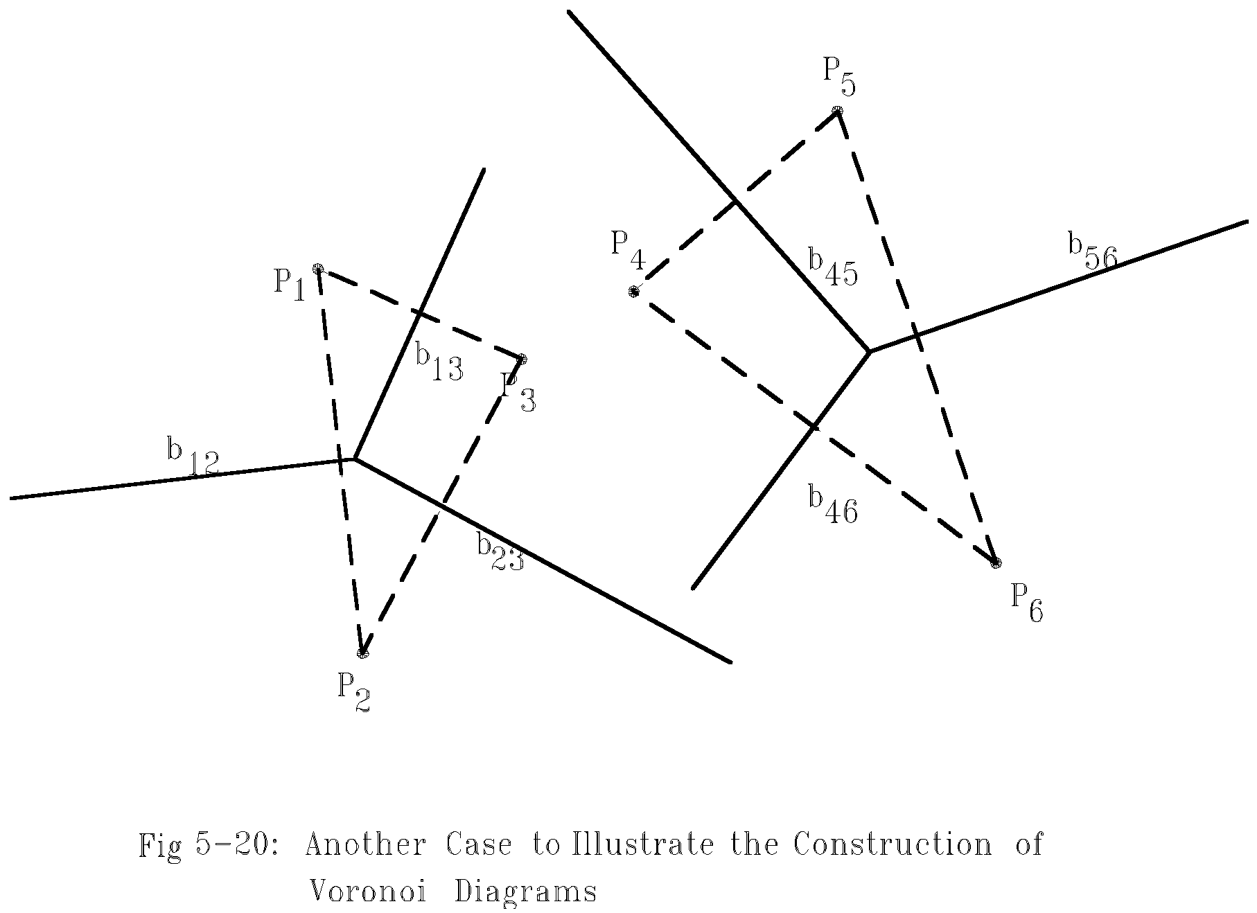
How to merge two Voronoi diagrams ?

Slide 16
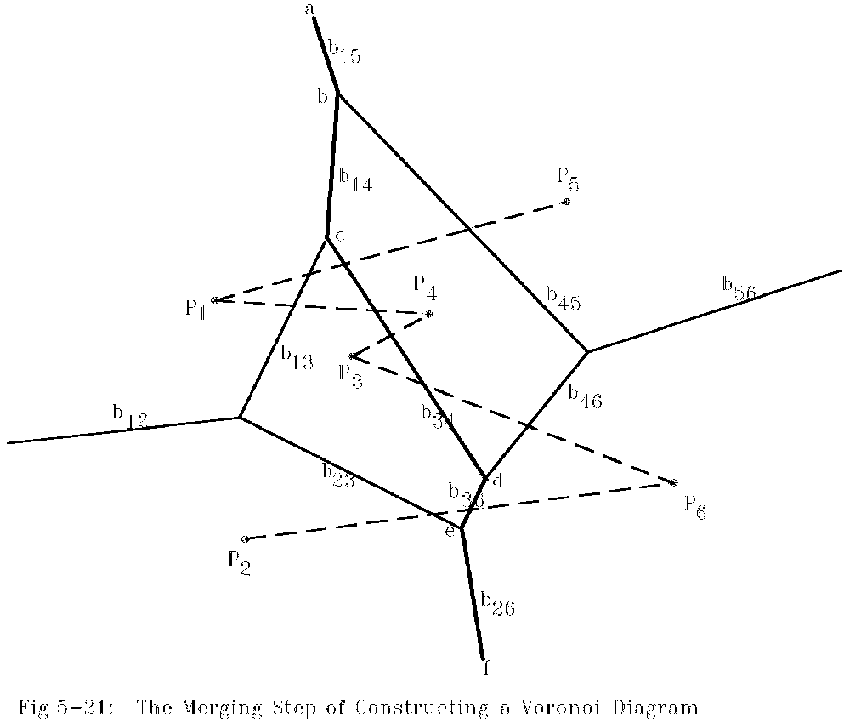
How to merge two Voronoi diagrams ?
Merging:
b15→b45→b14→b13→b34→b46→b36→b23→b26

Slide 17
Merges Two Voronoi Diagrams into One Voronoi Diagram
Input : (a) S_{L} and S_{R} where S_{L} and S_{R} are divided by a perpendicular line L.
(b) VD(S_{L} ) and VD(S_{R} ).
Output : VD(S) where S = S_{L} ∩S_{R}
Step 1 Find the convex hulls of S_{L} and S_{R} . Let them be denoted as Hull(S_{L}) and Hull(S_{R}), respectively. (A special algorithm for finding a convex hull in this case will by given later.)

Slide 18
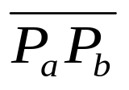
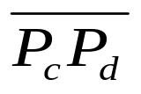
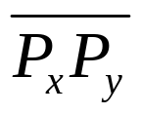
Merges Two Voronoi Diagrams into One Voronoi Diagram
Step 2 Find segments and which join HULL(S_{L} ) and HULL(S_{R} ) into a convex hull (P_{a} and P_{c} belong to S_{L} and P_{b} and P_{d} belong to S_{R}) Assume that lies above . Let x = a, y = b, SG= and HP = ∅ .
Step 3 Find the perpendicular bisector of SG. Denote it by BS. Let HP = HP∪{BS}. If SG = , go to Step 5; otherwise, go to Step 4.

Slide 19
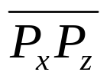

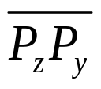
Merges Two Voronoi Diagrams into One Voronoi Diagram
Step 4 The ray from VD(S_{L} ) and VD(S_{R}) which BS first intersects with must be a perpendicular bisector of either or for some z. If this ray is the perpendicular bisector of , then let SG = ; otherwise, let SG = . Go to Step 3.
Step 5 Discard the edges of VD(S_{L}) which extend to the right of HP and discard the edges of VD(S_{R}) which extend to the left of HP. The resulting graph is the Voronoi diagram of S = S_{L}∪S_{R}.

Slide 20
Merges Two Voronoi Diagrams into One Voronoi Diagram
Def : Given a point P and a set S of points, the distance between P and S is the distance between P and P_{i} which is the nearest neighbor of P in S.
The HP obtained from the above algorithm is the locus of points which keep equal distances to S_{L} and S_{R} .
The HP is monotonic in y.

Slide 21

Merges Two Voronoi Diagrams into One Voronoi Diagram
# of edges of a Voronoi diagram ≤ 3n - 6, where n is # of points.
Reasoning:
  # of edges of a planar graph with n vertices ≤ 3n - 6.
  A Delaunay triangulation is a planar graph.
  Edges in Delaunay triangulation
  edges in Voronoi diagram.

Slide 22
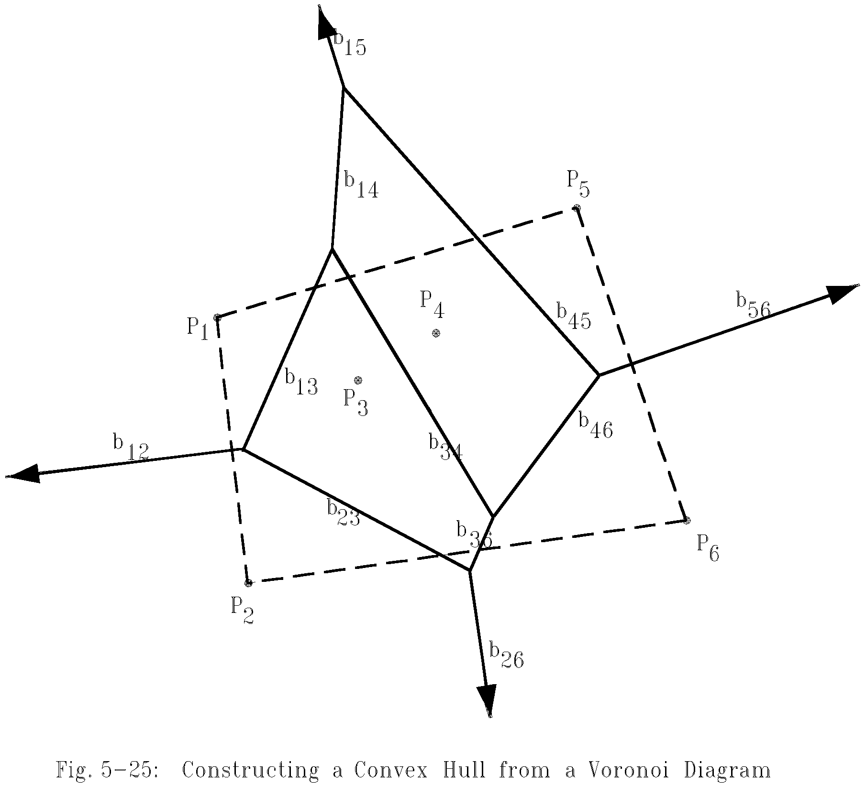
Construct Convex Hull from Voronoi diagram
After a Voronoi diagram is constructed, a convex hull can by found in O(n) time.

Slide 23
Construct Convex Hull from Voronoi diagram
Step 1 : Find an infinite ray by examining all Voronoi edges.
Step 2 : Let P_{i} be the point to the left of the infinite ray. P_{i} is a convex hull vertex. Examine the Voronoi polygon of P_{i} to find the next infinite ray.
Step 3 : Repeat Step 2 until we return to the Starting ray.

Slide 24
Time complexity
Time complexity for merging 2 Voronoi diagrams:
  Step 1: O(n)
  Step 2: O(n)
  Step 3 ~ Step 5: O(n)
  (at most 3n - 6 edges in VD(S_{L}) and VD(S_{R}) and at most n segments in HP)
  ⇒ T(n) = 2T(n/2) + O(n)=O(n log n)

Slide 25
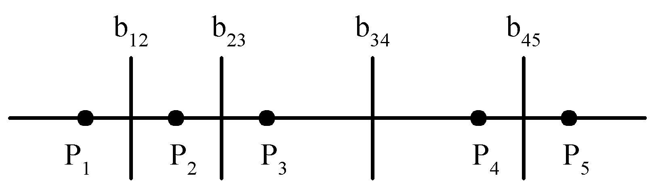
Lower bound
The lower bound of the Voronoi diagram problem is Ω(n log n).
∵sorting ∝ Voronoi diagram problem
The Voronoi Diagram for a Set of Points on a Straight Line

Slide 26
Optimality
The divide-and-conquer algorithm for solving the Voronoi diagram problem is optimal

Slide 27
Applications of the Voronoi diagrams
The Euclidean nearest neighbor searching problem.
O(log n) with O(n log n) preprocessing
The Euclidean all nearest neighbor problem.
O(n) with O(n log n) preprocessing

