Slide 1
Chord RECOGNITION
YUJIA QIU

Slide 2
INTRO
This project is to process input audio files and recognize one of 12 major chords, i.e., C, C#, … B.
The whole project is mainly based on FFT and the Maximum Likelihood method, to find the three most likely notes in the input audio.
Based on these notes, a decision is made about whether the file contains a valid chord and if so which chord it is.
Piano triad chords were used to test the algorithm. The algorithm was implemented as the C program chordrecog which ran under Unix.

Slide 3

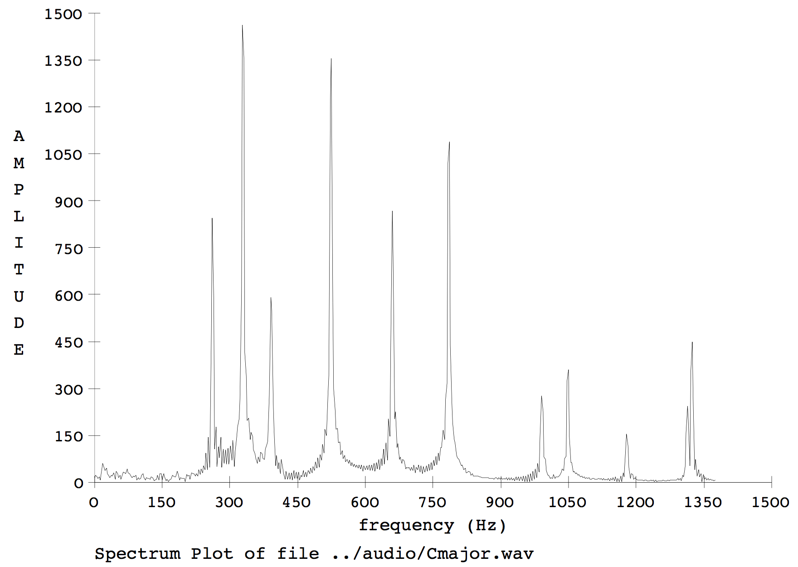

METHOD
FFT -- Fast Fourier Transform
8192(2^13) samples
C4, E4, G4
f0: 261.626, 329.628, 391.995,
2*f0: 523.252 659.256 783.99

Slide 4
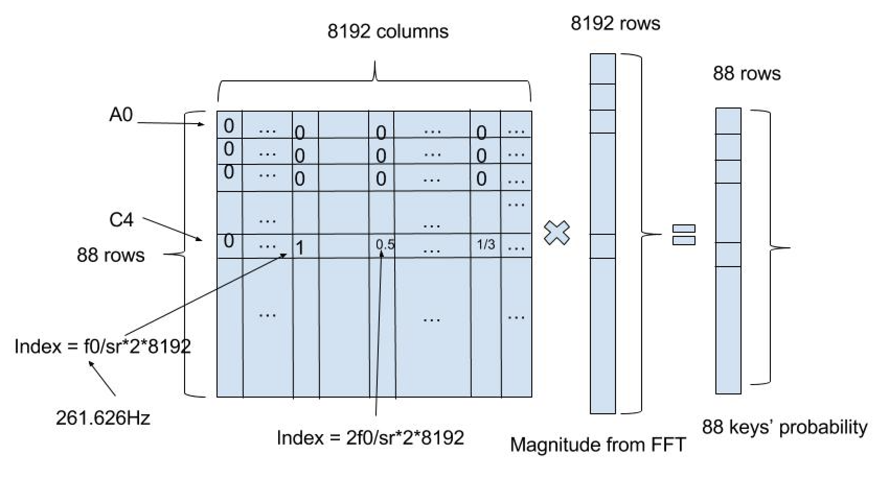
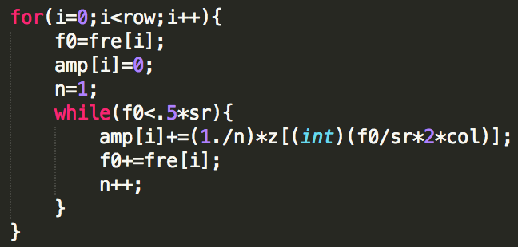

method
Maximum-Likelihood Estimation
$\left(\frac{f}{sr}\right)×2×8192=index$
Every note is the combination of several harmonic frequency, including f0 (fundamental frequency), 2*f0, 3*f0…
A weight for each nth harmonic of f0 is assumed to be 1/n.

Slide 5
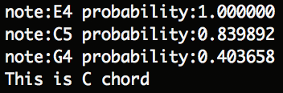
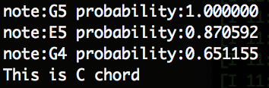
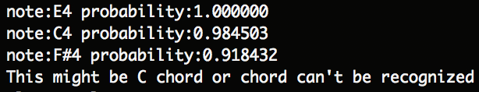
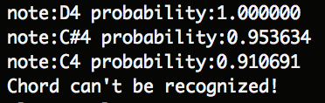
output
The notes match C major, it is assumed the input audio is in fact a C major chord.
Sometimes, because of surrounding noises, the result may not be accurate. But because the three notes are contained in the C major chord, we still assume it’s a C major chord.
There are only two notes that match the C chord, which means this may or may not be a C chord.
There is only one note matches, which means input audio cannot be a chord

Slide 6
RESULT
12 major chords from Apple app GarageBand
12 major chords from a piano in the Music Building
Three random notes (non-chord) as the input from Apple app GarageBand
The results for all of these sound file input were 100% correct.

Slide 7
Limitation
There are only 12 chords in my database
Only triad chords are considered
Test case is limited

Slide 8
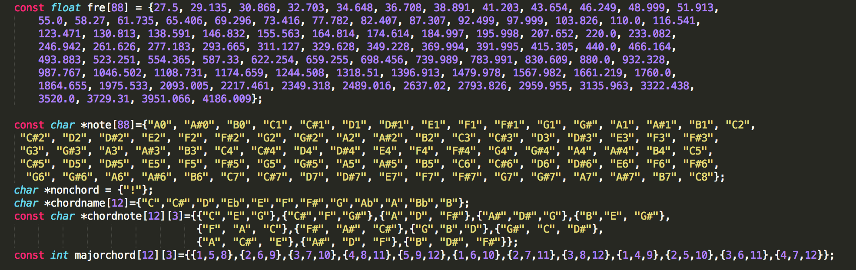
Code -- database

Slide 9
Thank you!

