Slide 1
Harmonist DATA TOOLKIT:
DEMO and tutorial
Judy Lewis, PhD
Vanderbilt Institute for Clinical and Translational Research
Vanderbilt Department of Biomedical Engineering

Slide 2
Rladies meetup
Motivation for and demo of Shiny App, IeDEA Harmonist Data Toolkit
Tutorial on implementing one of the features found in the Harmonist Data Toolkit

Slide 3

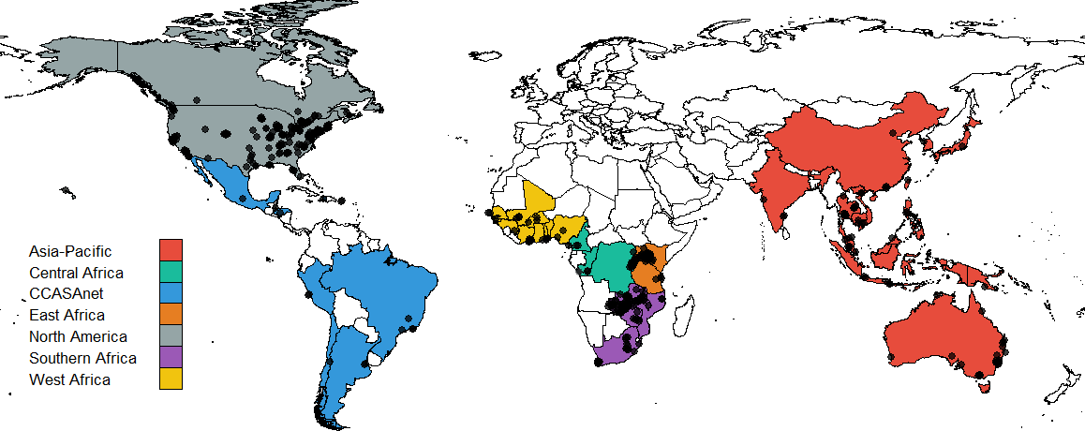

harmoniST project
International epidemiologic Databases to Evaluate AIDS
Established in 2005
Now:
  46 countries
  >1.7 million patients
  100’s of publications
North America
(NA-ACCORD)
West Africa
Asia-Pacific
Central
Africa
East Africa
Southern Africa
Latin America
(CCASAnet)

Slide 4
Harmonist project
iedeades.org: Common data model
iedeahub.org
  Data requests
  Research project management
iedeadata.org
  Data quality checking
  Report generation
  Secure file transfer

Slide 5
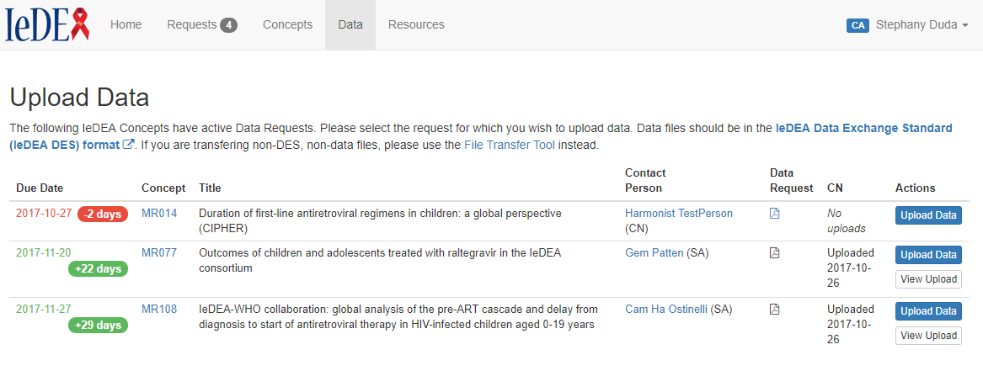
Iedeahub.org

Slide 6
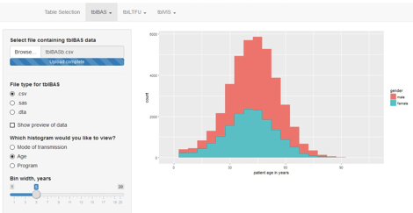
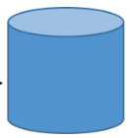



Harmonist data flow
IeDEA regional data Submission
Standards-compliant
regional data
Data files are stored in the secure cloud (encrypted) for retrieval by study investigator
Data pass through the Harmonist Data Toolkit to check data quality, standards compliance, and generate reports.
Data managers are prompted to correct errors and reupload.

Slide 7
Data quality checking and reporting
Initial: Data quality algorithms in R
Solution: Harmonist Data Toolkit
Users must install and run R
Files to be checked must be .csv
Cryptic reporting
Difficult to maintain (hard-coded)
No mechanism for file exchange
Web interface (Shiny)
Shiny UI
Rmarkdown = reproducible reports
REDCap (API → R)
AWS (API → R) File storage/retrieval

Slide 8
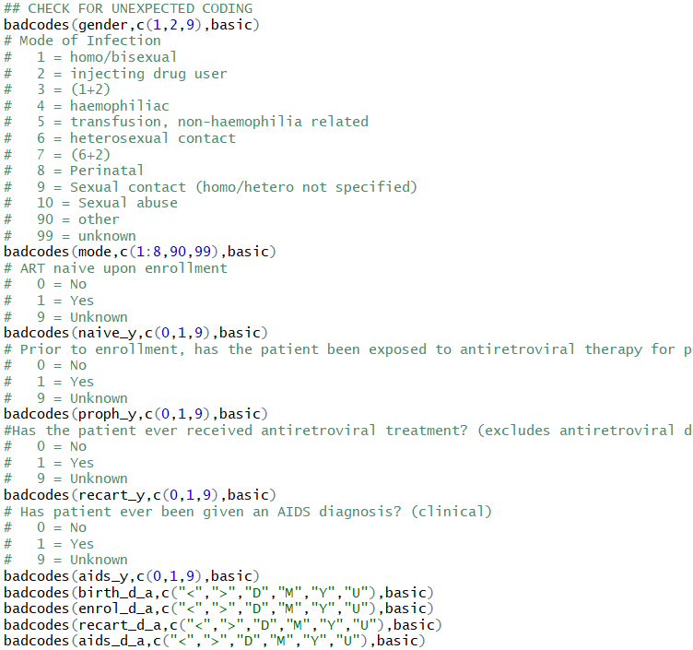

Snippet of previous code
Now, thanks to

Slide 9
Demo

Slide 10
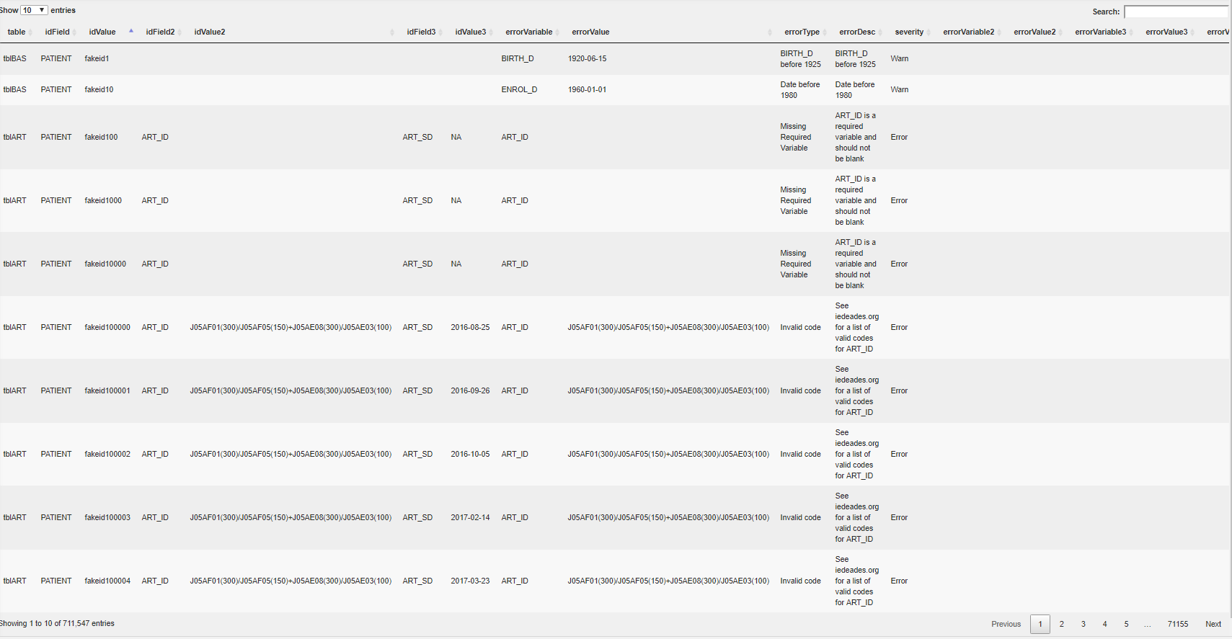
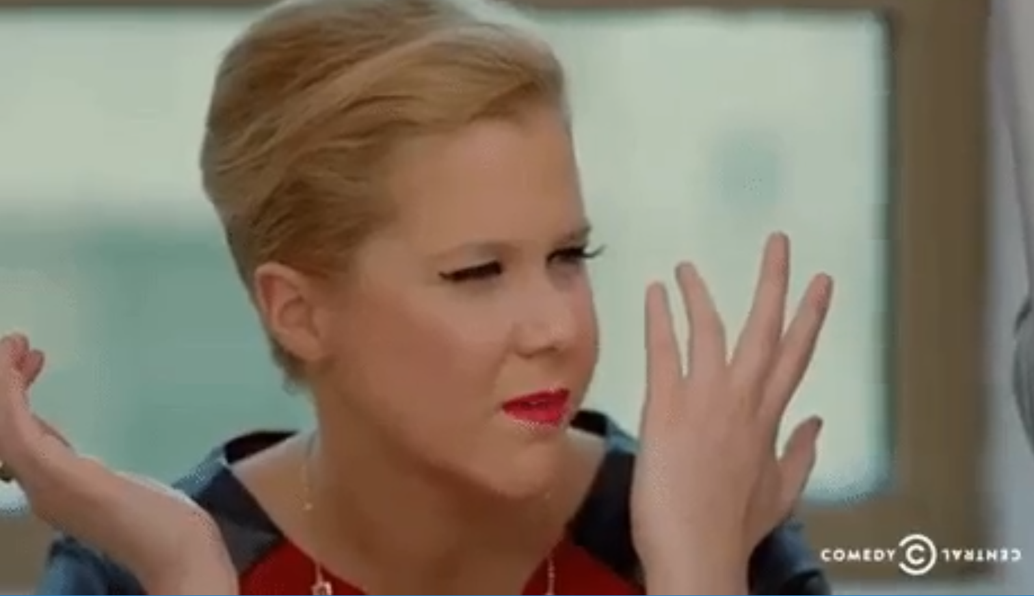
The problem:
You have a huge data frame to DISPLAY

Slide 11
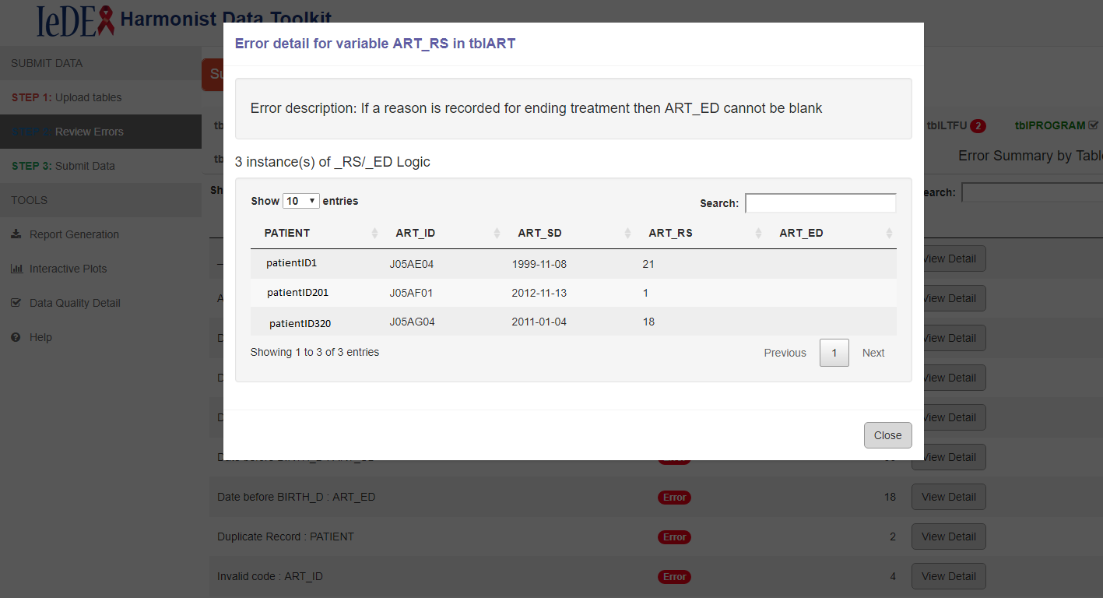
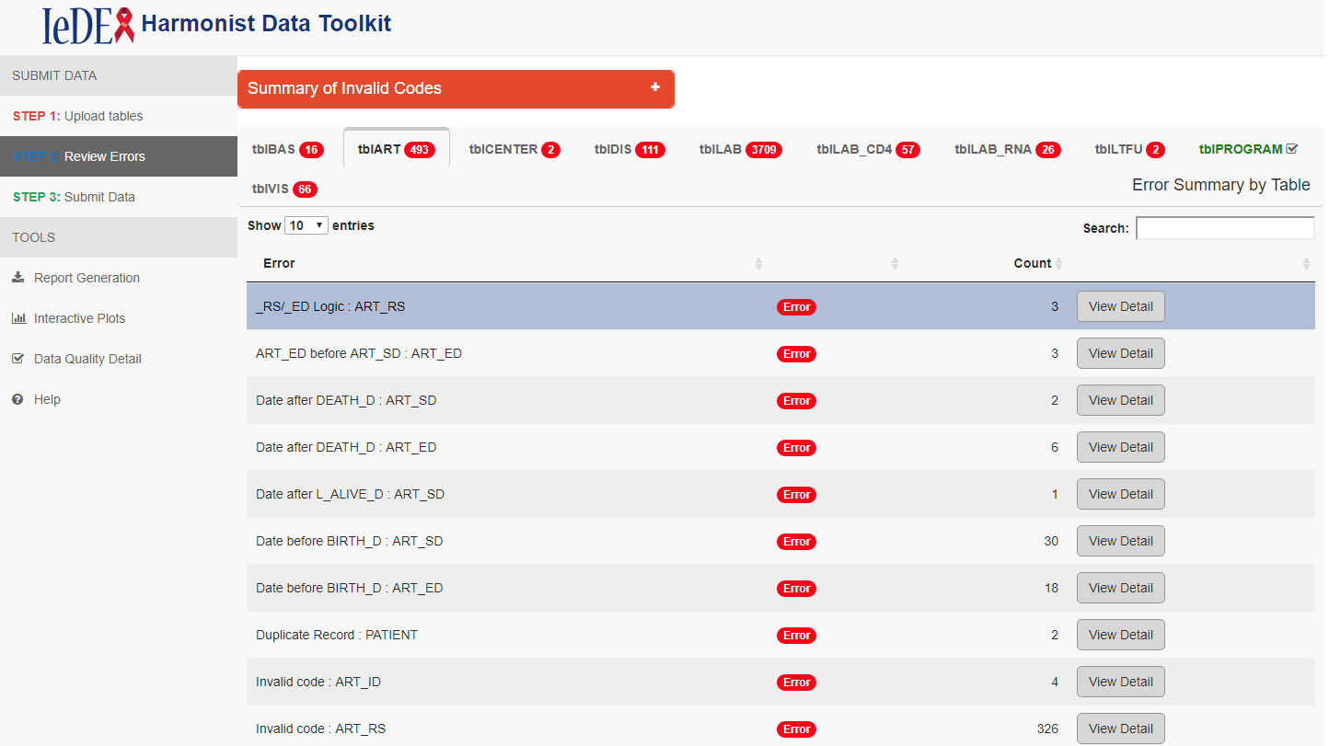
Let’s learn How to…
Generate a shinydashboard box with tabbed datatables
  Number/names of tabs not known in advance
  Summary tables
  Badges beside each tab name
Add functioning “View Details” buttons to each row of summary
Create a pop up (modal) containing the detail related to the selected row

Slide 12
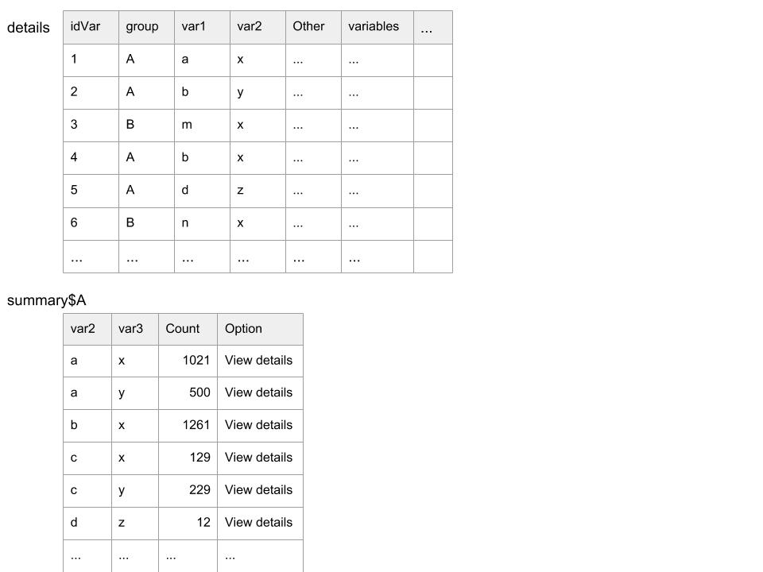
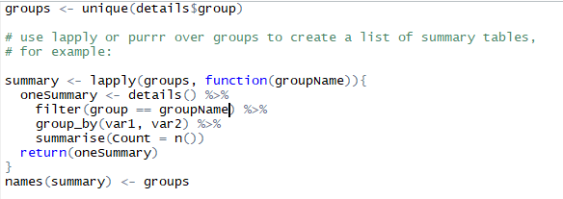
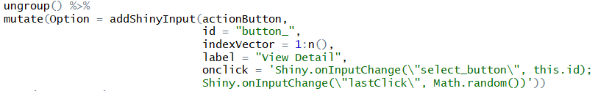
Basic Idea: List of (Tabbed) Summary Tables with “View Details” buttons
Create list of summary tables
What about “View Details” buttons??

Slide 13
Let’s break it down
addShinyInput is a helper function that creates a vector of Shiny inputs
First argument is the type of Shiny input you want to create
id argument is the beginning of the id you want to assign to each Shiny input (for example, in the call above, the button in the 3rd row would have the id “button_3”)
indexVector argument is a vector of values to append to id to create the vector of Shiny input id’s
Other arguments are specific to the type of Shiny input chosen (label, onclick)
onclick specifies javascript to run when each actionButton is clicked…

Slide 14
onclick
Shiny.onInputChange(new Shiny input name, value of new Shiny input)
When “View Details” is clicked in the 3rd row of the summary table
  input$select_button =
  input$last_click =
Shiny code:
observeEvent(input$last_click,{
selectedRow <- as.numeric(str_after_first(input$select_button,"button_"))
“button_3”
Some random number

Slide 15
Code is on github
For the details I’ve glossed over, like reactive variable to track currently selected tab…
https://github.com/judytlewis/RLadiesNashville

