Slide 1
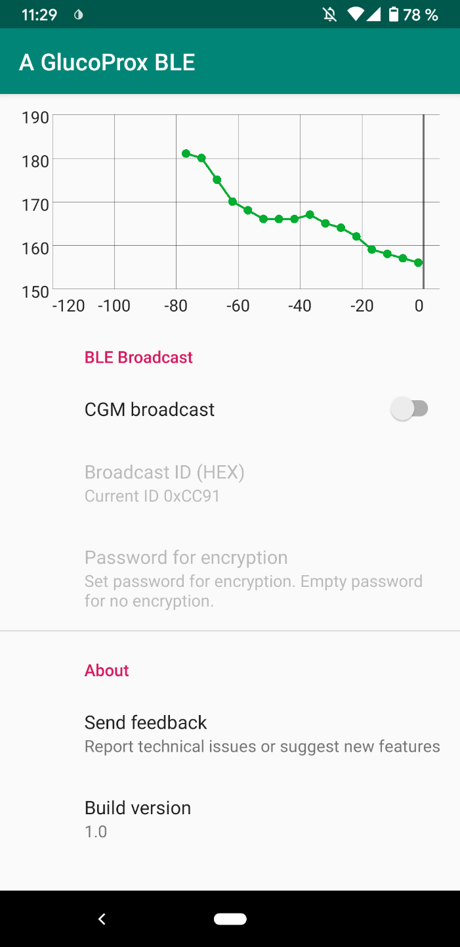
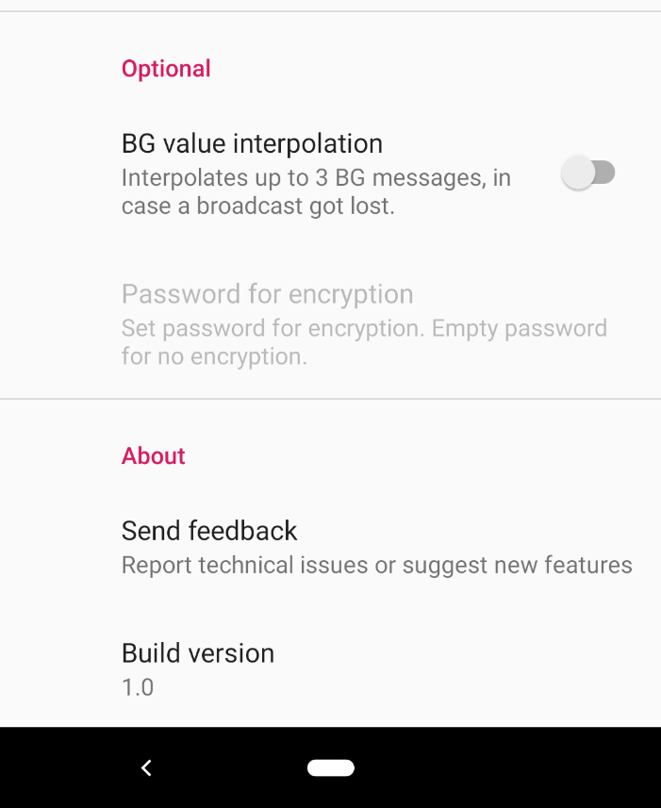
BG Graph
Shows received data
of the last two hours
Enable/disable
BLE broadcasts
Enable/disable
BG value interpolation
Interpolates up to three missing
values in the 5 min rhythm.
Values are missing when
a broadcast gets lost.
Sets the ID for
BLE broadcasts
As Android changes its
MAC Address regularly,
this 16 bit ID is used
to identify the sender.
Password for encryption
Use an empty password
to disable encryption.
Opens the GitHub
issue page

