Slide 1
Final Presentation
By Adam Rothstein
and Jesse Cox

Slide 2
Literature review
Sommers finds an increase in BA to a maximum taking about 7 years
Horowitz finds lower levels disparity in talent and competition not driving improvement

Slide 3
Data
We used MLB baseball statistics from baseball-reference.com
Players entering the league in 2013
Team stats from 2014 for 30 teams 162 games

Slide 4
Variables
Dependent variables were Batting Average changes and whether or not it was positive
Our explanatory variables included average age, team batting average, team runs/game teams total runs, teams win percentage.

Slide 5
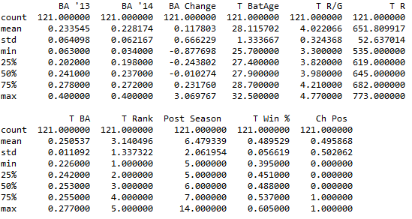
Summary Statistics

Slide 6
Problems with the data
Change in batting average is not always positive since we are using change over a period of one season
We created a dummy variable that indicated a positive or negative change

Slide 7
Experiment
We performed two experiments
Simple multivariable regression on just the percent change in batting average and
Logistic regression on the dummy variable for positive change in batting average

Slide 8
Results
We found all explanatory variables to be significant within the regression except for the player’s team’s rank and win percentage.
Team batting age was the most significant variable and holds a negative coefficient.
Our logistic model also had a very low pseudo R2 value at .0862
We used the same explanatory variables and also got similar results

Slide 9
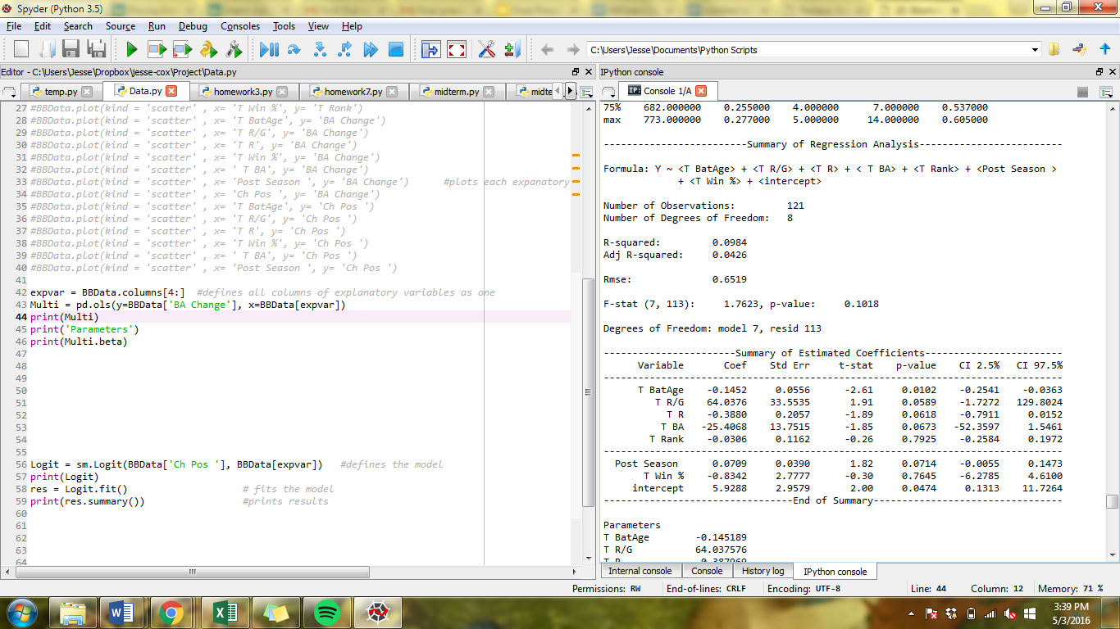
Multivariate Output

Slide 10
Results
Only 3 significant variables: Team runs, runs per game and post-season performance.
They are more significant than the ones in the multivariate model.

Slide 11
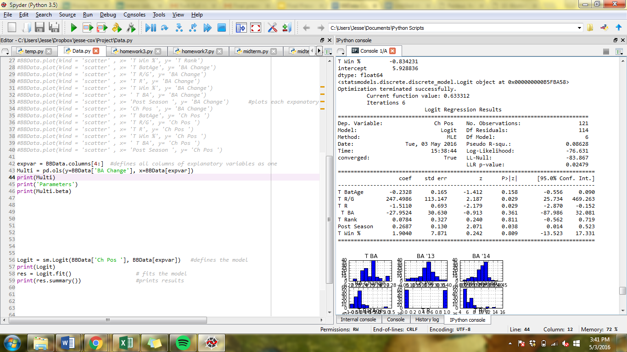
Logistic Output

Slide 12
Conclusion
We believe that the variables that were not significant in the multivariate regression were so because they were correlated to each other
If we had access or the time to compile a bigger data set for this experiment we would’ve had more of a significance.
We also would’ve dropped the insignificant variables.

Slide 13
Future Research
A more comprehensive data set should have been used spanning different years
This is very time consuming but should produce more uniform results and we could have dropped more observations
Could be used in diff-in-diff analysis of drug policy changes.

