Slide 1
Finding The most influential skills on the pga tour
Alexander Wentz
Joel Flores

Slide 2
Background
Data comes from ESPN Statistics for the Top 20 golfers from 2003-2016
280 Observations
Statistics include information on age, rank, wins, top 10 finishes, earnings, driving accuracy, driving distance, save percentage, greens in regulation, putting average, rounds, and events
What skill are the most important when it comes to maximizing earnings on the tour?

Slide 3
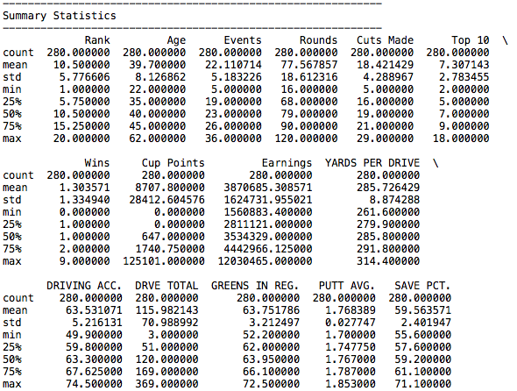
Summary statistics

Slide 4
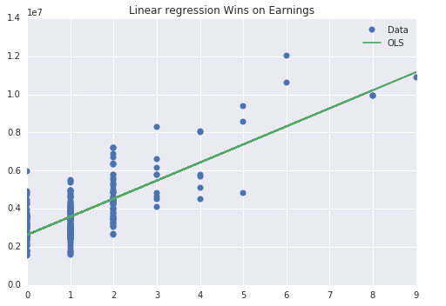
Max TOURNAMENT wins = max SEASON earnings

Slide 5
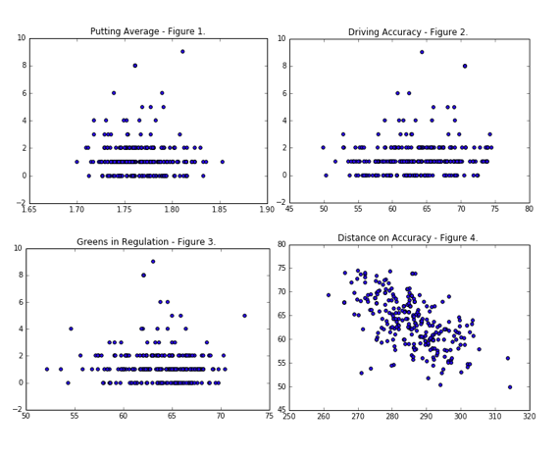

Slide 6
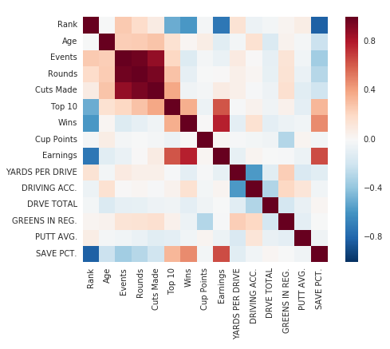
Heat map

Slide 7
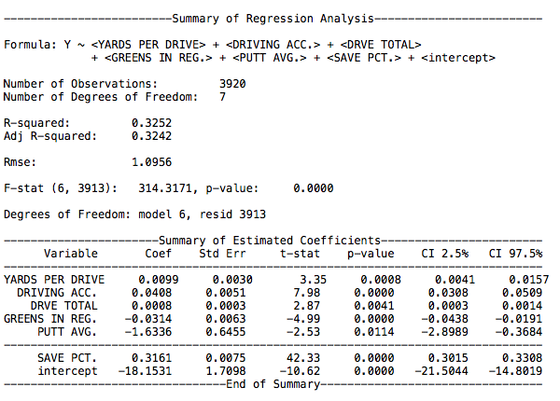

Slide 8
Trouble with regressions
Not enough data
Sample size was too restrictive
Data was not detailed enough
Went against golf logic

Slide 9
Conclusion
Save percentage and Putting average are extremely important!
Short game > long game

