Slide 1
Graduation Rates and Rate My Professors
Virginia Amerman & Claudia Gomes

Slide 2
Why we are doing this project
Graduation rates are important for higher education institutions and students
Research has been done regressing resource allocation and graduation rates
Other variables that have been shown to affect graduation rates:
Mental health
Percent of Pell grant recipients
Student population

Slide 3
How our project is different
There has been no data relating what the student thinks about their institution and how they are treated and graduation rates
Used ratemyproffessors.com to find what students really think about their insitution

Slide 4
Rate My Professor Quality Rating System
Quality Rating | Definition
Reputation | How your school is viewed by the world
Internet | How is the internet at your school
Opportunity | If your school has the “hook-up”. If they have a powerful alumni network. How much has the college/university helped you take advantage of career opportunities.
Campus | How does your campus look
Social | What is the social scene like on campus. If there are lots of different events like concerts, lectures, rallies and sporting events

Slide 5
Quality Rating System Cont.
Location | How is the campus location relative to other key areas. If getting around is easy around your school.
Food | How are the dining halls and other public eating places at your school in terms of looks and actual taste of the food.
Library | Does your library have convent hours, good technology, and a quiet place to study.
Clubs | What is the extracurricular scene like
Happiness | If you are happy with the school overall
Average Professor Score | The average score of all the professors who have been rated on ratemyproffessor.com for that institution

Slide 6
Graduation Rate data
Chronicle of Higher Education’s College Completion Research
Deleted all two year institutions and those who reported no four-year graduation rate
Measuring only six-year graduation data
Data now composes 1849 schools

Slide 7
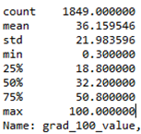
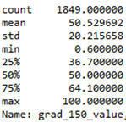
Graduation Rate Data Cont.
Four-year Graduation Rates
Six-Year Graduation Rates

Slide 8
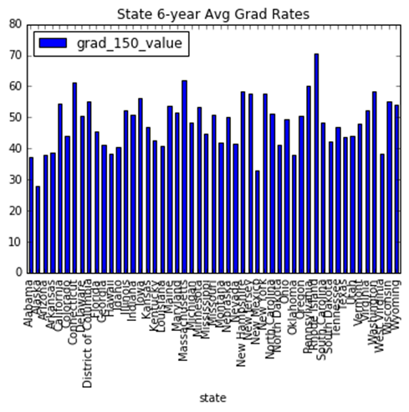
Six-Year Graduation Rates Per State
-Lowest in New Mexico & Alaska
-Highest in Rhode Island

Slide 9
Web Scraping
Our goal was to webscrape Rate My Professor to get the data we wanted from all 50 states.
We started with just Maryland universities and then expanded it to include all states

Slide 10
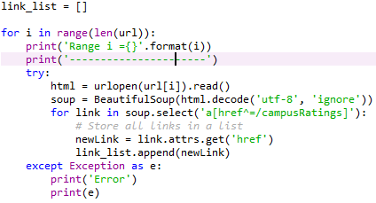
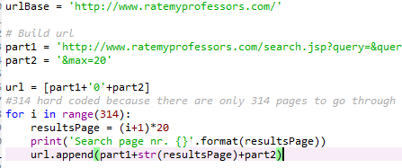
Web Scraping Cont.

Slide 11
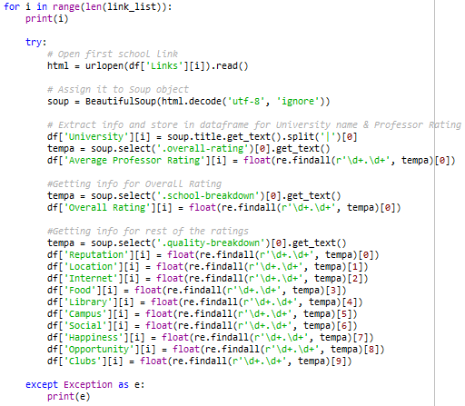
Web Scraping Cont.

Slide 12
Rate My Professors Statistics
Variables | Mean | Median
Average Professor Rating | 3.529 | 3.83
Overall Rating | 2.647 | 3.2
Reputation | 2.842 | 3.2
Location | 2.856 | 3.5
Internet | 2.63 | 3.1
Food | 2.237 | 2.6

Slide 13
Rate My Professor Statistics Continued
Variables | Mean | Median
Library | 2.7 | 3.3
Campus | 2.729 | 3.3
Social | 2.839 | 3.5
Happiness | 2.325 | 2.8
Opportunity | 2.359 | 2.8
Clubs | 2.946 | 3.7

Slide 14
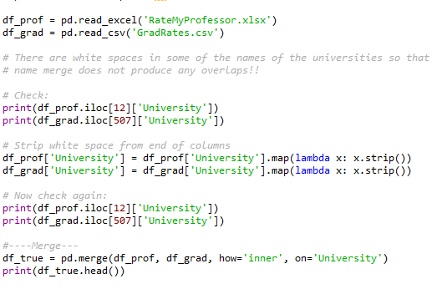
Merging data

Slide 15
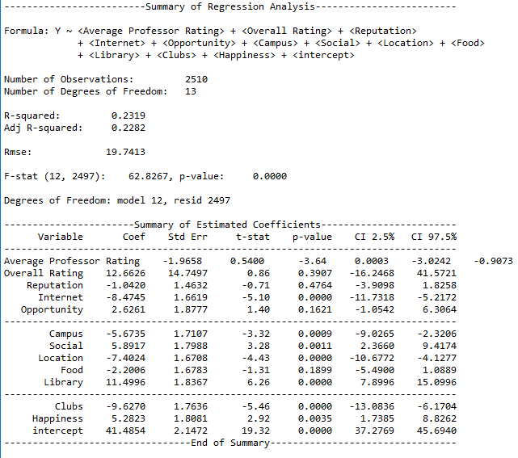
Regression
With all variables:

Slide 16
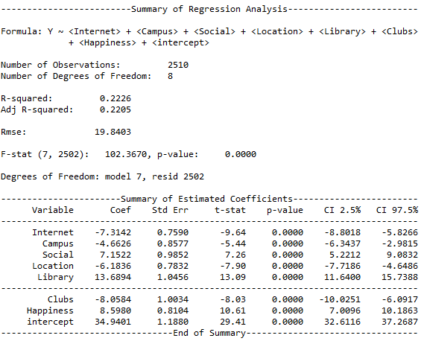
Regression
After dropping
Unneeded variables:

Slide 17
Regression Analysis
Positive correlation: social, library, and happiness
Negative correlation: internet, campus, location, and clubs

Slide 18
Conclusion
Importance of research
Future research and applications

