Slide 1
Best Bars in Baltimore
By: Brian Jensen & Nicole Delgado

Slide 2
Project Description
Used Python tools such as:
Pandas
Yelp API
Matplotlib
Numpy
Using Yelp API, we compared the amount of stars and reviews each bar received and found the best bar in Baltimore.
Combined bar data with recent crime activity to see the correlation between the best bar and crimes on April 16.

Slide 3
Updated Data
Imported data from UMD College Park
Data on crimes in Baltimore
Grabbed specific data from 4/16
Dropped the following:
Duplicate Businesses
Businesses with less than 8 reviews
Added Geographical Coordinates
For both bars & crime data
Sorted Data by star ratings & reviews

Slide 4
Simple Summary Statistics
 | Rating | Review | Latitude | Longitude
Count | 313 | 313 | 313 | 313
Mean | 3.682109 | 132.134185 | 39.285290 | -76.613759
Min | 2 | 8 | 38.977700 | -76.935130
Max | 5 | 1512 | 39.533622 | -76.308766
Mode for Review Ratings: 8 (6)
Mode for Star Ratings: 4 (131)

Slide 5
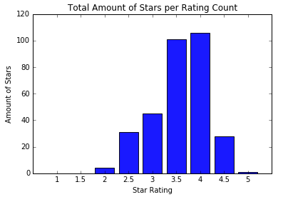

Slide 6
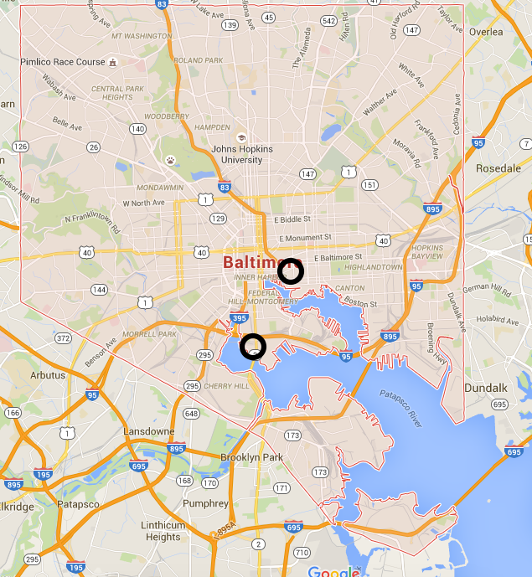
Joe Benny’s
Bar Liquorice

Slide 7
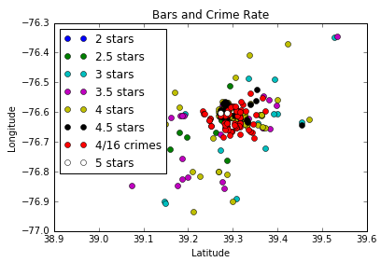

Slide 8
Conclusion
Highest Star Rating Bars:
Bar Liquorice
Joe Benny’s
Best Bar in Baltimore:
Joe Benny’s
Crime around these bars on 4/16:
High

Slide 9
Future Studies
Which bars have the most crime around them?
Finding this through comparing crime and bar distance to see how much crime is around each bar in our data.
Use price filters to search for different costs of bars in the area

