Slide 1
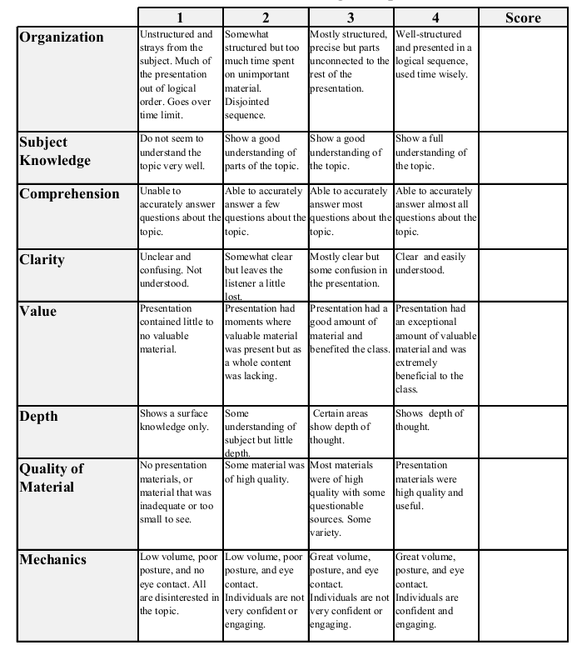
Econ 431 Final Presentation
Tra Nguyen
Maryland Corporate Tax
Total:_________

Slide 2
Arguments
Maryland state corporate income tax rate is too high.
It’s better to reduce tax rate from 8.25% to 6%.
Since 2013, the tax rate hasn’t changed.

Slide 3
Data
750 observations
50 states
15 years: 2000 – 2014
Variables:
Tax revenue per capita
Tax rate, GDP per capita, Year.

Slide 4
Data cleaning:
Drop unsuitable observations: 19 observations
Tax rate = 0
Tax revenue > 0
Drop outliers: 15 observations
Lie outside 3 standard deviations.
Drop Alaska.
=> 716 observations.

Slide 5
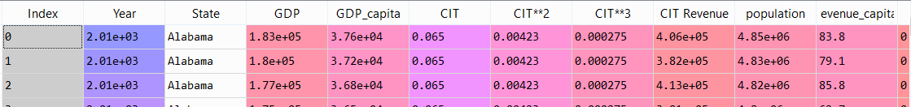
Data Frame

Slide 6
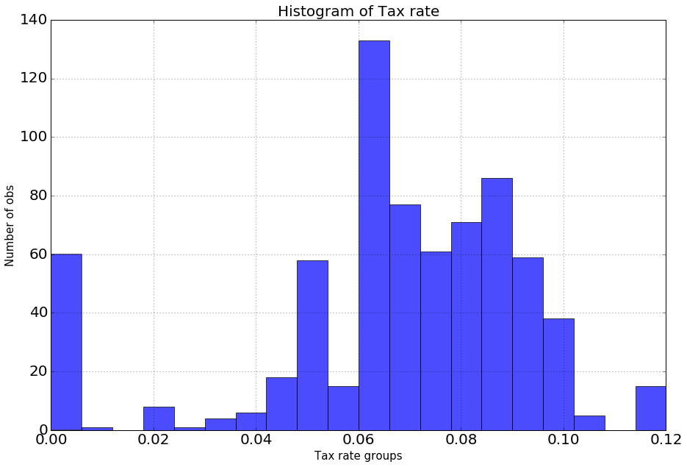
Summary Stats: Tax rate
Mean | 6.71%
STDev | 2.65%
Min | 0
25% | 6%
50% | 7%
75% | 8.5%
Max | 12%
Maryland | 8.25%

Slide 7
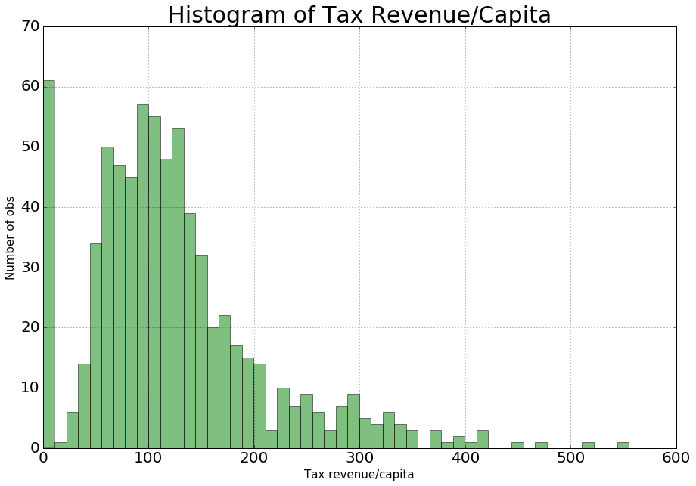
Tax revenue/capita
Mean | 124.04
STDev | 85.70
Min | 0
25% | 70.09
50% | 108.99
75% | 154.53
Max | 555.07
Maryland | 164.44

Slide 8
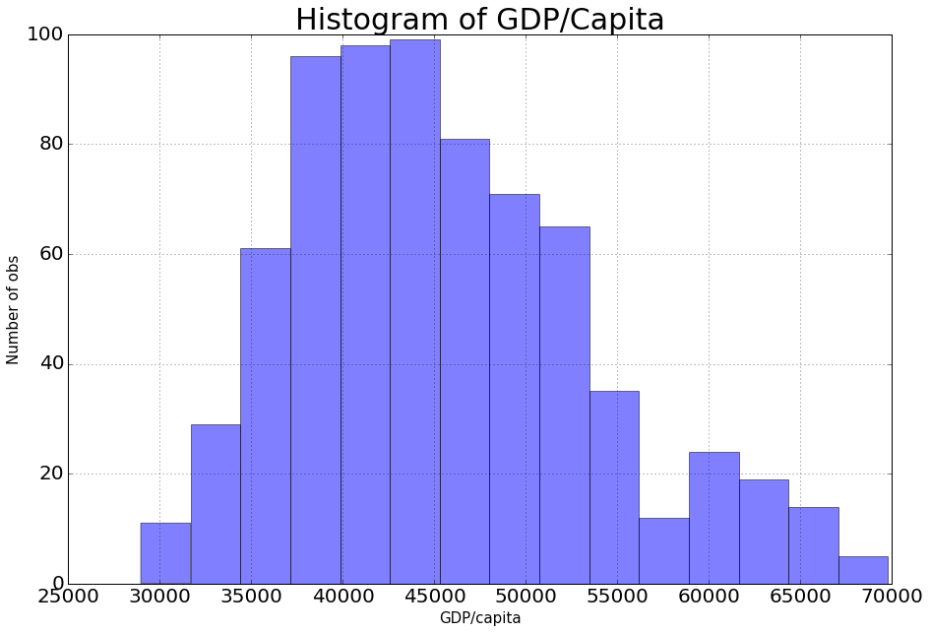
GDP/capita
Mean | 45,476
STDev | 8,197
Min | 28,957
25% | 39,188
50% | 44,100
75% | 50,566
Max | 69,787
Maryland | 53,454

Slide 9
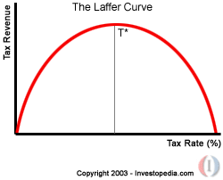
Models

Slide 10
Models
y = alpha + β₁*CIT + β₂*CIT² + β₃*GDP/capita + β₄*Year
y = alpha + β₁*CIT + β₂*CIT² + β₃*GDP/capita + β₄*Year + Σ(β_{i}*D_{i})
y = alpha + β₁*CIT² + β₂*CIT³ + β₃*GDP/capita + β₄*Year + Σ(β_{i}*D_{i})
y : Tax revenue/capita
CIT: Tax rate.

Slide 11
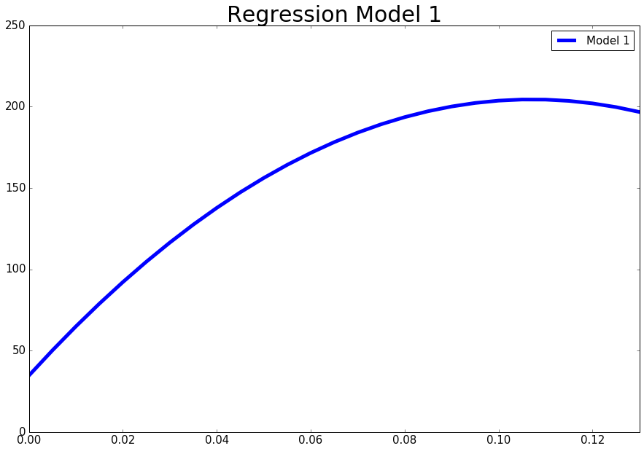
Results: Model 1
Variables | Model 1
Intercept | -5316.36
CIT | 3199.93
CIT² | -14574.89
GDP/Capita | 0.0039
Year | 2.55
R² | 0.4240

Slide 12
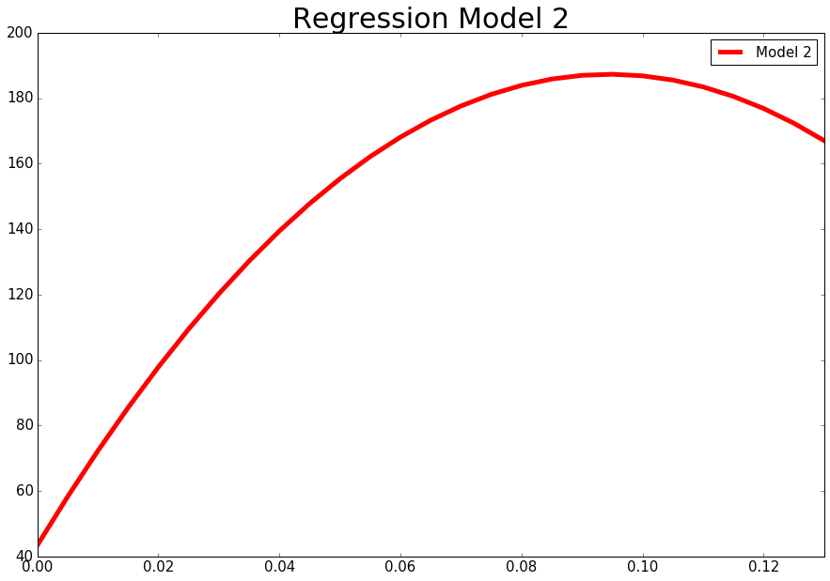
Results: Model 2
Variables | Model 2
Intercept | -5781.10
CIT | 3044.24
CIT² | -16101.57
GDP/Capita | 0.0032
Year | 2.80
midwest | 14.94
northeast | 44.83
south | 12.06
R² | 0.4442

Slide 13
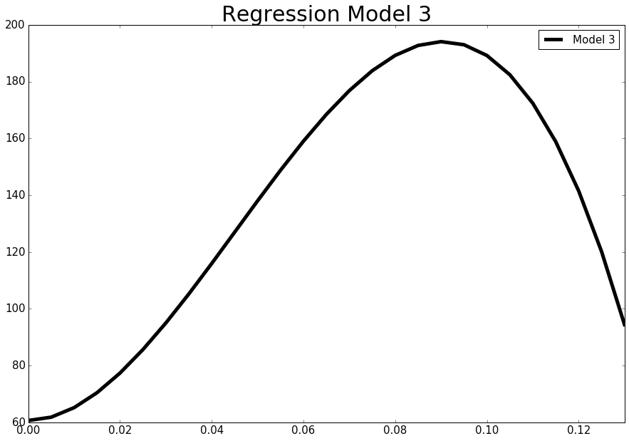
Result: Model 3
Variables | Model 3
Intercept | -5709.03
CIT² | 49042.19
CIT³ | -361873.96
GDP/Capita | 0.0028
Year | 2.78
midwest | 21.98
northeast | 42.78
south | 16.52
R² | 0.4370

Slide 14
Optimal Tax Rate
 | Model 1 | Model 2 | Model 3
Tax Rate | 10.72% | 9.45% | 9.03%
Predicted Y | $203.45 | $185.10 | $189.52
Maryland:
Tax Rate: 8.25%
Tax revenue/capita: $164.4

Slide 15
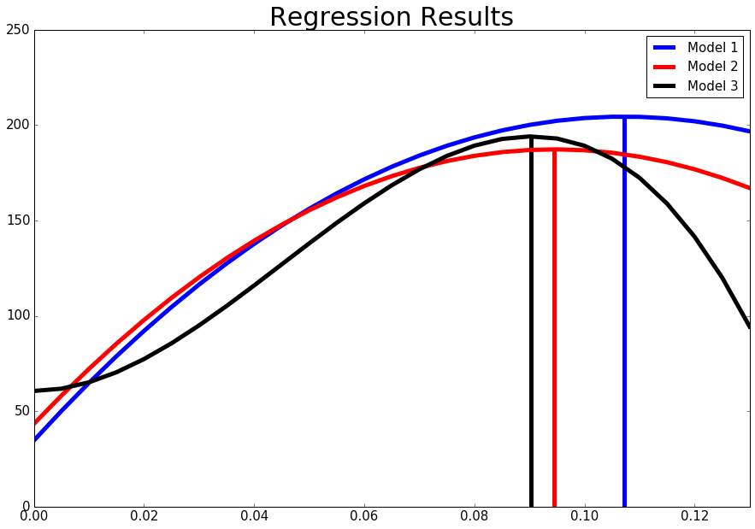

Slide 16
Result vs. Prediction
Prediction: Maryland Tax rate > Optimal Tax Rate
=> Lower tax rate to compete.
Results: Maryland Tax Rate < Optimal Tax Rate
=> No need to lower tax rate.

Slide 17
Problems
Models don’t explain most of the variations of the dependent variable.
Highest R = 44.4%.
No state-specific solutions.
No variable to link “state” and “tax rate”.

Slide 18
Conclusion
Maryland Tax Rate isn’t too high.
Need more study.
Not easily quantified.
Need more and better variables.

Slide 19
Thank You!!! Q&A

Slide 20
References
Bureau of Economic Analysis. (n.d.). Regional Data-GDP & Personal Income. Retrieved from http://www.bea.gov/: http://www.bea.gov/itable/iTable.cfm?ReqID=70&step=1#reqid=70&step=10&isuri=1&7003=1000&7035=-1&7004=naics&7005=1&7006=xx&7036=-1&7001=11000&7002=1&7090=70&7007=2014,2013,2012,2011,2010,2009,2008,2007,2006,2005,2004,2003,2002,2001,2000&7093=levels
CSV of States and State Abbreviations. (2008, April 6). Retrieved from http://www.fonz.net/: http://www.fonz.net/blog/archives/2008/04/06/csv-of-states-and-state-abbreviations/
Morrison, R. (2013, February 26). Tax Foundation Testifies on Corporate Tax Cut in Maryland. Retrieved from http://taxfoundation.org/: http://taxfoundation.org/article/tax-foundation-testifies-corporate-tax-cut-maryland
Tax Foundation. (2013, March 22). State Corporate Income Tax Rates, 2000-2014. Retrieved from http://taxfoundation.org/: http://taxfoundation.org/article/state-corporate-income-tax-rates
U.S. Census Bureau. (n.d.). Population Estimates-Historical Data. Retrieved from https://www.census.gov/: https://www.census.gov/popest/data/historical/index.html
U.S. Census Bureau. (n.d.). State Government Tax Collections. Retrieved from https://www.census.gov: https://www.census.gov/govs/statetax/historical_data.html
Yakolev, P., & Nur-Tegin, K. (2015). A CASE FOR LOWERING MARYLAND’S CORPORATE INCOME TAX. Rockville: The Maryland Public Policy Institute.

