Slide 1
Alex Wentz Joel Flores

Slide 2
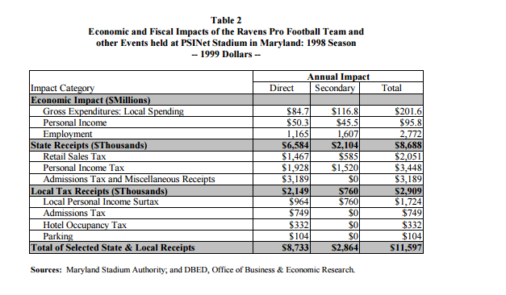
Should Cities Want NFL Teams?

Slide 3
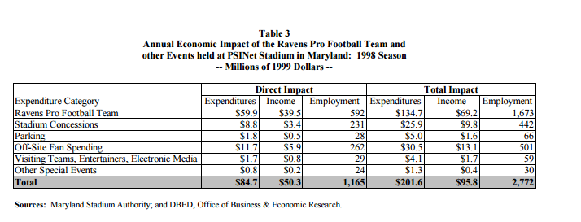
Worked out for Baltimore

Slide 4
Baltimore the Exception not the Rule
Anirban Basu, CEO of the Sage Policy Group stats the Ravens bring in about $20 million per home game
However Basu also states that Baltimore is an exception and most cities are not as lucky

Slide 5
The LA Example
The city of Los Angles approved a $71.1 million investment to help build a stadium for the NBA’s Lakers and Clippers
Estimates put City revenues as a result of the stadium at $3,850,863.35 a year
A little under 19 years to break even

Slide 6
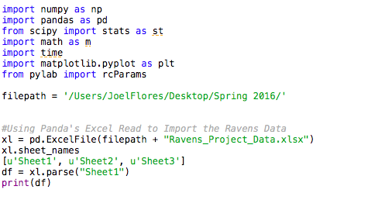
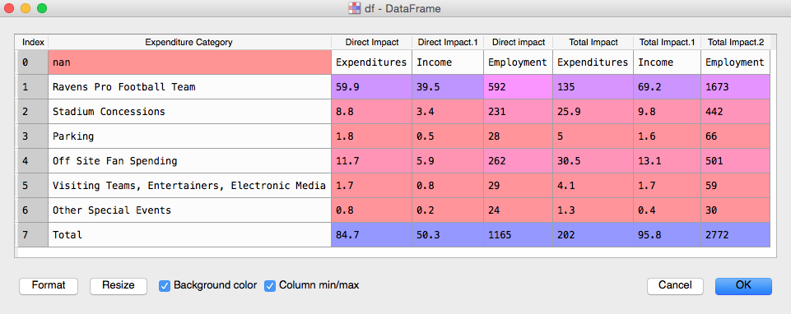
Example Code

Slide 7
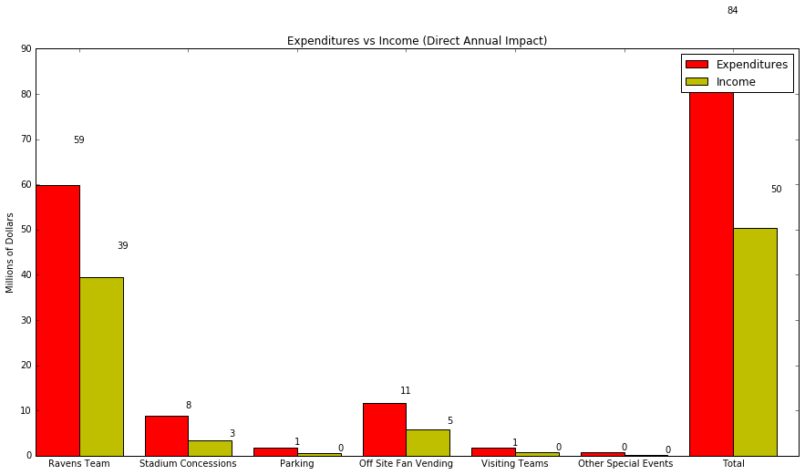
Example Graph

Slide 8
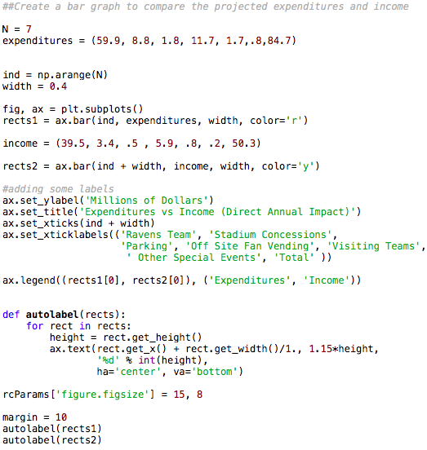
Graph Code

Slide 9
Moving Forward
Goals:
Use diagrams to visualize the disparity between projected growth and actual growth
Find the most accurate way to isolate the economic effects of an NFL team
Create one universal database of as many common variables as possible.
Problems:
Research is done state by state
Limited data/Skewed Impact Reports

