Slide 1
The Path to Prosperity: Restoring America’s Promise
Congressman Ryan’s Plan
http://www.kff.org/medicare/upload/8179.pdf

Slide 2
What’s the Ryan plan?
On April 15, 2011, the House of Representatives passed, on a partisan vote, the budget plan by Paul D. Ryan, Republican of Wisconsin and chairman of the House Budget Committee
The proposal is projected to achieve a federal budget surplus by 2040
It would substantially reduce federal spending on major health programs
Medicare
Medicaid, the Children’s Health Insurance Program (CHIP) and
Exchange subsidies by 2022 (these are part of the ACA 2010)

Slide 3
Proponents of this reform:
This transformation of Medicare would help rein in federal Medicare spending
Plans compete for enrollees based on price and quality
Giving beneficiaries greater incentive and ability to choose a plan that best meets their needs
Giving beneficiaries more “skin in the game” will exert more pressure on plans to reduce costs

Slide 4
[1] Repeal parts of ACA 2010
Repeal Part D Coverage Gap
The proposal would re-open the “doughnut hole,” in which beneficiaries are responsible for paying all of their prescription drugs costs
Over time, prescription drugs would not be offered separately through private stand-alone plans but would presumably be covered under private plans, along with other medical benefits
Repeal Independent Payment Advisory Board (IPAB)
IPAB is making recommendations for Medicare spending cuts to Congress if Medicare spending growth exceeds GDP+1 % in 2015 or later years
The proposal would eliminate IPAB (though it has yet to be formed)

Slide 5
Defund ACA 2010: Cap on Medicaid
Cut large federal subsidies for low-income families to buy health insurance
Cut subsidies to the states that enroll poor families in Medicaid
Instead: Install federal block grants to States to pay for parts of Medicaid → rather than sharing actual outlays!
This reduces the federal government’s contribution to state-run Medicaid programs
Might force states to raise taxes or significantly reduce eligibility for Medicaid

Slide 6
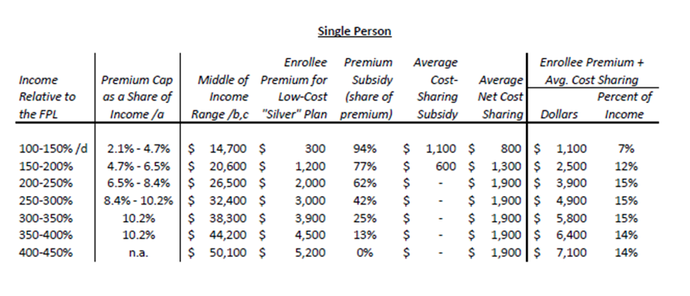
Premium subsidies in ACA 2010

Slide 7
[2] Changes in Medicare 1
With Medicare spending representing 15 % of the federal budget, reducing federal Medicare spending is key
For people now < 55, the traditional Medicare – a defined benefit plan — would cease to exist
Starting in 2022 Medicare would be converted to a defined “premium support” system
2022: all newly-eligible Medicare beneficiaries only have access to private insurance plans

Slide 8
Changes in Medicare 2
Private plans would compete for customers
Premiums can be charged per age group
The government would make payments directly to private health plans , rather than pay providers directly
Starting in 2022 the eligibility age (for premium support) would increase to 67
Richer individuals receive lower government premium subsidies

Slide 9
So what’s the cost for the retiree?
If “premium support” is insufficient → beneficiaries would be responsible for additional costs
CBO: the total cost of providing health care (premium and other costs) to a typical 65-year old in a private plan is $20,500 in 2022
The government would contribute $8,000 or 39 %
The remaining $12,500 would be paid by the beneficiary

Slide 10
Does the plan save any money?

Slide 11
Cost savings?
Does the Ryan plan offer anything to control overall health-care spending?
YES: The plan would “advance common-sense solutions focused on lowering costs, expanding access and protecting the doctor-patient relationship”
BUT: What the alternative solutions expanding access would be, especially the financing of these solutions, is not made clear!

Slide 12
Does the plan increase spending?
Only if private plans are more expensive than Medicare
CBO projects:
OOP costs for the typical 65-year old in 2022 would be more than twice as large
$12,500 under the Ryan proposal
$5,630 under traditional Medicare
Why is the cost of providing benefits greater under private plans than under traditional Medicare?

Slide 13
Private vs. public: what is cheaper?
Private plans have higher administrative costs
30% in U.S. vs. 15% in CAN, roughly
They typically pay higher fees to providers than Medicare
Private health insurance premiums tend to rise faster than Medicare spending per beneficiary
Medicare can control
the prices it pays the providers of health care
BUT not the volume of these services
Private plans may achieve lower utilization through tighter cost/care management than Medicare
Part of private admin cost used
to fight fraud (unnecessary health care bills) – good
to fight paying necessary health care bills – bad

Slide 14
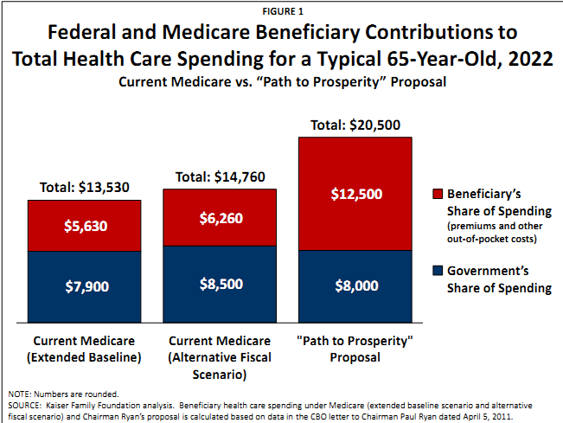

Slide 15
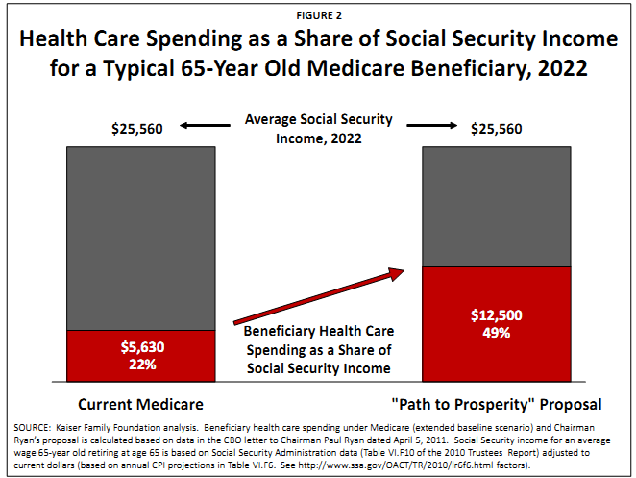

Slide 16
Stakeholders: Low income groups

Slide 17
Replacing Medicaid for the old with MSA
Incomes < 100 % of FPL:
eligible for a medical savings account (MSA) in 2022
$7,800 would be deposited into the MSA
this amount would be indexed to grow by CPI-U.
100 % of FPL < Incomes < 150 % of FPL:
$5,850 would be deposited into the MSA
Individuals would be able to use their MSA to help cover premiums, cost sharing, and acute care services
replacing Medicaid for the old (some old are on Medicaid)
replacing Medicare Part D

Slide 18
So will the poor be better off?
Assuming average OOP spending of approximately $12,500 in 2022 for a typical 65-year old
Government contribution of $7,800 to the MSA for a beneficiary living below FPL would cover about 2/3 of total spending that year
Remaining $4,700, approximately 43 percent of the average income among beneficiaries living below FPL, is paid by the beneficiary
This estimate is likely to be conservative because it assumes low income individuals have similar OOP spending as other “typical” beneficiaries
However, low-income beneficiaries, particularly those who are dually eligible for Medicare and Medicaid, tend to have higher than average health spending
It also does not take into account expenses that Medicaid would cover under current law, such as dental or long-term care

Slide 19
Separately, the proposal would transform the Medicaid program into block grant, which could further limit Medicaid payments for long-term care services and supports for low-income beneficiaries dually eligible for Medicare and Medicaid.

Slide 20

An aside: Ryan claims it’s the same insurance that members of congress have!
And …it isn’t!
Based on: http://economix.blogs.nytimes.com/2011/04/18/comparing-ryans-medicare-plan-to-what-congress-gets/?scp=2&sq=economix&st=cse

Slide 21
Same health insurance as members of congress for retired population?
The premiums for federal employee plans have been rising in step with the overall per-capita health spending
By contrast, under the Ryan plan, the federal contribution toward the purchase of private health insurance by future Medicare beneficiaries would be indexed only to the Consumer Price Index
(see Page 2 of the C.B.O. analysis).

Slide 22
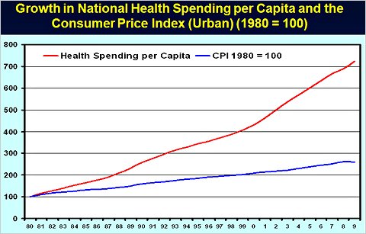
C.P.I. vs. Medical C.P.I
But over the last three decades, the C.P.I. has grown at a much slower rate than per-capita health spending, especially since 2000
Health Spending Data: CMS Data & Statistics; C.P.I.: President’s Economic Report to the Congress, 2011, Table B-20.

Slide 23
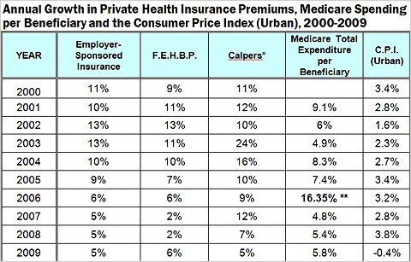
C.P.I. growth vs. premium growth
Department of Health and Human Services, Office of the Assistant Secretary for Planning and Evaluation, April 12, 2011.

Slide 24
* California Public Employees’ Retirement System, which functions as a private health insurance exchange for 1.3 million active and retired public employees.
** Start of Medicare Part D Prescription-Drug Plan

Slide 25
Indexing the federal contribution to Medicare beneficiaries to the C.P.I. can thus be expected to shift an ever-larger share of the total health spending to the retirees
If private insurance premiums after 2030 continued to grow at a rate exceeding the growth in the C.P.I., the federal contribution to Medicare might shrink even further

