Slide 1
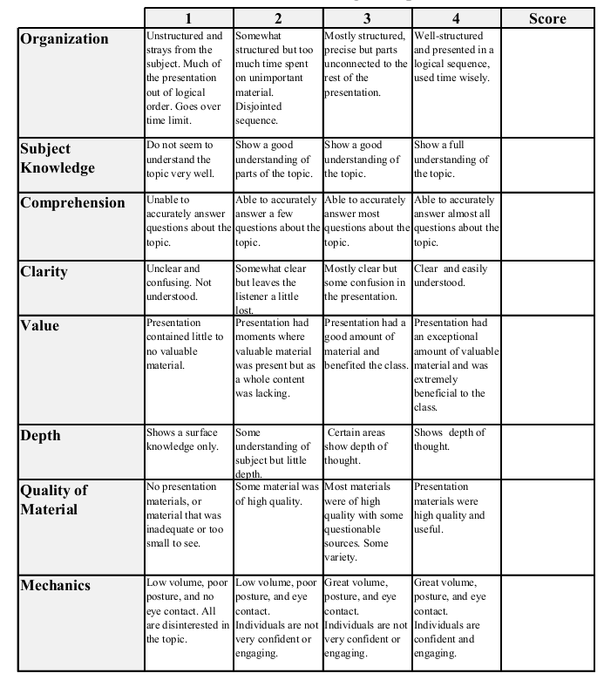
Fall 2013: Econ 339 Final Presentation
Your name
Date of presentation
Title of presentation
Reference: Author(s) (year), Title of presentation, Journal, vol., nr., p.??-??
Total:_________

Slide 2
Requirements
Copy the first page of this PowerPoint file into your presentation, so that it starts with the grading rubric!!
You have 7 minutes to present followed by 3 minutes for discussion.
The maximum number of slides you’ll be able to cover is around 7 to 8.
I recommend you don’t have more than 7 slides, otherwise you won’t be able to finish
You will have to hand in the slide presentation to get full credits

Slide 3
Tips
Check the grading rubric on the first page
Don’t read off the slides! Use note cards if necessary
Speak loud and clearly and not too fast
Take it serious
Be careful making jokes. It is very easy to come across as insincere etc. if your presentation is “too funny”. You want to avoid that in a professional setting where you do not know the audience (most of the times)

Slide 4
More tips
What follows are some tips/suggestions about how to make “good” slides

Slide 5
This is too much – it looks crowded
Use of contemporary data is problematic because many factors are correlated with housing segregation along with distance to medical facilities
It is better to examine a historical “natural experiment”
Racial integration of hospitals in the American South in the 1960s
Integration was mandated by the federal government as a condition of accepting Medicare funding
Chay, Almond and Greenstone (2007) show that hospital integration lowered the black-white infant mortality gap in Mississippi

Slide 6
This is better
Eligibility expansions have not achieved universal coverage for low-income teens
Individual mandate could potentially make a large difference
But, many low-income teens would be exempt from mandates
Other policy options:
outreach efforts targeting schools;
engage community partners who work with teens;

Slide 7
Figures and Graphs
Here are some examples of good and bad graphs

Slide 8
Use Figures and Graphs when possible. This one looks a bit boring though

Slide 9
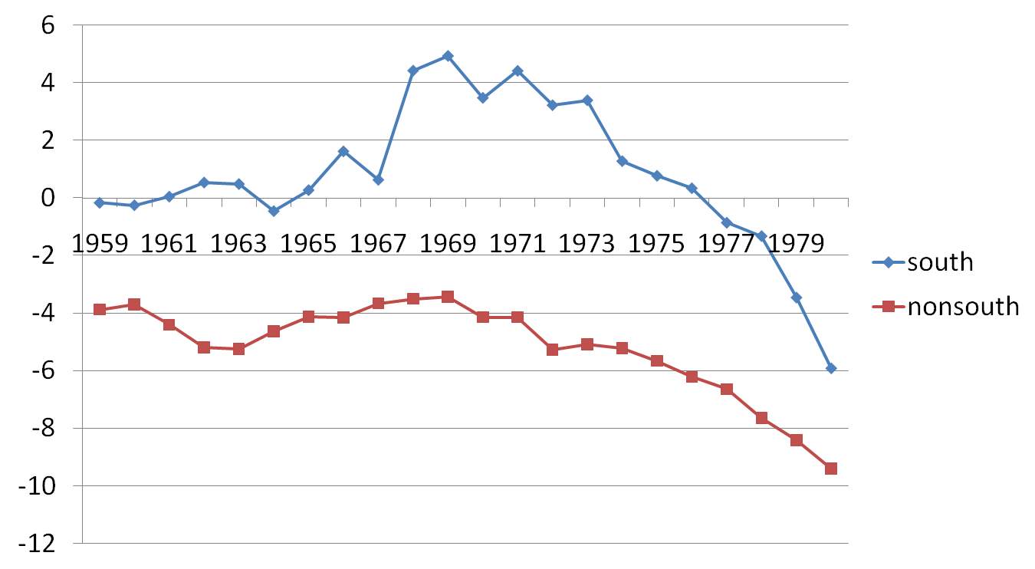
This one looks better!
Notes:
we expect that the decline should be greater in regions where segregation and restricted access were pervasive.
9

Slide 10
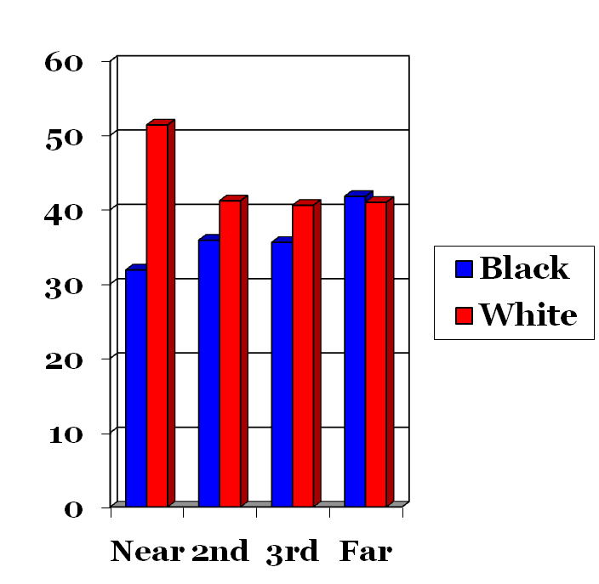
This is a good graph as well
1959-61 Vehicle Mortality
1968-70 Vehicle Mortality

Slide 11
1963 1966 1967 1971
White:
Cool graph!!
Black
Notes:
We use Geographic Information system (GIS) to visually describe the Mississippi mortality rate and hospital accessibility by county from 1959 to 1971 in this map. In this map, we have three layers: 1) Mississippi county map, which covers county mortality rate information; We use different color to categorize each county’s mortality rate. 2) Mississippi zip code map, which we download from US census website. (Actually, the definition of zipcode in US census is not exactly consistent with the US post office zipcode system) As we have all 113 hospital address from US hospital association, based on the zip code map, we can construct our 3rd layer, which is the accessible hospital number by each county. Hospital number are quantified by graduated symbols. The legend gives the categories for both mortality rate and hospital number.
Based on detailed hospital-level data, we further find that the Mississippi hospitals that received early Medicare certification served areas with more people eligible for Medicare and with smaller black population shares.

Slide 12
This is an example with really bad graphs

Slide 13
Tables
Here are some examples of good and bad tables

Slide 14
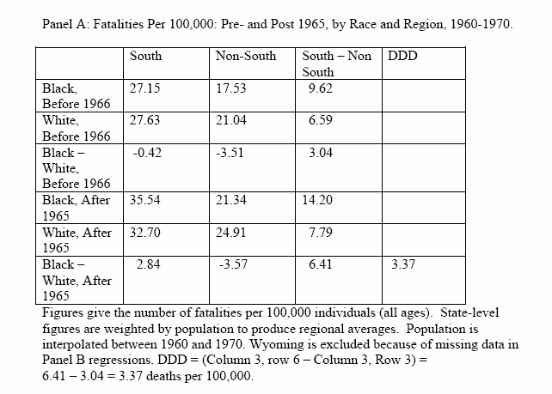
Bad table - nobody can read this

Slide 15
Really bad table

Slide 16
Good table
 | North |  | South |  | Mississippi
 | 1960 | 1970 | 1960 | 1970 | 1960 | 1970
Percent of Motor vehicle
Whites |  |  |  |  | 86.1% | 92.4%
In Metro area | 77.7% | 87.9% | 86.9% | 93.5%
In Non-metro area | 90.7% | 92.8% | 86.2% | 91.6%
Percent of Motor vehicle
Blacks |  |  |  |  | 43.3% | 61.5%
In Metro area | 47.7% | 55.7% | 50.0% | 64.3%
In Non-metro area | 68.9% | 74.1% | 51.7% | 64.4%

Slide 17
Have a conclusion - example
Mississippi: In 1960s a black motorist seeking medical attention after a car accident might have to travel 50-60 miles to get to a hospital
Racial integration substantially lowered distance to the nearest hospital for black motorists
Distance mattered: motor vehicle fatalities were lower if a hospital was close by

