Slide 1
Health Economics
Introduction

Slide 2
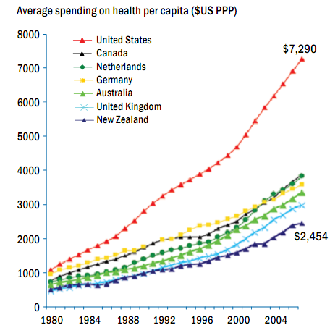

Slide 3
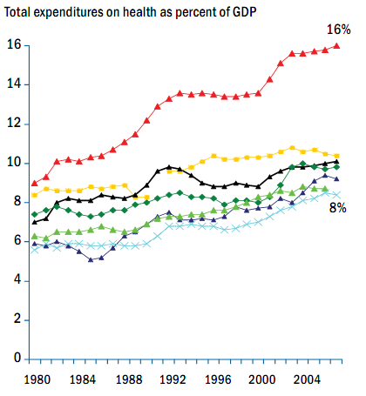
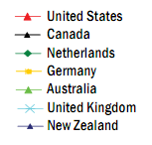

Slide 4
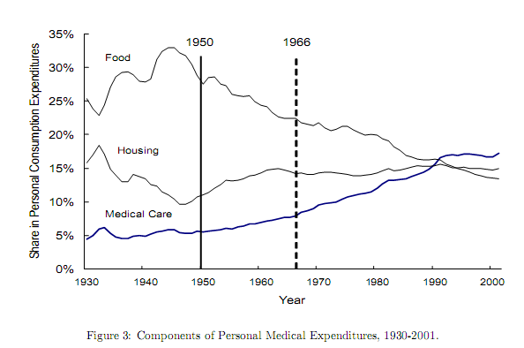
Source: Suen (2005)

Slide 5
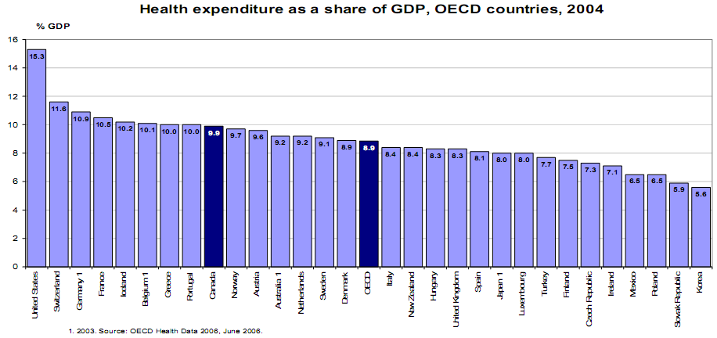

Slide 6
Correlations
Strong positive correlation between:
national per capita income and
national per capita medical spending
Translation: People of rich countries, spend more on health care
(strong effect)

Slide 7
Correlations
Weak positive correlation between
per capita income and
life expectancy
Translation: Rich people live longer
(weak effect)

Slide 8
Correlations
No correlation between:
changes in the proportion of GDP spent on health and
changes in life expectancy
Translation: Rich countries spending more on health care, cannot necessarily prolong life of population
(no effect?)

Slide 9
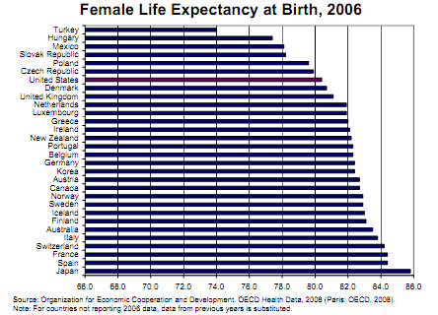

Slide 10
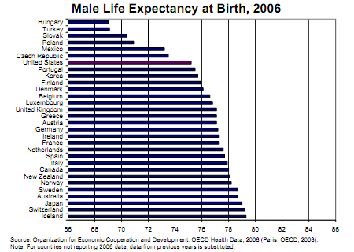

Slide 11
Life Expectancy at Birth in OECD Countries

Slide 12
Life Expectancy at 65 in OECD Countries

Slide 13
Proportion of Public/Private Health Expenditure
Before the implementation of Medicare Plan D which became effective in 2006, and according to the House Oversight and Government Reform Committee it contributed an 18.7 percent increase in Medicare spending in 2006, the fastest rate of growth since 1981 and double the rise in 2005.

Slide 14
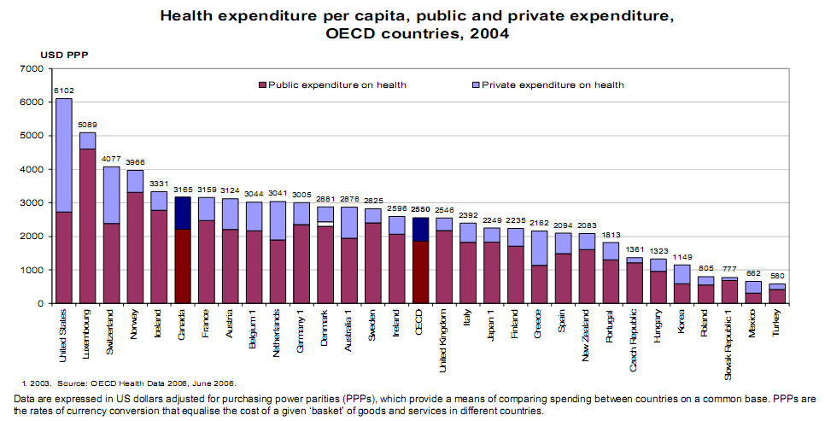

Slide 15
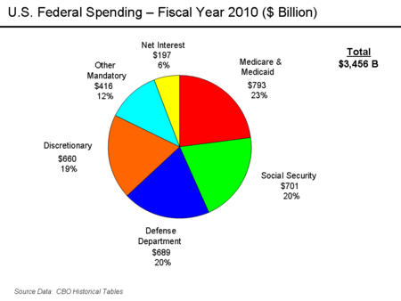

Slide 16
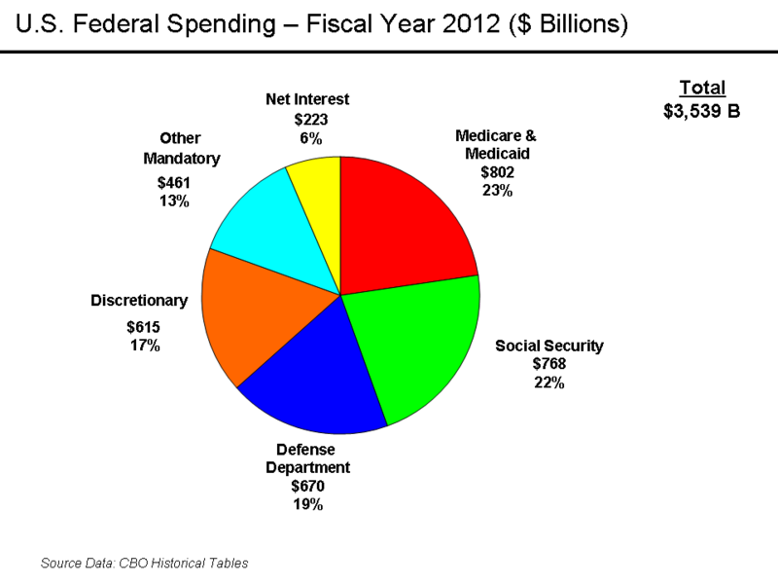

Slide 17
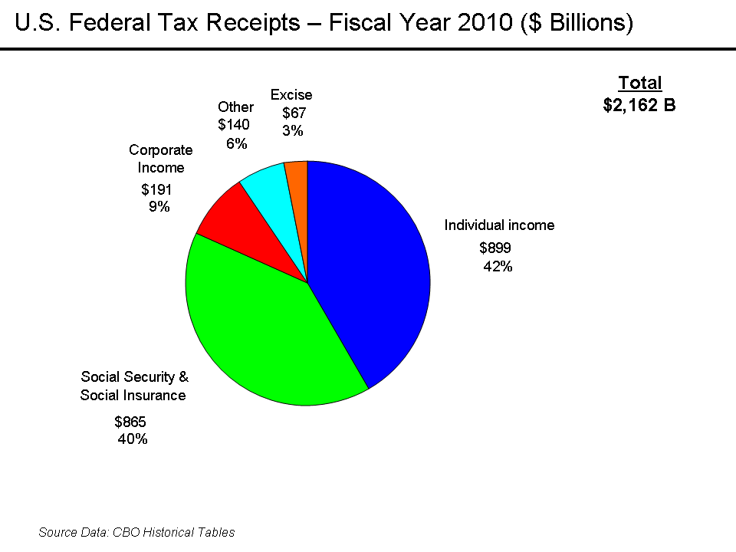

Slide 18
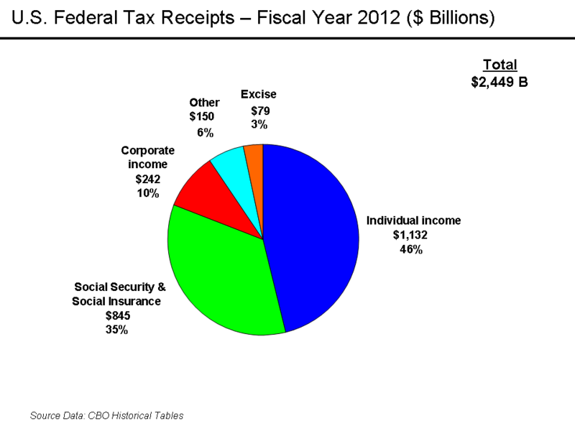

Slide 19
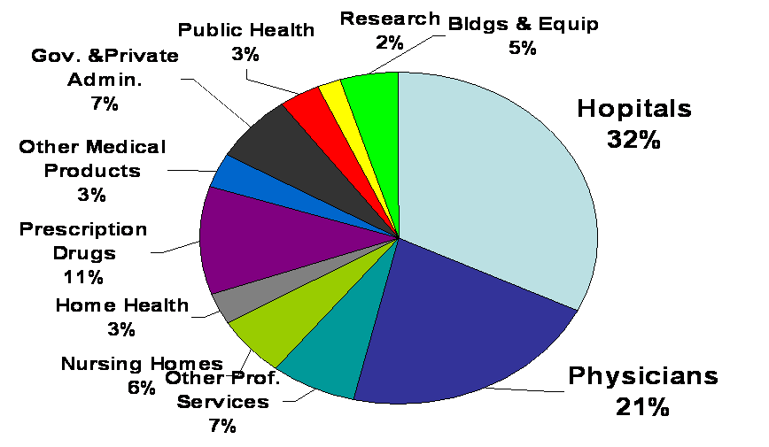
U.S. Health Spending in 2009 by type of service and activity

Slide 20
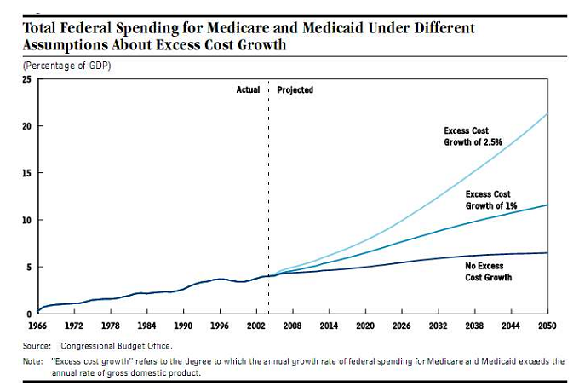

Slide 21
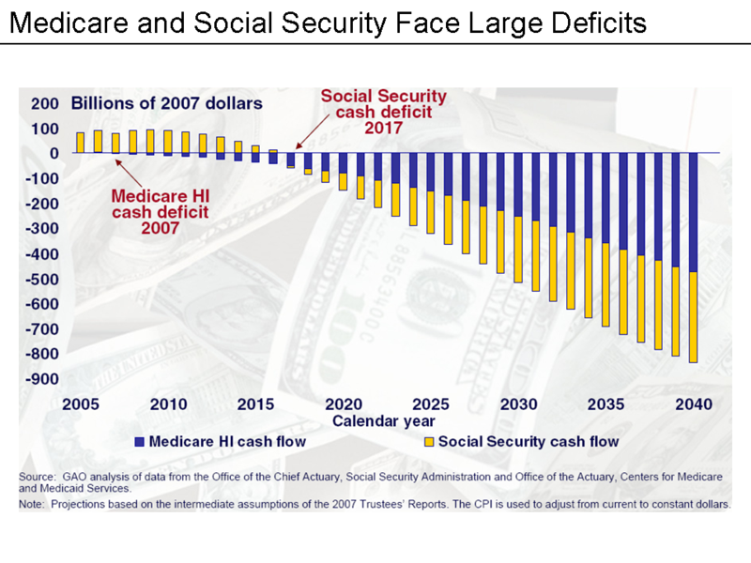

Slide 22
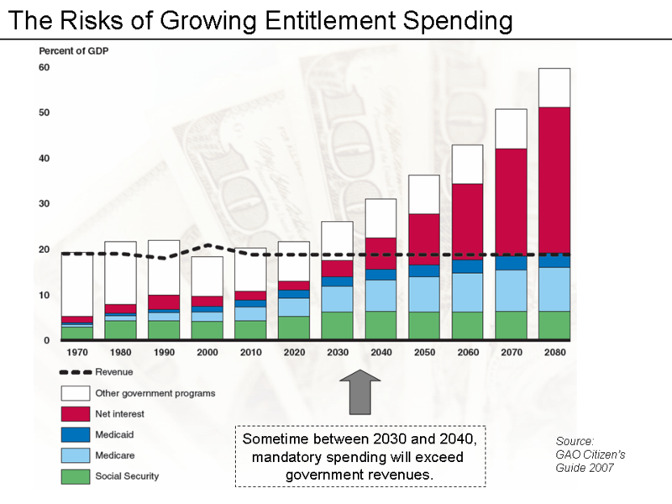

Slide 23
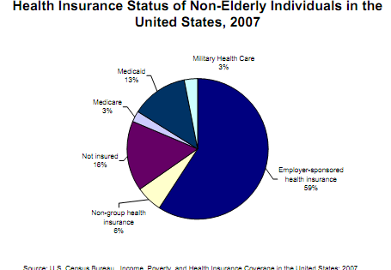

Slide 24
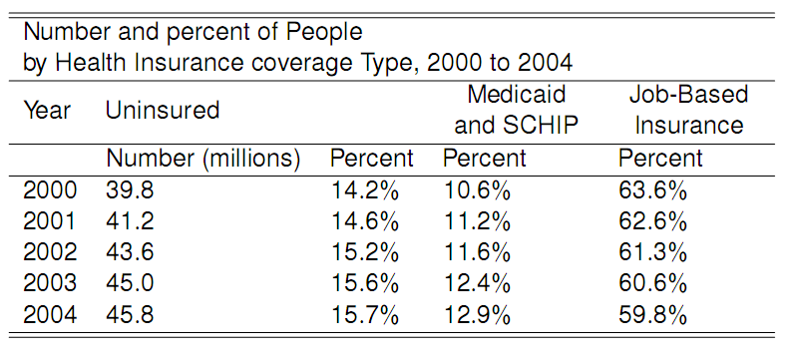

Slide 25
More Facts
Compared with Canada, Germany, and the UK, the US perennially ranks first in the stock of medical technologies, such as:
magnetic resonance imaging,
radiation therapy,
organ transplantation, and
cardiac catheterization.
What about admin costs?
The US is the only major industrialized nation that does not have a system of universal health-care insurance.

Slide 26
Economics and Health
Can economic analysis be applied to the health sector?
There are production factors, just like in other sectors
Prices, either explicit or implicit, exist just as in other sectors
Thus, traditional economic analysis may be applied to the health sector, BUT...

Slide 27
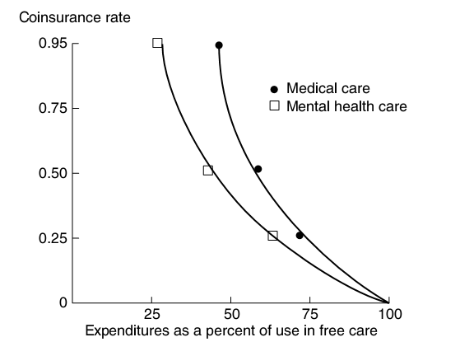
Proof of health care demand: The RAND Health Insurance Experiment

Slide 28
Economics is About …
Limited resources
Unlimited “wants”
Choosing between which ‘wants’ we can ‘afford’ given our resource ‘budget’

Slide 29
Opportunity Cost
“The value of forgone benefit which could be obtained from a resource in its next-best alternative use.”
Instead of going to College, you could be working as ??? and make $40,000 a year.
What is your opportunity cost of going to college?

Slide 30
Implications of Opportunity Cost
Deciding to do A implies deciding not to do B (i.e. value of benefits from A>B).
Cost can be incurred without financial expenditure.
Value not necessarily determined by “the market”.

Slide 31
Economists view of the world...
Pessimist: bottle ½ empty
Optimist: bottle ½ full
Economist: bottle ½ wasted
inefficient!

Slide 32
Concept 2: Efficiency
Efficiency = maximising benefit for resources used
Technical meeting a given objective Efficiency = at least cost (resources)
Allocative = producing the pattern of Efficiency output (supply) that matches the pattern of consumer want (demand)

Slide 33
Economics vs. Accounting
Economics is concerned with…
costs (resource use)
benefits
choice
efficiency
Accountancy is concerned with…
monitoring financial transactions

Slide 34
Economics and Objectivity
All decisions are based on subjective value judgements (or judgements of subjective value!)
Economics makes these explicit

Slide 35
Roadmap

