Slide 1
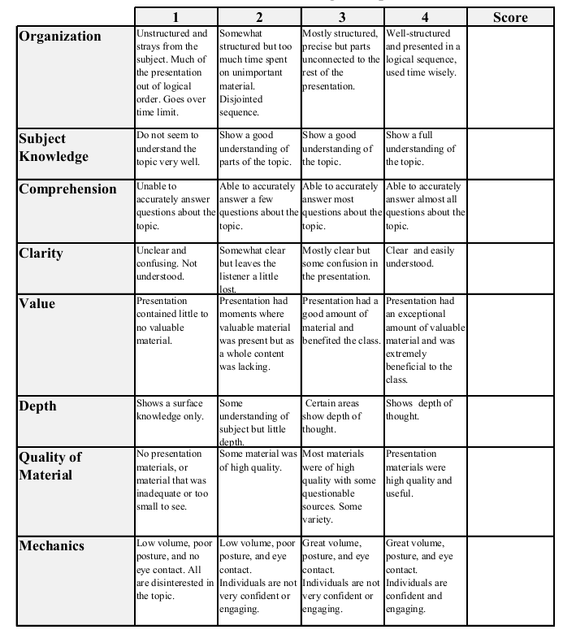
Fall 2014: Econ 339 Final Presentation
Catherine Engelbach
November 25, 2014
Misdiagnosis of ADHD
Reference: Evans, W., Morrill, M., & Parente, S. (2010). Measuring inappropriate medical diagnosis and treatment in survey data: The case of ADHD among school-age children. Journal Of Health Economics, 29(5), 657-673.
Total:_________

Slide 2
Questions investigated
Is ADHD over-diagnosed in school-age children?
Are younger children in the classrooms more likely to be diagnosed?
Are prescription medications used to treat ADHD wrongly/over prescribed?
Is age a factor?
Notes:
Children young for their grade compared to their fellow students are more likely to be diagnosed because of their lower maturity. In reality, it is an age issue and not a mental health issue.
If you have a child who just turned 5 and another who is almost 6 years old, there's an age difference of 20%.

Slide 3
ADHD overview
ADHD stands for attention-deficit/hyperactivity disorder.
It is "a neurological condition characterized by delayed brain development"
Inattention, hyperactivity, and impulsivity are behaviors associated with ADHD.
5-10% of children ages 6-18 have been diagnosed with ADHD in the United States.
Difficult to diagnose, mental health specialists should be consulted.
Notes:
This is a 500% increase from the late 1980s to the early 2000s. Many diagnosis are made by pediatrician or family physician, without any mental health specialist involvement. Teachers often mention the likelihood of ADHD

Slide 4
Why does it matter?
Proper diagnosis is important because children with ADHD have greater risk of:
learning disabilities
repeating a grade and failing test scores
dropping out
illegal drug use
car accidents
suffering from other psychiatric conditions
Stimulants used for treatment have side effects, and possibly long-term effects from long-term use.

Slide 5
Treatment
The treatment focused on for ADHD in this case study was prescription stimulant medication.
Stimulants do not treat the underlying disorder or provide a cure for ADHD.
In 2003, about 55% of children diagnosed with ADHD were taking stimulants.

Slide 6
Data
Three data sources were used:
the National Health Interview Survey (NHIS), 1997-2006
35,343 children
the Medical Expenditures Panel Survey (MEPS), 1996-2006
18,559 children
a private insurance prescription drug claims data set, 2003-06
22,371 children
Criteria included:
Ages 7-17, children must be enrolled in school
Data only used from states with current kindergarten age cutoff date
Child's birth date was within 120 days of cutoff date.
Notes:
NHIS includes any child regardless of insurance type or uninsured. MEPS and the private insurance prescription drug claims data set show children that use prescription stimulants to treat ADHD. NHIS measures diagnosis of ADHD.

Slide 7
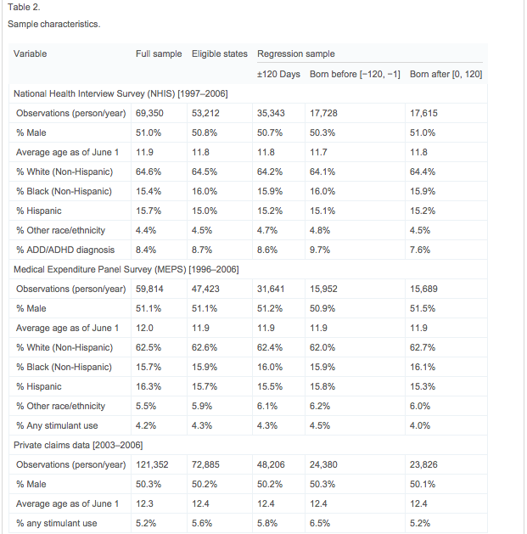

Slide 8
Results
In NHIS, younger children had a 9.7% diagnosis rate compared with 7.6% for those born after the cutoff date.
MEPS data found a 0.5% difference of stimulant usage between children born before and after the cutoff date.
The private claims data found stimulant use to be 6.5% in younger children and 5.2% in older children.

Slide 9
"Being born after the cutoff, and therefore being relatively old for grade, is associated with an 13-27% lower risk of ADHD treatment and a 24% lower risk of ADHD diagnosis."
Being young for your grade nearly doubles the chance of being diagnosed with or treated for ADHD
It is more likely to be wrongly diagnosed with ADHD than to be wrongly treated for ADHD
13% of boys have been diagnosed, 5% of girls
Highest among white, non-Hispanic children.
1.1 million children received an inappropriate diagnosis, and over 800,000 received stimulant medication due to relative maturity.
Notes:
"relative age is a more important determinant of ADHD diagnosis in comparison to treatment."

