Slide 1
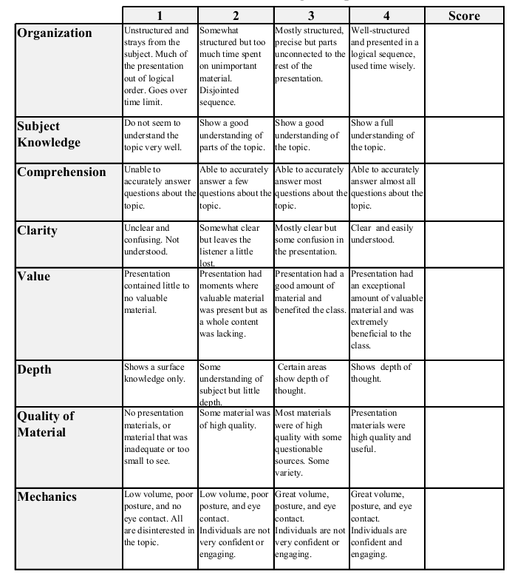
Fall 2014: Econ 339 Final Presentation
Helene M. Ouedraogo
Tuesday 11/25/2014
The causal effect of family income on child health in the UK
Reference: Daniel Kuehnle (2014) The causal effect of family income on child health in the UK
Journal of Health Economics, vol 36, Pages 137-150
Total:_________

Slide 2
Introduction
The causal effect of family income on child health in the UK
British data from the Millennium Cohort Study
(study representative of all children born in the UK between 2000 and 2001)
Variables and Data
Instrumental variables
Conclusion

Slide 3
Variables
Income -sources after deductions (e.g., tax, national insurance)
Child health (1 = poor, 2 = fair, 3 = good, 4 = very good, 5 = excellent. )
Base case specification
Household size
Parental health and education
Transmission mechanisms
Housing
Foetal-origins hypothesis
Nutrition
Parental smoking
Medications

Slide 4
Data

Slide 5
Instrumental variables
External information
British Office for National Statistics (ONS).
lagged Local unemployment rate (by one year)
Average local unemployment rate
Business growth rate and regional
Average

Slide 6
Data

Slide 7
Results
Unclear unobserved variables
Instrumental variables
Income has a causal effect

Slide 8
Conclusion
Causal effect of family income on child health in the UK
Internal Variables
External Variable
Effects

Slide 9
Thank You

